Slide 1

Digital Documents
SUSMITA SHA
CSE(Sec-A)
4th year
16800116011
E-Commerce

Slide 2
What are digital documents?
Digital documents are those that exist in electronic form. They may also exist in physical paper form, or they may exist exclusively in digital form. Digital documents may be stored on electronic media, such as hard drives, iCloud servers, exabyte tape or any manner of electronic media. One manner of determining the accuracy and authenticity of digital files is to examine the original digital size and compare the number of bytes within it. There is an ongoing debate about the best way to store electronic or digital files for archival purposes, since we don’t know what digital media and file formats will be used in 50 or 100 years.

Slide 3
Type of Digital Documents
Imaging(TIFF)
Structured documents(SGML)
Distributed Hypertext(HTML)
Active or Compound(OLE)

Slide 4
DOCUMENT IMAGING
An imaging system passes a paper document through a scanner that renders it digital & stores the digital data as a bit-mapped image.
Use key words for indexing & searching
PROBLEMS:
Contains only images & not text
No formal internal structure

Slide 5
TIFF(Tag Image File Format)
TIFF format is standard in document imaging and document management systems
Created by company Aldus jointly with Microsoft for postscript
Supports black & white images – to conserve storage capacity
Supports multiple pages
Limitation of document image
Does not allow repackaging
Solution: Structured documents

Slide 6
Structured documents
Users can manipulate , edit and work with document content
Apply database structuring capabilities to documents to allow tools to manipulate document content
Documents may be lengthy , complex , spreadsheets , graphics etc.
Example: TOC(Table of Contents)

Slide 7
Capabilities of structured documents
Document formatting & rendering
companies give their CDs containing manuals to customers . This reduces printing & packaging costs and faster updates of critical information . Audio rendering of documents opens up a new world for visually handicapped.
Create easily modifiable structures
Allows more dynamic documents ,user interaction & manipulation(bookmark, highlight text , write notes).Documents can be edited , linked to other items such as graphics , video ,photo etc.
Easier to search & query given the right structure & interface
Formats:
1. Document interchange formats (ODA –Office Document Architeture, CDA- Compound Document Architecture)
Adv:
I.Generate platform & application independent info
Ii.Keep format & styling
Iii.Support audio,graphics & video
Disadv:
I.Require expertise to use
Ii.Formats make users dependent on applications that can recognize the encoding used

Slide 8
2.Document structure languages(SGML- Standard Generalized Markup Language)
Adv:
Allows creation of document type definition.
Disadv:
Does not support non-text elements.
HYPERTEXT DOCUMENTS
Hypertext markes document based information more mobile.
Reasons for mobility of info:
_ info in enterprise is located in server but distributed throughout the organization.
_ Split the large document into smallrt piecs
_ Reuse document fragments for composing new documents

Slide 9
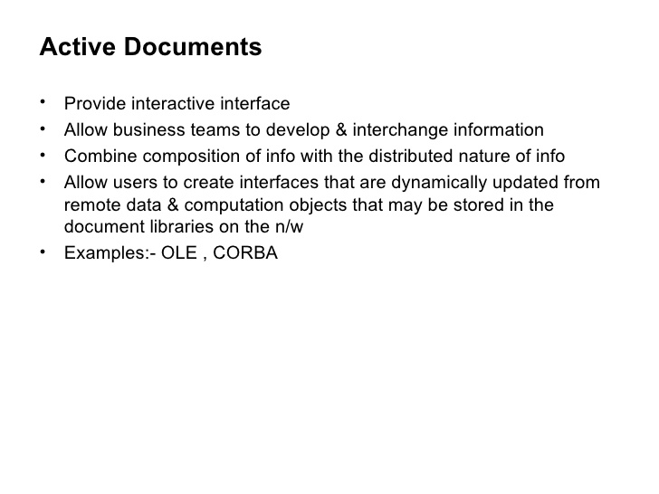

Slide 10
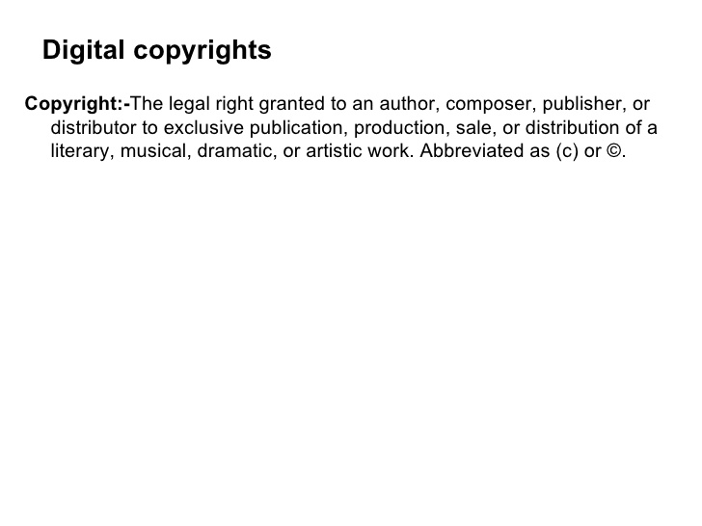
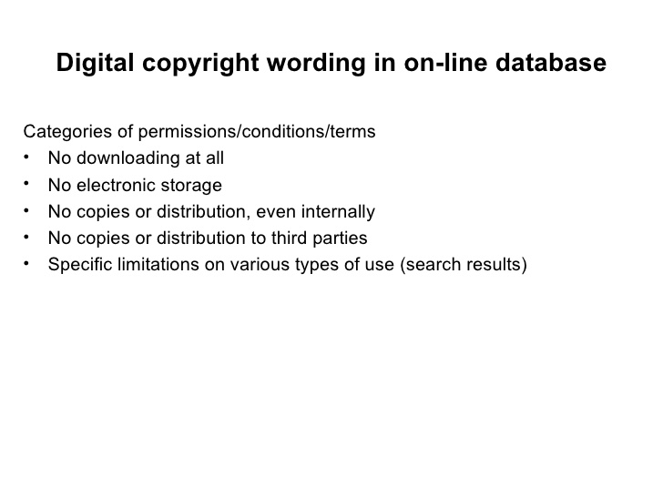

Slide 11
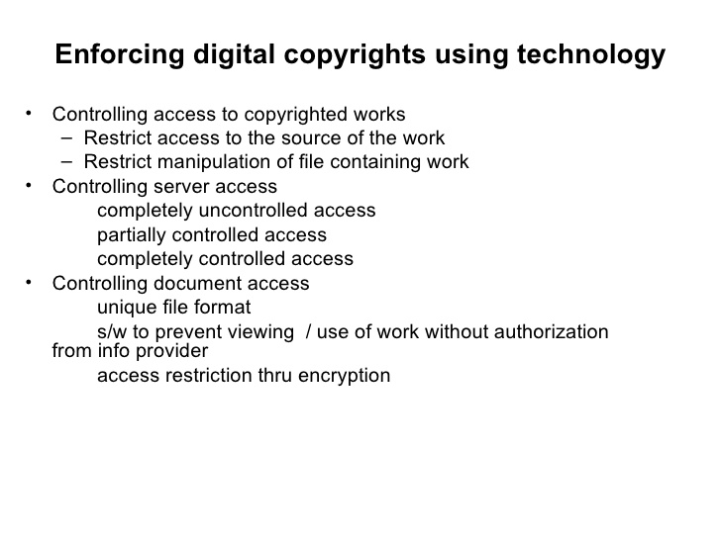

Slide 12
