Slide 1
Name :
Sourav Mondal
Roll No:
16800117003
Reg No :
171680120002
Stream :
CSE (4th year)
Subject :
E - Commerce

Slide 2
Enterprise Resource Planning (ERP)
Introduction :
Enterprise Resource Planning (ERP) is a software solution becoming necessary to implement with the passage of time. This software completely transforms a business into the digital world. This is a software solution used by all type of industries and businesses. Whether you’re running a small organization or large enterprises, ERP is the best tool available for efficient goal achievement. It efficiently manages the organizational day to day activities that include accounts, inventory, management, and others. ERP system is specially designed according to a defined data structure and provide access to data from authorized users. It has centralized all of the data and distributes it accordingly. It allows the management and other stakeholders to have complete trust in data accuracy.

Slide 3
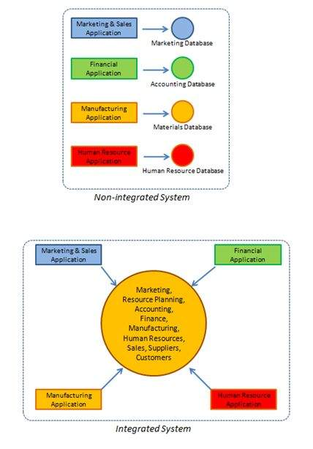

Slide 4
The Driving Force behind ERP :
There are two main driving forces behind Enterprise Resource Planning for a business organization.
In a business sense, Enterprise Resource Planning ensures customer satisfaction, as it leads to business development that is development of new areas, new products and new services.
Also, it allows businesses to face competition for implementing Enterprise Resource Planning, and it ensures efficient processes that push the company into top gear.
In an IT sense: Most software does not meet business needs wholly and the legacy systems today are hard to maintain. In addition, outdated hardware and software is hard to maintain.
Hence, for the above reasons, Enterprise Resource Planning is necessary for management in today's business world. ERP is single software, which tackles problems such as material shortages, customer service, finances management, quality issues and inventory problems. An ERP system can be the dashboard of the modern era managers.

Slide 5
Implementing ERP System :
Producing Enterprise Resource Planning (ERP) software is complex and also has many significant implications for staff work practice. Implementing the software is a difficult task too and one that 'in-house' IT specialists cannot handle. Hence to implement ERP software, organizations hire third party consulting companies or an ERP vendor.
This is the most cost effective way. The time taken to implement an ERP system depends on the size of the business, the number of departments involved, the degree of customization involved, the magnitude of the change and the cooperation of customers to the project.

Slide 6
Advantages of ERP System :
With Enterprise Resource Planning (ERP) software, accurate forecasting can be done. When accurate forecasting inventory levels are kept at maximum efficiency, this allows for the organization to be profitable.
Integration of the various departments ensures communication, productivity and efficiency.
Adopting ERP software eradicates the problem of coordinating changes between many systems.
ERP software provides a top-down view of an organization, so information is available to make decisions at anytime, anywhere.

Slide 7
Disadvantages of ERP System :
Adopting ERP systems can be expensive.
The lack of boundaries created by ERP software in a company can cause problems of who takes the blame, lines of responsibility and employee morale.

Slide 8
Conclusion :
While employing an ERP system may be expensive, it offers organizations a cost efficient system in the long run.
ERP software works by integrating all the different departments in on organization into one computer system allowing for efficient communication between these departments and hence enhances productivity.
The organizations should take extra precautions when it comes to choosing the correct ERP system for them. There have been many cases that organizations have lost a lot of money due to selecting the 'wrong' ERP solution and a service provider for them.

