Slide 1


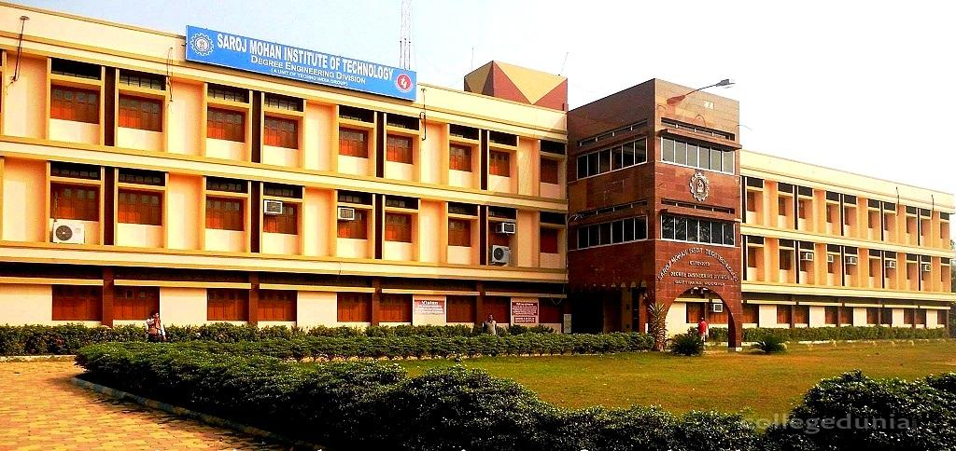
SAROJ MOHAN INSTITUTION OF TECHNOLOGY
Guptipara,hooghly
Subject→ E-COMMERCE

Slide 2
TOPIC NAME- DNS
PRESENTED BY
NAME - BIPASA PAL
DEPARTMENT - C.S.E
SECTION - B
ROLL NO.- - 16800116079
YEAR- - 4th year (8th Sem)

Slide 3
DOMAIN NAME
Domain name is a way to identify and locate computers connected to internet  No two organizations can have same domain name.
A domain name always consists of two or more components separated by periods called dots (.)
EXAMPLE: www.yahoo.co.in , www.facebook.com etc.
Once a domain has been established subdomains can be created within the domain.
EXAMPLE: The domain for the large company could be “Vni.com” and within this domain subdomains can be created for each of the company’s regional office. Eg: Bombay.vni.com

Slide 4
DOMAIN NAME SYSTEM
DNS Technology allows hosts on TCP/IP networks to be address by its name. DNS automatically convert the names we type in our web browsers address bar to the IP addresses of web servers hosting those sites.
Internet.bipasa.com
Host name
Organization
domain
Top level

Slide 5
TOP LEVEL DOMAINS
Top level domains are classified into 3 categories:
Organizational or generic domains
Geographical or country domains
Reverse domains

Slide 6
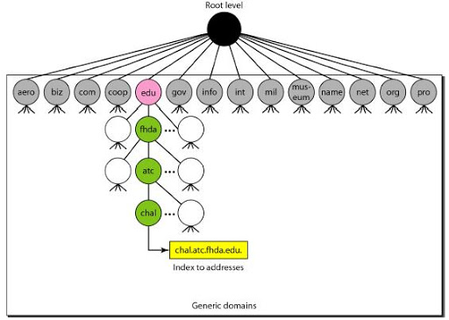
GENERIC DOMAIN
It contains registered hosts according to generic behaviors.

Slide 7
COUNTRY DOMAIN
Each Country Is Assigned A Single Top Level Domain, Like
.in(ac.in, nic.in, gov.in)
.us(ac.us, af.gov.us)

Slide 8
REVERSE DOMAINS
It is a special domain name in- addr.apra that is used translate the IP address to fully qualified domain name
EXAMPLE: 1.4.220.134 in-addr.apra will return sunc.scit.wlv. Here 1.4.220.134 is the IP address that is mapped to its name sunc.scit.wlv.at.uk with the help of in-addr.apra domain.

Slide 9
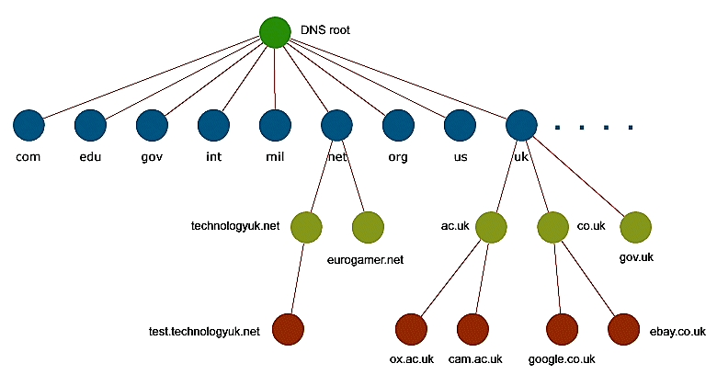
DNS TREE STRUCTURE

Slide 10
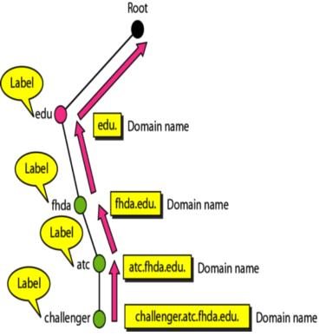
DOMAIN NAMES & LABELS

Slide 11
DNS EFFICIENCY
DNS is a very lightweight protocol
– Simple query
– response
Any performance limitations are due to the network limitations
– Speed of light
– Network congestion
– Switching/forwarding latencies

Slide 12
DNS SECURITY
Base DNS protocol (RFC 1034, 1035) is insecure
– “Spoof” attacks are possible
DNS Security Enhancements (DNSSEC, RFC 2565) remedies this flaw
– But creates new ones
• DoS attacks
• Amplification attacks
DNSSEC strongly discourages large flat zones
– Hierarchy (delegation) is good

