Slide 1

Presented by:
JAYEETA AICH
STREAM:CSE
ROLL:16800116072
YEAR: 4
SEM: 8

Slide 2
CONTENTS
Meaning of Trade Cycle
Features of Trade Cycle
Phases of a Trade Cycle
Nature of Trade Cycle
Causes of Trade Cycle
Life Cycle of a Trade Cycle
Factors responsible for Trade Cycle
Measures to control Trade Cycle
Fluctuations in a Trade Cycle
Conclusion

Slide 3
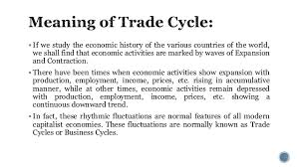

Slide 4
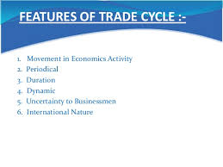

Slide 5
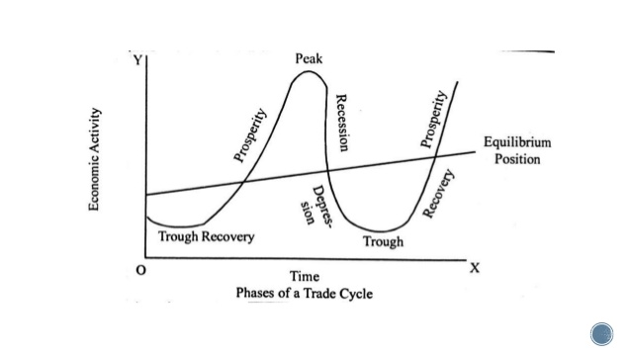
PHASES OF A TRADE CYCLE

Slide 6
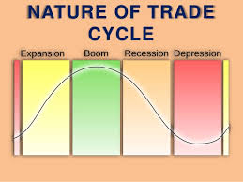

Slide 7
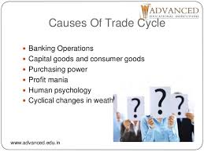

Slide 8
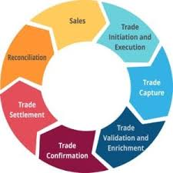
LIFE CYCLE OF A TRADE CYCLE

Slide 9
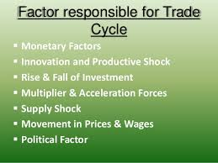

Slide 10
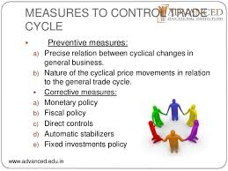

Slide 11
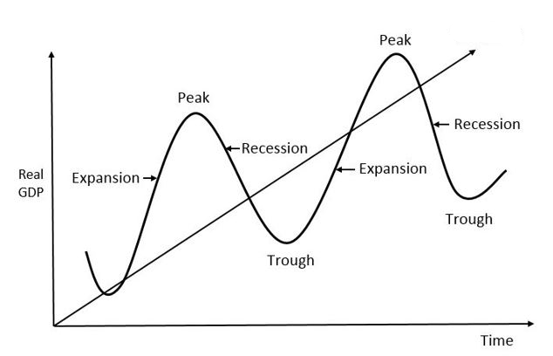
FLUCTUATIONS IN A TRADE CYCLE

Slide 12
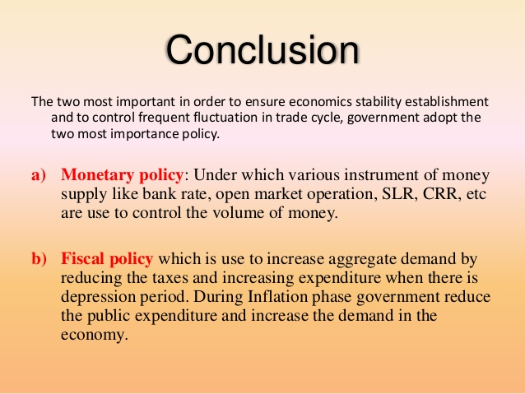

Slide 13
THANK YOU

