Slide 1

HTML (Hypertext Markup Language)
Language of Web Page
Presented By: Sayanta Mondal

Slide 2
Hypertext & Hyperlink
English -> Written -> Books
HTML -> Written -> Web page
Hyper Text Markup Language
Web pages are text files.
The key to hypertext is the use of hyperlinks, which allow you to jump from one topic to another topic.

Slide 3
Definition of HTML
HTML describes the content and
format of web pages using tags.
Ex. Title Tag: <title>A title </title>
It’s the job of the web browser to interpret tags and display the content accordingly.

Slide 4
HTML Syntax
An HTML file contains both formatting tags and content
Document content is what we see on the webpage.
Tags are the HTML codes that control the appearance of the document content.

Slide 5
HTML Syntax
HTML syntax:
two-sided tag:
Closing tag
<tag attributes>document content</tag>
of the tags
Actual content appears in webpage. It could be empty
Starting tag
tag.
Examples: <p> This is a paragraph</p>
Optional!
<body bgcolor = “yellow”> Color Text </body>

Slide 6
HTML Syntax
HTML syntax:
one-sided tag:
<tag />
e.g.
Breaking line tag: Horizontal line tag:
<br/>
<hr/>

Slide 7
Structure of the Web Page
Starting with the tag <html>...</html>
<html>
.......
</html>
Everything about the web page should be enclosed here

Slide 8
Structure of the Web Page
Inside the <html></html> tag
Each web page has a head part described in
<head></head> tag:
<html>
The title of the web page should be put here
<head>
<title> Testing Page</title>
</head>
</html>

Slide 9
Structure of the web page
Inside the <html></html> tag
Each web page has a body part described in <body></body> tag:
<html>
The content of
<head>
<title> Testing Page</title>^{the whole web}
page should be put here
</head>
<body>
This is a sample HTML file.
</body>
</html>

Slide 10
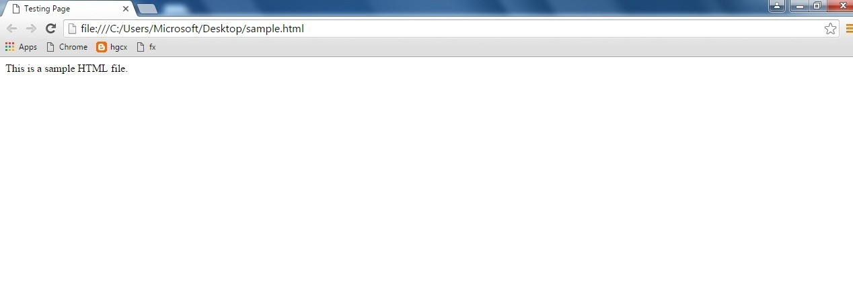
Title
Body

Slide 11
Create a basic HTML file
Open your text editor (notepad).
Type the following lines of code into the document:
<html>
<head>
<title> Testing Page</title>
</head>
<body>
This is a sample HTML file.
</body>
</html>

Slide 12
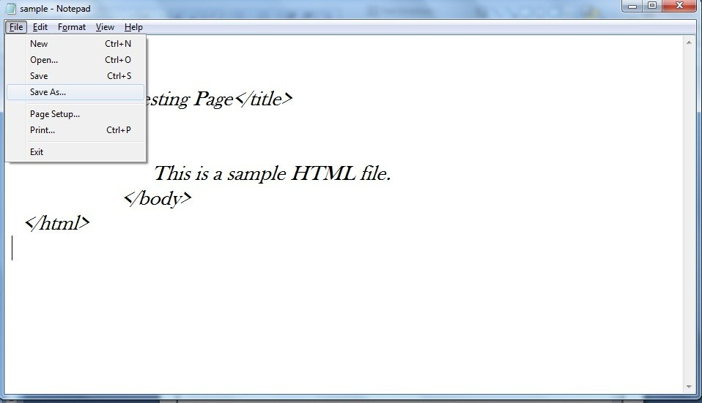

Slide 13
sample.html

Slide 14
Introduction to some common tags
Paragraph tag
List tag
Hyperlink tags

Slide 15
Paragraph tags <p>...</p>
<html>
<head>
<title> Testing Web Page</title>
</head>
<body>
<p> Here is the first paragraph. </p>
<p> Here is the second paragraph. </p>
</body>
</html>

Slide 16
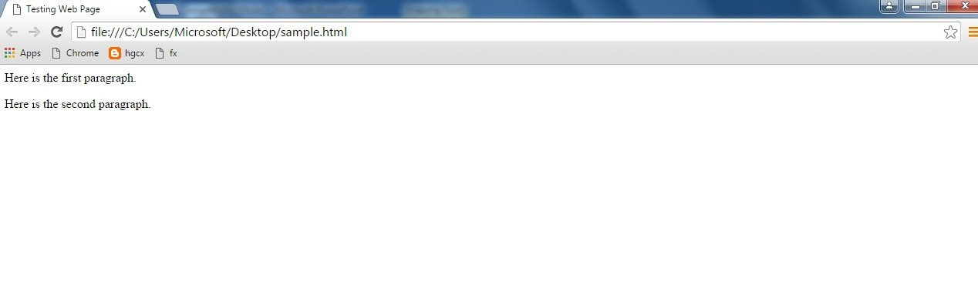
First paragraph
Space between paragraphs
Second paragraph

Slide 17

List tags
Ordered list: used to display information in a numeric order. The syntax for creating an ordered list is:
<ol >
<li>item1 </li> Sandhu</li>
<li>item2 </li>
…
</ol>
e.g.
<ol >
<li> Name: Satvir
<li> Software Dept.</li>
<li> Instructor: Satvir </li>
</ol>
Result:

Slide 18

List tags
Unordered list: list items are not listed in a particular order. The syntax is:
<ul > |  | e.g. | <ul>
</ul> | <li>item1 </li> <li>item2 </li> … |  | <li> Name: Satvir Sandhu</li> <li> Software Dept. </li> <li> Instructor: Satvir </li> </ul>
Result

Slide 19
Include a Picture
<img src=“FILENAME” />
<img src=“FILENAME” alt=“text” />
E.g.
<img src=“logo.gif” alt=“Google logo” />
<img src=“logo.gif” />

