Slide 1
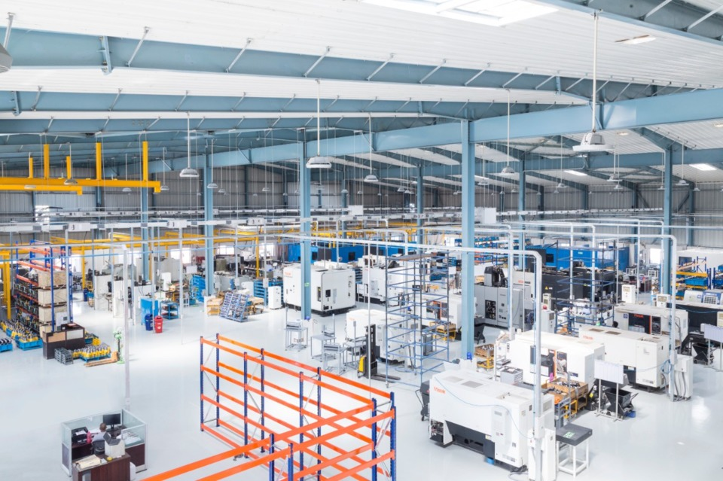
Creating a REGRESSION model for PREDICTING WASTE
Sujit Singh

Slide 2
Project Outline
Predict Wastage at Plant
Project Summary
Overview
Approach
Challenges
Project Details
Data Gathering
Data Cleanup
Data Explorations
Data Issues
Data Analysis & Insights
Results
Q & A
2

Slide 3
Approach
Predict Wastage at Plant
Overview
At JH, we manufacture building materials like FC Backer Boards, Planks, Trims etc. We have 10 manufacturing plants in USA. From raw materials inputs to all the way finished goods, we almost have to wait for 3 days before our products go for final quality checks like strength tests. If strength tests do not meet our stringent limits for product strength, products are rejected which costs millions of dollars to our company. We want to have some kind of predictive models in place which will enable our shop floor managers to predict the wastes based on certain input variables (like some test results in the production up streams ) so that they can take corrective measures to reduce or eliminate the final product waste. In this project, I’m trying to create a model to predict this waste!
Approach and Data Collection:
Our R&D Engineers capture data at the shop floor for various tests conducted at different steps and shared a sample excel data file containing several variables for 1 month of production data with actual final strength test results.
Technology and tools: Python, Python Panda, Sklearn & Tableau
Research Questions to Answer:
Which variable has highest contribution to predict the waste?
Develop the best predictive model for above business case?
Develop a POC and gain the confidence for long term initiative?

Slide 4

Challenges
Predict Wastage at Plant
Data Issues
Actual Target Variable (MOR value) is sparsely populated as it is based on sample tests data.
Just 1 month worth of data. Not enough data for training a good model
Too many variables to choose but we want a list of manageable features

Slide 5

Technologies Used:
Predict Wastage at Plant
Python
Pandas
Numpy
Sklearn
Linear Regression
Matplotlib
Tableau
Jupyter Notebook
Github

Slide 6
Data Sources
Predict Wastage at Plant
Excel Data File

Slide 7
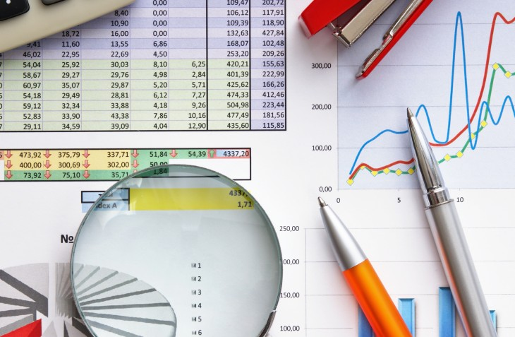
Predict Wastage at Plant
Data Gathering Examples

Slide 8
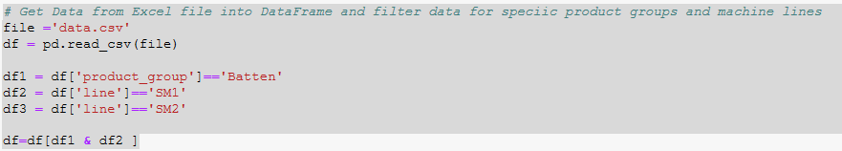
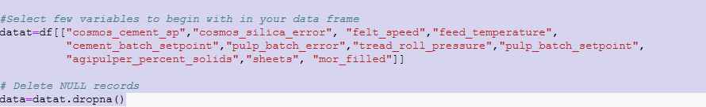
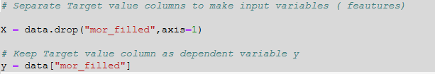
Predict Wastage at Plant
Data Preparation for Model

Slide 9
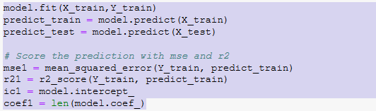
Predict Wastage at Plant
Applying Machine Learning and creating a Regression Model

Slide 10
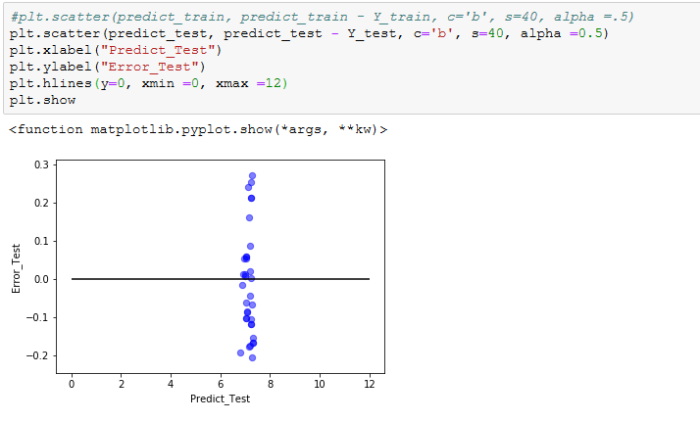
Predict Wastage at Plant
Prediction using Regression Model and Visualizing

Slide 11

Predict Wastage at Plant
Using Tableau for Visualizations on Predictive Model results

Slide 12
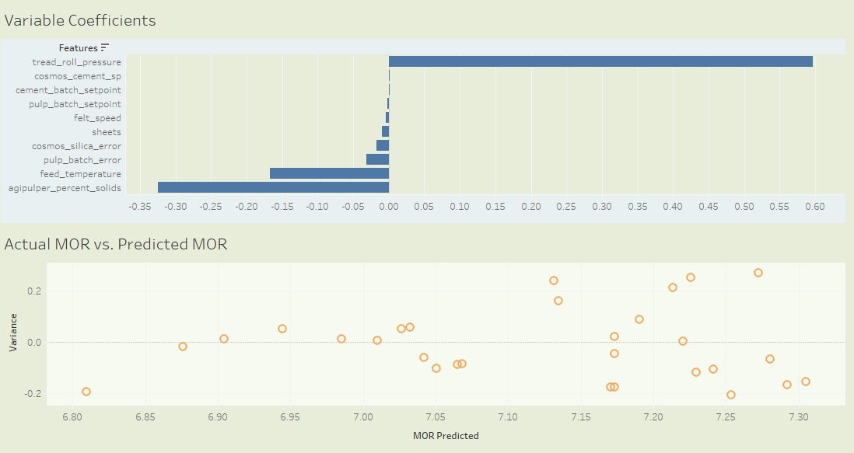
Predict Wastage at Plant
Dashboards Visualizations in Tableau

Slide 13
Predict Wastage at Plant
Critical Observations:
Different Product Groups need separate Predictive Model for better results
Some features have way more impacts on MOR result than others
Separate machine lines have impact on MOR
For certain product groups, the predictive results are better than other product groups

Slide 14
Predict Wastage at Plant
?

