Slide 1


Realtime stock data analysis
Submitted to: PROF. Mrudula Mukadam
On the fulfillment of final project (BIG Data technology)
TEAM:
Sujiv Shrestha
Ngoc vu nguyen
Solam jung rana

Slide 2

ABOUT PROJECT
This project is developed to analyze huge dataset of stock market and extract useful information out of it for maximizing profit in stock trading optimizing the processing of data fetching and aggregation utilizing various tools of Big Data Technology

Slide 3





TECHNOLOGIES USED
What are the technologies we used to develop the project?
Kafka
Spark
Hbase
Hive
Tableau

Slide 4
ARCHITECTURE
Live
Web
Producer
Topic
Consumer
Stream
SQL
Table 1
DATA
Zeppelin
Producer
Topic
Consumer
Stream
SQL
Table 2
File
Data Visualization
Hbase/Hive
History
Kafka
Spark

Slide 5

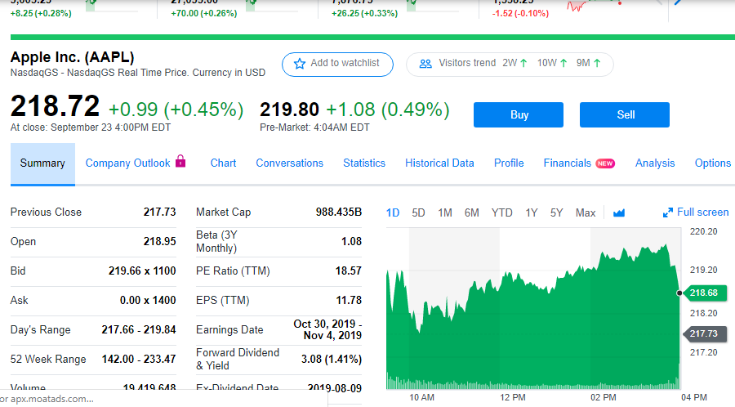
Data Source
Types of data used:
Web data Scrapped from Webpage (RealTime)
History Indices Data File Downloaded from Yahoo Finance Website [1980 – 2019]
Your company name

Slide 6
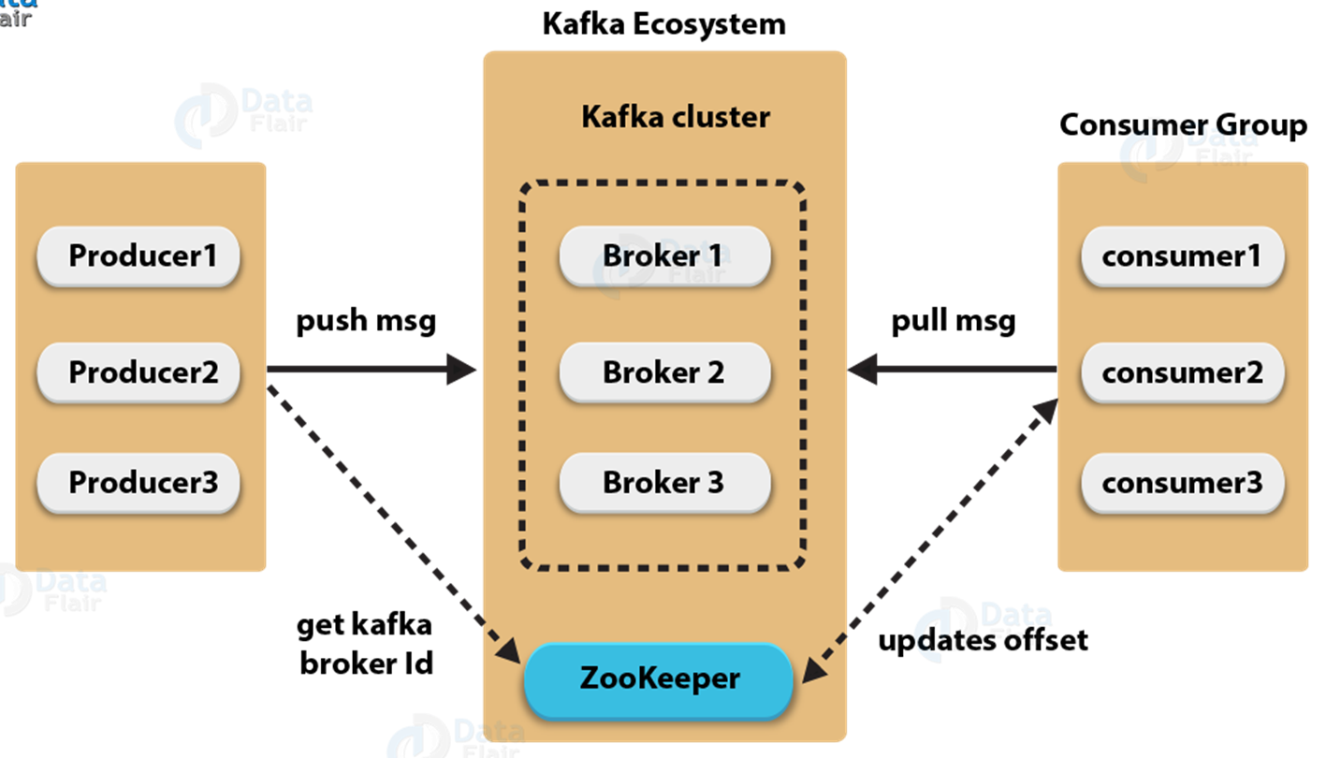
Kafka
WHY DID WE USE KAFKA?
provides real-time analytics
has higher throughput, reliability, and replication characteristics
Works great with Flume/Flafka, Spark Streaming, Storm, Hbase
Kafka is a durable event store; it maintains ordered sequences of entries called topics which are stored on disk and replicated within a cluster.

Slide 7
Kafka
(Command Lines)
Modify config file at:
config/server.properties
start kafka server:
bin/kafka-server-start.sh config/server.properties
create topic:
bin/kafka-topics.sh --create --zookeeper localhost:2181 --topic kafka-topic1--replication-factor 3 --partitions 3
verify that topic started:
bin/kafka-topics.sh --list --zookeeper localhost:2181
start kafka console producer:
bin/kafka-console-producer.sh --broker-list localhost:9092 --topic kafka-topic1
start kafka console consumer:
bin/kafka-console-consumer.sh --broker-list localhost:9092 --topic kafka-topic1 --from-beginning

Slide 8
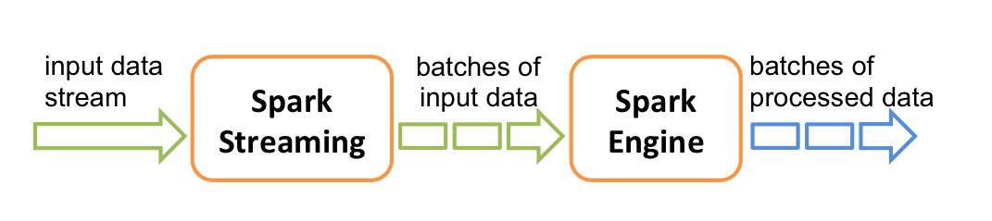
Spark streaming
HOW DOES SPARK STREAMING WORKS?
An extension of the core Spark API that enables scalable, high-throughput, fault-tolerant stream processing of live data streams.
Spark Streaming receives live input data streams and divides the data into batches, which are then processed by the Spark engine to generate the final stream of results in batches.

Slide 9
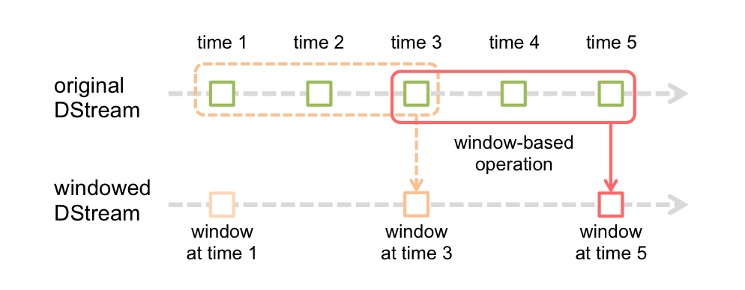
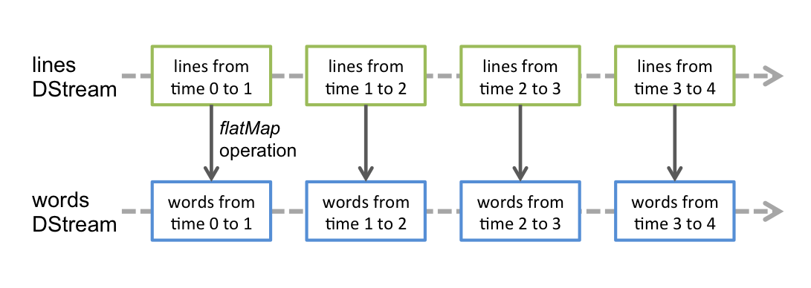
Spark streaming (cont..)

Slide 10
Spark streaming (cont..)
JobRun Commands:
spark-submit --class <CLASS_PATH> --master yarn <JAR_LOCATION> <JOB_CODE> <PORT> <ADDITIONAL_PARAMETERS>
Jobs:
K – Stream history indices data from file
Parameters:- Port for kafka data producer service , Input file location
S – Spark Stream job for processing history data
Parameters:-Port for kafka data consumer service
O – Online Stream Stock Data from web
Parameters:- Port for Kafka data producer service, streaming mode (real or mock), company symbol.
C – Analyze realtime stream data
Parameters:-Port for Kafka data consumer service

Slide 11
Spark streaming (cont..)
JobRun Commands:
spark-submit --class <CLASS_PATH> --master yarn <JAR_LOCATION> <JOB_CODE> <PORT> <ADDITIONAL_PARAMETERS>
Generate History Stock Data KafkaStream
spark-submit --class "cs523.kafka.MyKafkaProducer" --master yarn kafka/target/kafka-0.0.1-SNAPSHOT.jar k 9092 /kafka/input/AAPL.csv
Analyze History Stock Data KafkaStream
spark-submit --class "cs523.kafka.MyKafkaProducer" --master yarn kafka/target/kafka-0.0.1-SNAPSHOT.jar s 9092
Generate RealTime Stock Data From Web or Mock Data Stream
For RealTime Data
spark-submit --class "cs523.kafka.MyKafkaProducer" --master yarn kafka/target/kafka-0.0.1-SNAPSHOT.jar o 9092 real <COMPANY_SYMBOL>
For Mock Data
spark-submit --class "cs523.kafka.MyKafkaProducer" --master yarn kafka/target/kafka-0.0.1-SNAPSHOT.jar o 9092 mock
Analyze RealTime Stock Data Stream And Produce Recommendation
spark-submit --class "cs523.kafka.MyKafkaProducer" --master yarn kafka/target/kafka-0.0.1-SNAPSHOT.jar c 9092

Slide 12
Spark SQL
WHY SPARK SQL?
Spark SQL is a Spark module for structured data processing.
Provides a programming abstraction called DataFrames and can also act as a distributed SQL query engine.
Integrated
Unified Data Access
Standard Connectivity
Scalability

Slide 13
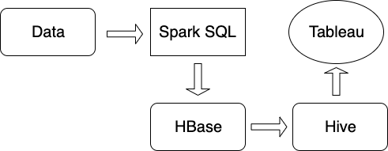
HBASE/HIVE
HBase is a NoSQL database used for real-time data streaming
Possible to write HiveQL queries over HBase tables so that HBase can make the best use of Hive’s features.
the middle layer between Hive and HBase is implemented with Hive’s additional library.
HBaseStorageHandler interface can be implemented to access Hbase from Hive queries.

Slide 14
TABLEAU DESKTOP & sERVER
WHY DID WE USE IT?
A powerful and fastest growing data visualization tool used in the Business Intelligence Industry.
Helps in simplifying raw data into the very easily understandable format.
Fast and easy
Outstanding user interface
Leverage the power of data
Easy visualization
Realtime exploration

Slide 15
HOW DOES TABLEAU WORK?
TABLEAU DESKTOP & SERVER (cont..)
Tableau connects and extracts the data stored in various places pulls data from any platform imaginable.
Ready data connectors are available to connect to any database.
The pulled data can be either connected live or extracted to the Tableau's data engine, Tableau Desktop.
The Data analyst, data engineer work with the data that was pulled up and develop visualizations.

Slide 16
WHAT WE USED?
TABLEAU DESKTOP & SERVER (cont..)
Tableau Desktop:
- Software that is largely used for business intelligence
- Transforms huge amount of data (mostly statistical data) into interactive visual representations, such as graphs and charts.
Tableau Server:
- Allows the users to publish, share and administrate this Tableau Desktop content.

Slide 17
HOW DID WE USE IT ?
TABLEAU DESKTOP & SERVER (cont..)
INSTALL TABLEAU DESKTOP
CONNECT TO HIVE
CREATE SHEET
ADD NEEDED FIELDS
SELECT THE VIEW
RENDER VISUALIZATION

Slide 18
HOW DID WE ADDED NEEDED FIELDS?
TABLEAU DESKTOP & SERVER (cont..)
UpperBound:
[MovingAverage]+[StandardDeviations]*[StandardDeviation]
LowerBound:
[MovingAverage]-[StandardDeviations]*[StandardDeviation]
Moving Average
WINDOW_AVG(AVG([Close]),-[LookbackPeriod],0)
StandardDeviation
WINDOW_STDEV(AVG([Close]),-[LookbackPeriod],0)
LookBackPeriod
Specific period of time to calculate MovingAverage
StandardDeviations
Deviations from the average value

Slide 19
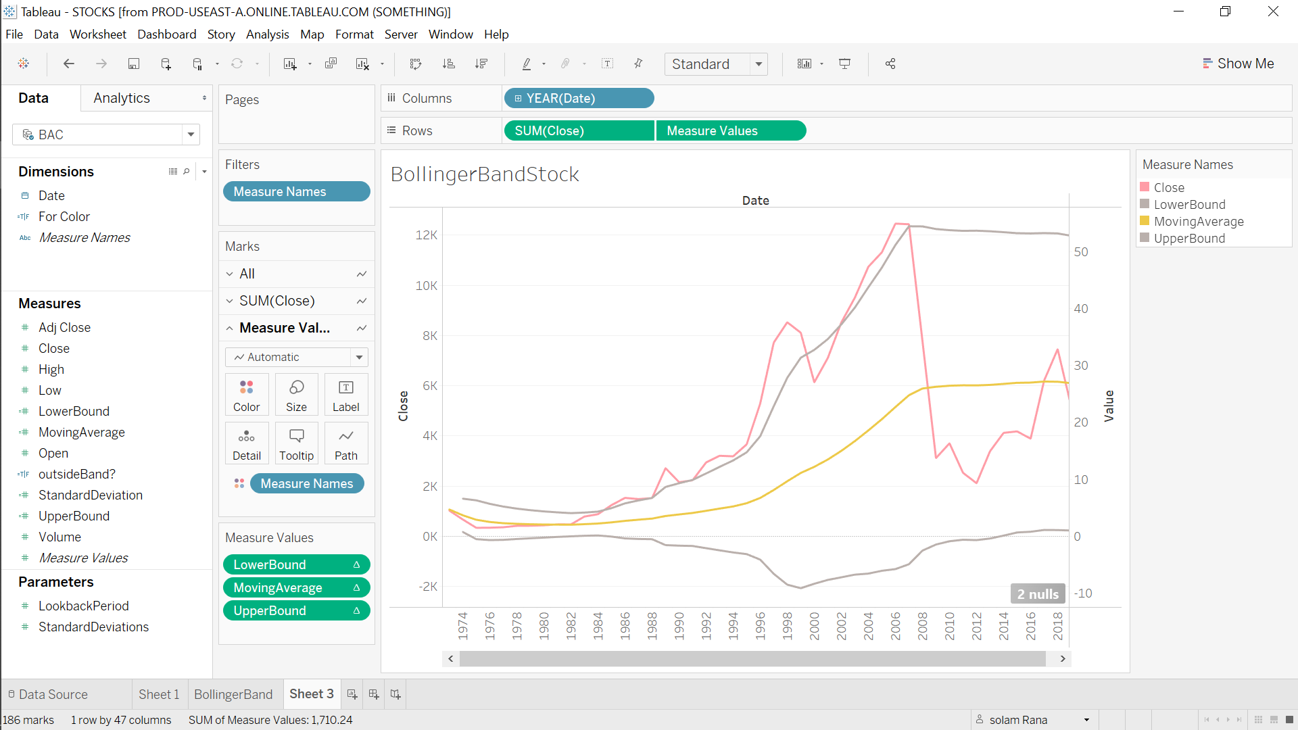
TABLEAU DESKTOP
HOW DOES IT LOOK?

Slide 20
Any queries?

Slide 21
THANK YOU
YOU GUYS ARE AWESOME

Slide 22
LETS GO FOR THE DEMO

