Slide 1

Scaling Expectations
Notes:
1
1
1
1
Speaker note

Slide 2
Scaling Expectations
Setup Project
First, initialize a Node.js project, install dependencies, and configure TypeScript.
npm init –y
npm install express sequelize mysql2 body-parser dotenv
npm install --save-dev typescript @types/node @types/express @types/sequelize
npx tsc --init
Notes:
2
2
2
2
Speaker note

Slide 3
Scaling Expectations
Key dependencies:
express: Web framework.
mysql2: MySQL driver.
sequelize: ORM for MySQL.
bcryptjs: To hash passwords.
jsonwebtoken: For JWT-based authentication
Notes:
3
3
3
3
Speaker note

Slide 4
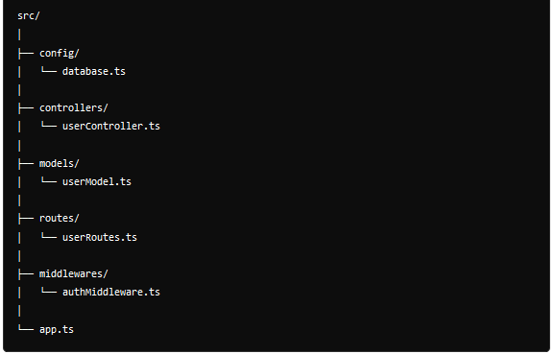
Scaling Expectations
Notes:
4
4
4
4
Speaker note

Slide 5
Scaling Expectations
In src/config/database.ts, set up Sequelize to connect to the MySQL database: import { Sequelize } from 'sequelize';
const sequelize = new Sequelize('your_db_name', 'your_username', 'your_password', {
host: 'localhost',
dialect: 'mysql'
});
export default sequelize;
Notes:
5
5
5
5
Speaker note

Slide 6
Scaling Expectations
In src/models/userModel.ts, define the user model, including a profile field.
import { DataTypes, Model } from 'sequelize';
import sequelize from '../config/database';
class User extends Model {
public id!: number;
public username!: string;
public password!: string;
public profile!: string; // Additional profile data
public readonly createdAt!: Date;
public readonly updatedAt!: Date;
}
User.init({
username: {
type: DataTypes.STRING,
allowNull: false,
unique: true
},
password: {
type: DataTypes.STRING,
allowNull: false
},
profile: {
type: DataTypes.TEXT,
allowNull: true
}
}, {
sequelize,
modelName: 'User'
});
export default User;
Notes:
6
6
6
6
Speaker note

Slide 7
Scaling Expectations
In src/controllers/userController.ts, implement the logic for registering and logging in users, including password hashing and JWT generation.
Notes:
7
7
7
7
Speaker note

Slide 8
Scaling Expectations
import { Request, Response } from 'express';
import User from '../models/userModel';
import bcrypt from 'bcryptjs';
import jwt from 'jsonwebtoken';
const registerUser = async (req: Request, res: Response) => {
const { username, password, profile } = req.body;
try {
const hashedPassword = await bcrypt.hash(password, 10);
const user = await User.create({ username, password: hashedPassword, profile });
res.status(201).json({ message: 'User created successfully', user });
} catch (error) {
res.status(500).json({ error: 'Error creating user' });
}
};
Notes:
8
8
8
8
Speaker note

Slide 9
Scaling Expectations
const loginUser = async (req: Request, res: Response) => {
const { username, password } = req.body;
try {
const user = await User.findOne({ where: { username } });
if (!user) {
return res.status(404).json({ message: 'User not found' });
}
const isPasswordValid = await bcrypt.compare(password, user.password);
if (!isPasswordValid) {
return res.status(401).json({ message: 'Invalid credentials' });
}
const token = jwt.sign({ id: user.id }, 'your_jwt_secret', { expiresIn: '1h' });
res.status(200).json({ message: 'Login successful', token });
} catch (error) {
res.status(500).json({ error: 'Error logging in' });
}
};
export { registerUser, loginUser };
Notes:
9
9
9
9
Speaker note

Slide 10
Scaling Expectations
Authentication Middleware
In src/middlewares/authMiddleware.ts, implement middleware to verify the JWT.
Notes:
10
10
10
10
Speaker note

Slide 11
Scaling Expectations
import { Request, Response, NextFunction } from 'express';
import jwt from 'jsonwebtoken';
const authMiddleware = (req: Request, res: Response, next: NextFunction) => {
const token = req.headers['authorization'];
if (!token) {
return res.status(401).json({ message: 'No token provided' });
}
try {
const decoded = jwt.verify(token, 'your_jwt_secret');
(req as any).userId = (decoded as any).id;
next();
} catch (error) {
return res.status(403).json({ message: 'Failed to authenticate token' });
}
};
export default authMiddleware;
Notes:
11
11
11
11
Speaker note

Slide 12
Scaling Expectations
Routes
In src/routes/userRoutes.ts, define the routes for user registration and login
Notes:
12
12
12
12
Speaker note

Slide 13
Scaling Expectations
import express from 'express';
import { registerUser, loginUser } from '../controllers/userController';
import authMiddleware from '../middlewares/authMiddleware';
const router = express.Router();
router.post('/register', registerUser);
router.post('/login', loginUser);
// Example of a protected route
router.get('/profile', authMiddleware, (req, res) => {
res.status(200).json({ message: `Profile of user ID ${(req as any).userId}` });
});
export default router;
Notes:
13
13
13
13
Speaker note

Slide 14
Scaling Expectations
Main Application File
In src/app.ts, set up the Express application.
Notes:
14
14
14
14
Speaker note

Slide 15
Scaling Expectations
import express from 'express';
import bodyParser from 'body-parser';
import sequelize from './config/database';
import userRoutes from './routes/userRoutes';
const app = express();
app.use(bodyParser.json());
app.use('/api/users', userRoutes);
const PORT = process.env.PORT || 3000;
sequelize.sync().then(() => {
app.listen(PORT, () => {
console.log(`Server running on port ${PORT}`);
});
}).catch((err) => {
console.error('Unable to connect to the database:', err);
});
Notes:
15
15
15
15
Speaker note

Slide 16
Scaling Expectations
import express from 'express';
import bodyParser from 'body-parser';
import sequelize from './config/database';
import userRoutes from './routes/userRoutes';
const app = express();
app.use(bodyParser.json());
app.use('/api/users', userRoutes);
const PORT = process.env.PORT || 3000;
sequelize.sync().then(() => {
app.listen(PORT, () => {
console.log(`Server running on port ${PORT}`);
});
}).catch((err) => {
console.error('Unable to connect to the database:', err);
});
Notes:
16
16
16
16
Speaker note

Slide 17
Scaling Expectations
Run the application ts-node src/app.ts
Notes:
17
17
17
17
Speaker note

