Slide 1
Module-III
Transaction

Slide 2
Contents
Transaction Model – ACID Properties – Transaction States – Serializability – Conflict Serializability – View Serializability – Testing Serializability –
Concurrency Control: Lock-based Protocols – Locks, Granting of locks, The Two-phase Locking Protocol, Implementation of locking, Time based protocol.
Deadlock Handling: Deadlock Prevention, Deadlock Detection and Recovery.

Slide 3
Transaction - States
What is a Transaction State?
A transaction is a set of operations or tasks performed to complete a logical process, which may or may not change the data in a database. To handle different situations, like system failures, a transaction is divided into different states.
A transaction state refers to the current phase or condition of a transaction during its execution in a database. It represents the progress of the transaction and determines whether it will successfully complete (commit) or fail (abort).

Slide 4
Transaction - States
A transaction involves two main operations:
Read Operation: Reads data from the database, stores it temporarily in memory (buffer), and uses it as needed.
Write Operation: Updates the database with the changed data using the buffer.
From the start of executing instructions to the end, these operations are treated as a single transaction. This ensures the database remains consistent and reliable throughout the process.

Slide 5
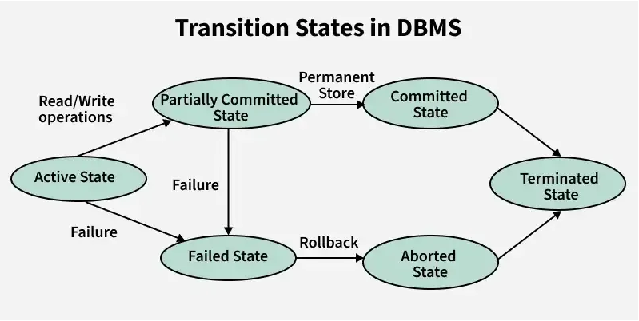

Slide 6
Transaction - States
These are different types of Transaction States :
1. Active State – This is the first stage of a transaction, when the transaction’s instructions are being executed.
It is the first stage of any transaction when it has begun to execute. The execution of the transaction takes place in this state.
Operations such as insertion, deletion, or updation are performed during this state.
During this state, the data records are under manipulation and they are not saved to the database, rather they remain somewhere in a buffer in the main memory.

Slide 7
Transaction - States
2. Partially Committed –
The transaction has finished its final operation, but the changes are still not saved to the database.
After completing all read and write operations, the modifications are initially stored in main memory or a local buffer. If the changes are made permanent on the DataBase then the state will change to “committed state” and in case of failure it will go to the “failed state”.

Slide 8
Transaction - States
3. Failed State –If any of the transaction-related operations cause an error during the active or partially committed state, further execution of the transaction is stopped and it is brought into a failed state. Here, the database recovery system makes sure that the database is in a consistent state.
4. Aborted State- If a transaction reaches the failed state due to a failed check, the database recovery system will attempt to restore it to a consistent state. If recovery is not possible, the transaction is either rolled back or cancelled to ensure the database remains consistent.

Slide 9
Transaction - States
In the aborted state, the DBMS recovery system performs one of two actions:
Kill the transaction: The system terminates the transaction to prevent it from affecting other operations.
Restart the transaction: After making necessary adjustments, the system reverts the transaction to an active state and attempts to continue its execution.

Slide 10
Transaction - States
6. Commuted- This state of transaction is achieved when all the transaction-related operations have been executed successfully along with the Commit operation, i.e. data is saved into the database after the required manipulations in this state. This marks the successful completion of a transaction.
7. Terminated State – If there isn’t any roll-back or the transaction comes from the “committed state”, then the system is consistent and ready for new transaction and the old transaction is terminated.

Slide 11
Example of Transaction States
Imagine a bank transaction where a user wants to transfer $500 from Account A to Account B.
Transaction States:
Active State:
The transaction begins. It reads the balance of Account A and checks if it has enough funds.
  Example: Read balance of Account A = $1000
Partially Committed State:
The transaction performs all its operations but hasn’t yet saved (committed) the changes to the database.
  Example: Deduct $500 from Account A’s balance ($1000 – $500 = $500) and temporarily update Account B’s balance (add $500).

Slide 12
Committed State:
The transaction successfully completes, and the changes are saved permanently in the database.
  Example: Account A’s new balance = $500; Account B’s new balance = $1500. Changes are written to the database.
Failed State:
If something goes wrong during the transaction (e.g., power failure, system crash), the transaction moves to this state.
  Example: System crashes after deducting $500 from Account A but before adding it to Account B.

Slide 13
Aborted State:
The failed transaction is rolled back, and the database is restored to its original state.
  Example: Account A’s balance is restored to $1000, and no changes are made to Account B.
These states ensure that either the transaction completes successfully (committed) or the database is restored to its original state (aborted), maintaining consistency and preventing errors.

Slide 14
Schedule
Schedule, as the name suggests, is a process of lining the transactions and executing them one by one.
When there are multiple transactions that are running in a concurrent manner and the order of operation is needed to be set so that the operations do not overlap each other, Scheduling is brought into play and the transactions are timed accordingly.

Slide 15
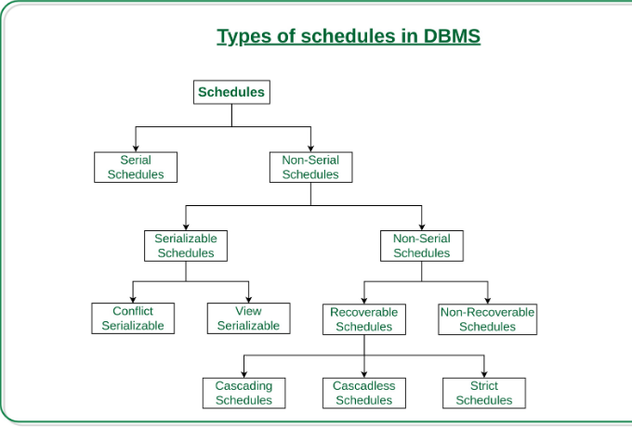

Slide 16
Serial Schedules: Schedules in which the transactions are executed non-interleaved, i.e., a serial schedule is one in which no transaction starts until a running transaction has ended are called serial schedules.
Example: Consider the following schedule involving two transactions T ₁ and T ₂ .

Slide 17
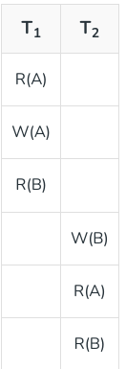
In serial transaction:
Only one transaction at a time is active.
The commit or a abort of the active transaction initiates execution of the next transaction.
No interleaving occurs in serial schedules.

Slide 18
Non-serial Schedule
A schedule where the transactions are overlapping or switching places. As they are used to carry out actual database operations, multiple transactions are running at once.
It's possible that these transactions are focusing on the same data set. Therefore, it is crucial that non-serial schedules can be serialized in order for our database to be consistent both before and after the transactions are executed.

Slide 19
Non-Serial Schedule:
This is a type of Scheduling where the operations of multiple transactions are interleaved. This might lead to a rise in the concurrency problem.
The transactions are executed in a non-serial manner, keeping the end result correct and same as the serial schedule. Unlike the serial schedule where one transaction must wait for another to complete all its operation, in the non-serial schedule, the other transaction proceeds without waiting for the previous transaction to complete.
This sort of schedule does not provide any benefit of the concurrent transaction. It can be of two types namely, Serializable and Non-Serializable Schedule. The Non-Serial Schedule can be divided further into Serializable and Non-Serializable.

Slide 20
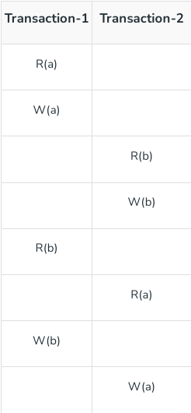
Interleaving:
In a serial schedule, if a transaction waits for an I/O operation to complete, idle CPU time is generated and wasted for lack of use.
Other transactions may also be in line waiting for the completion of a transaction.
For these reasons, serial schedules are generally considered unacceptable in practice.
Interleaving could improve the use of the CPU cycles.

Slide 21
Serializability
If a non-serial schedule can be transformed into its corresponding serial schedule, it is said to be serializable.
Simply said, a non-serial schedule is referred to as a serializable schedule if it yields the same results as a serial timetable.

Slide 22
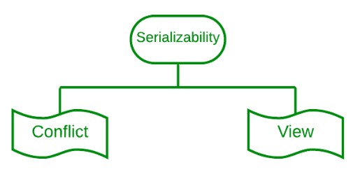
Types of Serializability
Conditions for Conflicts:
They belong to different transactions.
They access the same time.
At least one of the operation is a Write operation

Slide 23
Conflict Serializability
It refers to a subset of serializability that focuses on maintaining the consistency of a database while ensuring that identical data items are executed in an order.
In a DBMS each transaction has a value and all the transactions, in the database rely on this uniqueness. This uniqueness ensures that no two operations with the conflict value can occur simultaneously.

Slide 24
For example lets consider an order table and a customer table as two instances. Each order is associated with one customer even though a single client may place orders. However there are restrictions for achieving conflict serializability in the database.
Different transactions should be used for the two procedures.
The identical data item should be present in both transactions.
Between the two operations, there should be at least one write operation.

Slide 25
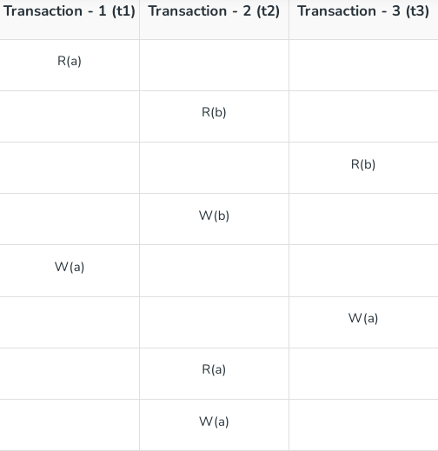
Three transactions—t1, t2, and t3—are active on a schedule "S" at once. Let's create a graph of precedence.

Slide 26
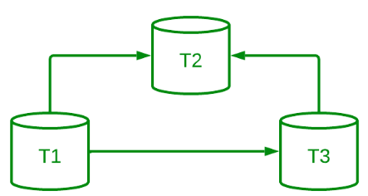
As there is no incoming edge on Transaction 1, Transaction 1 will be executed first. T3 will run second because it only depends on T1. Due to its dependence on both T1 and T3, T2 will finally be executed.
Therefore, the serial schedule's equivalent order is: t1 --> t3 --> t2

Slide 27
View Serializability
View serializability is a kind of operation in a serializable in which each transaction should provide some results, and these outcomes are the output of properly sequentially executing the data item.
The view serializability, in contrast to conflict serialized, is concerned with avoiding database inconsistency. The view serializability feature of DBMS enables users to see databases in contradictory ways.

Slide 28
View Serializability
The schedules S1 and S2.
The two transactions T1 and T2 should be used to establish these two schedules.
Each schedule must follow the three transactions in order to retain the equivalent of the transaction.
These three circumstances are listed below.

Slide 29
View Serializability-Circumstances
The first prerequisite is that the same kind of transaction appears on every schedule. This requirement means that the same kind of group of transactions cannot appear on both schedules S1 and S2.
The schedules are not equal to one another if one schedule commits a transaction but it does not match the transaction of the other schedule.

Slide 30
View Serializability-Circumstances
2. The second requirement is that different read or write operations should not be used in either schedule.
On the other hand, we say that two schedules are not similar if schedule S1 has two write operations whereas schedule S2 only has one.
The number of the write operation must be the same in both schedules, however there is no issue if the number of the read operation is different.

Slide 31
View Serializability-Circumstances
3. The second to last requirement is that there should not be a conflict between either timetable. execution order for a single data item.
Assume, for instance, that schedule S1's transaction is T1, and schedule S2's transaction is T2. The data item A is written by both the transaction T1 and the transaction T2.
The schedules are not equal in this instance.

Slide 32
View Equivalency
Schedules (S1 and S2) must satisfy these two requirements in order to be viewed as equivalent:
The same piece of data must be read for the first time. For instance, if transaction t1 is reading "A" from the database in schedule S1, then t1 must also read A in schedule S2.
The same piece of data must be used for the final write. As an illustration, if transaction t1 updated A last in S1, it should also conduct final write in S2.
The middle sequence need to follow suit. As an illustration, if in S1 t1 is reading A, and t2 updates A, then in S2 t1 should read A, and t2 should update A.

Slide 33
View Equivalency
View Serializability refers to the process of determining whether a schedule's views are equivalent.

Slide 34
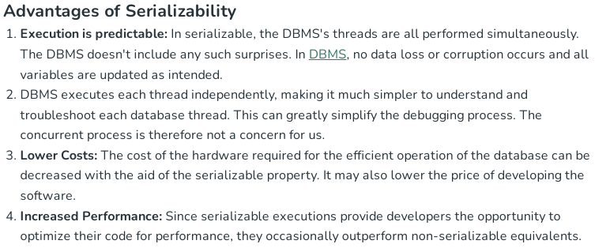
Advantages of Serializability

Slide 35
Testing the Conflict serializability
A Precedence Graph or Serialization Graph is used commonly to test the Conflict Serializability of a schedule.
It is a directed Graph (V, E) consisting of a set of nodes V = {T₁, T₂, T₃……….T_{n}} and a set of directed edges E = {e₁, e₂, e₃………………e_{m}}.

Slide 36
Testing the Conflict serializability
The graph contains one node for each Transaction Ti.
An edge ei is of the form Tj –> Tk where Tj is the starting node of ei and Tk is the ending node of ei.
An edge ei​ is drawn from node Tj to node Tk if a conflicting operation in Tj occurs before the corresponding conflicting operation in Tk​ in the schedule.

Slide 37
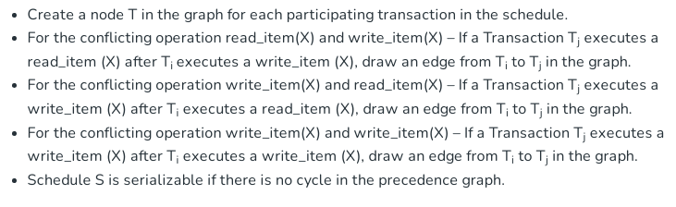

Slide 38

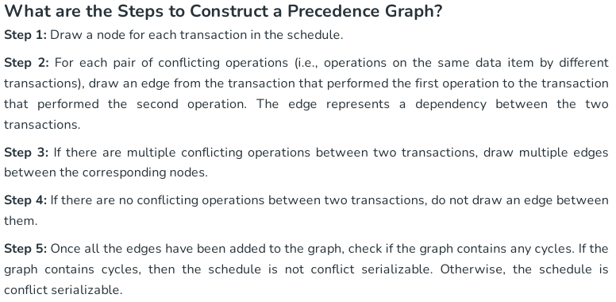
Creating Precedence graph

Slide 39
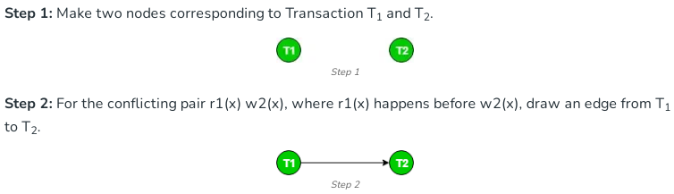
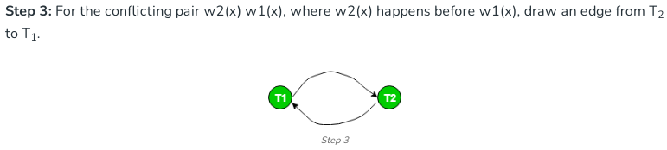

Slide 40
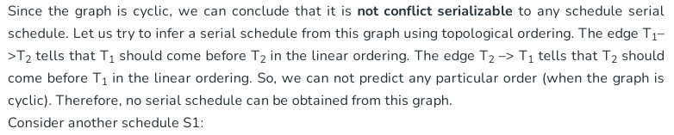

Slide 41
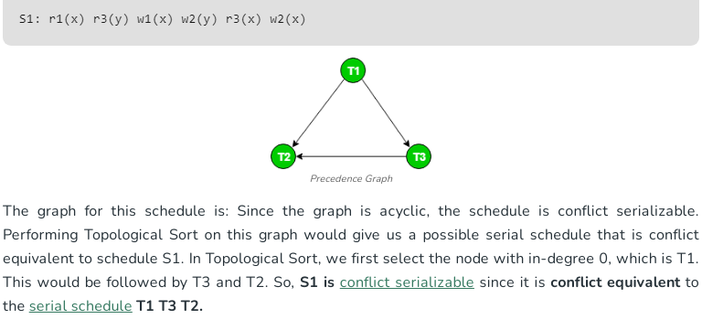

Slide 42
Concurrency control
In a database management system (DBMS), allowing transactions to run concurrently has significant advantages, such as better system resource utilization and higher throughput. However, it is crucial that these transactions do not conflict with each other.
The ultimate goal is to ensure that the database remains consistent and accurate.
  For instance, if two users try to book the last available seat on a flight at the same time, the system must ensure that only one booking succeeds.
Concurrency control is a critical mechanism in DBMS that ensures the consistency and integrity of data when multiple operations are performed at the same time.

Slide 43
Concurrency control
Concurrency control is a concept in Database Management Systems (DBMS) that ensures multiple transactions can simultaneously access or modify data without causing errors or inconsistencies. It provides mechanisms to handle the concurrent execution in a way that maintains ACID properties.
By implementing concurrency control, a DBMS allows transactions to execute concurrently while avoiding issues such as deadlocks, race conditions, and conflicts between operations.
The main goal of concurrency control is to ensure that simultaneous transactions do not lead to data conflicts or violate the consistency of the database. The concept of serializability is often used to achieve this goal.

Slide 44
Concurrent Execution and Related Challenges
In a multi-user system, several users can access and work on the same database at the same time. This is known as concurrent execution, where the database is used simultaneously by different users for various operations. For instance, one user might be updating data while another is retrieving it.
When multiple transactions are performed on the database simultaneously, it is important that these operations are executed in an interleaved manner. This means that the actions of one user should not interfere with or affect the actions of another. This helps in maintaining the consistency of the database.

Slide 45
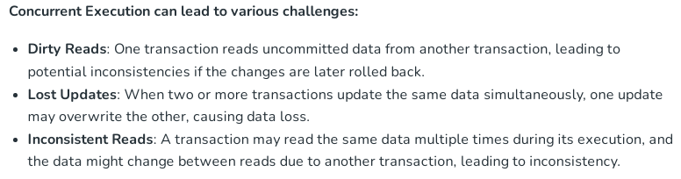
Concurrent Execution and Related Challenges

Slide 46
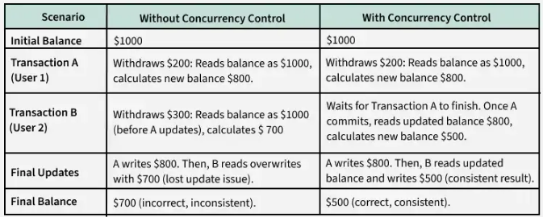
Needed for Concurrency control?

Slide 47
Needed for Concurrency control?
Without Concurrency Control: Transactions interfere with each other, causing issues like lost updates, dirty reads or inconsistent results.
With Concurrency Control: Transactions are properly managed (e.g., using locks or timestamps) to ensure they execute in a consistent, isolated manner, preserving data accuracy.
Concurrency control is critical to maintaining the accuracy and reliability of databases in multi-user environments.
By preventing conflicts and inconsistencies during concurrent transactions, it ensures the database remains consistent and correct,
even under high levels of simultaneous activity.

Slide 48
Concurrency control protocols
Concurrency Control Protocols
Concurrency control protocols are the set of rules which are maintained in order to solve the concurrency control problems in the database.
It ensures that the concurrent transactions can execute properly while maintaining the database consistency.
The concurrent execution of a transaction is provided with atomicity, consistency, isolation, durability, and serializability via the concurrency control protocols.

Slide 49
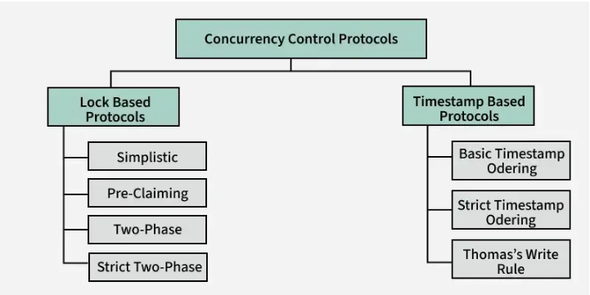
Concurrency control protocols

Slide 50
Lock based protocol
Lock-based concurrency control (BCC) is a method used to manage how multiple transactions access the same data.
This protocol ensures data consistency and integrity when multiple users interact with the database simultaneously.
This method uses locks to manage access to data, ensuring transactions don’t clash and everything runs smoothly when multiple transactions happen at the same time.

Slide 51
Lock based protocol
What is a Lock?
A lock is a variable associated with a data item that indicates whether it is currently in use or available for other operations.
Locks are essential for managing access to data during concurrent transactions. When one transaction is accessing or modifying a data item, a lock ensures that other transactions cannot interfere with it, maintaining data integrity and preventing conflicts.
This process, known as locking, is a widely used method to ensure smooth and consistent operation in database systems.

Slide 52
Lock Based Protocols
These protocols prevent concurrency issues by allowing only one transaction to access a specific data item at a time.
Locks help multiple transactions work together smoothly by managing access to the database items.
Locking is a common method used to maintain the serializability of transactions.
A transaction must acquire a read lock or write lock on a data item before performing any read or write operations on it.

Slide 53
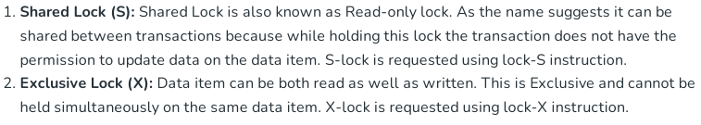
Types of Locks

Slide 54
Rules of Locking
The basic rules for Locking are given below :
Read Lock (or) Shared Lock(S)
❖ If a Transaction has a Read lock on a data item, it can read the item but not update it.
❖ If a transaction has a Read lock on the data item, other transaction can obtain Read Lock on the data item but no Write Locks.
❖ So, the Read Lock is also called a Shared Lock.
Write Lock (or) Exclusive Lock (X)
❖ If a transaction has a write Lock on a data item, it can both read and update the data item.
❖ If a transaction has a write Lock on the data item, then other transactions cannot obtain either a Read lock or write lock on the data item.
❖ So, the Write Lock is also known as Exclusive Lock.

Slide 55
Lock Compatibility Matrix
A transaction can acquire a lock on a data item only if the requested lock is compatible with existing locks held by other transactions.
Shared Locks (S): Multiple transactions can hold shared locks on the same data item simultaneously.
Exclusive Lock (X): If a transaction holds an exclusive lock on a data item, no other transaction can hold any type of lock on that item.
If a requested lock is not compatible, the requesting transaction must wait until all incompatible locks are released by other transactions.
Once the incompatible locks are released, the requested lock is granted.

Slide 56
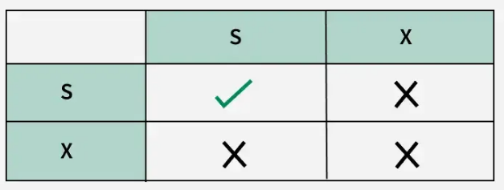
Lock Compatibility Matrix

Slide 57
Concurrency Control Protocols
Concurrency Control Protocols are the methods used to manage multiple transactions happening at the same time. They ensure that transactions are executed safely without interfering with each other, maintaining the accuracy and consistency of the database.
These protocols prevent issues like data conflicts, lost updates or inconsistent data by controlling how transactions access and modify data.

Slide 58
Types of Lock-Based Protocols
1. Simplistic Lock Protocol
2. Pre-Claiming Lock Protocol
3. Two-phase locking (2PL)
4. Strict Two-Phase Locking Protocol

Slide 59
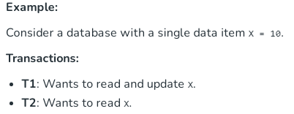
Simplistic Lock protocol
It is the simplest method for locking data during a transaction. Simple lock-based protocols enable all transactions to obtain a lock on the data before inserting, deleting, or updating it.
It will unlock the data item once the transaction is completed.

Slide 60
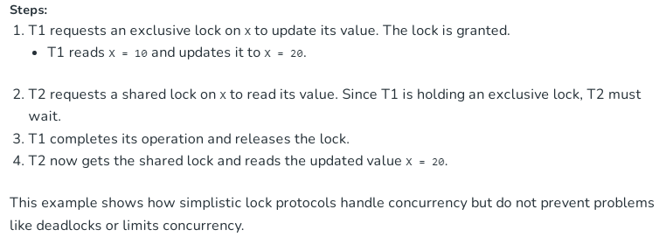
Simplistic Lock protocol

Slide 61
Pre-Claiming Lock Protocol
The Pre-Claiming Lock Protocol evaluates a transaction to identify all the data items that require locks.
Before the transaction begins, it requests the database management system to grant locks on all necessary data elements.
If all the requested locks are successfully acquired, the transaction proceeds.
Once the transaction is completed, all locks are released. However, if any of the locks are unavailable, the transaction rolls back and waits until all required locks are granted before restarting.

Slide 62
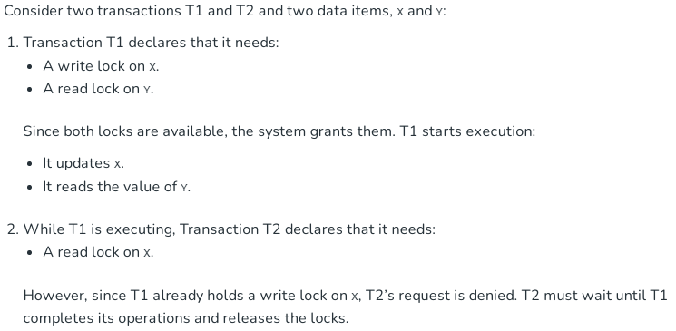
Pre-Claiming Lock Protocol

Slide 63
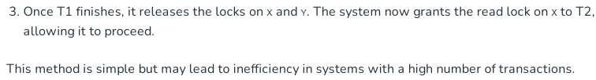
Pre-Claiming Lock Protocol

Slide 64
Two-phase locking (2PL)
A transaction is said to follow the Two-Phase Locking protocol if Locking and Unlocking can be done in two phases :
Growing Phase: In this step, the transaction gathers all the locks it needs to access the required data. During this phase, it cannot release any locks.
Shrinking Phase: Once a transaction starts releasing locks, it cannot acquire any new ones. This ensures that no other transaction interferes with the ongoing process.

Slide 65
Two-phase locking (2PL)
The Two-Phase Locking (2PL) Protocol is a key technique used in database management systems to manage how multiple transactions access and modify data at the same time.
When many users or processes interact with a database, it’s important to ensure that data remains consistent and error-free.
Without proper management, issues like data conflicts or corruption can occur if two transactions try to use the same data simultaneously.

Slide 66
Strict Two-Phase Locking Protocol
Strict Two-Phase Locking requires that in addition to the 2-PL all Exclusive(X) locks held by the transaction be released until after the Transaction Commits.

Slide 67
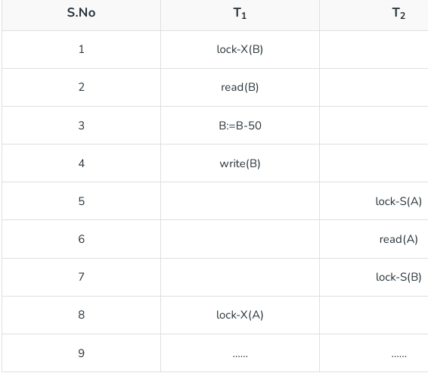

Slide 68
Deadlock
In the given execution scenario, T1 holds an exclusive lock on B, while T2 holds a shared lock on A.
At Statement 7, T2 requests a lock on B, and at Statement 8, T1 requests a lock on A.
This situation creates a deadlock, as both transactions are waiting for resources held by the other, preventing either from proceeding with their execution.

Slide 69
Starvation
Starvation is also possible if concurrency control manager is badly designed.
For example: A transaction may be waiting for an X-lock on an item, while a sequence of other transactions request and are granted an S-lock on the same item.
This may be avoided if the concurrency control manager is properly designed.

Slide 70
Two phase Locking – Lock Conversions
In the Two-Phase Locking Protocol, lock conversion means changing the type of lock on data while a transaction is happening. This process is carefully controlled to maintain consistency in the database.
Upgrading a Lock: This means changing a shared lock (S) to an exclusive lock (X).
For example, if a transaction initially only needs to read data (S) but later decides it needs to update the same data, it can request an upgrade to an exclusive lock (X). However, this can only happen during the Growing Phase, where the transaction is still acquiring locks.
  Example: A transaction reads a value (S lock) but then realizes it needs to modify the value. It upgrades to an X lock during the Growing Phase.

Slide 71
Downgrading a Lock: This means changing an exclusive lock (X) to a shared lock (S).
For instance, if a transaction initially planned to modify data (X lock) but later decides it only needs to read it, it can downgrade the lock. However, this must happen during the Shrinking Phase, where the transaction is releasing locks.
  Example: A transaction modifies a value (X lock) but later only needs to read the value, so it downgrades to an S lock during the Shrinking Phase.

Slide 72
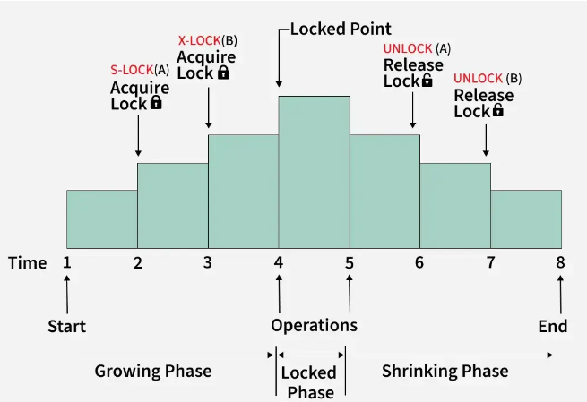

Slide 73
These rules ensure that the Two-Phase Locking Protocol maintains consistency and avoids conflicts between transactions.
By limiting when upgrades and downgrades can occur, the system prevents situations where multiple transactions interfere with each other’s operations.

Slide 74
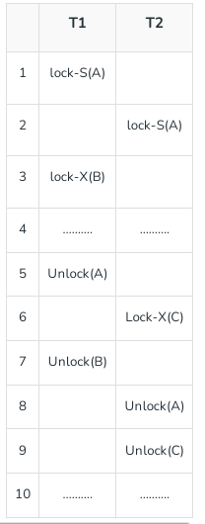
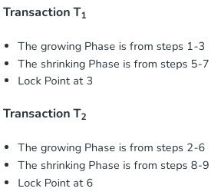

Slide 75
Lock Point
The lock point in a transaction is the moment when the transaction finishes acquiring all the locks it needs.
After this point, no new locks can be added, and the transaction starts releasing locks.
It’s a key step in the Two-Phase Locking Protocol to ensure the rules of growing and shrinking phases are followed.

Slide 76
Example of 2PL
Imagine a library system where multiple users can borrow or return books. Each action (like borrowing or returning) is treated as a transaction. Here’s how the Two-Phase Locking Protocol (2PL) works, including the lock point:
  User A wants to:
  Check the availability of Book X.
  Borrow Book X if it’s available.
  Update the library’s record.

