Slide 1
Android Layout & View Types
Frame, Linear, Relative, Table, ListView, GridView, RecyclerView
Presented by: [Sujon Ahmed]

Slide 2
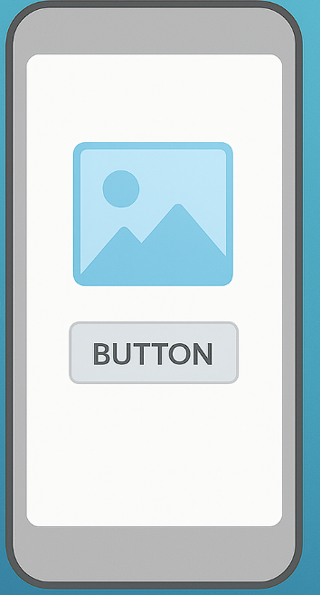
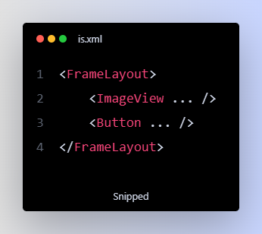
Frame Layout
Definition: A layout that stacks child views on top of each other, like layers. এ Overlapping Layout
একটার উপর আরেকটা ভিউ বসানো যায়
Simple UI design-এর জন্য
Example: Image on a button

Slide 3
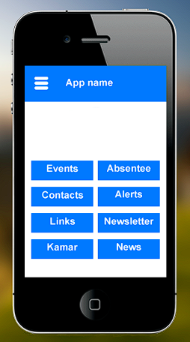
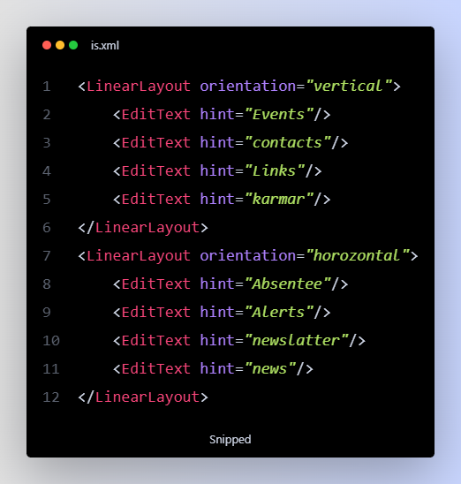
Linear Layout
Definition: A layout that arranges child views in a single direction — either vertically or horizontally. লাইন ধরে ভিউ বসে (Vertical বা Horizontal)
Simple Form Design-এ ব্যবহৃত হয়
Example: Name + Email fields

Slide 4
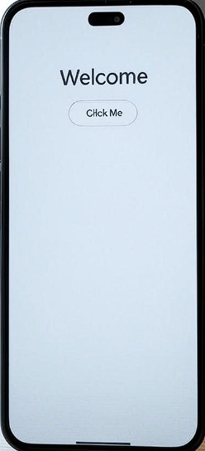
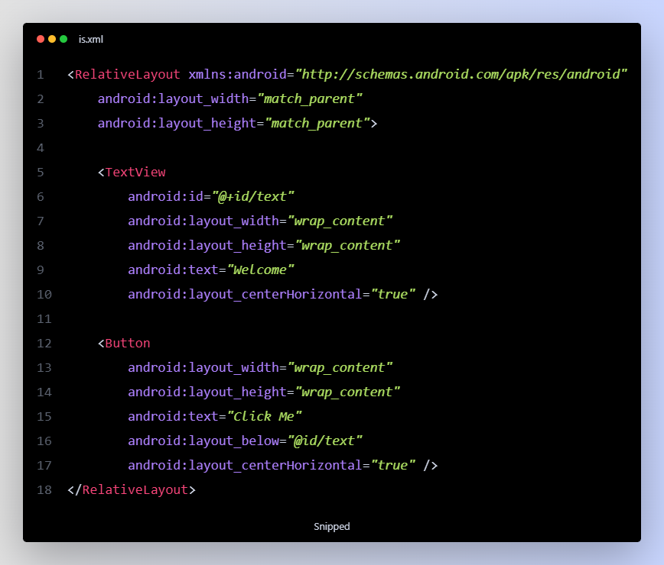
Relative Layout
Definition: A layout where child views are positioned relative to each other or the parent.
A view’s position is set relative to another view
Allows for creating complex UI layouts
Example: A Button placed below a Text View

Slide 5
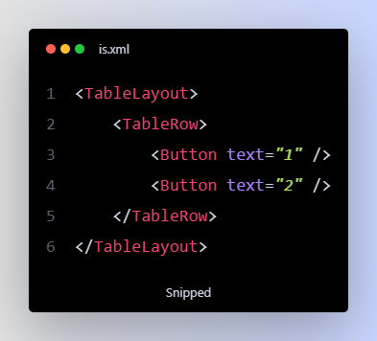
Table Layout
Definition: A layout that organizes views in rows and columns like a table.
Views placed in row-column format
Common in calculator-type UIs
Example: Calculator App

Slide 6
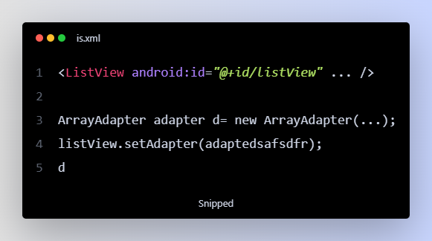
List View
Definition: A view that shows a vertical list of scrollable items
Good for static or dynamic data
Displays one item per row
Example: Contact List

Slide 7
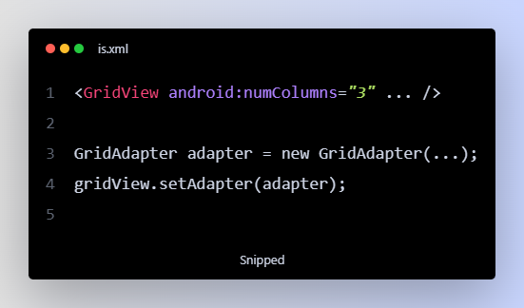
Grid View
Definition: A view that displays items in a scrollable 2D grid (rows and columns)
Good for images or icons
Displays content in multiple columns
Example: Photo Gallery

Slide 8
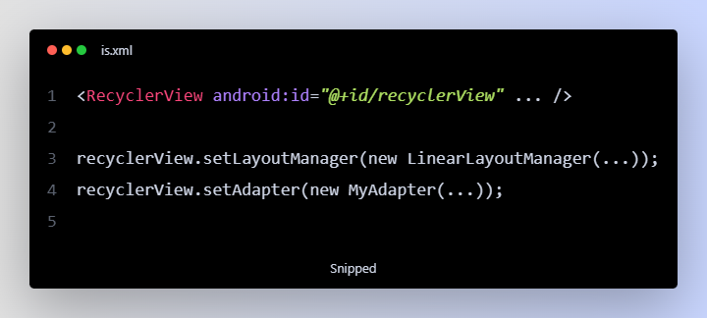
Recycler View
Definition: A modern, flexible, and efficient version of List View used for large or dynamic datasets.
Memory-efficient and smooth scrolling
Highly customizable
Example: Facebook Feed, Shopping App

