Slide 1
Numerical Method
Presented by
Md. Sahabuddin Hossain
Salman M Rahman
Jubayer Rahman
180108
180109
180110

Slide 2
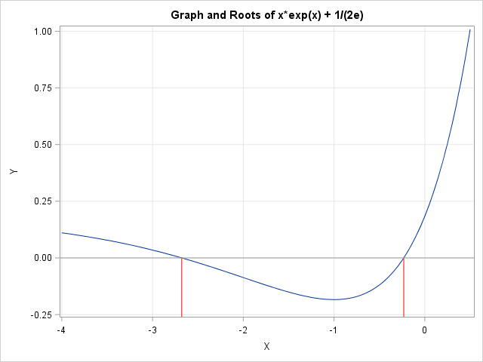
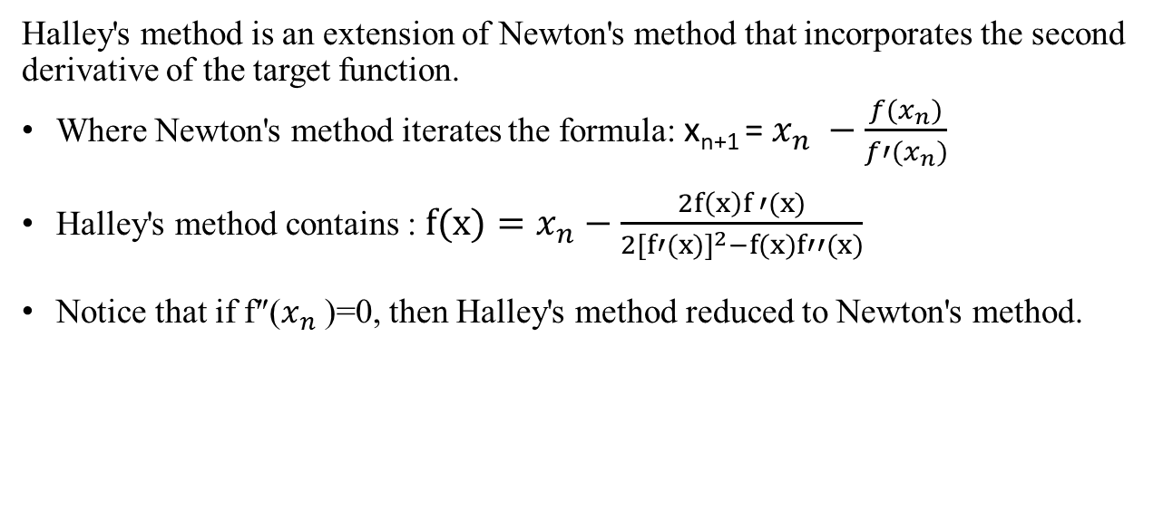
Halley’s Method:
Halley's method is an extension of Newton's method that incorporates the second derivative of the target function.
Where Newton's method iterates the formula: x_{n+1} = $x_{n} −\frac{f(x_{n})}{f′(x_{n})}$
Halley's method contains : $f(x)=x_{n}−\frac{2f\left(x\right)f ′(x)}{2{[f′(x)]}^{2}−f(x)f′′(x)}$
Notice that if f″($x_{n}$)=0, then Halley's method reduced to Newton's method.

Slide 3
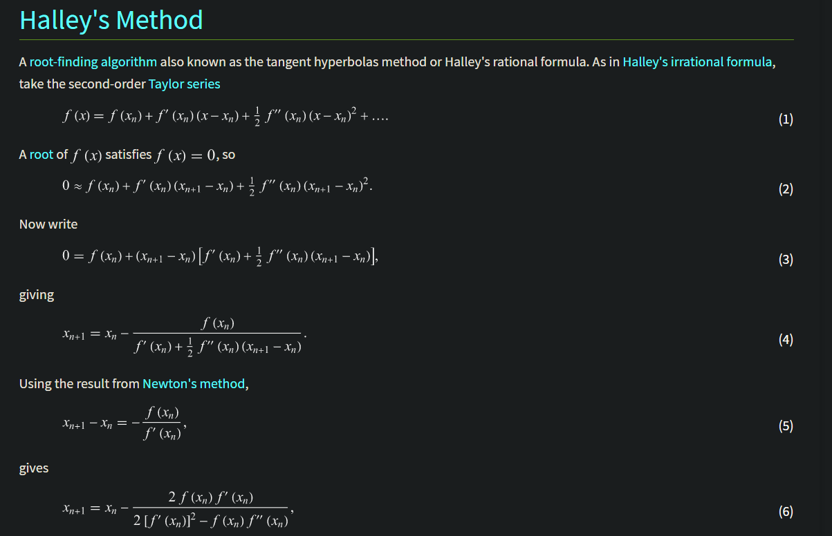
Mathematical Proof

Slide 4
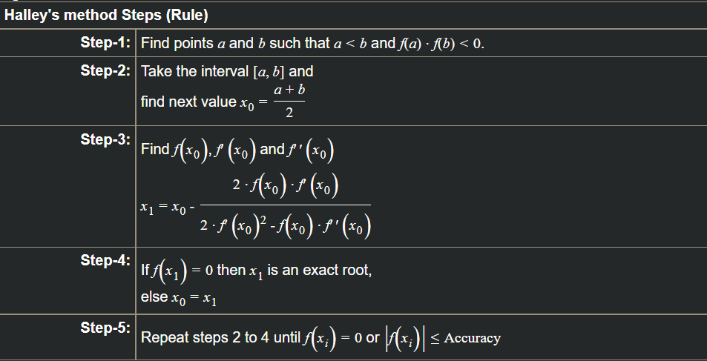
Algorithm:

Slide 5
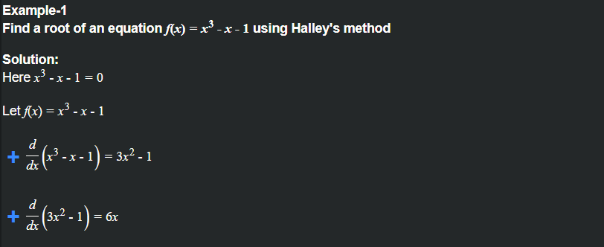
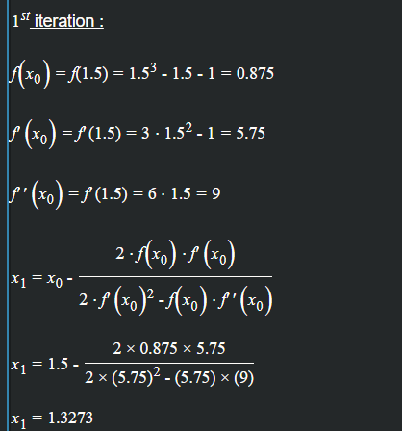
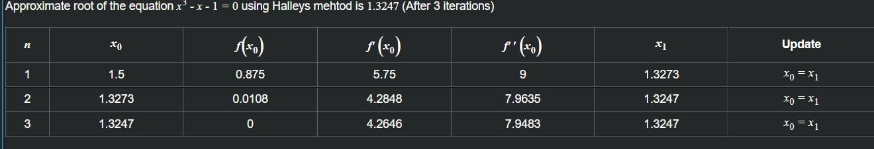
Example:

Slide 6
Limitations:
Division by zero problem can occur.
Multiple roots cannot be found.
Sometimes for given its not possible to guess the root.

Slide 7
Thank You

