Slide 1
PROJECT PROPOSAL
Predicting Smoking Relapse After Successful Cessation Using Machine Learning
An Explainable Machine Learning Framework for Predicting Time-to-Relapse and Risk Factors
Presented By
Group No: 03
Course Code: CSE366
Section: 09
Presented To
Mohammad Mohi Uddin
Department of CSE, EWU
Name | ID
Md. Sadman | 2023-2-60-304
Shahriar Arefin | 2023-3-60-517
Sujoy Karmakar | 2023-3-60-514

Slide 2
Presentation Outline
• Introduction and Motivation
• Summary of Existing Literature
Data Set Used
• Identified Research Gaps
• Proposed Research Objectives
• Proposed Methodology (System Architecture)
• Expected Results & Evaluation Metrics
• Conclusion & Clinical Impact

Slide 3
Introduction & Motivation
The Global Burden: Tobacco use remains a leading cause of preventable death worldwide, killing 7 million people annually, which also include over 1.6 million non-smokers as they are exposed to second-hand smoke.[1]
The Cessation Barrier: While many smokers successfully quit initially, about 85% experience a relapse within the first 6 to 12 months.[2]
The Clinical Challenge: Preventative interventions are costly and labor-intensive. Currently, clinicians lack automated tools to flag which individuals are at high risk of picking up smoking again.
The Motivation: This motivates the need for a highly accurate, predictive machine learning framework that can dynamically score an individual's relapse risk, allowing healthcare providers to deploy timely, personalized digital health interventions.

Slide 4
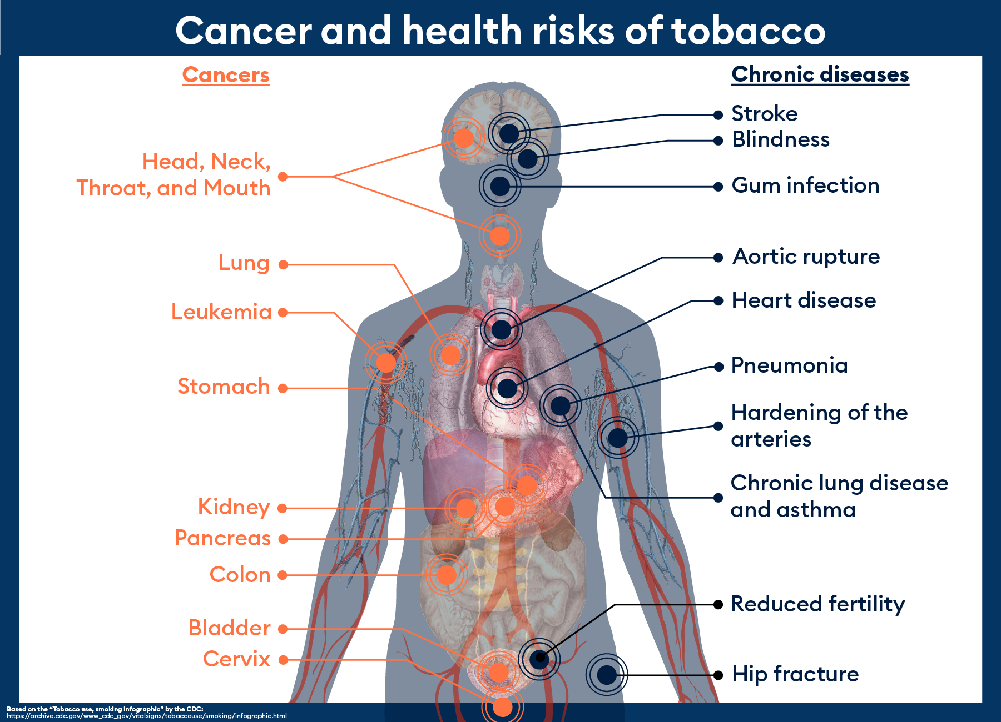

Slide 5



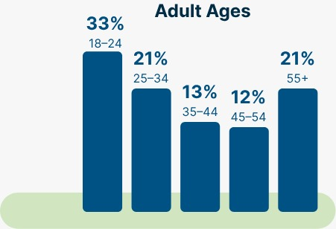

Dataset Used
Large-Scale Cohort
Population Assessment of Tobacco and Health (PATH)
Nationally representative US demographic sample.
Longitudinal Tracking
A nationally representative, longitudinal cohort study of tobacco use and how it affects the health of people in the United States.
Multi-wave data capturing behavioral changes over time.
Rich Feature Set
Tobacco history, cessation methods, and health outcomes.
The PATH Study spans a survey duration from 2013 to 2024.
The initial Wave 1 surveyed 45,971 total respondents.

Slide 6
Summary of Existing Literature
Paper | Dataset | Methods Used | Accuracy / AUC | Limitations
Paper 1 Predicting smoking cessation among US adults (Issabakhsh et al., 2023)[3] | PATH study (Waves 1–3 longitudinal survey) | Random Forest, Gradient Boosting Machines (GBM) | 72% accuracy | Massive class imbalance (only 7% successfully quit); requires specific variable selection to prevent overfitting to the non-quitting majority.
Paper 2 Predicting Smoking Lapses from EMA and Sensor Data (Perski et al., 2024)[4] | Ecological Momentary Assessments (EMA) and real-time sensor data | Support Vector Machines (SVM), XGBoost | -- | Relies on high-frequency behavioral tracking and real-time data rather than annual population surveys.
Paper 3 Predicting Smoking Cessation Treatment Outcomes (Coughlin et al., 2018)[5] | Post-treatment clinical cohorts | Decision Trees (CART analysis) | >80% accuracy | Evaluates clinical patients post-cognitive behavioral therapy rather than general population datasets like PATH.

Slide 7
Identified Research Gaps
Focus on Cessation Over Relapse: Existing PATH-based ML models focus almost exclusively on initial cessation, lacking longitudinal tracking to predict long-term relapse.
1
Lack of Macro-Level Relapse Data: Current ML models predicting relapse rely heavily on small clinical cohorts or localized real-time tracking (EMA), leaving a gap in nationally representative applications.
2
Unaddressed Compound Class Imbalance: Literature lacks methodological solutions for the extreme data scarcity in PATH data regarding relapse (tracking the tiny fraction of relapse cases within the already small 7% subset of successful quitters).
3

Slide 8
Proposed Research Objectives
Model Development: Build and validate ML classifiers (e.g., Random Forest, XGBoost) to predict smoking relapse using multi-wave longitudinal PATH data.
Predictor Identification: Identify and rank the primary socio-demographic, biological, and behavioral determinants of relapse at a national level.
Imbalance Handling: Implement and evaluate advanced sampling techniques (e.g., SMOTE) to resolve the severe compound class imbalance inherent in the dataset.
Algorithm Comparison: Compare the performance, sensitivity, and specificity of various models to establish a robust framework for population-level relapse prediction.

Slide 9
Proposed Methodology
Step 1 — Preprocessing
  Longitudinal cohort extraction from PATH study waves
  Missing data imputation using MICE
  Class imbalance resolution using SMOTE
Step 2 — Feature Engineering and Selection
  Extract socio-demographic and smoking history variables
  Map alternative tobacco and e-cigarette usage transitions
  Dimensionality reduction to isolate highly predictive features
Step 3 — Classification
  Binary outcome prediction (relapse vs. sustained cessation)
  Tree-based ensemble modeling (XGBoost, LightGBM, Random Forest)
  Stratified k-fold cross-validation
Step 4 — Explainability and Evaluation
  SHAP values for global and local decision interpretation
  Performance assessment using AUC-ROC and PR-AUC metrics

Slide 10
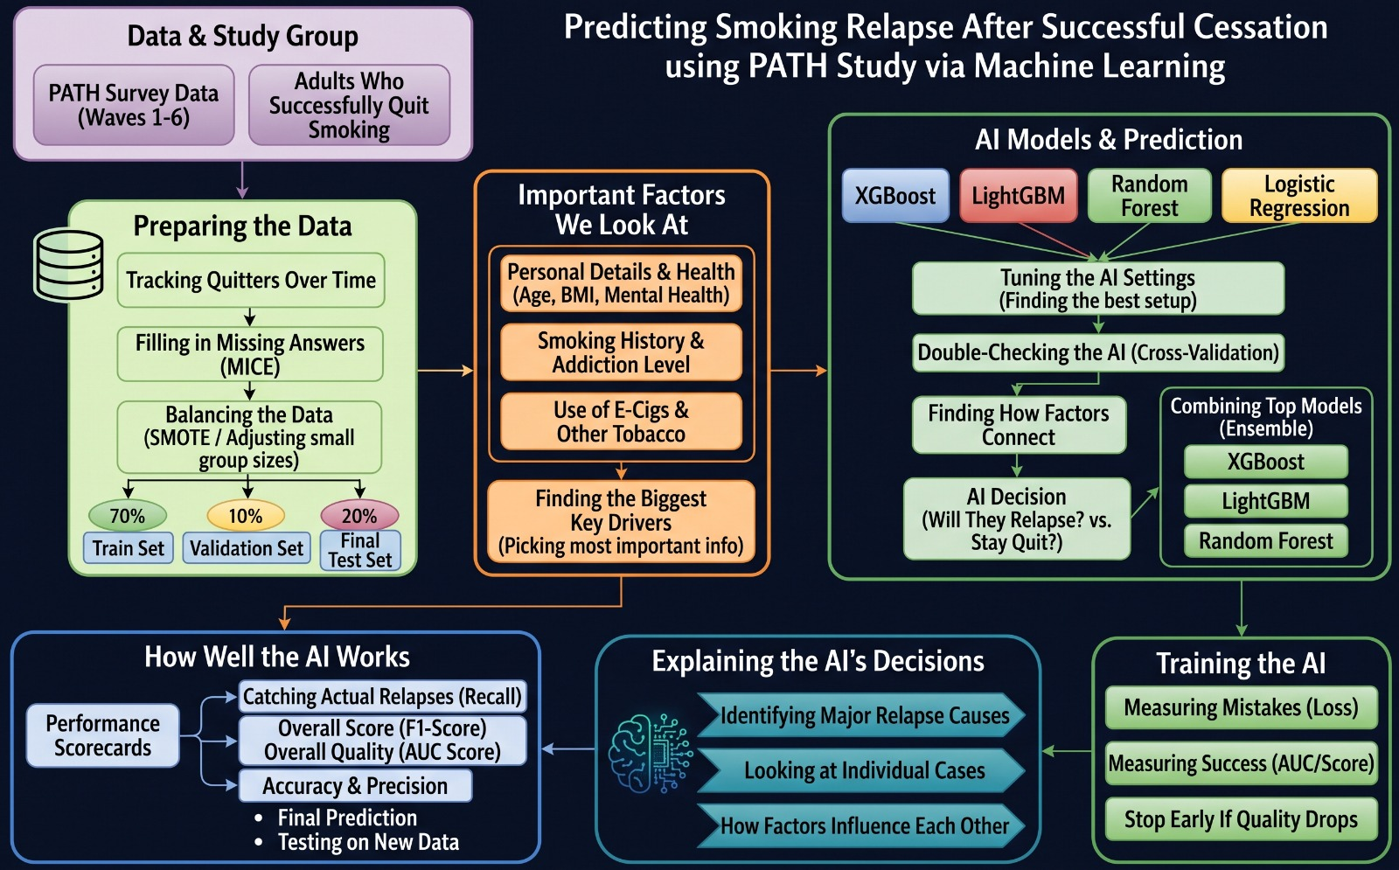
Proposed Methodology (Architecture)

Slide 11
Expected Results
High Predictive Performance: The ensemble machine learning models, particularly XGBoost and LightGBM, are expected to achieve strong discriminative ability (e.g., an AUC-ROC score exceeding 0.80) in distinguishing between sustained quitters and those who relapse.
Identification of Key Risk Factors: The analysis will likely isolate specific variables—such as the severity of prior nicotine dependence, concurrent use of e-cigarettes or other tobacco products, and specific mental health indicators—as the primary drivers of relapse.
Successful Imbalance Resolution: Applying techniques like SMOTE will demonstrably improve the model's Sensitivity (Recall), allowing the algorithm to accurately catch true relapse cases without being overwhelmed by the large majority of people who stay quit.
Actionable Risk Profiles: Through SHAP value interpretations, the model will output clear, personalized risk profiles, illustrating exactly how different socio-demographic and behavioral factors compound to trigger a relaps.

Slide 12
Conclusion
This research will demonstrate the viability of using advanced machine learning to predict long-term smoking relapse on a nationally representative scale. By successfully navigating the extreme data imbalance inherent in longitudinal surveys like the PATH study, the project shifts the predictive focus from initial cessation to sustained abstinence. Ultimately, the developed framework will provide public health officials and clinicians with a data-driven tool to identify highly vulnerable individuals, allowing for proactive, targeted interventions before a relapse occurs.

Slide 13
Key References
World Health Organization. (2026, June 26). Tobacco and nicotine. https://www.who.int/news-room/fact-sheets/detail/tobacco
Arms Acres. (2024, March 19). Addiction relapse rates in the United States. https://www.armsacres.com/blog/addiction-relapse-rates-in-the-us
Coughlin, L. N., Tegge, A. N., Sheffer, C. E., & Bickel, W. K. (2018). A Machine-Learning Approach to Predicting Smoking Cessation Treatment Outcomes. Nicotine & Tobacco Research, 22, 415-422. https://doi.org/10.1093/ntr/nty259
Issabakhsh, M., Sánchez-Romero, L. M., Le, T. T. T., et al. (2023). Machine learning application for predicting smoking cessation among US adults: An analysis of waves 1-3 of the PATH study. PLOS ONE, 18, e0286883. https://doi.org/10.1371/journal.pone.0286883
Perski, O., Kale, D., Leppin, C., et al. (2024). Supervised Machine Learning to Predict Smoking Lapses from Ecological Momentary Assessments and Sensor Data: Implications for Just-in-Time Adaptive Intervention Development. https://doi.org/10.31219/osf.io/jgrpy

Slide 14
Thank You

