Slide 1
India Air Quality Index (AQI) Analysis
Comprehensive Data Analytics Project | 2023-2025

Slide 2
Real-World Problem Statement
• India faces significant air quality challenges affecting public health and economy
• No comprehensive understanding of geographic hotspots and temporal patterns
• Limited monitoring infrastructure in some regions reduces early-warning capability
• Need for data-driven policy decisions based on systematic analysis
• Understanding dominant pollutants and seasonal patterns for targeted intervention

Slide 3
Project Objectives
→ Understand air quality status across India (2023-2025)
→ Identify geographic hotspots with persistent poor air quality
→ Assess pollutant composition and spatial/temporal variation
→ Evaluate monitoring infrastructure coverage and gaps
→ Analyze trends and seasonal patterns
→ Recommend data-driven actions for intervention and policy

Slide 4
Dataset Overview
• Source: Kaggle - India AQI Index Dataset (2023-2025)
• Total Observations: 235,785
• Geographic Coverage: 32 states, 291 areas
• Monitoring Stations: 441072
• Key Columns: date, state, area, aqi_value, prominent_pollutants, air_quality_status
• Time Period: 2022-04-01 to 2025-04-30

Slide 5
Data Cleaning & Methodology
→ Data Cleaning: Duplicate removal, date conversion, text standardization, type conversion
→ EDA: Distribution analysis, missing values, statistical summary
→ KPI Calculation: Average/median/max AQI, monitoring coverage, status distribution
→ Time Analysis: Daily, monthly, yearly trends; seasonal patterns
→ Geographic Analysis: State-level and area-level AQI metrics
→ Risk Assessment: Hotspot identification, monitoring gaps, opportunities

Slide 6
Key Performance Indicators (KPIs)
Metric | Value | Metric | Value
Avg AQI | 111 | States | 32
Max AQI | 500 | Observations | 235,785

Slide 7
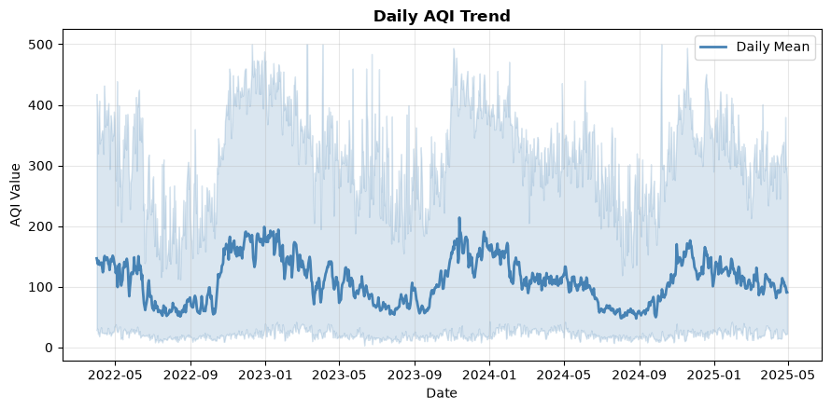
AQI Trend Analysis

Slide 8
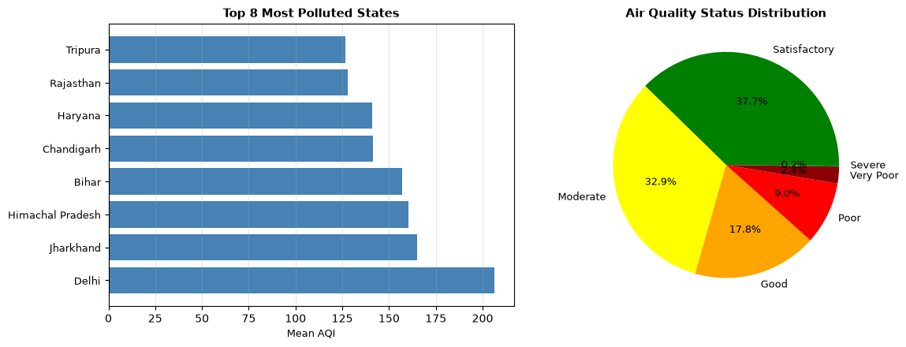
State & Area Analysis

Slide 9
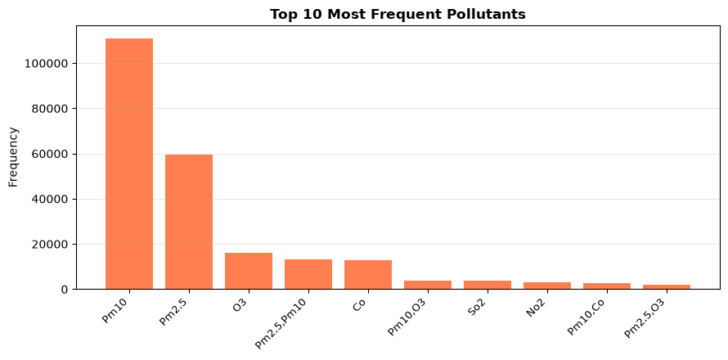
Pollutant Analysis

Slide 10
Risk & Opportunity Analysis
RISKS:
• High-AQI states with persistent poor air quality (health impact)
• Undermonitored areas limiting early-warning capability
• Seasonal peaks requiring proactive management
OPPORTUNITIES:
• Expand monitoring infrastructure in identified gaps
• Implement targeted interventions in moderate-AQI areas
• Leverage seasonal forecasting for preparedness
• Scale successful practices from improving states

Slide 11
Key Insights
1. OVERALL STATUS: Average AQI of 111 indicates widespread pollution
2. STATE DISPARITIES: Significant variation from 47 to 206 across states
3. POLLUTANT FOCUS: Specific dominant pollutants require targeted emission controls
4. MONITORING GAPS: Uneven station distribution limits early-warning in some regions
5. SEASONAL PATTERNS: Predictable seasonal peaks enable proactive intervention

Slide 12
Recommended Actions
→ Expand real-time monitoring in undermonitored high-AQI areas
→ Implement sector-specific emission controls (vehicular, industrial, agricultural)
→ Activate seasonal air quality management protocols
→ Conduct source apportionment studies for targeted interventions
→ Launch public awareness campaigns on AQI levels and health impacts
→ Establish inter-state coordination mechanisms for regional strategies

Slide 13
Dashboard & Project Output
INTERACTIVE DASHBOARD (Streamlit):
✓ Executive Overview with KPI cards and AQI trends
✓ State & Area Analysis with geographic heatmaps
✓ Pollutant & Risk Analysis with identification of hotspots
✓ Insights & Recommendations section with actionable insights
RUN: streamlit run project.py
Open: http://localhost:8501 in your browser

Slide 14
Project Limitations
• Data Gaps: Some areas have incomplete temporal coverage
• External Factors: Lacks meteorological data (temperature, wind, humidity)
• No Causality: Analysis shows correlations, not direct cause-effect relationships
• Geographic Resolution: Area-level aggregation masks micro-level variations
• Prediction: Analysis-focused; no predictive model included
• Monitoring Variance: Monitoring density varies significantly by state

Slide 15
Conclusion
This comprehensive analysis of India's air quality (2023-2025) reveals significant challenges requiring urgent action. With an average AQI of 111 and substantial geographic disparities, systematic intervention is essential.
Key findings identified hotspots, seasonal patterns, and monitoring infrastructure gaps. The interactive dashboard enables ongoing assessment and decision-making.
Next steps: Implement evidence-based policies, expand monitoring infrastructure, conduct source apportionment studies, and establish regional coordination mechanisms for sustained air quality improvement.

