Slide 1

Targeting Brand Ambassadors using Data from the Olympic Games
DSC 611: Data Visualization
Final Project Presentation: Group B
Sujoy Datta Choudhury
Christina Huffaker
Zaoxian Liu

Slide 2
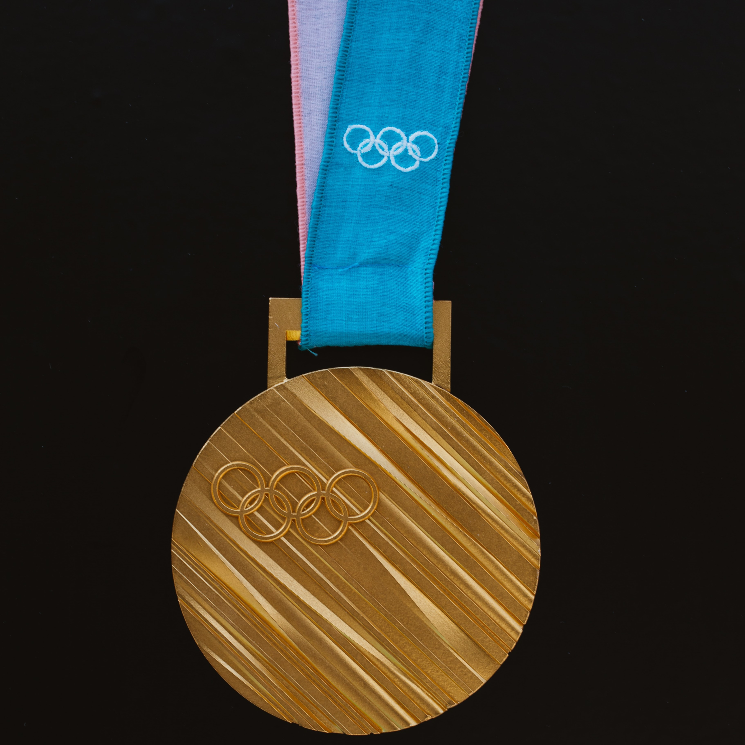
Statement of Problem
Goal of sporting goods companies:
Increase visibility
Positive associations of brand
Accomplished by:
Sponsorships of high-achieving teams / athletes

Slide 3
Motivation
Existing marketing strategy:
Too expensive
Poor ROI
New methods are needed
Build system based on new strategy
Identify potential brand ambassadors

Slide 4
Related Works
Jensen, Wakefield, Cobbs & Turner (2016)
Popular sponsorship strategy is unwise
& offers poor ROI
Wang & Kaplanidou (2013)
Even negative emotions (such as a team loss)
can be leveraged to generate purchases
Mazodier, Corsi & Quester, P. (2018)
Advertising messages typical of a particular sporting event are generally most successful

