Slide 1

Targeting Brand Ambassadors using Data from the Olympic Games
DSC 611: Data Visualization
Final Project Presentation: Group B
Sujoy Datta Choudhury
Christina Huffaker
Zaoxian Liu

Slide 2
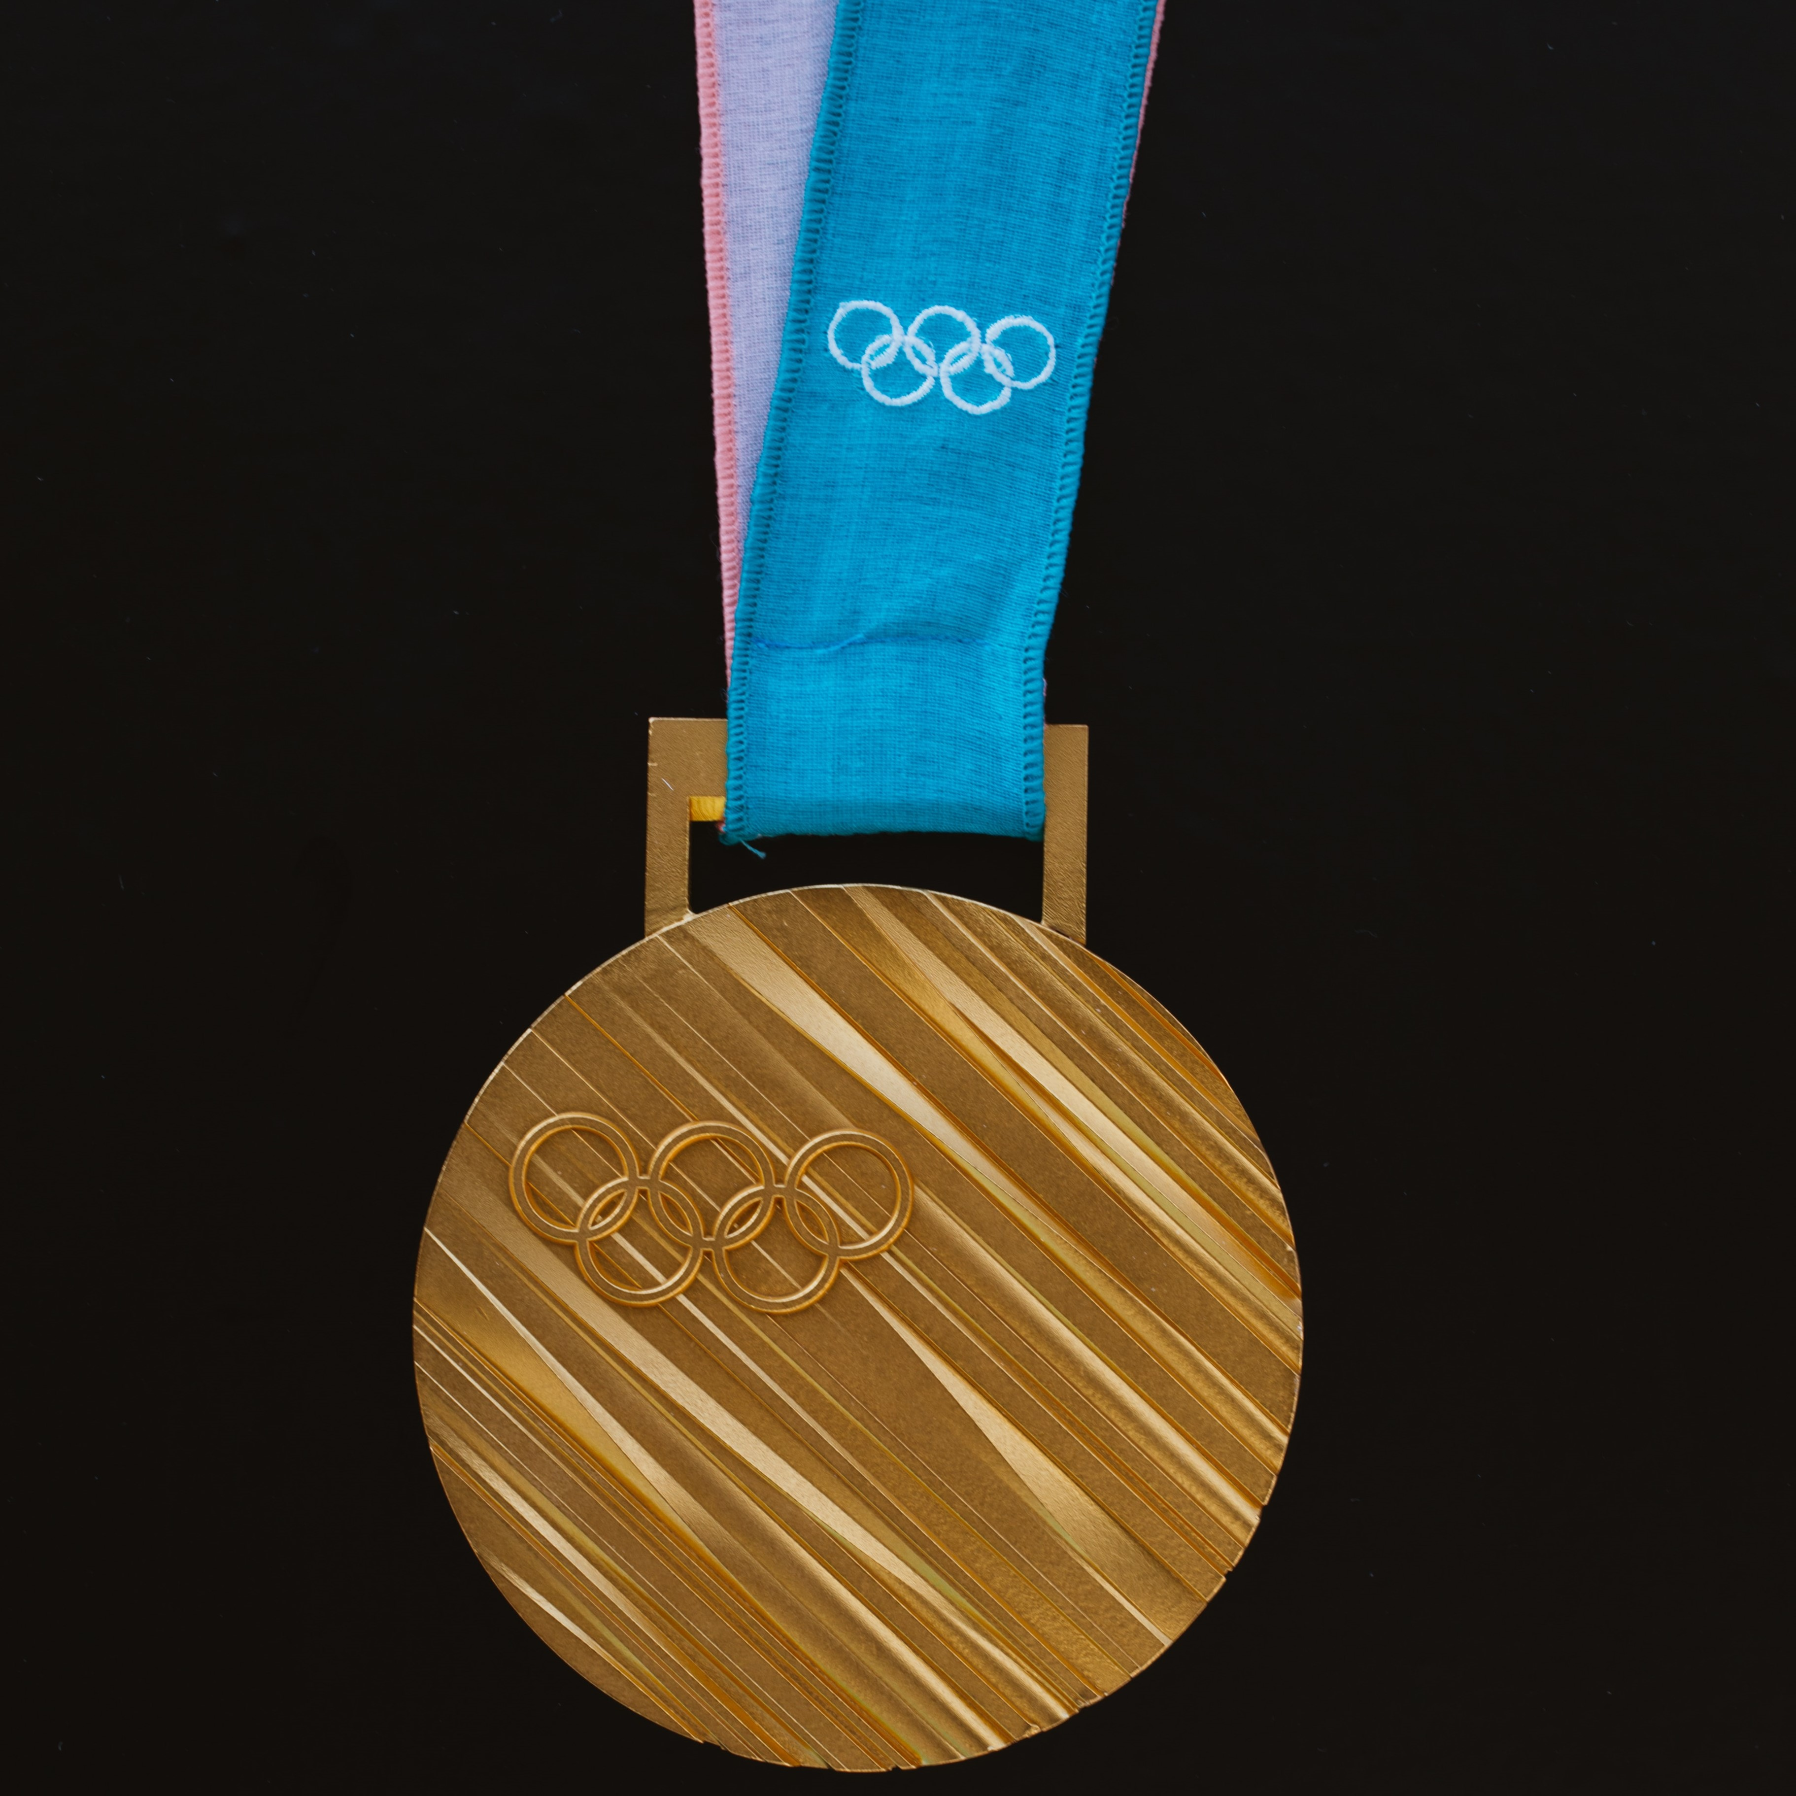
Statement of Problem
Goal of sporting goods companies:
Increase visibility
Positive associations of brand
Accomplished by:
Sponsorships of high-achieving teams / athletes

Slide 3
Motivation
Existing marketing strategy:
Too expensive
Poor ROI
New methods are needed
Build system based on new strategy
Identify potential brand ambassadors

Slide 4
Related Works
Jensen, Wakefield, Cobbs & Turner (2016)
Popular sponsorship strategy is unwise
& offers poor ROI
Wang & Kaplanidou (2013)
Even negative emotions (such as a team loss)
can be leveraged to generate purchases
Mazodier, Corsi & Quester (2018)
Advertising messages typical of a particular sporting event are generally most successful

Slide 5
Source Data
Kaggle dataset
120 years of Olympic History: Athletes and Results
Variables
Age, Sex, Team, Year, Season, Medal and Country
Subset data
Year from 2000 to 2016

Slide 6
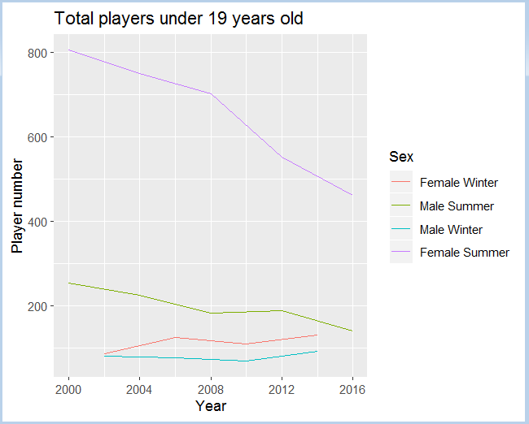
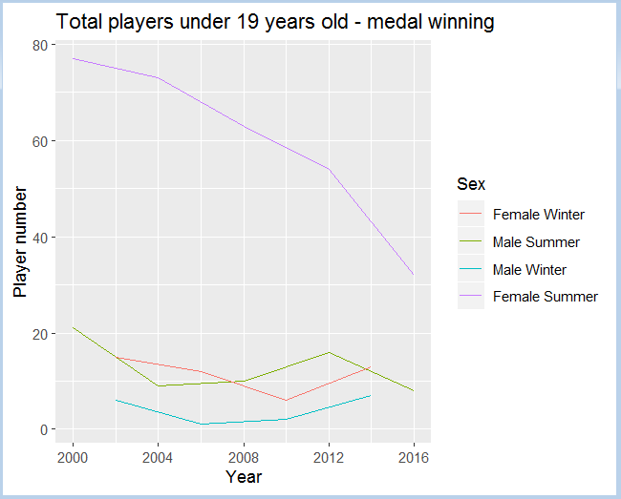
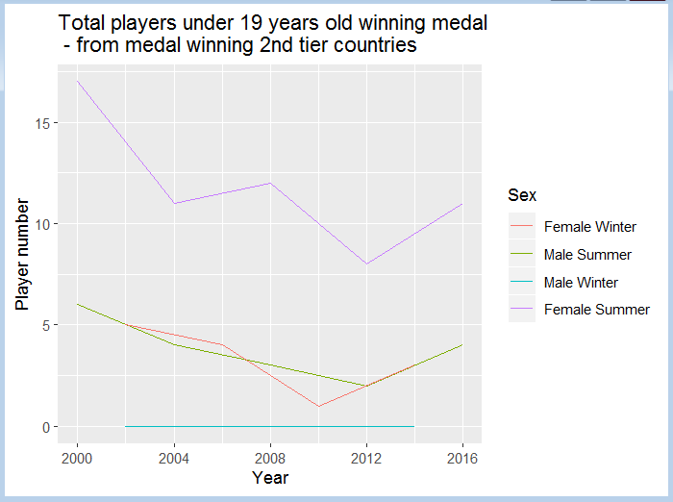
Player under 19 years old - Total number vs how many got medal

Slide 7
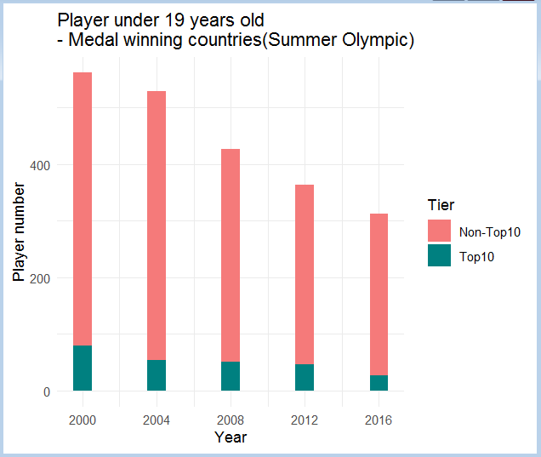
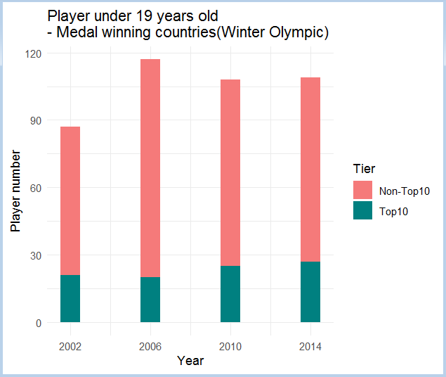
Player under 19 years old from countries - Medal winning top10 vs the rest countries

Slide 8
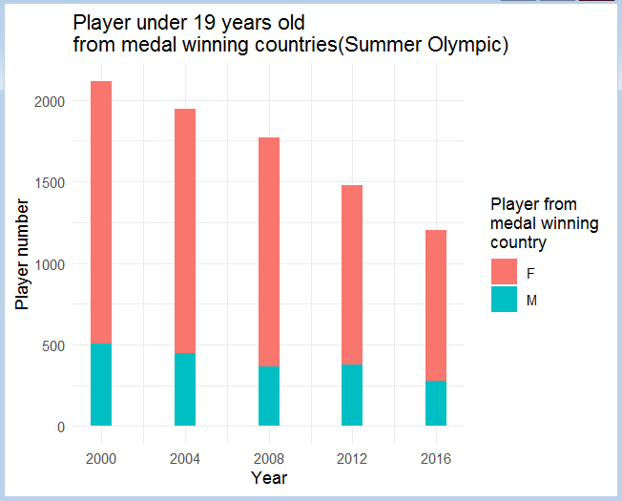
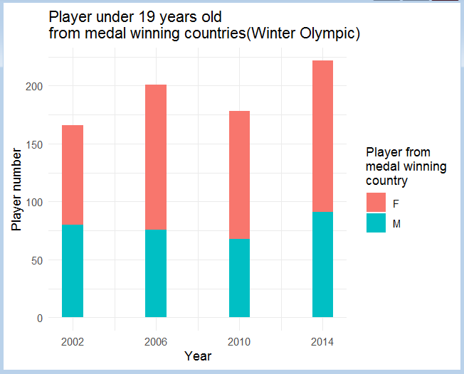
Total player under 19 years old
- Number of male vs female

Slide 9
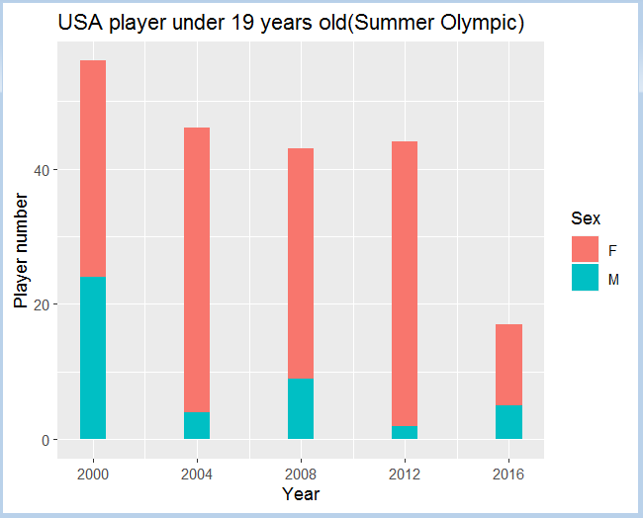
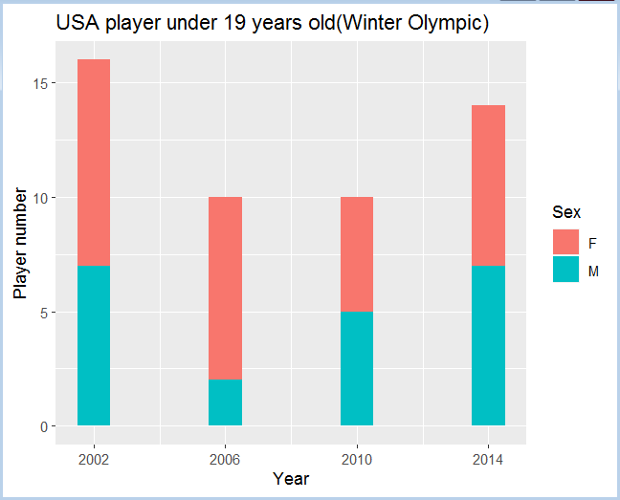
USA player under 19 years old - Number of male vs female

Slide 10
Results
Targeted Athletes (< 19 Years Old)
Female dominance
Targeted Brand Ambassadors
Demo

Slide 11
Conclusion
Target Region
Table Tennis (China)
Cricket (India, UK, Australia)
Badminton (Asia, Europe)
Taekwondo (Korea)
Target Age Group

Slide 12

Thank You

