Slide 1
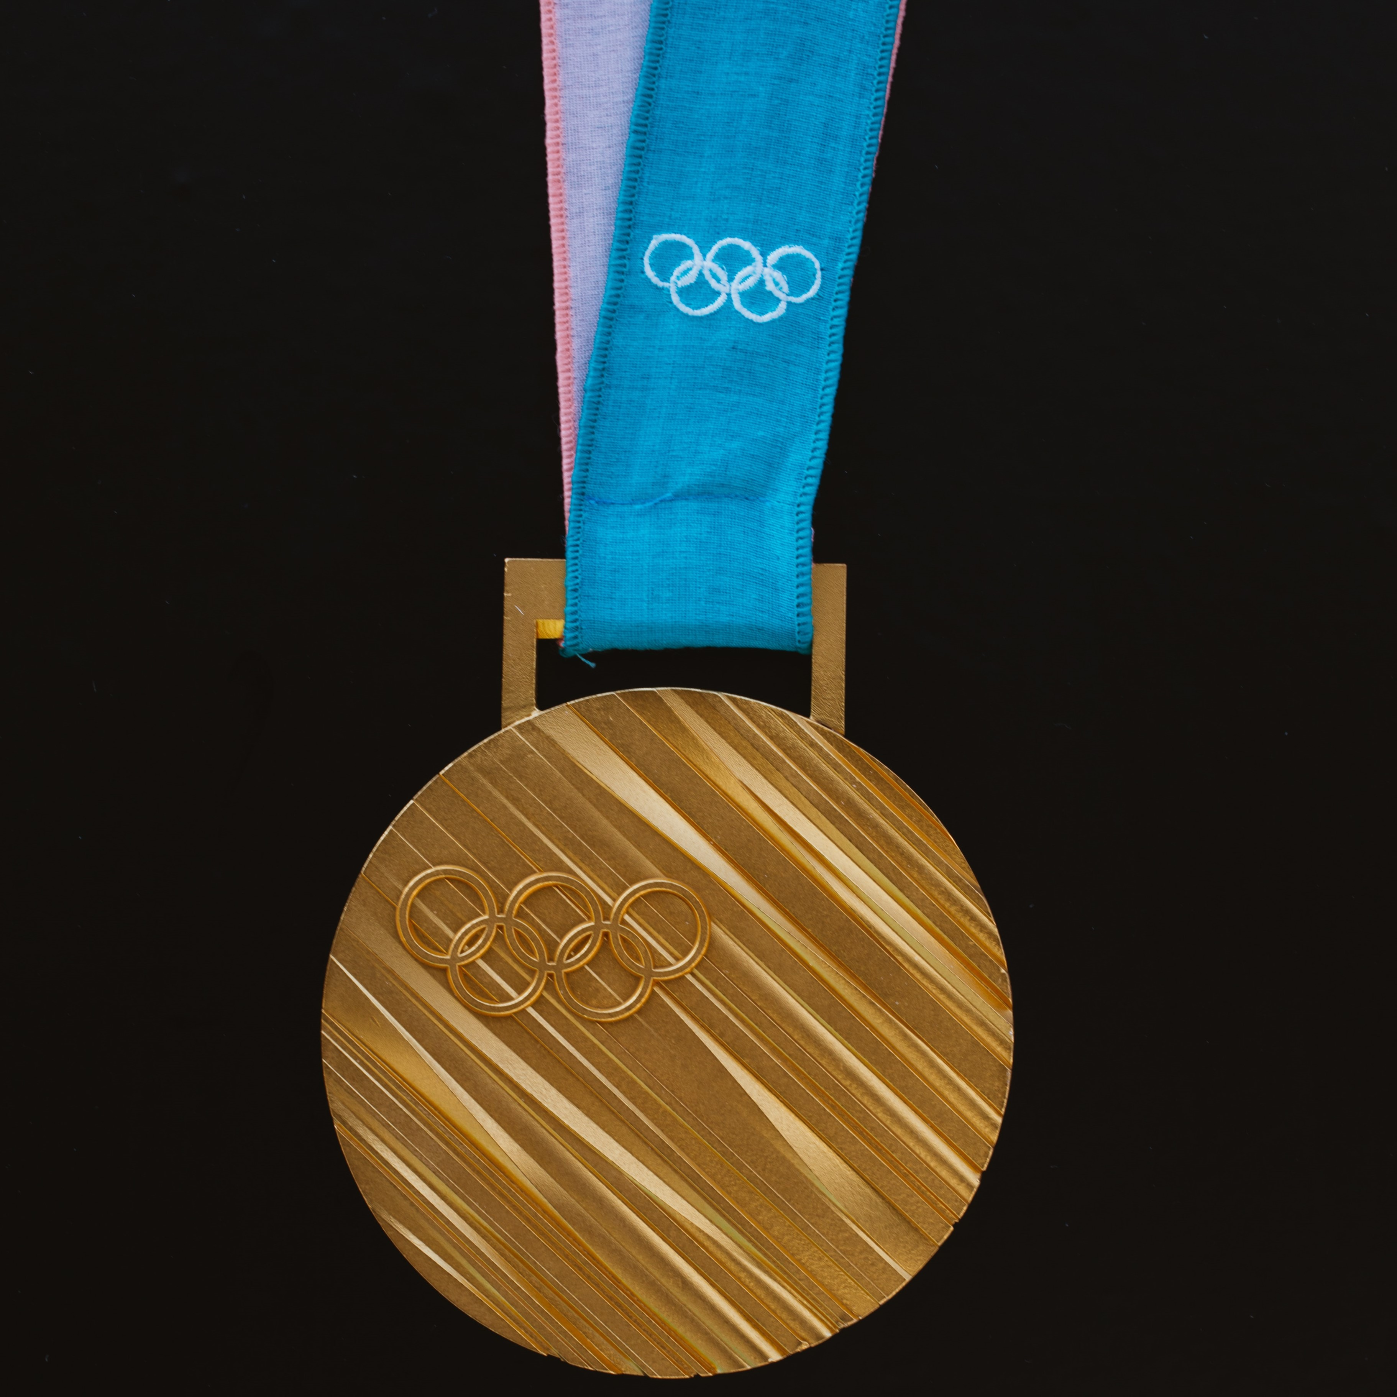

Source Data
Kaggle dataset
120 years of Olympic History: Athletes and Results
Variables
Age, Sex, Team, Year, Season, Medal and Country
Subset data
Year from 2000 to 2016

Slide 2
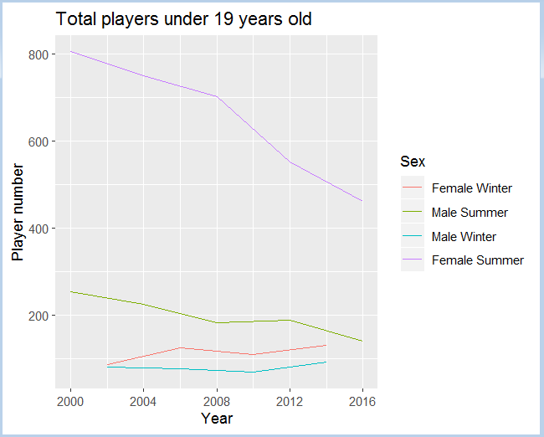
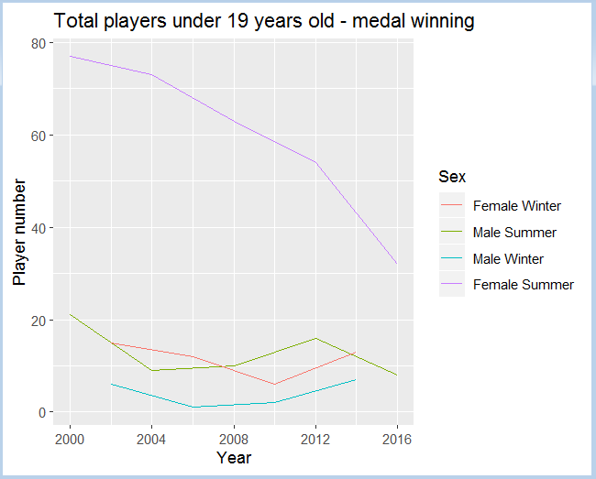
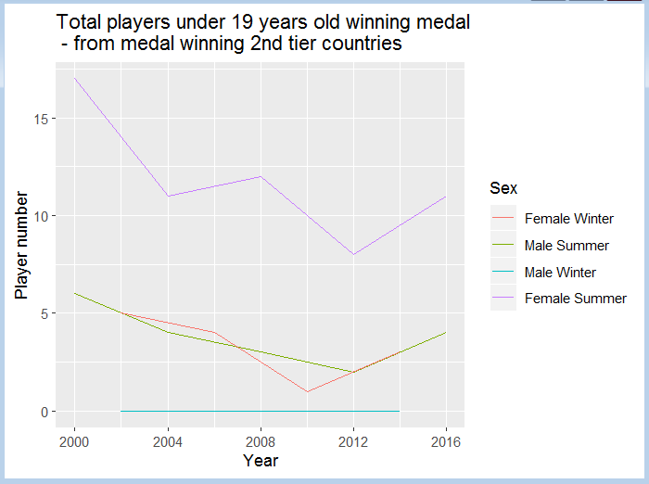
Player under 19 years old - Total number vs how many got medal

Slide 3
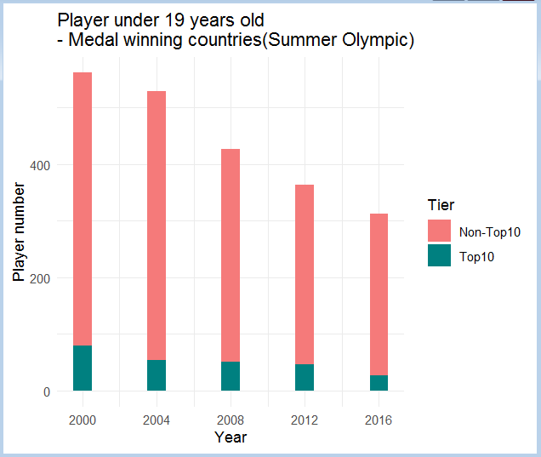
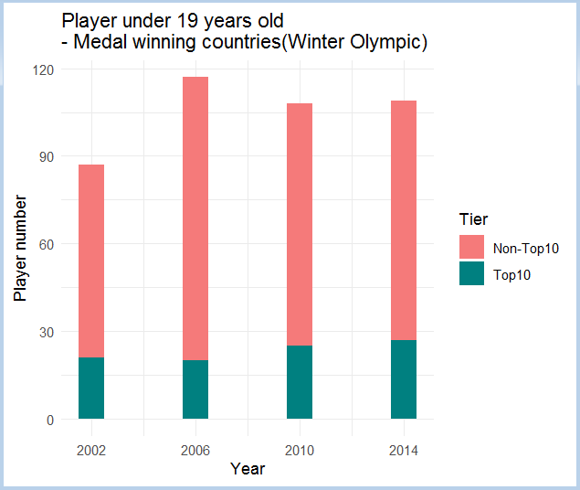
Player under 19 years old from countries - Medal winning top10 vs the rest countries

Slide 4
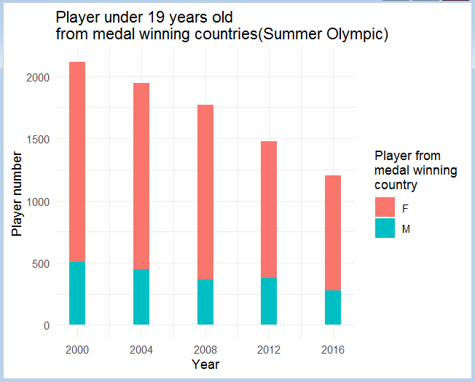
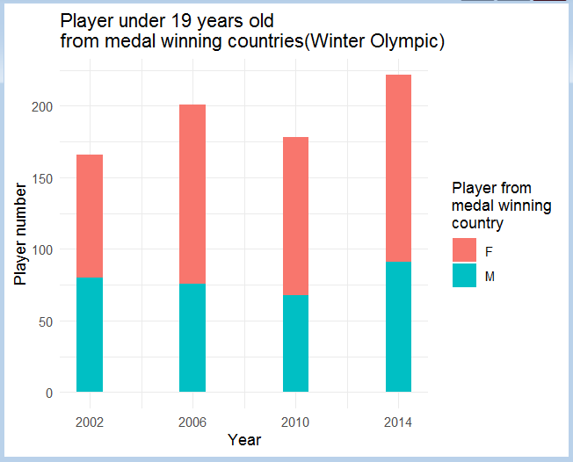
Total player under 19 years old
- Number of male vs female

Slide 5
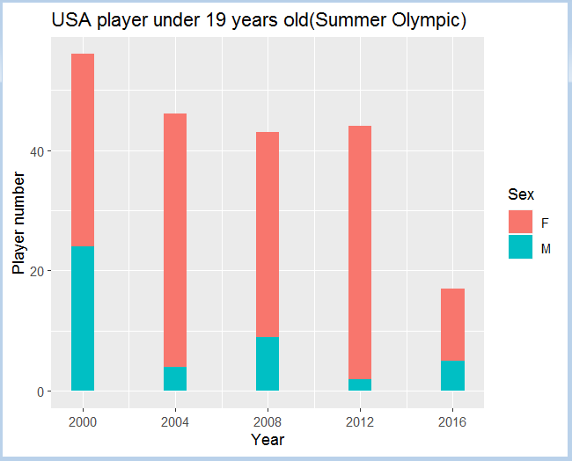
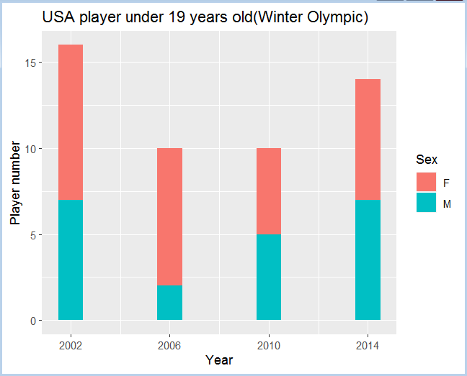
USA player under 19 years old - Number of male vs female

