Slide 1

Condorcet Consistent Bundling with Social Choice
Shreyas Sekar, Sujoy Sikdar, Lirong Xia

Slide 2
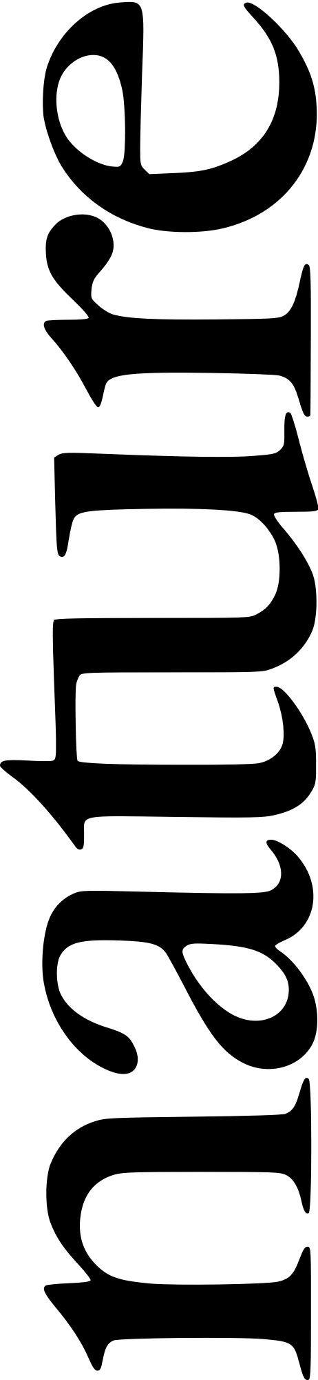



Optimal Bundle Selection… Journals in a Library
Many journals to choose from
Limited space
JAIR
Algorithmica
…
$$k≪n$$
$$n$$
ECONOMETRICA
Software
Users have preferences over the journals
Examples: Committees, TV channel packages, insurance policies, …

Slide 3
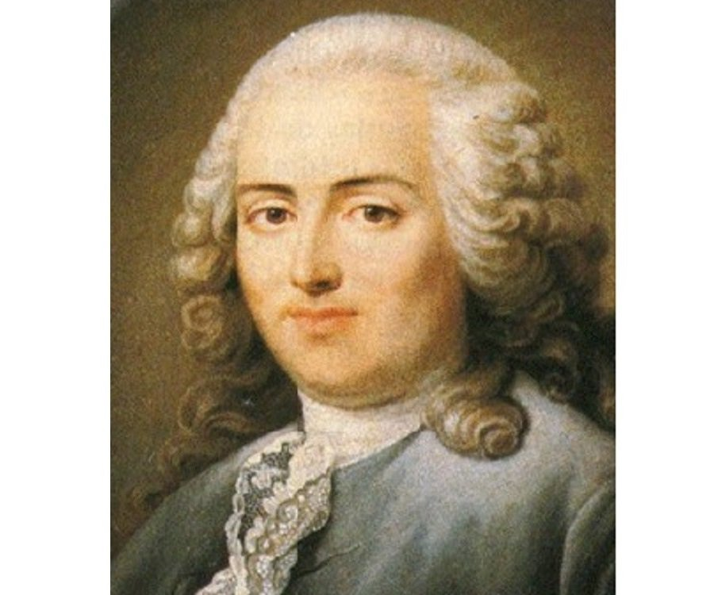



Optimal Bundle Selection: Preferences
Linear orders on the journals:
$$≻$$
$$≻$$
$$≻…$$
Software
Motivating Question
How to select bundles of size k to satisfy majority of users,
who have preferences over individual items?
Condorcet Criterion
Copeland
Maximin/Minimax
This Work
Ranked Pairs
Schulze

Slide 4
The Condorcet Criterion
Candidate who defeats every other candidate by pair-wise majority, must be the winner.
Software
Voting rule
>
>
Software
>
>
Software
>
>
Software
Notes:
Single item setting: Condorcet criterion
Need not always exist.
So how do we select winner?
Tournament graph

Slide 5
Relaxing Condorcet: Different notions of winners
Copeland: most pairwise victories
Condorcet winners may not always exist: how to select?
Maximin: maximize the minimum margin of victory

Slide 6

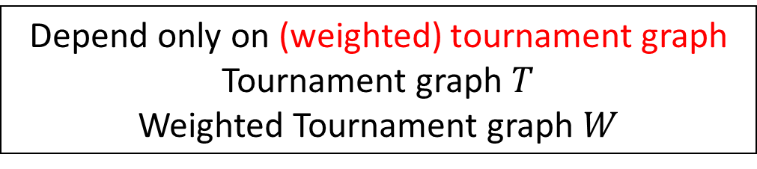

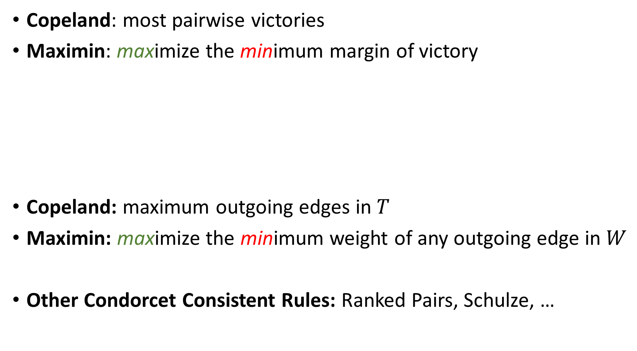


Relaxing Condorcet via Tournament Graphs
Copeland: most pairwise victories
Maximin: maximize the minimum margin of victory
Copeland: maximum outgoing edges in $T$
Maximin: maximize the minimum weight of any outgoing edge in $W$
Other Condorcet Consistent Rules: Ranked Pairs, Schulze, …
$$1$$
Depend only on (weighted) tournament graph
Tournament graph $T$
Weighted Tournament graph $W$
$$2$$
Software
$$2$$
$$2$$

Slide 7
Condorcet criterion for Bundles
Combinatorial Voting
Care about every item
Compare all bundles
Proportional Representation
Care about favorite item
Compare bundle to items outside the bundle
[Gehrlein, 1985]
Our Work
Condorcet Winning
Bundle
Every item in the bundle, defeats every item outside
Notes:
There is a wide spectrum of multi-winner voting rules. At one end we have comb. voting. This may be too complicated and it may be unreasonable to expect agents to form preferences over every possible bundle.
At other end prop. rep. where agents care about only their favorite item in the bundle that is interpreted as being their representative.
Our work builds on the notion of Condorcet sets proposed by Gehrlein where the bundle is compared to items outside the bundle.
Compare all bundles? Too complicated:
For agents to form and express preferences
Computational complexity
Combinatorial voting
Powerful tools of compact preference languages when bundles can be decomposed
Proportional representation?
Assumes agents are satisfied by a single item in the bundle

Slide 8

Another Angle on Gehrlein’s notion
Strong Gehrlein Stability
Every item in the bundle, defeats every item outside
$$≡$$
Defeats every neighboring bundle
Local dominance:
Compare to neighboring bundles
Notes:
A bundle is a Condorcet winner iff it beats every neighboring bundle
Local Dominance: No improvement by replacing a single item
Similar to the notion of local Condorcet winner
Sujoy: maybe remove this slide and merge with next slide?

Slide 9

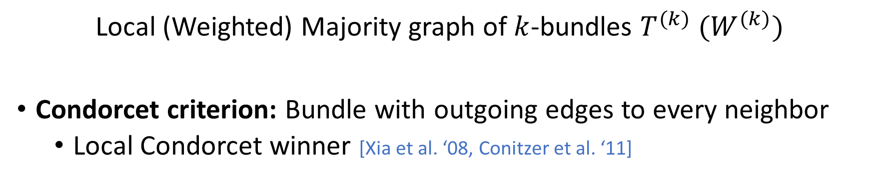
Weighted majority graphs for $k$-size bundles
Software
Software
Software
Local (Weighted) Majority graph of $k$-bundles $T^{(k)} (W^{(k)})$
Condorcet criterion: Bundle with outgoing edges to every neighbor
Local Condorcet winner [Xia et al. ‘08, Conitzer et al. ‘11]

Slide 10
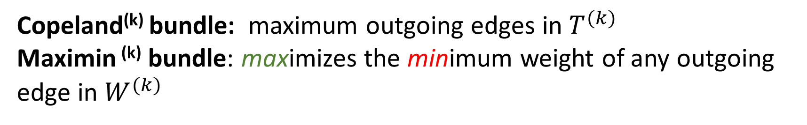
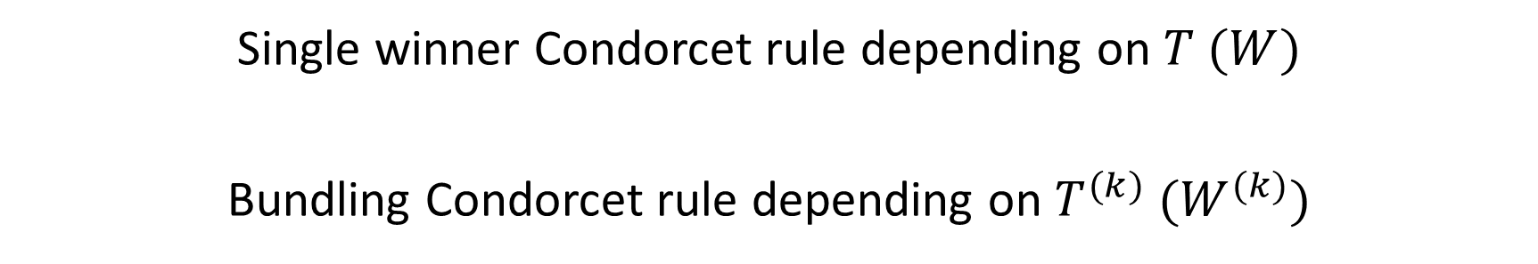
Generic Template for Condorcet Consistent Bundling
Condorcet winning bundles may not always exist
Single winner Condorcet rule depending on $T$ $(W)$
Bundling Condorcet rule depending on $T^{(k)}$ $(W^{(k)})$
Copeland^{(k)} bundle: maximum outgoing edges in $T^{(k)}$
Maximin ^{(k)} bundle: maximizes the minimum weight of any outgoing edge in $W^{(k)}$

Slide 11
Example (N=100 users, k=3)
JAIR
35
Software
80
55
JAIR
Software
Maximin Winning
Bundle
80
Software
90
JAIR
Software
(score = 35)
70
JAIR
55
Copeland winning bundle
(score = 2 bundles defeated)

Slide 12
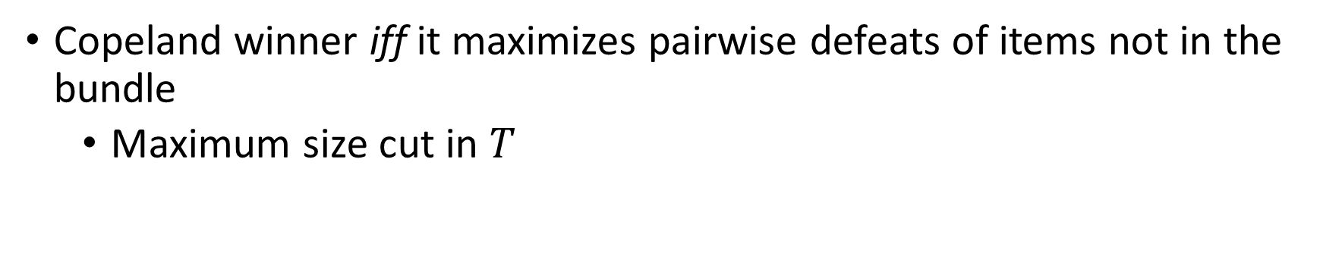
Copeland^{(k)} Mechanism
Copeland winner iff it maximizes pairwise defeats of items not in the bundle
Maximum size cut in $T$
Theorem: Compute optimal Copeland ^{(k)} bundle efficiently
(no ties case):
Select $k$ items with largest out-degree in $T$
Notes:
Maximizes # pairwise defeats.

Slide 13
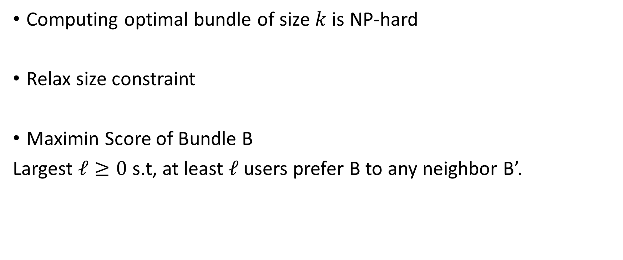
Maximin^{(k)} Mechanism
Computing optimal bundle of size $k$ is NP-hard
Relax size constraint
Maximin Score of Bundle B
Largest $ℓ≥0$ s.t, at least $ℓ$ users prefer B to any neighbor B’.
Notes:
Maximin w/o tournament graph. Define objective
In terms of no. of items
Hard to compute k winner.
No outside item is preferred over an item inside by $> l$ users.

Slide 14
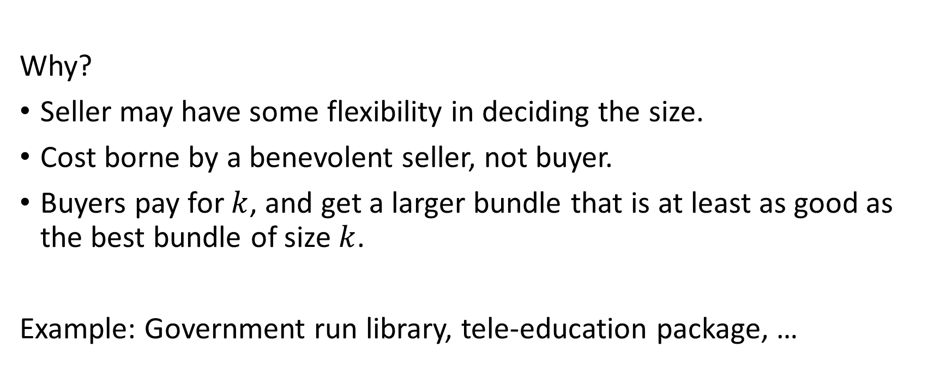
Size-Relaxing Maximin-Approx.
Theorem
Compute bundle of size $≤2k$ that is as good as Opt.bundle of size k
in terms of maximin score
Why?
Seller may have some flexibility in deciding the size.
Cost borne by a benevolent seller, not buyer.
Buyers pay for $k$, and get a larger bundle that is at least as good as the best bundle of size $k$.
Example: Government run library, tele-education package, …
Notes:
Relaxing k.
What does the final winning bundle mean? Book example.
Approximating objective is weird. Optimal beaten by 60/100. 2 approx. guarantees not beaten by 120 but only 100 people.

Slide 15
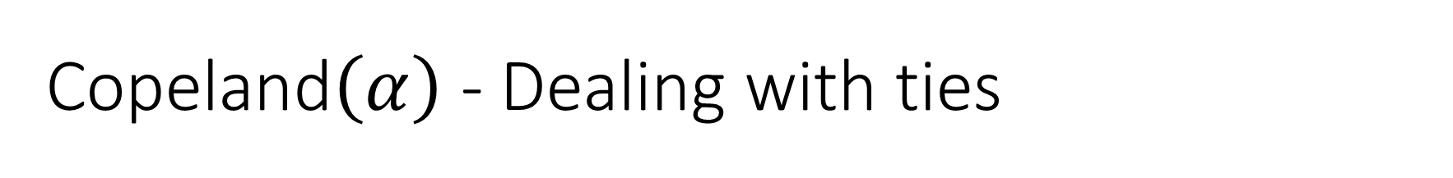

Copeland$\left(α\right)$ - Dealing with ties
$α$ controls importance of tie
$α=0$
$α=0.5$
$α=1$
JAIR
JAIR
JAIR
ECONOMETRICA
ECONOMETRICA
Algorithmica
COMSOC
ECONOMETRICA
Notes:
Copeland winner is not well defined when there are ties
Suspect hard for other values of $α$

Slide 16
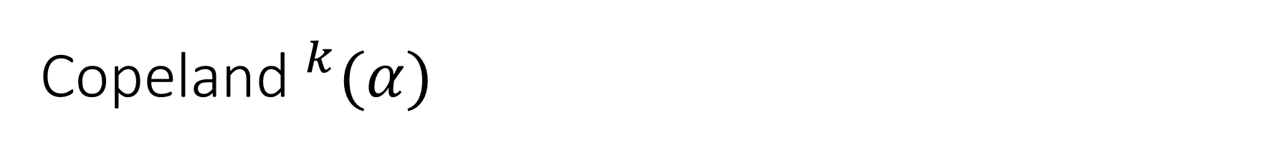

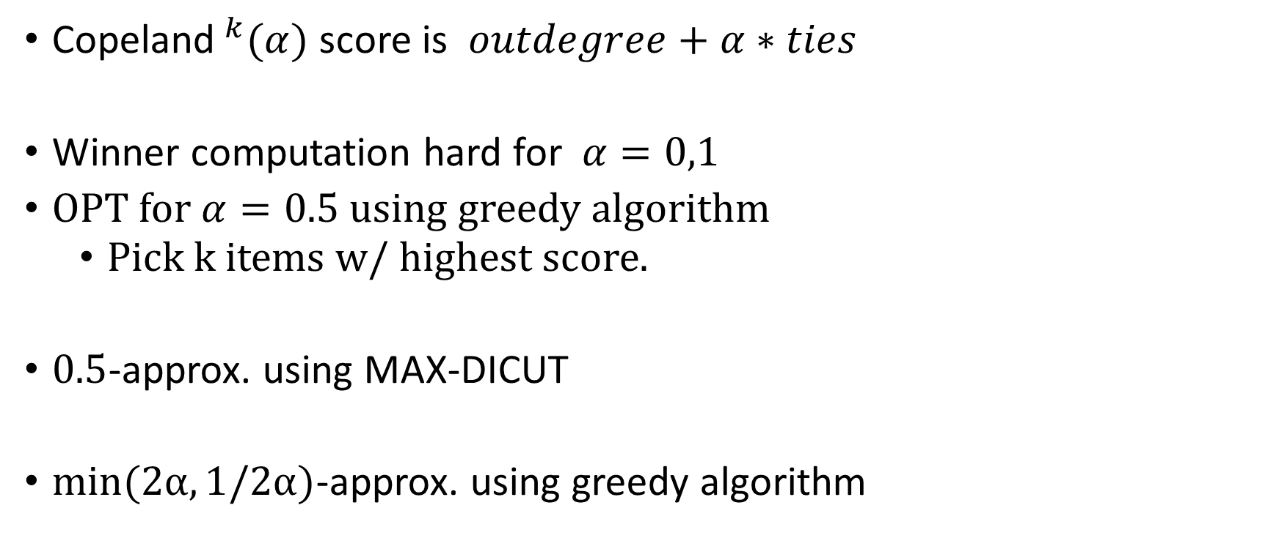
Copeland$^{k}(α)$
Copeland$^{k}(α)$ score is $outdegree+α∗ties$
Winner computation hard for $α=0,1$
OPT for $α=0.5$ using greedy algorithm
Pick k items w/ highest score.
$0.5$-approx. using MAX-DICUT
$\min{(2α,1/2α)}$-approx. using greedy algorithm
in $W^{(k)}$
Notes:
Better approximation guarantees in the range (0.25,1)

Slide 17
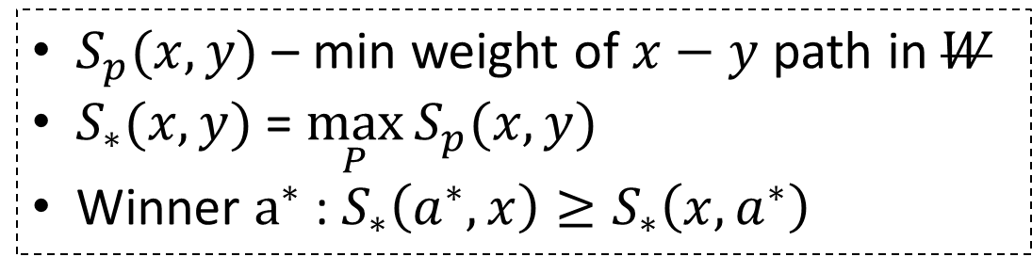
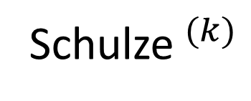
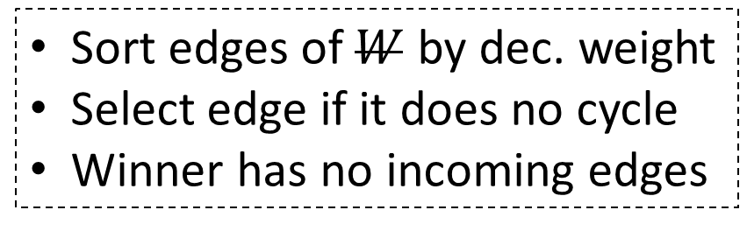
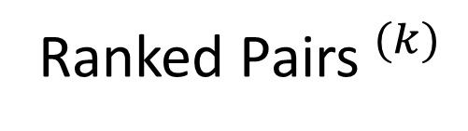


Ranked Pairs and Schulze for Bundles
Thank you
$$W^{(k)}$$
Sort edges of $W$ by dec. weight
Select edge if it does no cycle
Winner has no incoming edges
Ranked Pairs$^{(k)}$
$$W^{(k)}$$
$S_{p}(x,y)$ – min weight of $x−y$ path in $W$
$S_{∗}(x,y)$ = $\max_{P}{S_{p}(x,y)}$
Winner $a^{∗}$ : $S_{∗}\left(a^{∗},x\right)≥S_{∗}\left(x,a^{∗}\right)$
Schulze$^{(k)}$
Results
Poly-time algorithm for winning Ranked Pairs$^{(k)}$ and S$chulze ^{(k)}$ bundles

