Slide 1

Optimal Multi-Attribute Decision Making in Social Choice
Sujoy Kumar Sikdar
Computer Science
Rensselaer Polytechnic Institute
Advised by: Lirong Xia, Sibel Adali

Slide 2
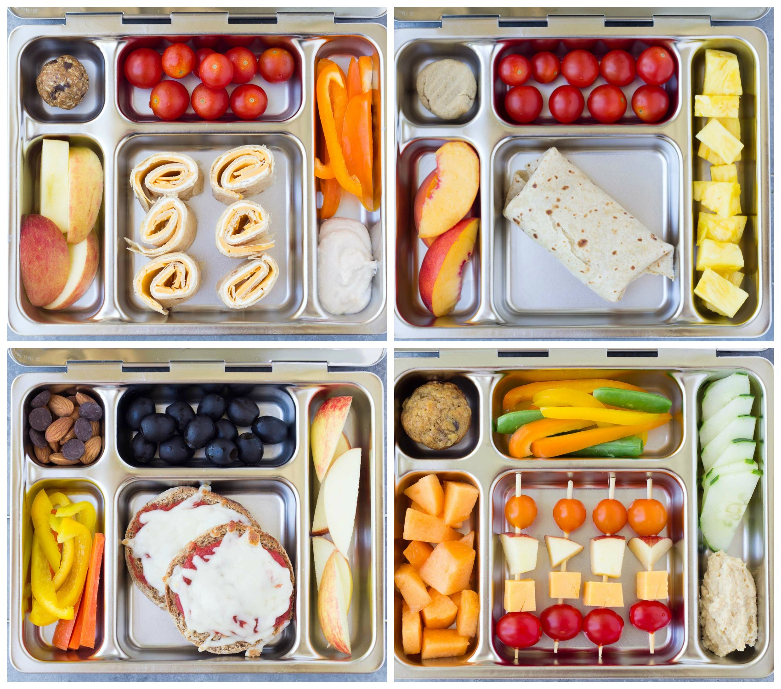



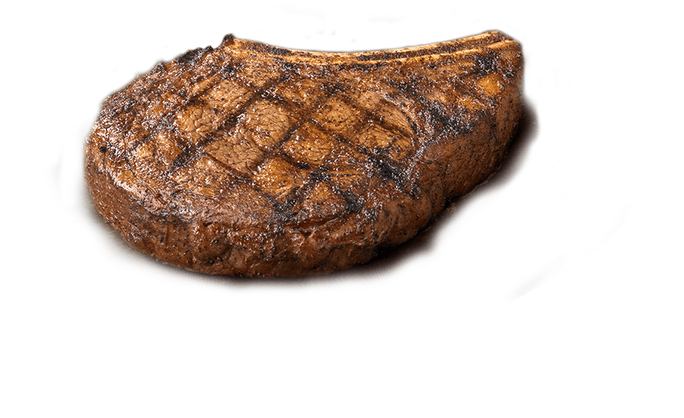










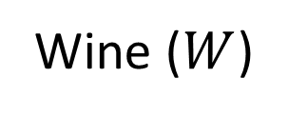
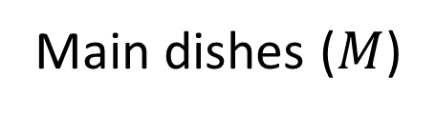
Exchanging with Friends
Dinner Menu for Friends
[Boutilier et al. ’99]
{ , } X
{ , }
Main dishes ($M$)
Wine ($W$)
School Meal Program
Exchanging Houses and Cars
[Moulin ’95]

Slide 3
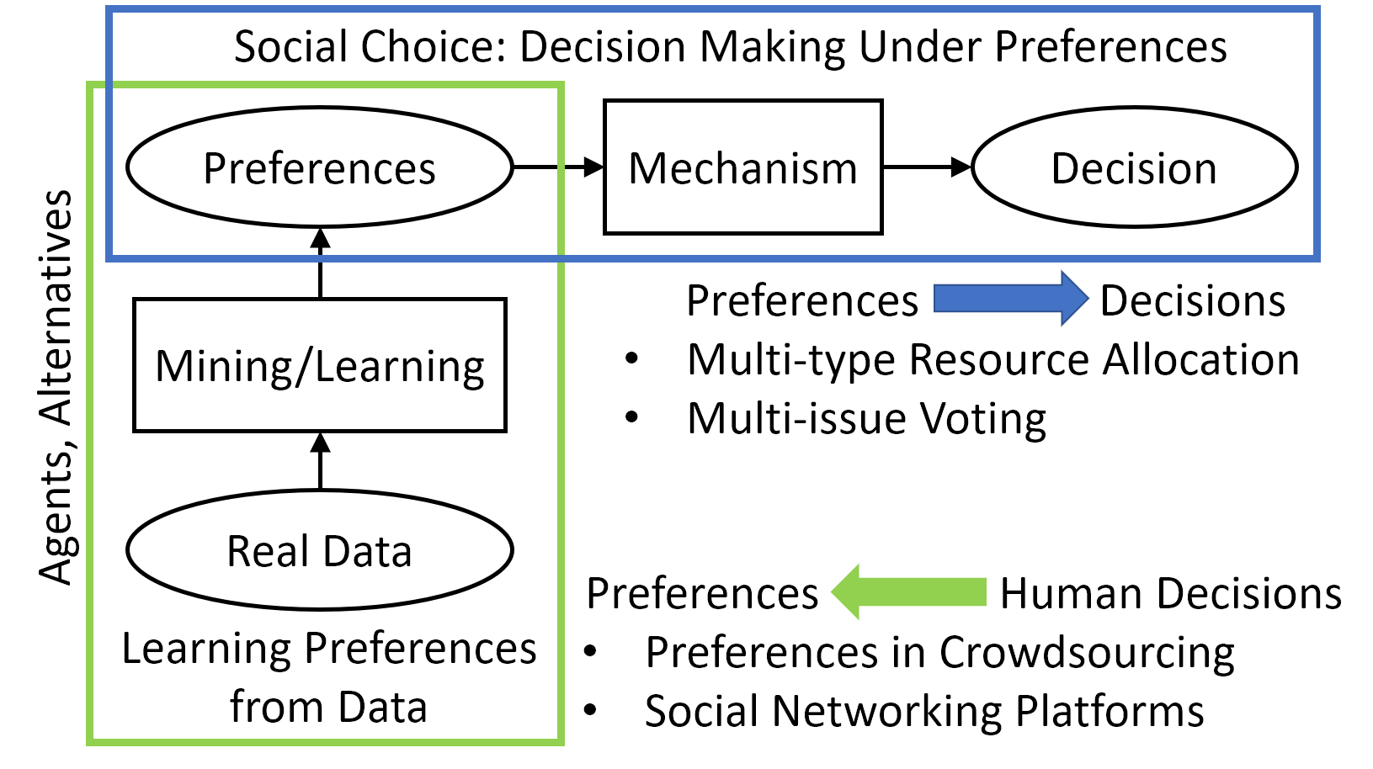

Slide 4
Multi-attribute Decision Making
Alternatives characterized by multiple attributes
Bundles of items of different types
Values for each of multiple issues
Goal: Find a decision satisfying agents’ preferences.
Challenges
Computation is hard in many settings
Preference representation and elicitation
Impossible to satisfy desired properties in general

Slide 5
Contributions
Agents’ preferences often have natural structure.
For agents: Easier to express preferences.
For designer: Tractability.
 | Problem | Preference Structure | Contribution
 | Multi-type Exchange Markets [AAAI ‘17] | Lexicographic extensions of CP-nets | First core selecting mechanism
 | Multi-issue Voting [AAMAS ‘17] | CP-nets PCP-nets | New class of voting rules under Loss Minimization Framework
 | Question Answering [ICCCN ‘17] | Heuristic-Lexicographic | Learning crowd behavior

Slide 6









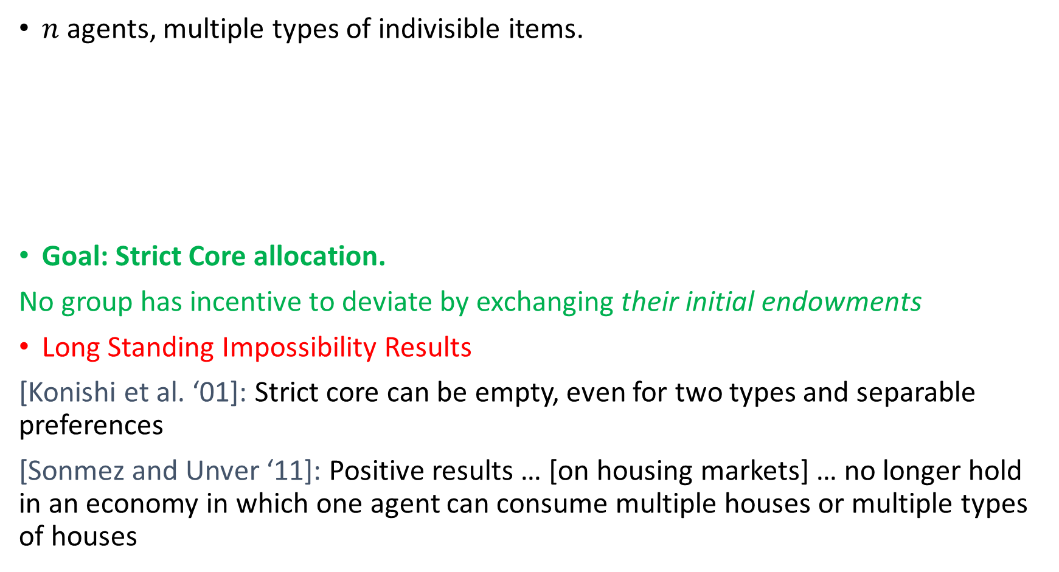
Multi-Type Exchange Markets
$n$ agents, multiple types of indivisible items.
Goal: Strict Core allocation.
No group has incentive to deviate by exchanging their initial endowments
Long Standing Impossibility Results
[Konishi et al. ‘01]: Strict core can be empty, even for two types and separable preferences
[Sonmez and Unver ‘11]: Positive results … [on housing markets] … no longer hold in an economy in which one agent can consume multiple houses or multiple types of houses
Initial Endowments
Acceptable Bundles

Slide 7

Top-Trading-Cycles (TTC) Mechanism is Strict Core Selecting for Multi-Type Housing Markets
Agents may own and accept multiple items of each type
Under Lexicographic preferences
Group-strategyproof
Under Conditionally-Most-Important (CMI) tree preferences.
Generalizes several important classes of preference languages
Generalizes Fujita et al. ‘15, Sikdar et al. ’17
Resists manipulation*

Slide 8
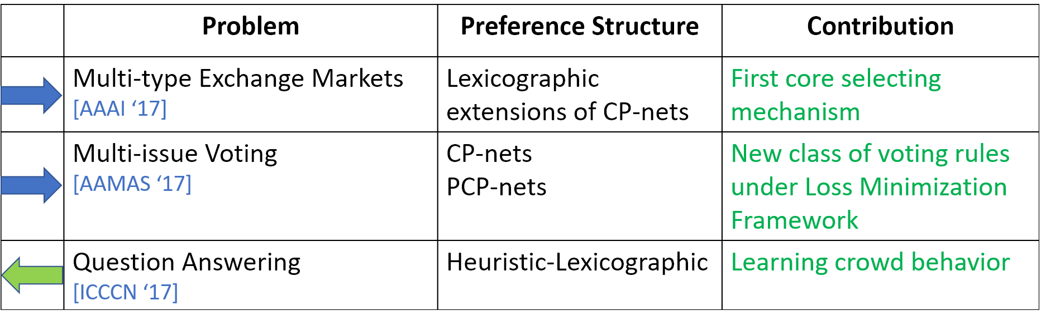
Multi-Attribute Decision Making Possible When Preferences Have Some Structure
Lower cognitive burden
Elicit preferences
Express complex preferences
Lower communication cost
Lower computational complexity
Design better mechanisms
Thank you!

