Slide 1

Optimal Decision Making with CP-nets and PCP-nets
Sibel Adali, Sujoy Sikdar, Lirong Xia

Slide 2
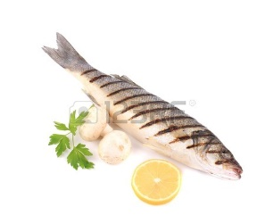


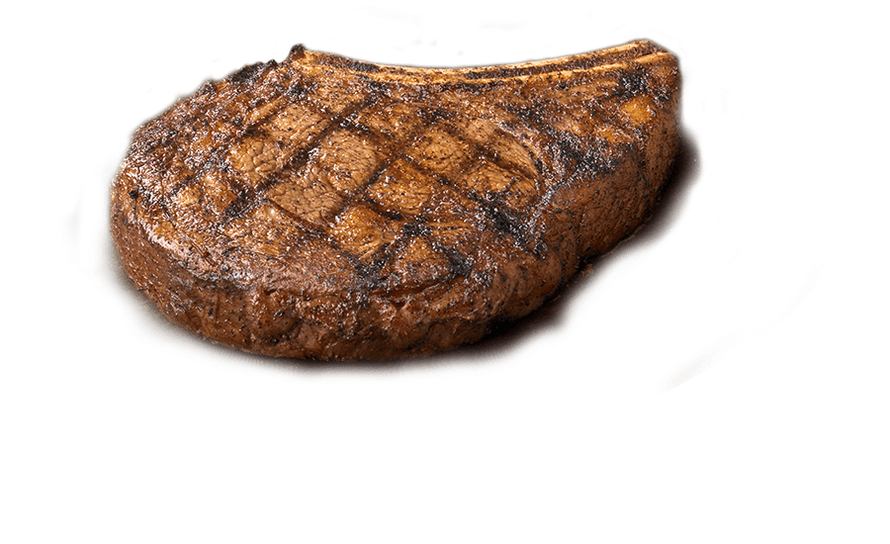
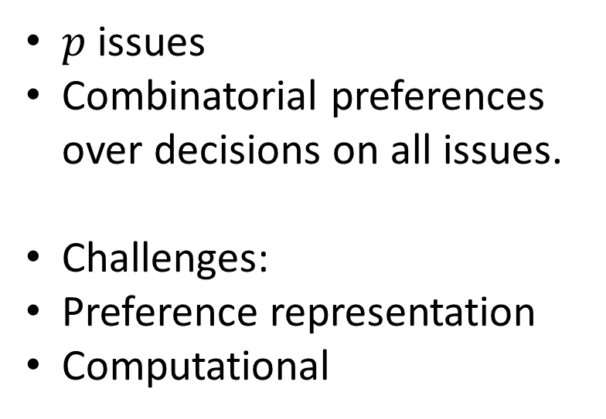
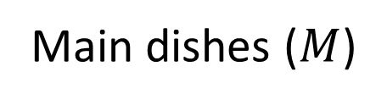
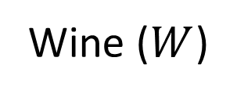
Multi-Issue Voting
$p$ issues
Combinatorial preferences over decisions on all issues.
Challenges:
Preference representation
Computational
{ , } X
{ , }
Main dishes ($M$)
Wine ($W$)
Goal: Cater to people’s preferences
What is the best decision for all issues?
How to compare two decisions?

Slide 3
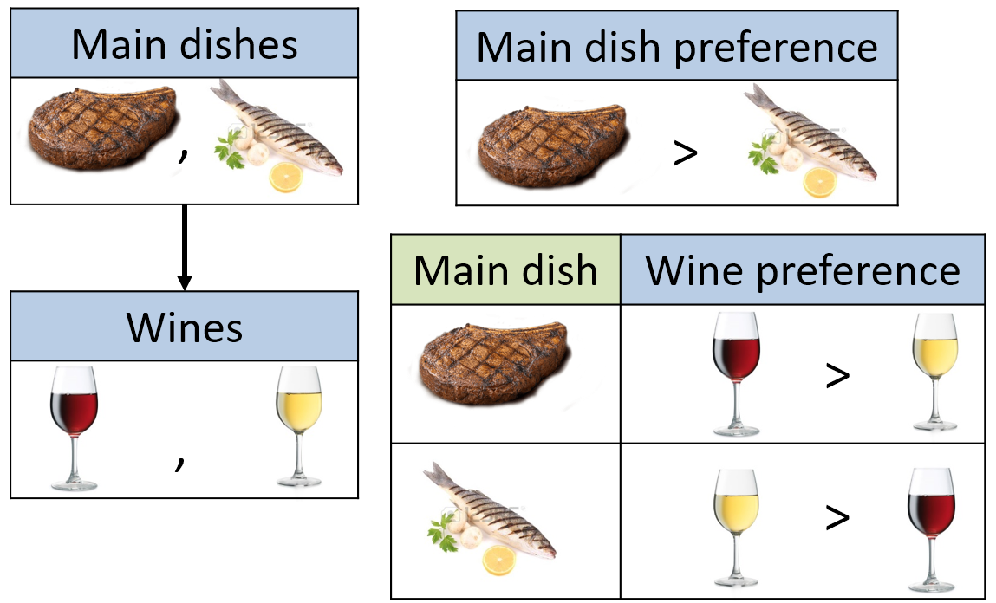



Compact Preference Languages and CP-nets
[Boutilier et al. ‘04]
“I prefer red wine to white wine with my meal,
ceteris paribus, given that meat is served.”

Slide 4
Winners are Undominated
No other decision is preferred
Acyclic CP-nets:
Always exists
Unique
Cyclic CP-nets: ???
Doesn’t always exist
May not be unique

Slide 5
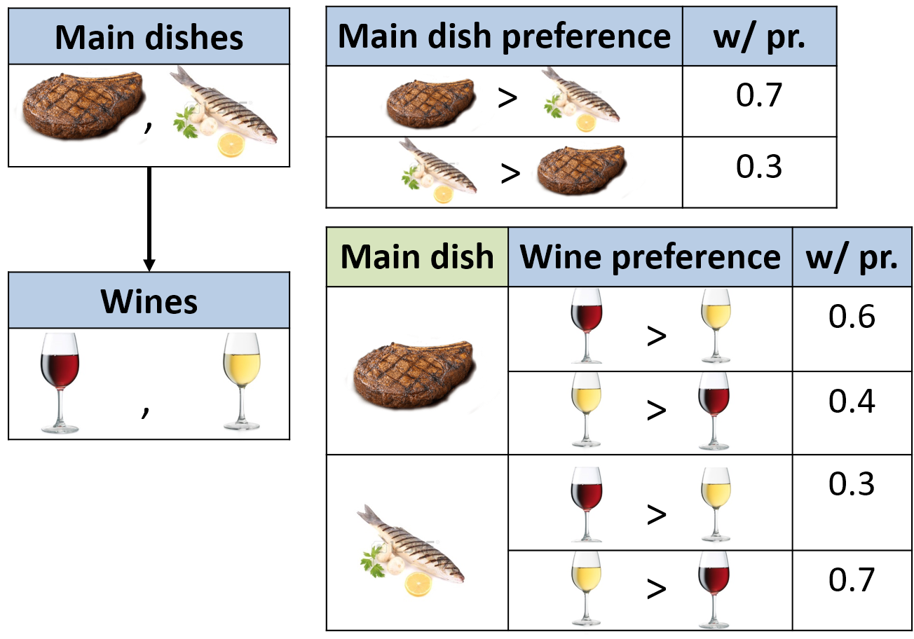
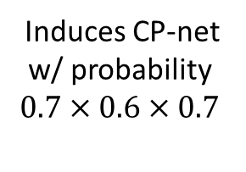
PCP-nets
[Bigot et al. ’13, Cornelio et al. ‘13]
Induces CP-net
w/ probability
$0.7×0.6×0.7$

Slide 6
PCP-nets are useful
Uncertain preferences [Bigot et al. ’13, Cornelio et al. ‘13]
Dynamic preferences [Cornelio et al. ‘14]
Aggregate CP-net profile as a single PCP-net [Cornelio et al. ‘14]

Slide 7
Previous Work
Winner determination
Common assumptions:
Dependencies are acyclic
All preferences have the same structure

Slide 8
Quantitative approach to decision making
Loss Minimization Framework
# (weakly) dominating decisions
Optimal decision = Loss minimizing decision

Slide 9
Main messages
Full generality w.r.t. preferences:
Cyclic dependencies
CP-net and PCP-net profiles
Natural notions of loss
Generalizes previous work
New class of voting rules
And axiomatic properties

Slide 10

Loss of a decision
Inputs:
(P)CP-net $C$
Decision $\vec{d}$
Output:
Loss $L(C,\vec{d})$

Slide 11
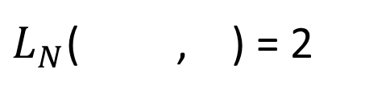
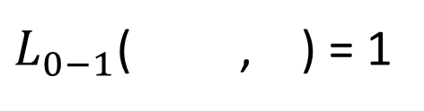
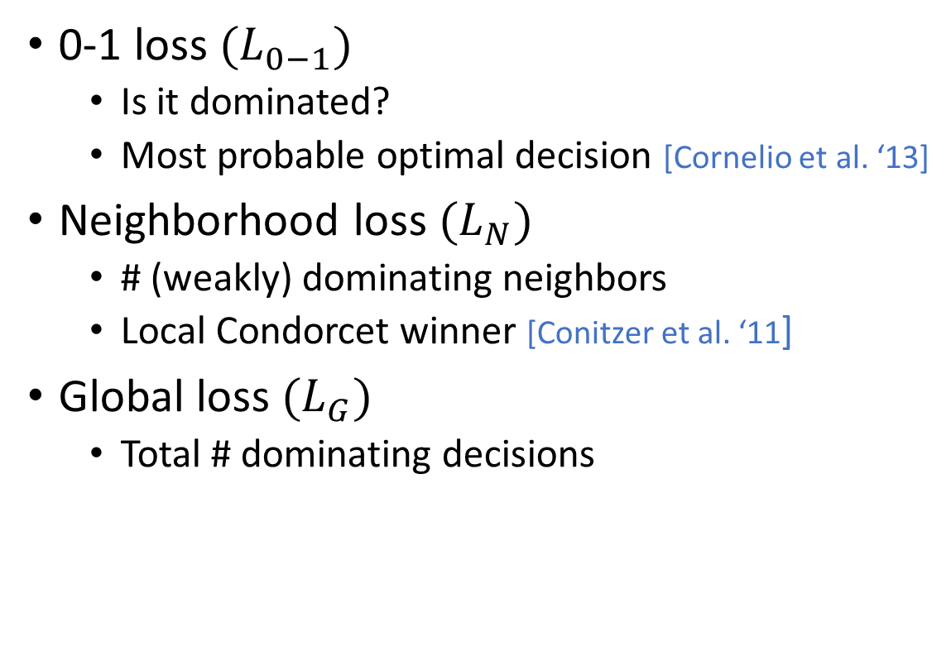
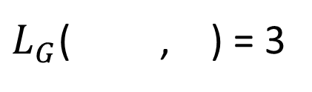
Natural loss functions
0-1 loss $(L_{0−1})$
Is it dominated?
Most probable optimal decision [Cornelio et al. ‘13]
Neighborhood loss $(L_{N})$
# (weakly) dominating neighbors
Local Condorcet winner [Conitzer et al. ‘11]
Global loss $(L_{G})$
Total # dominating decisions
$L_{0−1}$( , ) = 1
$L_{N}$( , ) = 2
$L_{G}$( , ) = 3

Slide 12
Improving flip dynamics
Improving Flips

Slide 13
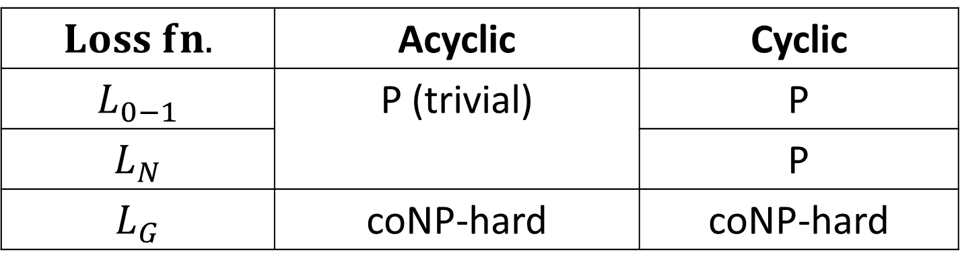
Computing the Loss
$$Loss fn.$$ | Acyclic | Cyclic
$$L_{0−1}$$ | P (trivial) | P
$$L_{N}$$ |  | P
$$L_{G}$$ | coNP-hard | coNP-hard

Slide 14
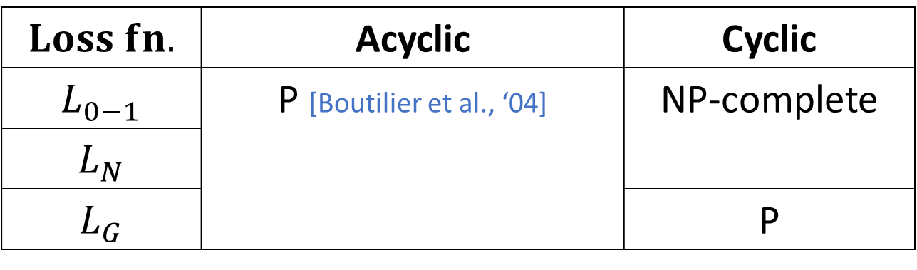
Computing the Optimal Decision for CP-nets
Input: CP-net
Output: Optimal decision = Loss minimizing decision
$$Loss fn.$$ | Acyclic | Cyclic
$$L_{0−1}$$ | P [Boutilier et al., ‘04] | NP-complete
$$L_{N}$$
$$L_{G}$$ |  | P

Slide 15
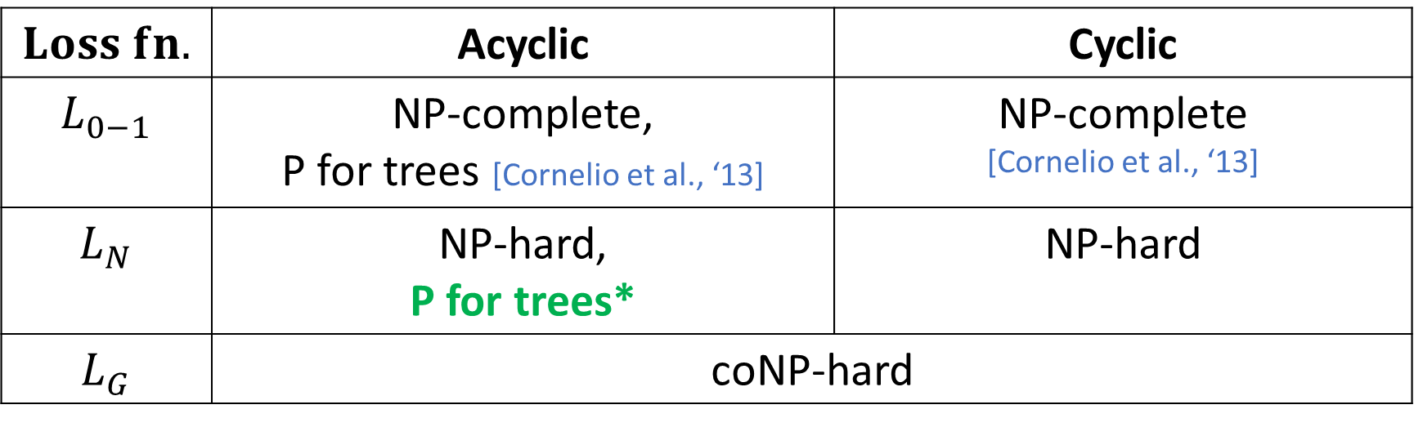
Optimal Decision for PCP-nets
$$Loss fn.$$ | Acyclic | Cyclic
$$L_{0−1}$$ | NP-complete, P for trees [Cornelio et al., ‘13] | NP-complete [Cornelio et al., ‘13]
$$L_{N}$$ | NP-hard, P for trees* | NP-hard
$$L_{G}$$ | coNP-hard
* Exponential in tree-width
Using a variable-elimination algorithm

Slide 16

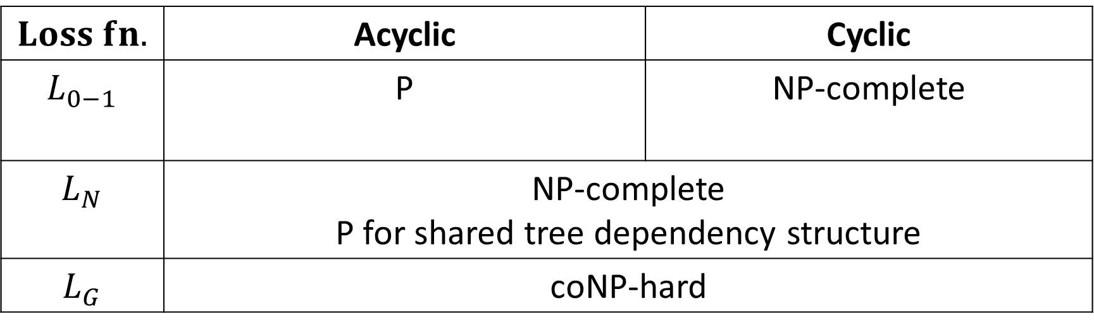
A new class of voting rules
Input: CP-net profile $P$
Output: Decision for every issue
$$Loss fn.$$ | Acyclic | Cyclic
$$L_{0−1}$$ | P | NP-complete
$$L_{N}$$ | NP-complete P for shared tree dependency structure
$$L_{G}$$ | coNP-hard
Notes:
LN-OPT for profiles becomes hard for even acyclic case
Identified tractable sub-case.

Slide 17
Axiomatic Properties
Anonymity
Consistency
Issue-wise neutrality
Weak monotonicity
Satisfied by every rule

Slide 18
Summary and Conclusions
Quantitative approach to multi-issue voting
Fully general:
Cyclic dependencies
CP-net and PCP-net profiles
New loss minimization framework
Natural loss functions
New class of voting rules
Identifying tractable sub-cases for optimal outcome of PCP-nets
Large space of possible loss functions
Good social choice normative properties
Computationally tractable
Notes:
We might expect that computing LOSS is easier than computing OPTDECISION.
Turns out that for acyclic CP-nets LG-LOSS is coNP-hard but LG-OPTDECISION is in P.
LN-LOSS is in P but LN-OPTDECISION is NP-complete for cyclic CP-nets.

