Slide 1
Top-Trading-Cycles Mechanisms with Acceptable Bundles
Sujoy Sikdar, Sibel Adali, Lirong Xia
Rensselaer Polytechnic Institute

Slide 2
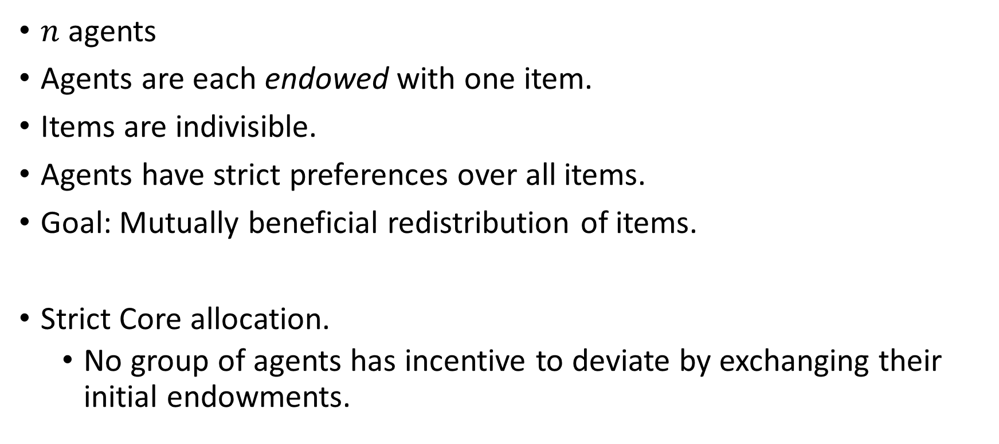
Housing Markets
$n$ agents
Agents are each endowed with one item.
Items are indivisible.
Agents have strict preferences over all items.
Goal: Mutually beneficial redistribution of items.
Strict Core allocation.
No group of agents has incentive to deviate by exchanging their initial endowments.

Slide 3







Gale’s Top Trading Cycles (TTC)
Endowments
Preferences
$≻$ $≻$
While any item remains
Build a graph
agent -> top item
item -> owner
Implement all cycles
Strict Core (unique [Roth and Postlewaite, ‘77]).
Individually rational
Pareto optimal.
Strong Group Strategy-proof. [Bird, ‘84]
top
top
[Shapley and Scarf, ‘74]

Slide 4

Bringing More Than One Item to the Table?
When some agents initially own multiple items, … no mechanism satisfies both core-selection and strategy-proofness… [Sonmez, 1999]
Strict core can be empty, even for two types and separable preferences [Konishi et al. 2001]
Fujita et al. (2015): Multiple items, Single Type, Lexicographic Preferences
Sikdar et al. (2017): One item of each type, Lexicographic extensions of CP-nets

Slide 5







Housing Markets with Acceptable Bundles
$n$ agents, multiple types of indivisible items.
Goal: Strict Core allocation.
Preferences?
When can we extend the TTC mechanism to housing markets with acceptable bundles?
Initial Endowments
Acceptable Bundles

Slide 6
Contributions
TTC is
strict core selecting, and
non-bossy
whenever it outputs an acceptable full allocation under CMI-tree preferences.
TTC always outputs an acceptable full allocation for multi-type housing markets with size constraints when preferences are strict CMI-trees.
Generalizes Fujita et al. (2015), and Sikdar et al. (2017)
Manipulation is NP-complete.
[No core selecting mechanism is strategyproof under lexicographic preferences (Sikdar et al. 2017)]

Slide 7

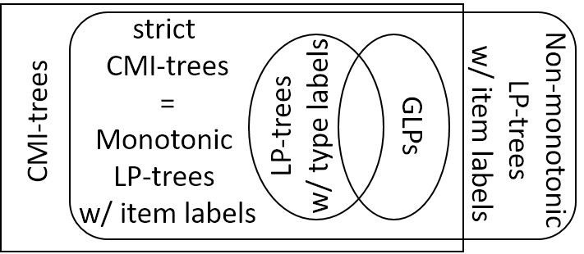

Conditionally Most Important (CMI)-tree preferences
Assigned
Not assigned
CMI
1
0
Comparison
$$≻$$

Slide 8
TTC Extension
While at least one agent remains:
Identify most important allowable item for each agent
Build a graph:
Each agent points to most important item
Each item points to initial owner
Implement all cycles
Remove agents with no allowable most important item
Strict Core Selecting when agents’ preferences are CMI-trees and whenever the output is an acceptable full allocation.

Slide 9
Multi-Type Housing Markets w/ Size Constraints
Accept exactly as many items of each type as original endowment
Initial Endowments
Acceptable Bundles
Generalizes Fujita et al. (2015), and Sikdar et al. (2017)
TTC output is always an acceptable full allocation
under preferences represented by Strict CMI-trees
Strict CMI-trees are a weaker restriction than Lexicographic preferences Fujita et al. (2015) and Lexicographic extensions of CP-nets Sikdar et al. (2017)

Slide 10
Round 1 of TTC
Multi Type Housing Markets w/ Size Constraints
Endowments
Acceptable bundles
CMI preferences

Slide 11
Round 2 of TTC
CMI preferences

Slide 12
Round 3 of TTC
CMI preferences
1
0

Slide 13
TTC continued…
Output
CMI preferences
Acceptable
Full
0
Strict Core Allocation

Slide 14
Summary
New framework of Housing Markets with Acceptable Bundles (HMAB)
New graphical language of CMI-trees
Generalizes LP-trees, GLPs, lexicographic extension of CP-nets.
Extension of TTC to HMAB which is
Strict core selecting
Non-bossy
Whenever TTC outputs an acceptable full allocation
Multi-type Housing Markets with Size Constraints
Generalizes previous settings of Fujita et al. (2015), Sikdar et al. (2017)
TTC always outputs an acceptable allocation
Thank you!

