Slide 1

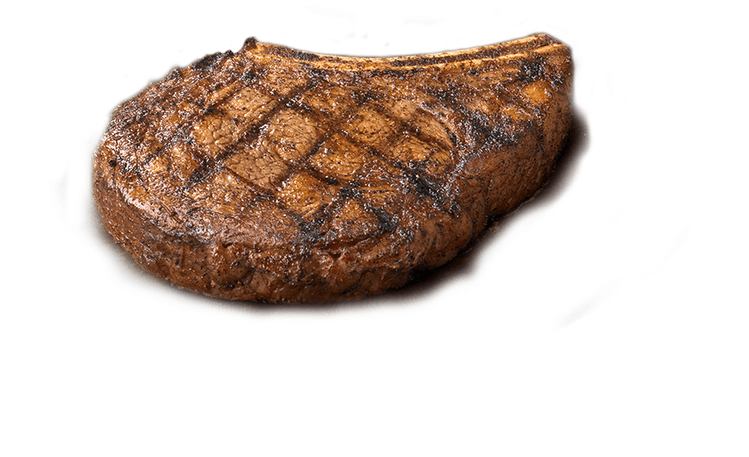
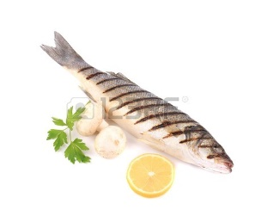
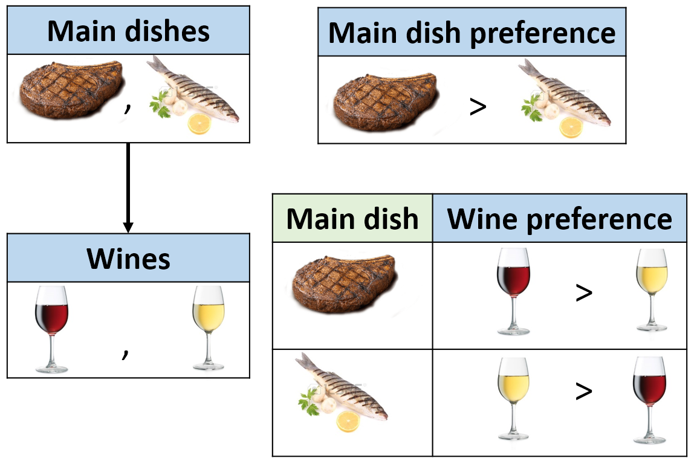






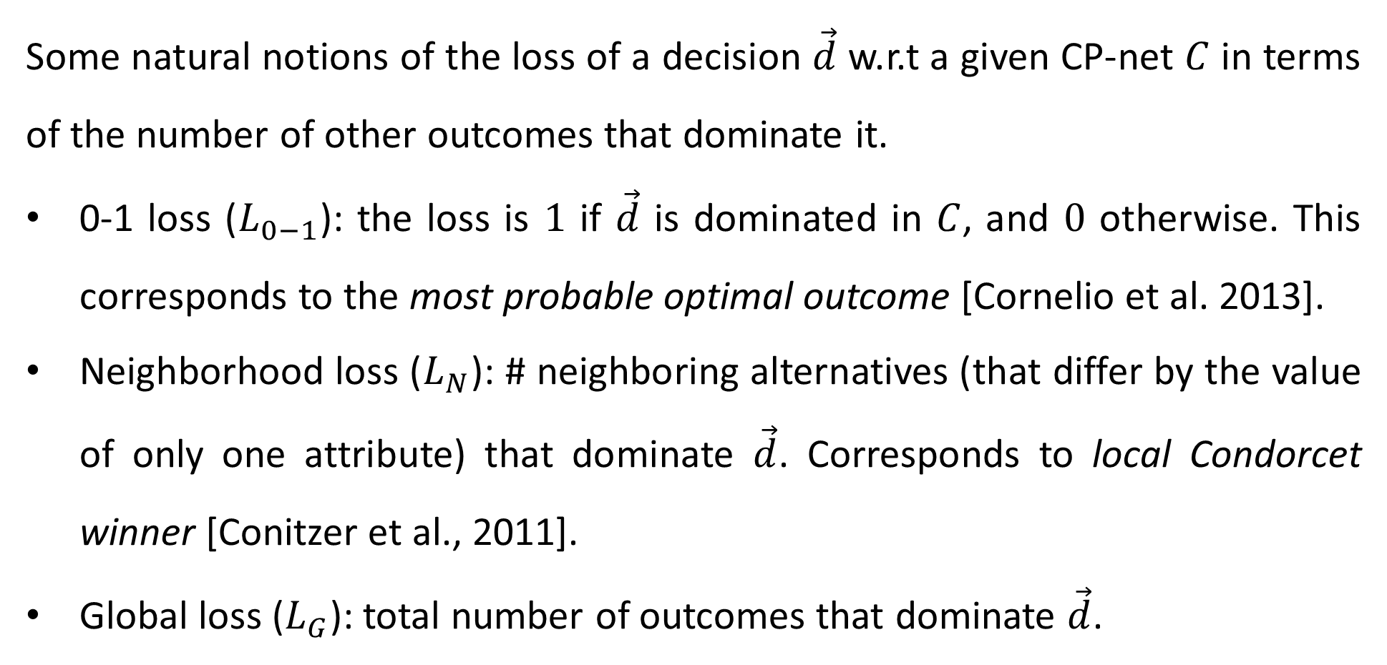
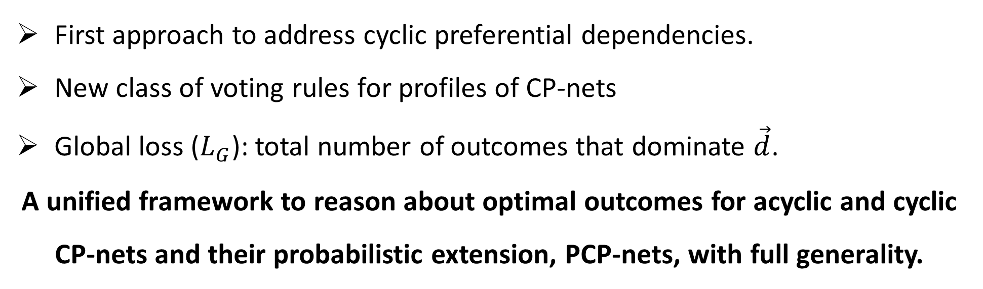
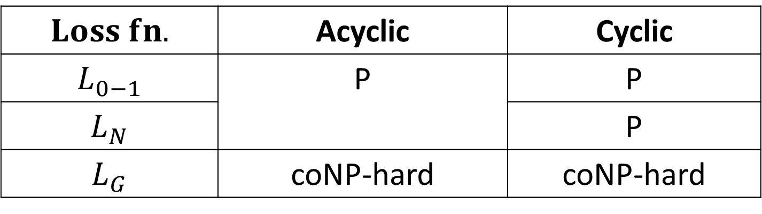
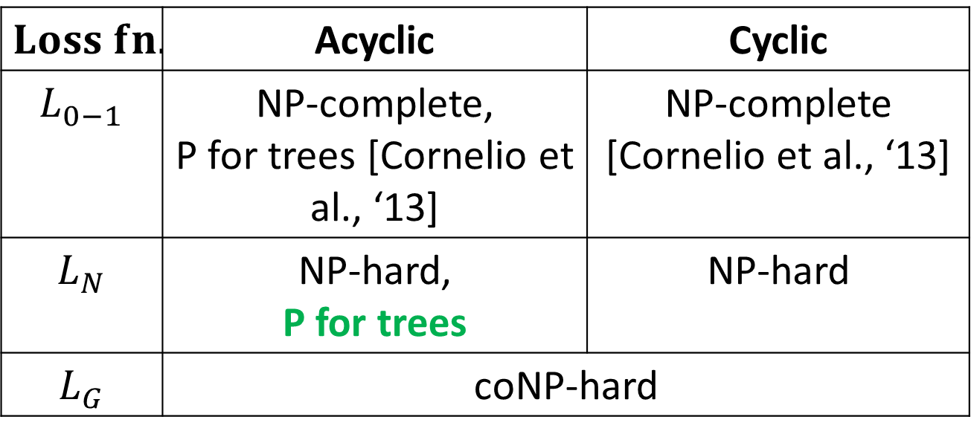
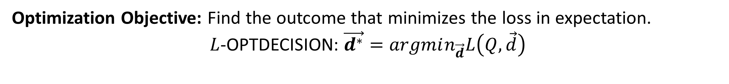
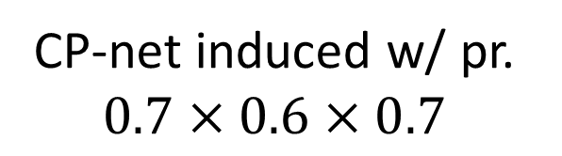
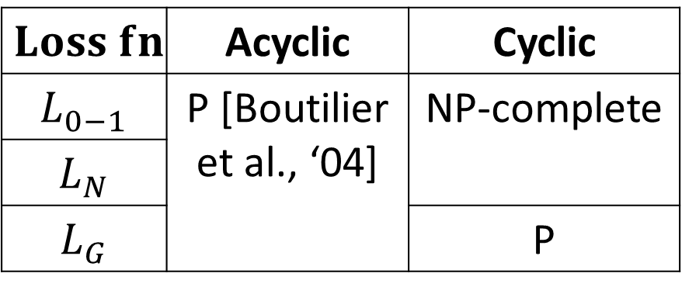
Computing Optimal Decisions for Probabilistic Conditional Preference Networks
Sujoy Sikdar, Lirong Xia, Sibel Adalı
Department of Computer Science, Rensselaer Polytechnic Institute
Multi-Issue Voting
Motivation
Main dishes
Main dish preference | w/ pr.
 | 0.7
 | 0.3
CP-net induced w/ pr.
$0.7×0.6×0.7$
Alternatives characterized by multiple issues.
Agents have combinatorial preferences on the issues.
Goal: Make an optimum group decision on every issue.
Examples:
Multi-issue referenda, Omnibus legislative bills.
Configuring a meal from a dinner menu.
First approach to address cyclic preferential dependencies.
New class of voting rules for profiles of CP-nets
Global loss ($L_{G}$): total number of outcomes that dominate $\vec{d}$.
A unified framework to reason about optimal outcomes for acyclic and cyclic CP-nets and their probabilistic extension, PCP-nets, with full generality.
,
>
Choices faced in a restaurant.
>
{ , } X
{ , }
Main dish | Wine preference | w/ pr.
 |  | 0.6
 |  | 0.4
 |  | 0.3
 |  | 0.7
Main dishes X Wines
Wines
>
,
>
Loss Minimization Framework
>
Some natural notions of the loss of a decision $\vec{d}$ w.r.t a given CP-net $C$ in terms of the number of other outcomes that dominate it.
0-1 loss ($L_{0−1}$): the loss is $1$ if $\vec{d}$ is dominated in $C$, and $0$ otherwise. This corresponds to the most probable optimal outcome [Cornelio et al. 2013].
Neighborhood loss ($L_{N}$): # neighboring alternatives (that differ by the value of only one attribute) that dominate $\vec{d}$. Corresponds to local Condorcet winner [Conitzer et al., 2011].
Global loss ($L_{G}$): total number of outcomes that dominate $\vec{d}$.
>
An example of a PCP-net over meal configurations and induced CP-net.
Computing the Optimal Decision: Complexity
CP-nets
Optimization Objective: Find the outcome that minimizes the loss in expectation.
$L$-OPTDECISION: $\vec{d^{∗}}=argmin_{\vec{d}}L\left(Q,\vec{d}\right)$
A compact preferences language with conditional preferential dependencies using ceteris paribus statements
“I prefer red wine to white wine with my meal,
ceteris paribus, given that meat is served.”
$$Loss fn.$$ | Acyclic | Cyclic
$$L_{0−1}$$ | P [Boutilier et al., ‘04] | NP-complete
$$L_{N}$$
$$L_{G}$$ |  | P
$$Loss fn.$$ | Acyclic | Cyclic
$$L_{0−1}$$ | NP-complete, P for trees [Cornelio et al., ‘13] | NP-complete [Cornelio et al., ‘13]
$$L_{N}$$ | NP-hard, P for trees | NP-hard
$$L_{G}$$ | coNP-hard
Main dishes
Main dish preference
Computing the Loss of a Decision: Complexity
(a) CP-nets
,
>
$$Loss fn.$$ | Acyclic | Cyclic
$$L_{0−1}$$ | P | P
$$L_{N}$$ |  | P
$$L_{G}$$ | coNP-hard | coNP-hard
(b) PCP-nets
Main dish | Wine preference
Complexity of $L$-OPTDECISION: $\vec{d^{∗}}=argmin_{\vec{d}}L\left(Q,\vec{d}\right)$.
Wines
>
Contributions
,
Complexity of $L$-LOSS: $L\left(Q,\vec{d}\right)$.
Loss minimization framework for CP-nets and PCP-nets.
Clear definition of optimality criteria for acyclic and cyclic (P)CP-nets with full generality.
Natural loss functions that correspond to well studied notions of optimality.
Complexity results for (i) computing loss, and, (ii) finding the optimal decision.
Tractable cases for particular loss functions under this framework.
Future work:
Axiomatic characterization of voting rules characterized by a loss function.
Identifying further reasonable loss functions and tractable cases under each.
>
PCP-nets
An example of CP-net preferences over a restaurant menu.
Uncertain preferences of a single agent.
Incorporate agents’ changing preferences.
Aggregate representative CP-net preferences of multiple agents.
PCP-nets induce a probability distribution over CP-nets with the same dependency structure.
Dominance relationships imposed by a CP-net.

