Slide 1
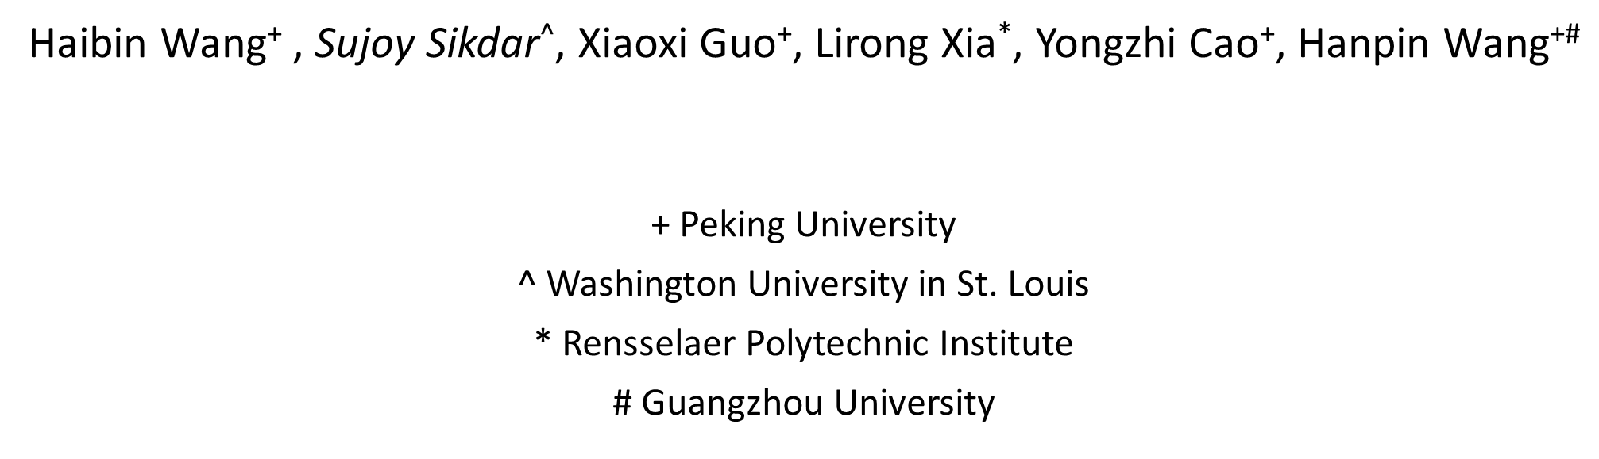
Multi-type Resource Allocation with Partial Preferences
Haibin Wang⁺ , Sujoy Sikdar^, Xiaoxi Guo⁺, Lirong Xia*, Yongzhi Cao⁺, Hanpin Wang^{+#}
+ Peking University
^ Washington University in St. Louis
* Rensselaer Polytechnic Institute
# Guangzhou University

Slide 2








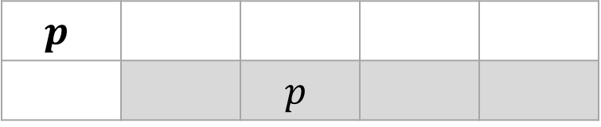

Multi-Type Allocation Problem (MTRA)
…
$n$ agents
$p$ types of items
Assignments: Each agents’ allocation is a collection of fractional bundles
S
:
…
C
:
…
$$p$$
 |  | $$p$$
$$\sum{=}$$
S
C
1 unit of each type

Slide 3




Preferences over Bundles
Acyclic CP-net
Partial Preference
S
:
$$≻$$
$$⇒$$
C
:
|
$$≻$$
|
$$≻$$

Slide 4
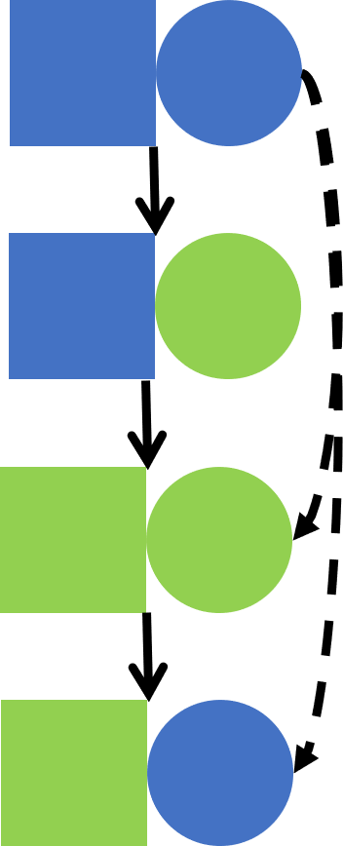
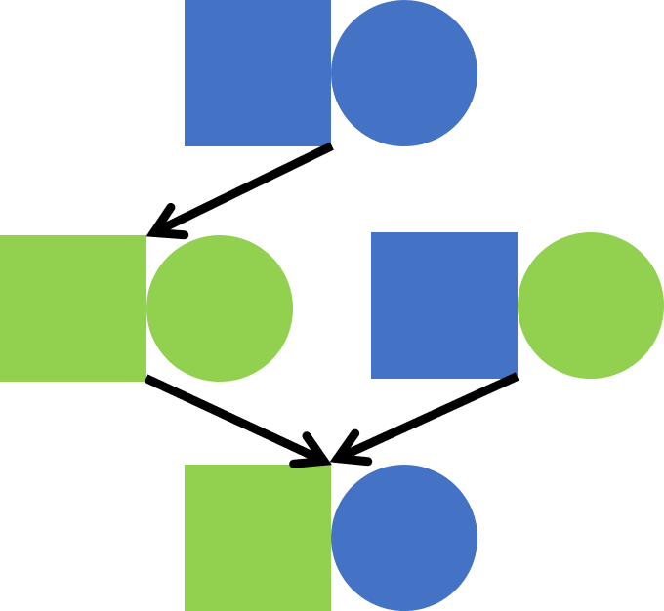
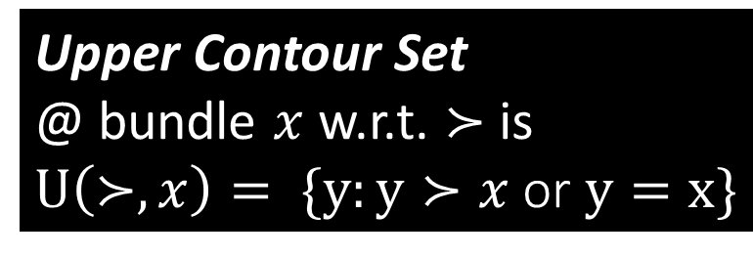

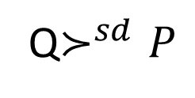
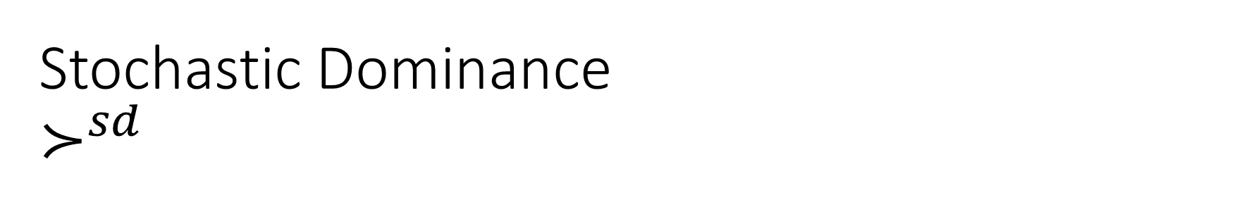

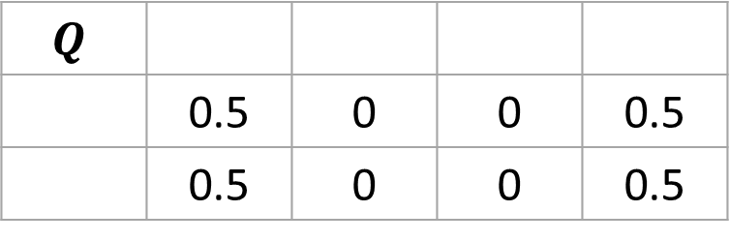
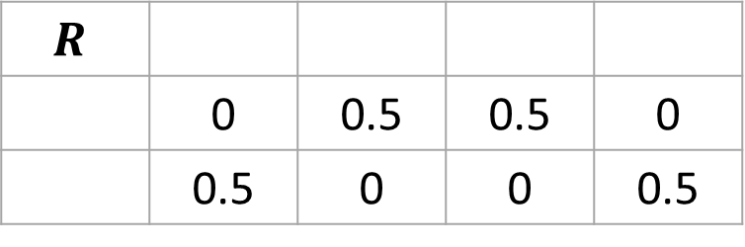
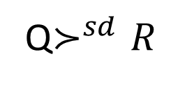
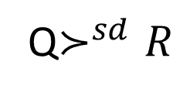
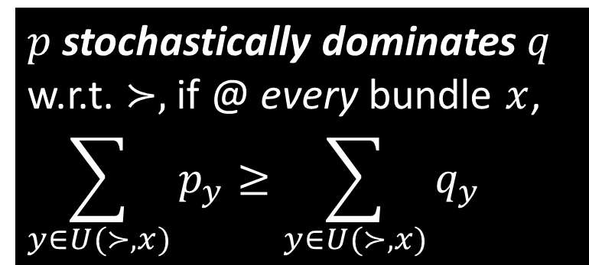
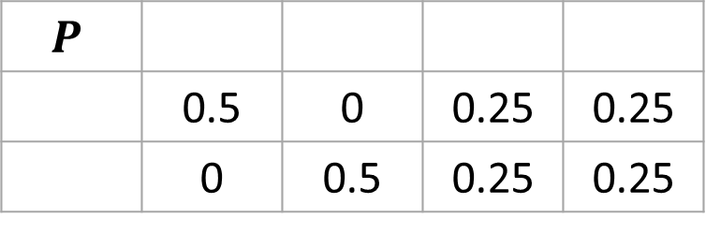
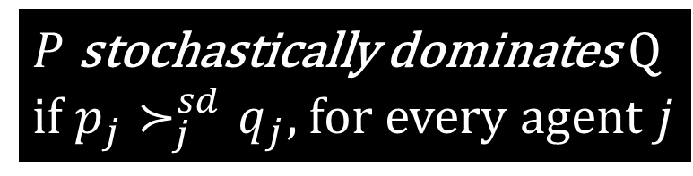
Stochastic Dominance $$≻^{sd}$$
$$P$$
 | 0.5 | 0 | 0.25 | 0.25
 | 0 | 0.5 | 0.25 | 0.25
$$Q$$
 | 0.5 | 0 | 0 | 0.5
 | 0.5 | 0 | 0 | 0.5
Upper Contour Set
@ bundle $x$ w.r.t. $≻$ is
$U\left(≻, x\right)= \{y:y≻x$or $y=x\}$
$$R$$
 | 0 | 0.5 | 0.5 | 0
 | 0.5 | 0 | 0 | 0.5
$p$ stochastically dominates $q$
w.r.t. $≻,$if @ every bundle $x$,
$$\sum_{y∈U(≻, x)}{p_{y}}≥\sum_{y∈U(≻, x)}{q_{y }}$$
$P$ stochastically dominates Q
if $p_{j}≻_{j}^{sd}q_{j}$, for every agent $j$
Q$≻^{sd}P$
Q$≻^{sd}R$
$$⇒$$
$$Q≻^{sd}R$$
Q$≻^{sd}R$

Slide 5
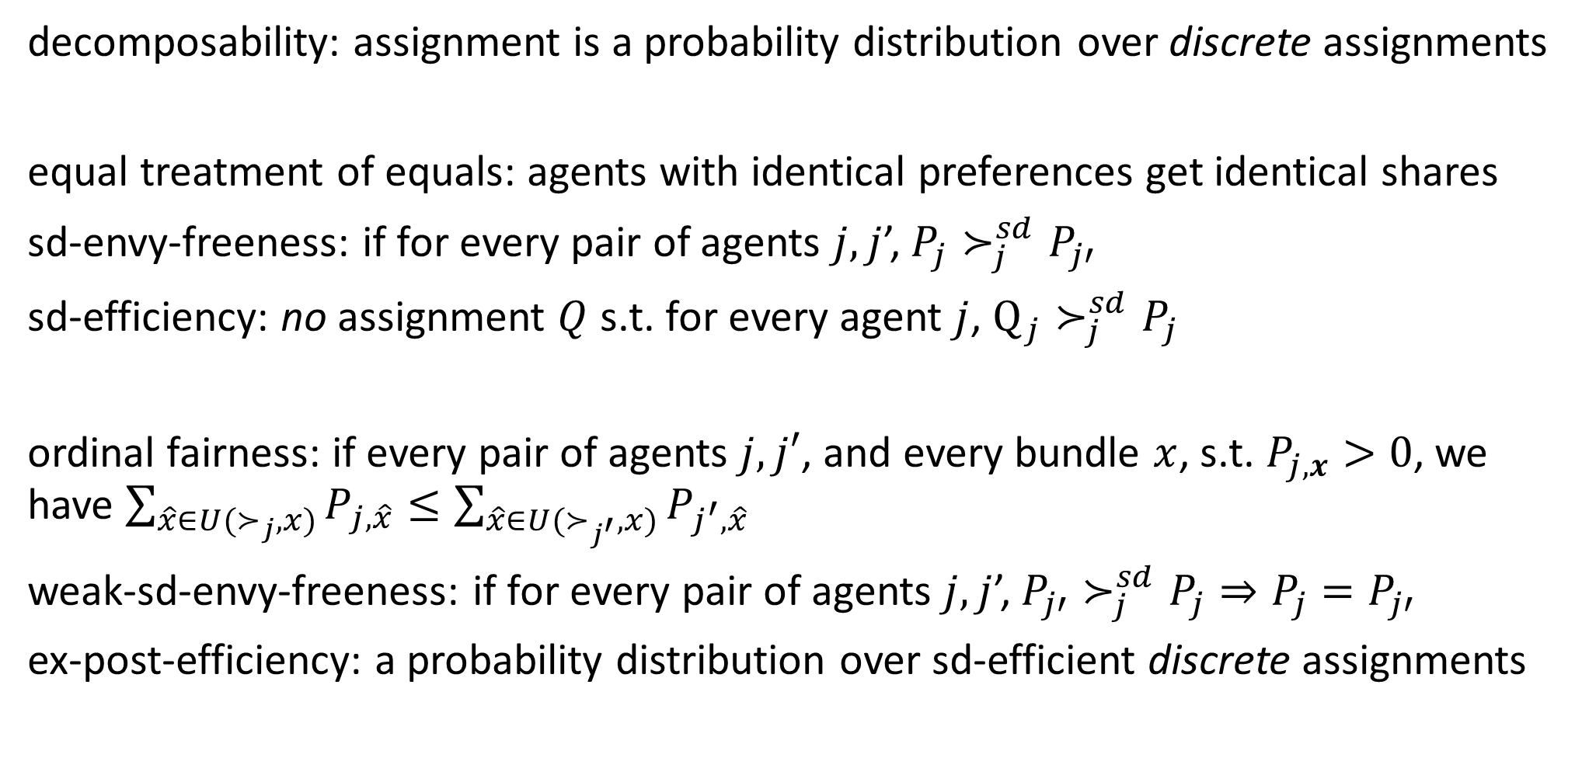
Fairness, Efficiency, and Indivisibility
decomposability: assignment is a probability distribution over discrete assignments
equal treatment of equals: agents with identical preferences get identical shares
sd-envy-freeness: if for every pair of agents $j,j$’,$P_{j}≻_{j}^{sd}P_{j′}$
sd-efficiency: no assignment $Q$ s.t. for every agent $j$, $Q_{j}≻_{j}^{sd}P_{j}$
ordinal fairness: if every pair of agents $j,j′$, and every bundle $x$, s.t. $P_{j,x}>0$, we have $\sum_{\hat{x}∈U(≻_{j},x)}{P_{j,\hat{x}}}≤\sum_{\hat{x}∈U(≻_{j^{′}},x)}{P_{j^{′},\hat{x}}}$
weak-sd-envy-freeness: if for every pair of agents $j,j$’,$P_{j′}≻_{j}^{sd}P_{j}⇒P_{j}=P_{j′}$
ex-post-efficiency: a probability distribution over sd-efficient discrete assignments
Assignments NOT guaranteed to be decomposable when there are multiple types
NO mechanism is sd-efficient AND sd-envy-free under general partial preferences

Slide 6

Non-manipulability
sd-strategyproofness: if $f\left(≻\right)≻_{j}^{sd}f(≻′)$, for every agent $j$, every misreport
sd-weak-strategyproofness: if $f\left(≻^{′}\right)≻_{j}^{sd}f\left(≻\right)⇒f\left(≻^{′}\right)\left(j\right)=f(≻)(j)$
upper-invariance

Slide 7

Multi-type Random Priority (MRP)
Topologically sort partial orders $≻_{j}$ to linear order $≻_{j}^{′}$
Pick priority ordering $σ$ over agents uniformly at random
Agents arrive according to $σ$, and are allocated their favorite remaining bundle
Remove agent and all items in bundle
@ round 1
@ round 2

Slide 8
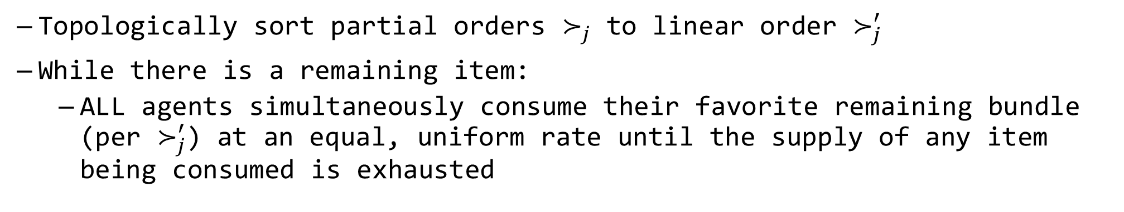
Multi-type Probabilistic Serial (MPS)
Topologically sort partial orders $≻_{j}$ to linear order $≻_{j}^{′}$
While there is a remaining item:
ALL agents simultaneously consume their favorite remaining bundle (per $≻_{j}^{′}$) at an equal, uniform rate until the supply of any item being consumed is exhausted
round 1
 | 0.5 | 0 | 0 | 0
 | 0 | 0.5 | 0 | 0
round 2
 | 0.5 | 0 | 0.5 | 0
 | 0 | 0.5 | 0 | 0.5

Slide 9






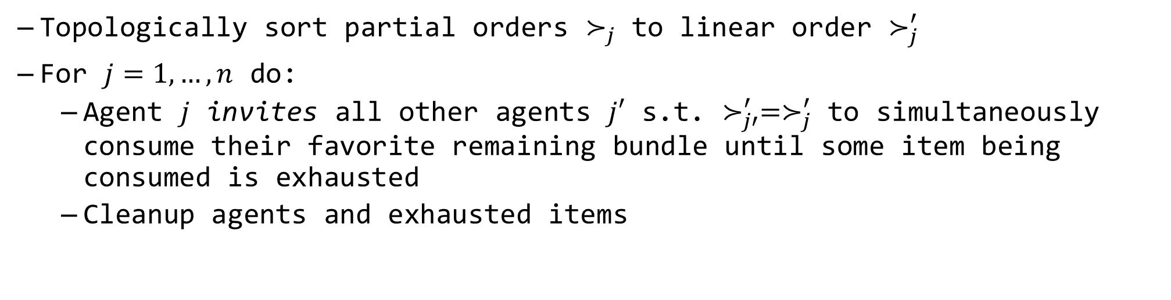







Multi-type General Dictatorship (MGD)
Topologically sort partial orders $≻_{j}$ to linear order $≻_{j}^{′}$
For $j=1,…, n$ do:
Agent $j$ invites all other agents $j′$ s.t. $≻_{j′}^{′}=≻_{j}^{′}$ to simultaneously consume their favorite remaining bundle until some item being consumed is exhausted
Cleanup agents and exhausted items
$$≻$$
$$≻$$
$$≻$$
$$≻$$
round 1
round 2
round 3
$$≻$$
0.5
1
0.5
$$≻$$
$$≻$$
$$≻$$
0.5
0.5
$$≻$$
$$≻$$
$$≻$$
$$≻$$

Slide 10




Properties under General Partial Preferences
MRP satisfies ex-post-efficiency, weak-sd-envy-freeness, equal treatment of equals, weak-sd-strategyproofness, and decomposability.
… but not upper invariance or sd-strategyproofness
MPS satisfies sd-efficiency, weak-sd-envy-freeness and equal treatment of equals.
… but not sd-envy-freeness, upper invariance, or sd-strategyproofness
$$≻^{sd}$$
$$≻$$
$$≻$$
$$≻$$
NO mechanism is sd-efficient AND sd-envy-free under general partial preferences
MGD satisfies sd-efficiency, ex-post-efficiency, equal treatment of equals, and decomposability.

Slide 11




Acyclic CP-net Preferences
Dependency
Graph
Conditional Preference Table
S
:
$$≻$$
$$⇒$$
C
:
|
$$≻$$
|
$$≻$$

Slide 12
Properties under Acyclic CP-net Preferences
MRP is sd-strategyproof and upper invariant.
and satisfies ex-post-efficiency, weak-sd-envy-freeness, equal treatment of equals, weak-sd-strategyproofness, and decomposability
MPS is sd-envy-free, ordinally fair, and upper invariant.
satisfies sd-efficiency, and equal treatment of equals
… but not ex-post-efficient (not guaranteed to be decomposable)
MPS is weak-sd-strategyproof with the same dependency graph.

Slide 13
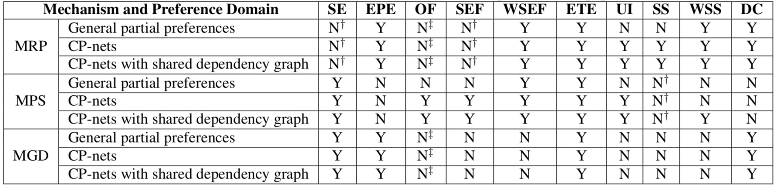
Summary
First fair and efficient mechanisms for MTRAs to the best of our knowledge
First extensions of RP and PS mechanisms to either partial preferences or MTRAs
SE:sd-efficiency, EPE: ex-post-efficiency, OF: ordinal fairness, SEF: sd-envy-freeness, ETE: equal treatment of equals, UI: upper invariance, SS: sd-strategyproofness, DC: decomposability, WX: weak-X

