Slide 1

Sentiment Analysis
Sujoy Paul
Alberta Health Services
Manager, Database Services

Slide 2
What is sentimental analysis
Also known as opinion mining, opinion extraction, subjectivity analysis, emotion analysis
It “is the computational study of opinions, sentiments and emotions expressed in text” (1)
Sentiment is about feelings, not facts

Slide 3
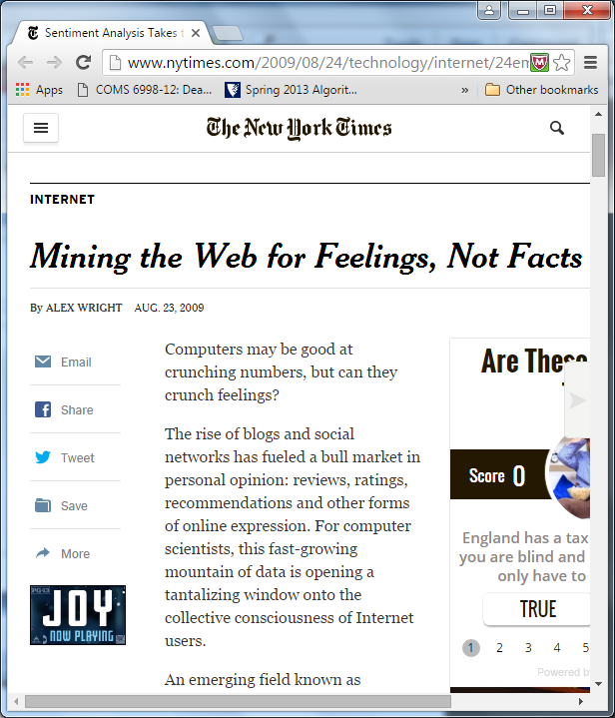
Sentiment analysis– NY Times
Computers may be good at crunching numbers, but can they crunch feelings?

Slide 4
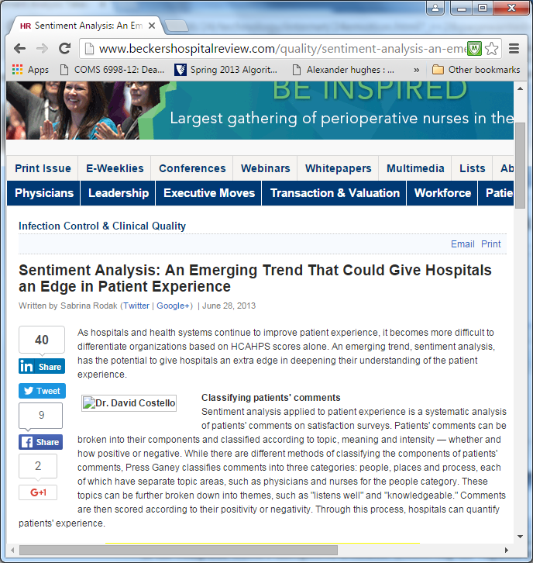
Sentiment Analysis in patient care(2)

Slide 5
Facts versus opinions
Facts: objective expressions about entities, events and their attributes. eg. I bought a Dell laptop today
Opinions: subjective expressions of emotions, attitudes or feelings toward the event, entity and their attributes, eg. I really love the new laptop

Slide 6
Kinds of sentiment analysis
Document level sentiment classification: applicable for single entity analysis in the whole document, eg. One product (positive/negative)
Sentence level: only at the sentence level to express positive/negative/neutral opinion.
Can be subjective/objective
Subjective is not necessarily a sentiment
Entity/aspect level: also known as feature selection; catered for fine-grained analysis
It looks directly at the opinion itself.
Opinion consists of sentiment(-ve/+ve) and target

Slide 7
Practical Applications
Market research on industries, eg. retail entertainment, hospitality, product development
Brand Management, Advertisement optimization
Competitor analysis, Social media monitoring
Health care : analyze patient data, biomedical text; hence exploring public accountability and use of taxpayers money

Slide 8
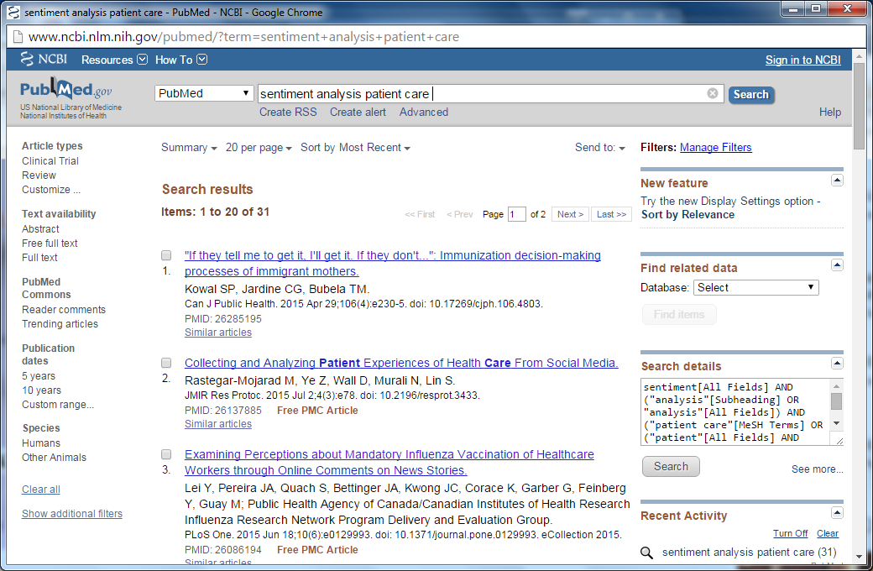
From Pubmed

Slide 9
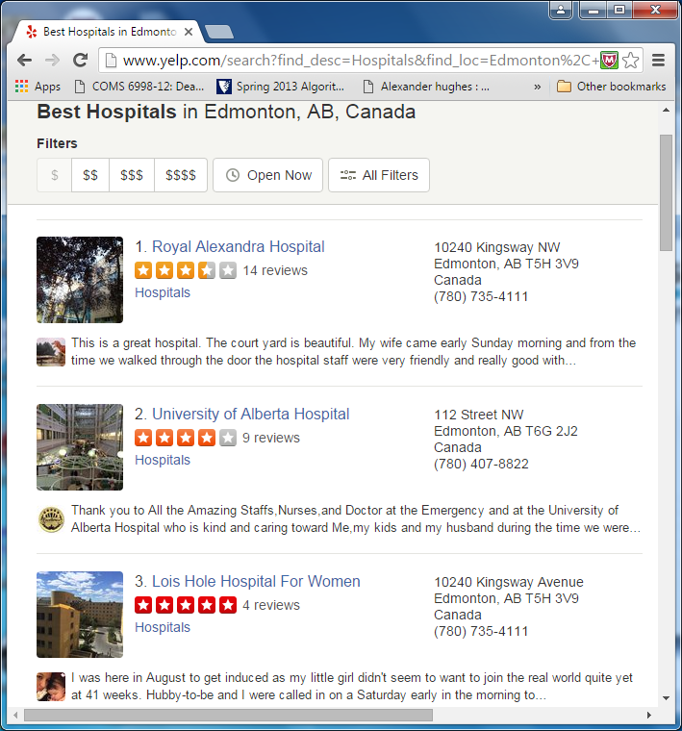
Alberta Hospital Reviews

Slide 10
Patient centred healthcare
For example,Yelp reviews shows customer ratings
Helps change customer choice behaviour thereby increasing revenue
Correlation between online commercial rating ( eg Yelp) and HCAHPS in US.
Eg higher Yelp scores correlated with lower mortality rates for myocardial infarction and pneumonia and lower readmission rates for multiple conditions (3)

Slide 11
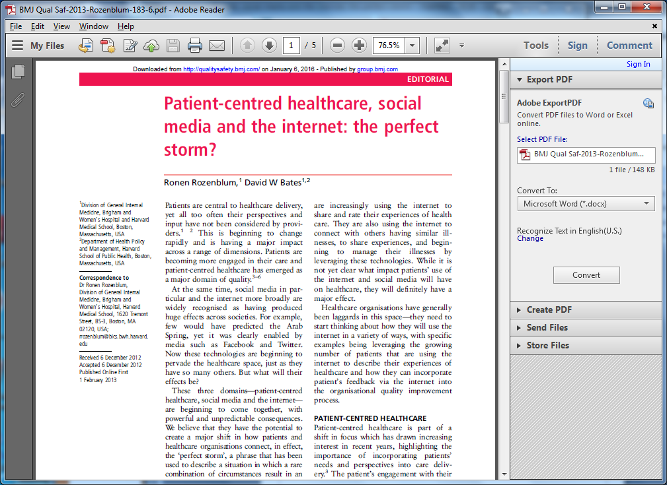
Patient centred healthcare

Slide 12
Sentiment analysis problems
“Online comments left without solicitation on a website are likely to have a natural selection bias towards examples of both good and bad care. It is likely that these online reviews are contributed more by those in particular demographic groups including younger and more affluent people [26]. Further, there are aspects of patients’ comments that are very hard for sentiment analysis to process. Irony, sarcasm, and humor, frequently adopted by English speakers when talking about their care, cannot be easily detected using this process” (4)
Notes:
Note: healthcare sentiment problems

Slide 13
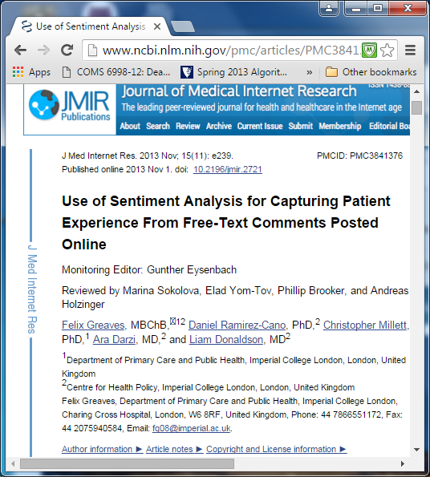
Healthcare Sentiment Analysis
Notes:
http://www.ncbi.nlm.nih.gov/pmc/articles/PMC3841376/

Slide 14
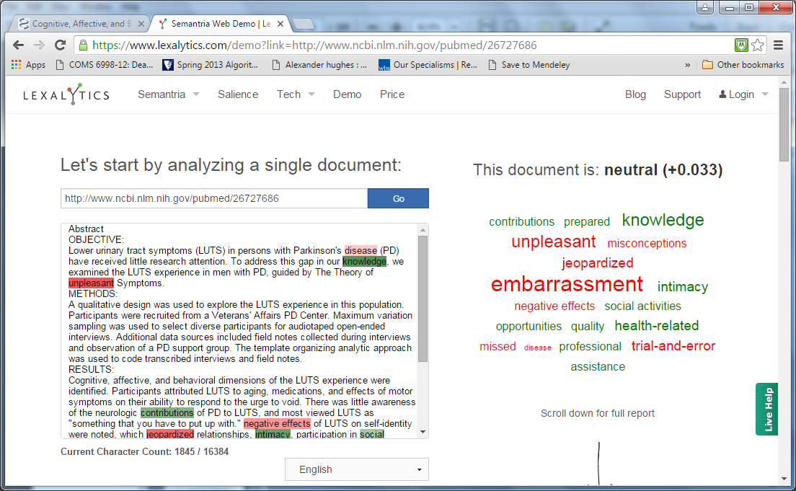
Document Analysis

Slide 15
References
Sentiment Analysis and Subjectivity, Bing Liu, Handbook of Natural Language Processing, 2nd ed, 2010
http://www.beckershospitalreview.com/quality/sentiment-analysis-an-emerging-trend-that-could-give-hospitals-an-edge-in-patient-experience.html

Slide 16
References
3. http://www.ncbi.nlm.nih.gov/ pmc/articles/PMC4074426/
4. http://www.ncbi.nlm.nih.gov/
pmc/articles/PMC3841376/
5. Mining twitter for consumer attitudes towards airlines, Jeffrey Breen : http://www.inside-r.org/howto/mining-twitter-airline-consumer-sentiment
6. Opinion Lexicon: https://www.cs.uic.edu/~liub/FBS/sentiment-analysis.html

Slide 17
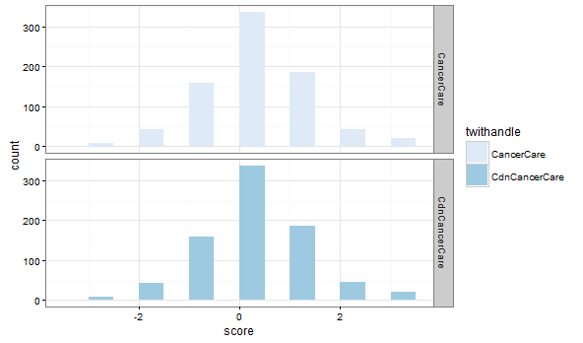
SA of Canadian and US Cancer Care

Slide 18
Install Packages
#install packages
install.packages(c("tm","twitteR","plyr","stringr","ggplot2"))
install.packages(c("httr","RColorBrewer","devtools","dplyr"))
#install package for twitter authentication purposes
library(devtools) #if not installed, do that obviously
devtools::install_version("httr", version="0.6.0", repos="http://cran.us.r-project.org")

Slide 19
Load Libraries
devtools::install_github("jrowen/twitteR", ref = "oauth_httr_1_0")
install_url("http://cran.r-project.org/src/contrib/Archive/sentiment/sentiment_0.2.tar.gz")
require(sentiment)
#load the library
libs<-c("tm","plyr","httr","twitteR","dplyr","stringr","ggplot2","RColorBrewer","sentiment")
lapply(libs,require,character.only=TRUE)

Slide 20
Twitter Authentication
#start the twitter authentication
api_key <- “XXXXXXXXXXXXXXXXXXXXXXXXXXXXXXXX"
api_secret <- “XXXXXXXXXXXXXXXXXXXX"
access_token <- “XXXXXXXXXXXXXXXXXXXXXXXXXXXXXX"
access_token_secret <- “XXXXXXXXXXXXXX"
setup_twitter_oauth(api_key,api_secret,access_token,access_token_secret)

Slide 21
Retrieving Tweets
# looking for the US Cancer care handle
cancercare.list <-twitteR::searchTwitter('CancerCare',n=1000)
# convert the list to data frame
cancercare.df <-twListToDF(cancercare.list)
#write to the file
write.csv(cancercare.df,file='C:/texts/senttext_conf/uscancercare.csv',row.names=FALSE)

Slide 22
Retrieving Cdn Tweets
#do the same with Canadian Cancer care
cdncancercare.list <-searchTwitter('CancerCare',n=1000)
cdncancercare.df <-twListToDF(cdncancercare.list)
write.csv(cdncancercare.df,file='C:/texts/senttext_conf/cdncancercare.csv',row.names=FALSE)

Slide 23
Sentiment Function
# function that scores the sentiments (reference 6)
score.sentiment=function(sentences,pos.words,neg.words,.progress='none')
{
scores=laply(sentences,function(sentence,pos.words,neg.words){
sentence=gsub('[[:punct:]]','',sentence)
sentence=gsub('[[:cntrl:]]','',sentence)
sentence=gsub('\\d+','',sentence)
sentence = gsub("(RT|via)((?:\\b\\W*@\\w+)+)", "", sentence)
# remove at people
sentence = gsub("@\\w+", "", sentence)
# remove punctuation
#sentence = gsub("[[:punct:]]", "", sentence)
# remove numbers
sentence = gsub("[[:digit:]]", "", sentence)

Slide 24
Function(Continued)
# remove html links
sentence = gsub("https://w+", "", sentence)
# remove unnecessary spaces
sentence = gsub("[ \t]{2,}", "", sentence)
sentence = gsub("^\\s+|\\s+$", "", sentence)
sentence=tolower(sentence)
word.list=str_split(sentence,'\\s+')
words=unlist(word.list)

Slide 25
Lexicon Words
#load the lexicon words (Ref. 6) categorizing the words with sentiments
hu.liu.pos=scan("C:/texts/senttext_conf/opinion-lexicon/positivewords.txt",what='character',comment.char=';')
hu.liu.neg=scan("C:/texts/senttext_conf/opinion-lexicon/negativewords.txt",what='character',comment.char=';')
#can add own words to the list
pos.words=c(hu.liu.pos,'upgrade')
neg.words=c(hu.liu.neg,'wtf','wait','waiting')

Slide 26
Read the Tweets
#read the tweets from the csv files
Datasetcancercare <-read.csv("C:/texts/senttext_conf/uscancercare.csv")
Datasetcancercare$text <-as.factor(Datasetcancercare$text)
Datasetcdncancercare <-read.csv("C:/texts/senttext_conf/cdncancercare.csv")
Datasetcdncancercare$text <-as.factor(Datasetcdncancercare$text)

Slide 27
Score the Tweets
#score the tweet texts for the Canadian and US
Datasetcancercare.scores=score.sentiment(Datasetcancercare$text,pos.words,neg.words,.progress='text')
path="C:/texts/senttext_conf/"
write.csv(Datasetcancercare.scores,file=paste(path,"Datasetuscancercarescores1.csv",sep=""),row.names=TRUE)
Datasetcdncancercare.scores=score.sentiment(Datasetcdncancercare$text,pos.words,neg.words,.progress='text')
write.csv(Datasetcdncancercare.scores,file=paste(path,"Datasetcdncancercarescores.csv",sep=""),row.names=TRUE)

Slide 28
Histogram of CDN and US Tweets
#draw the histogram of the scores for Canadian and US tweets
hist(Datasetcdncancercare.scores$score)
hist(Datasetcancercare.scores$score)

Slide 29
Histogram using ggplot
#use ggplot to draw the 2 histograms together
Datasetcdncancercare.scores$twithandle<-'CdnCancerCare'
Datasetcancercare.scores$twithandle<-'CancerCare'
#bind the 2 scores using rbind
cancer.scores = rbind( Datasetcdncancercare.scores, Datasetcancercare.scores )
g<-ggplot(cancer.scores, aes(x=score,fill=twithandle))+
geom_histogram(binwidth=0.5)+
facet_grid(twithandle ~ .) +
theme_bw() + scale_fill_brewer()
g

