Slide 2
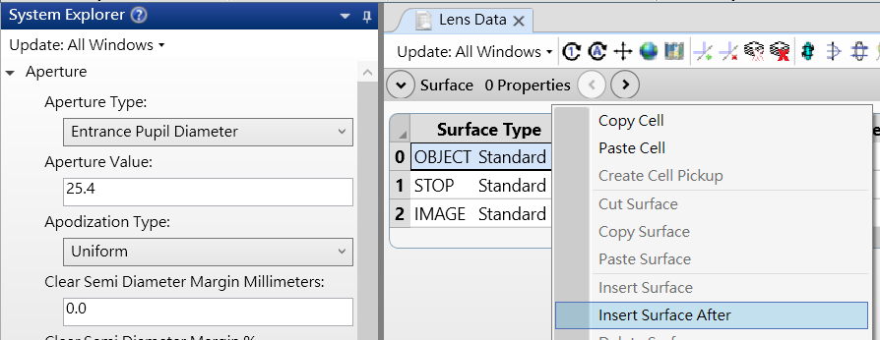
Import the doublet into zemax
Always add Dummy surface

Slide 3
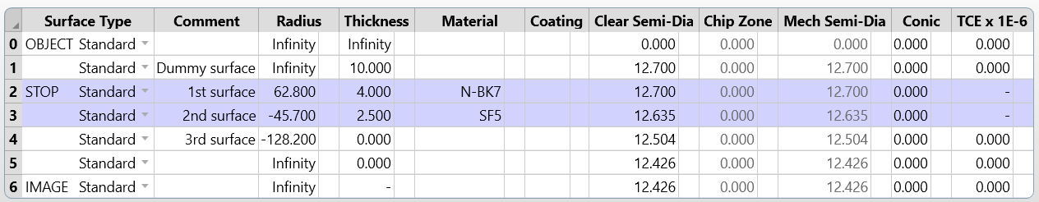


Fill the value
Effective focal length : $\frac{1}{f_{total}}=\frac{1}{f_{1}}+\frac{1}{f_{2}}$
Lens maker : $\frac{1}{f}=(n−1)(\frac{1}{R_{1}}−\frac{1}{R_{2}})$

Slide 4
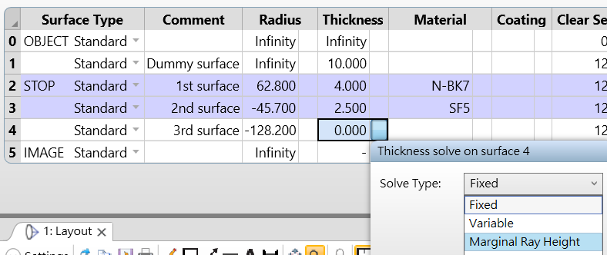
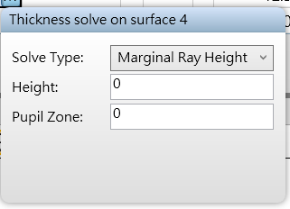
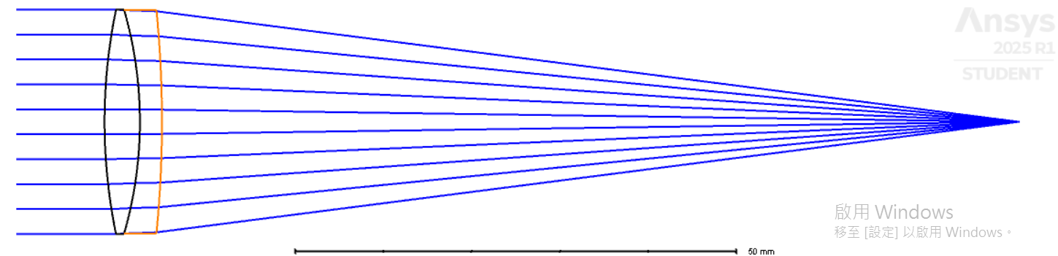

Slide 5
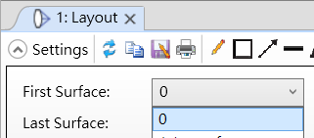
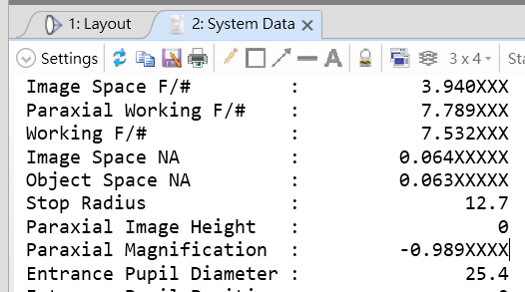
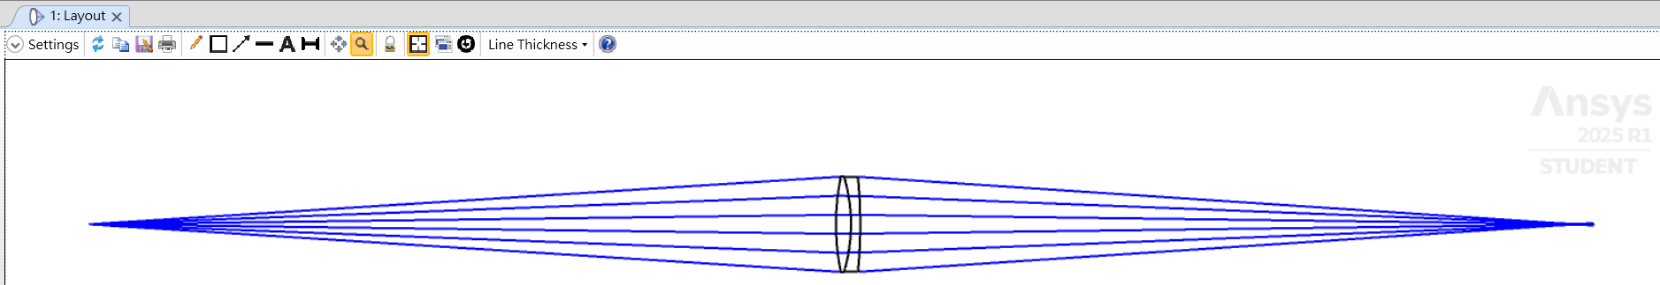
Get one negative one magnification
Cancel Dummy surface $→$ object surface_thickness: infinity$→$ twice focal lenght
Select object surface

