Slide 1
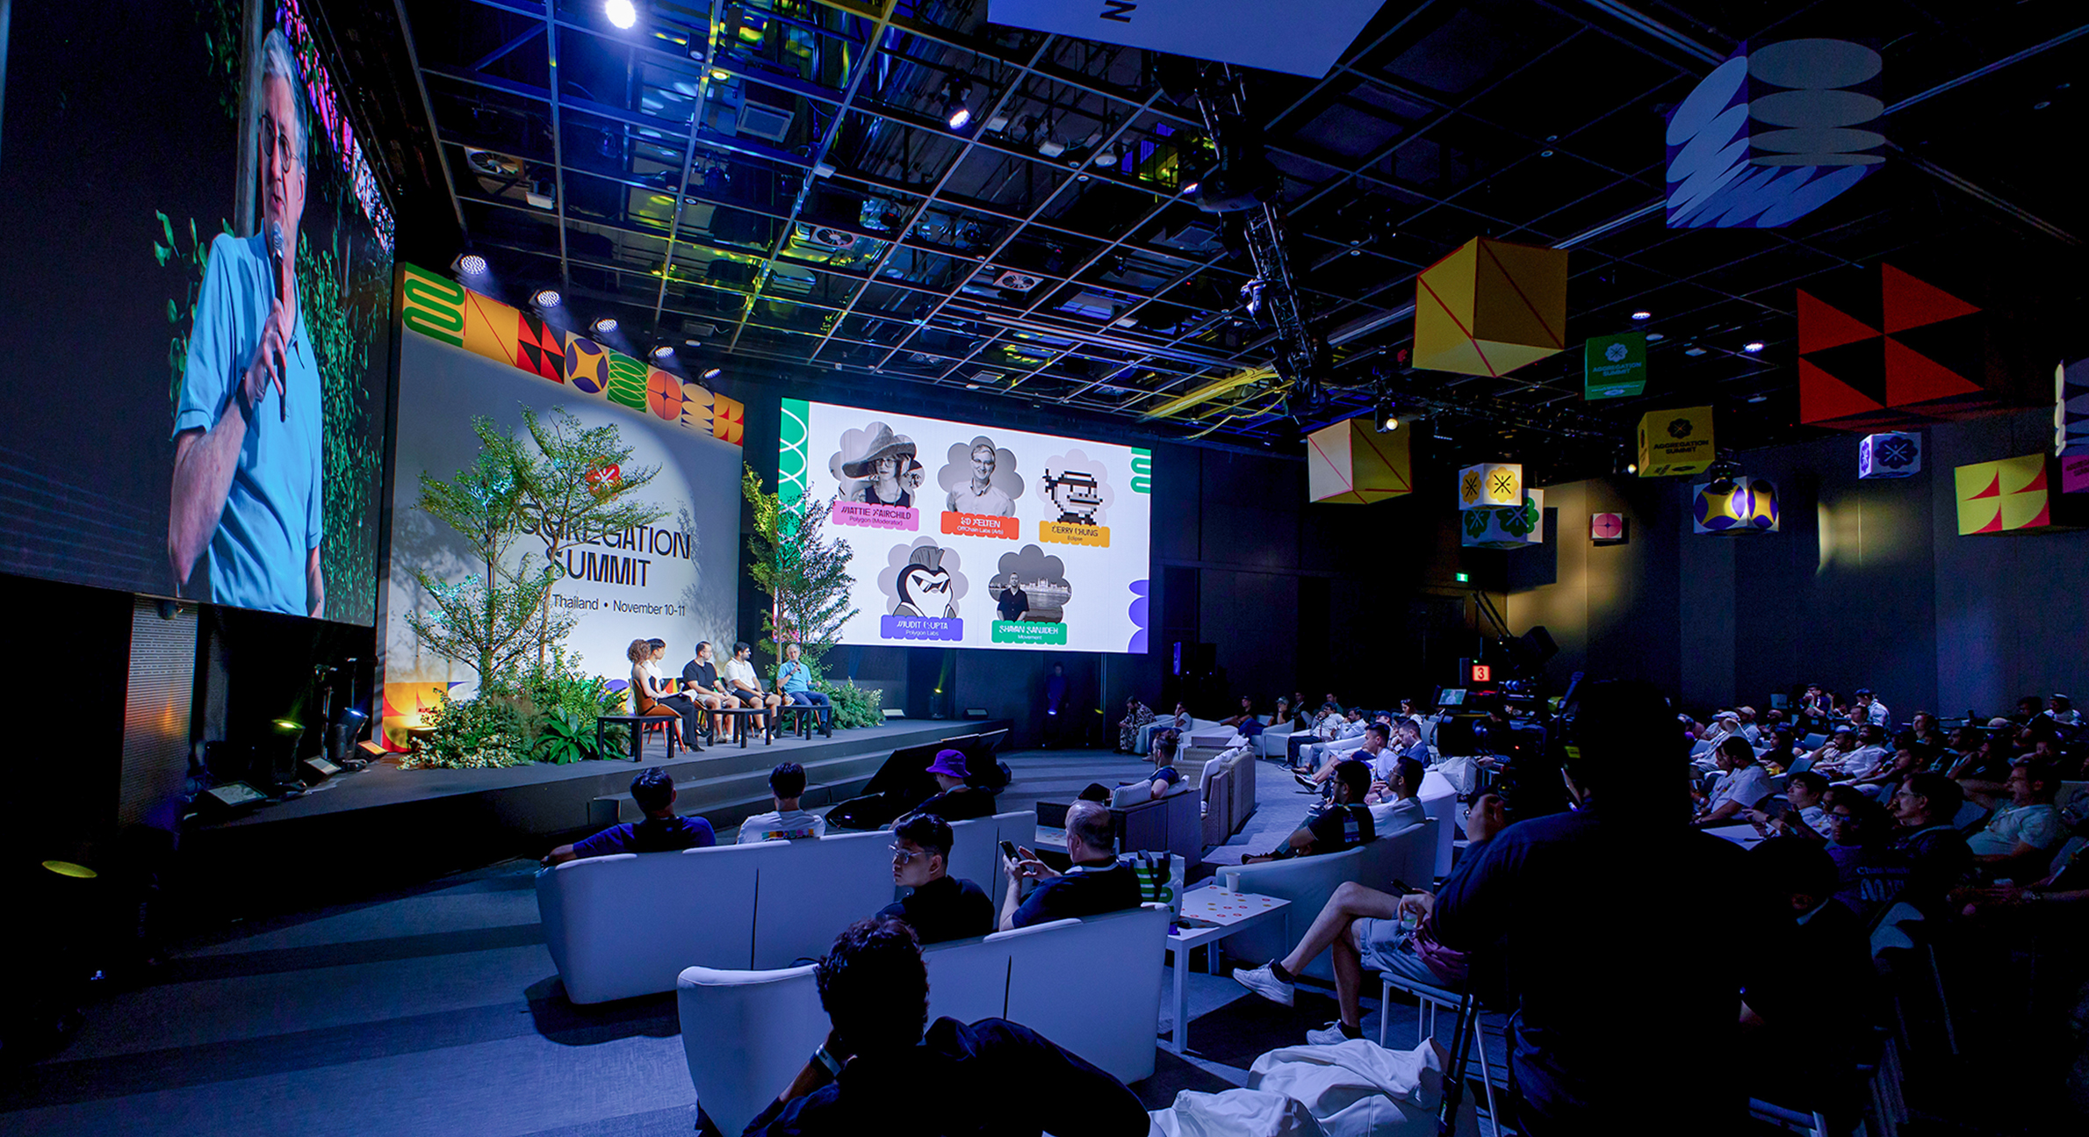
PROOF
WEB3 EVENT AGENCY · BY CHRIS & PARTNERS · SEOUL
Global Stages.
Proven Execution.
Portfolio · 2026

Slide 2
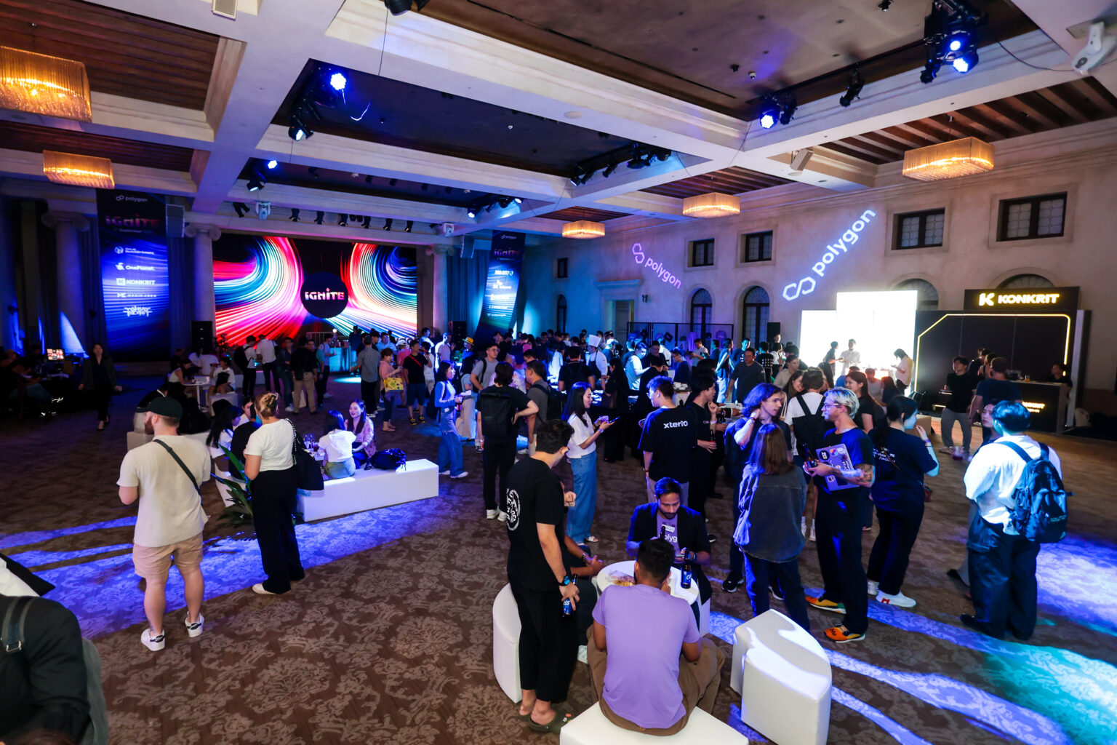
01 — WHO WE ARE
A Web3 event agency,
built by Chris & Partners.
★ OFFICIAL PARTNER · KOREA BLOCKCHAIN WEEK · SINCE 2023
PROOF is the Web3 event agency of Chris & Partners — a Seoul-based professional organizer with 15 years of international operations. Global projects hand us the brief; we deliver the event — side party, VIP reception, sponsor activation or full conference — from Seoul to Bangkok to Singapore. We know the venues, the vendors and the variables before you brief us.
150+
15yr
Global
Seoul
EVENTS ORGANIZED
PCO TRACK RECORD
EVENT OPERATIONS
HEADQUARTERS
PROOF · BY CHRIS & PARTNERS
02

Slide 3
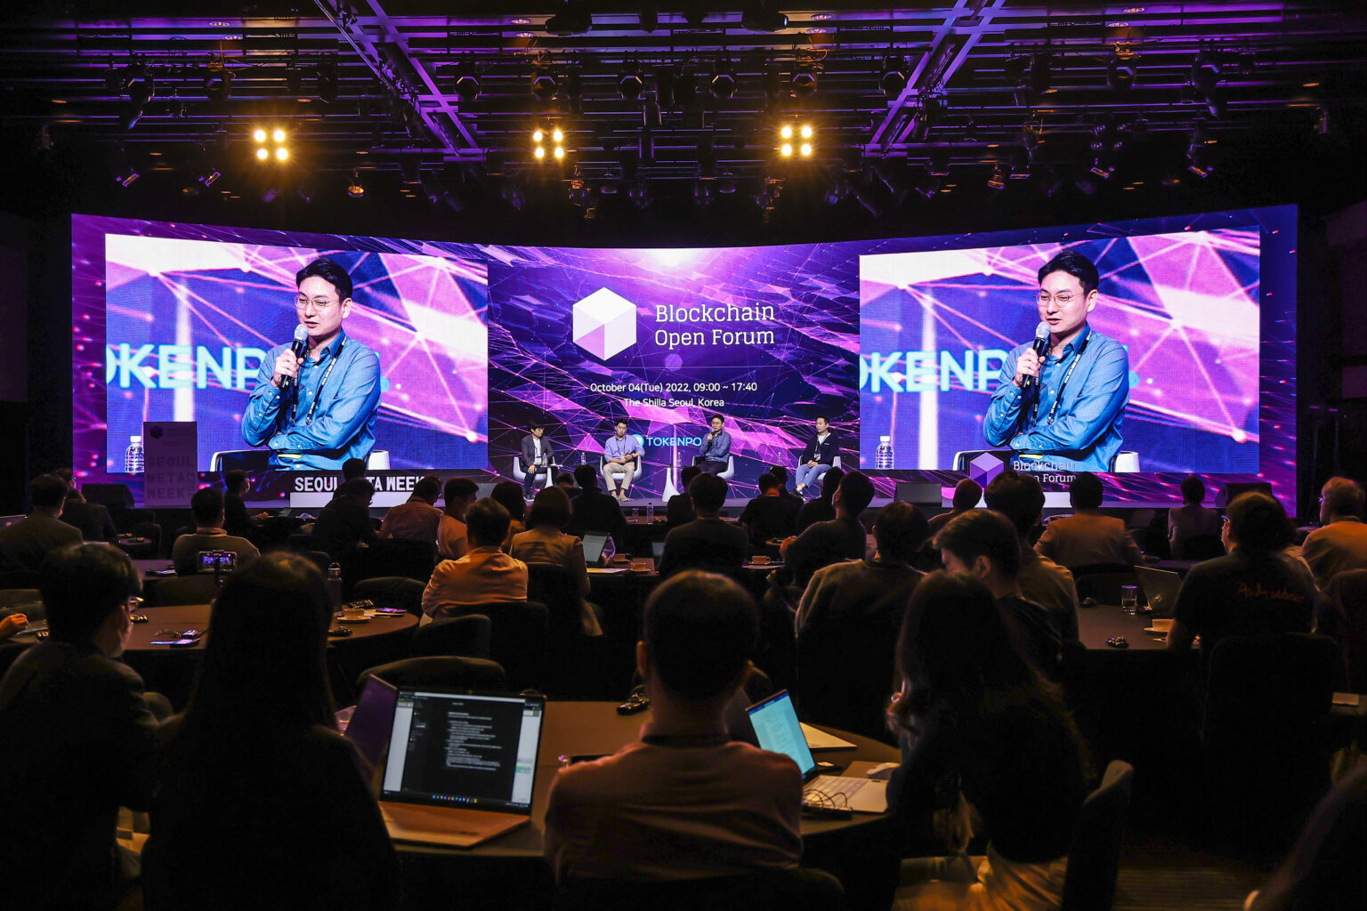
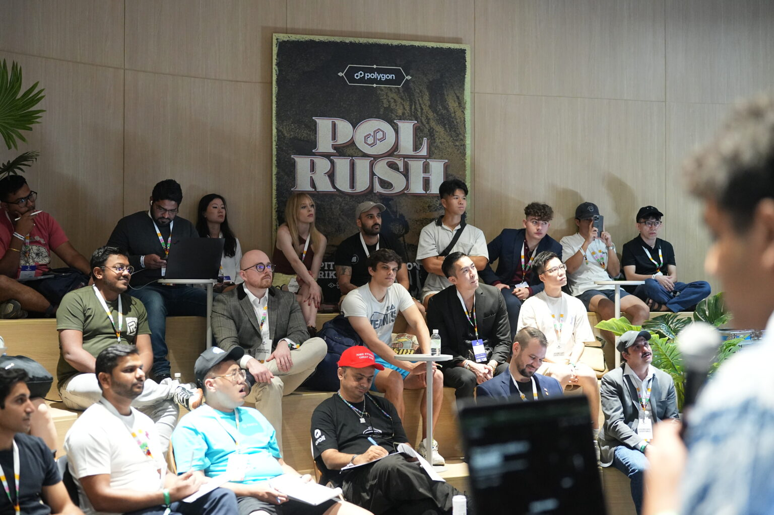
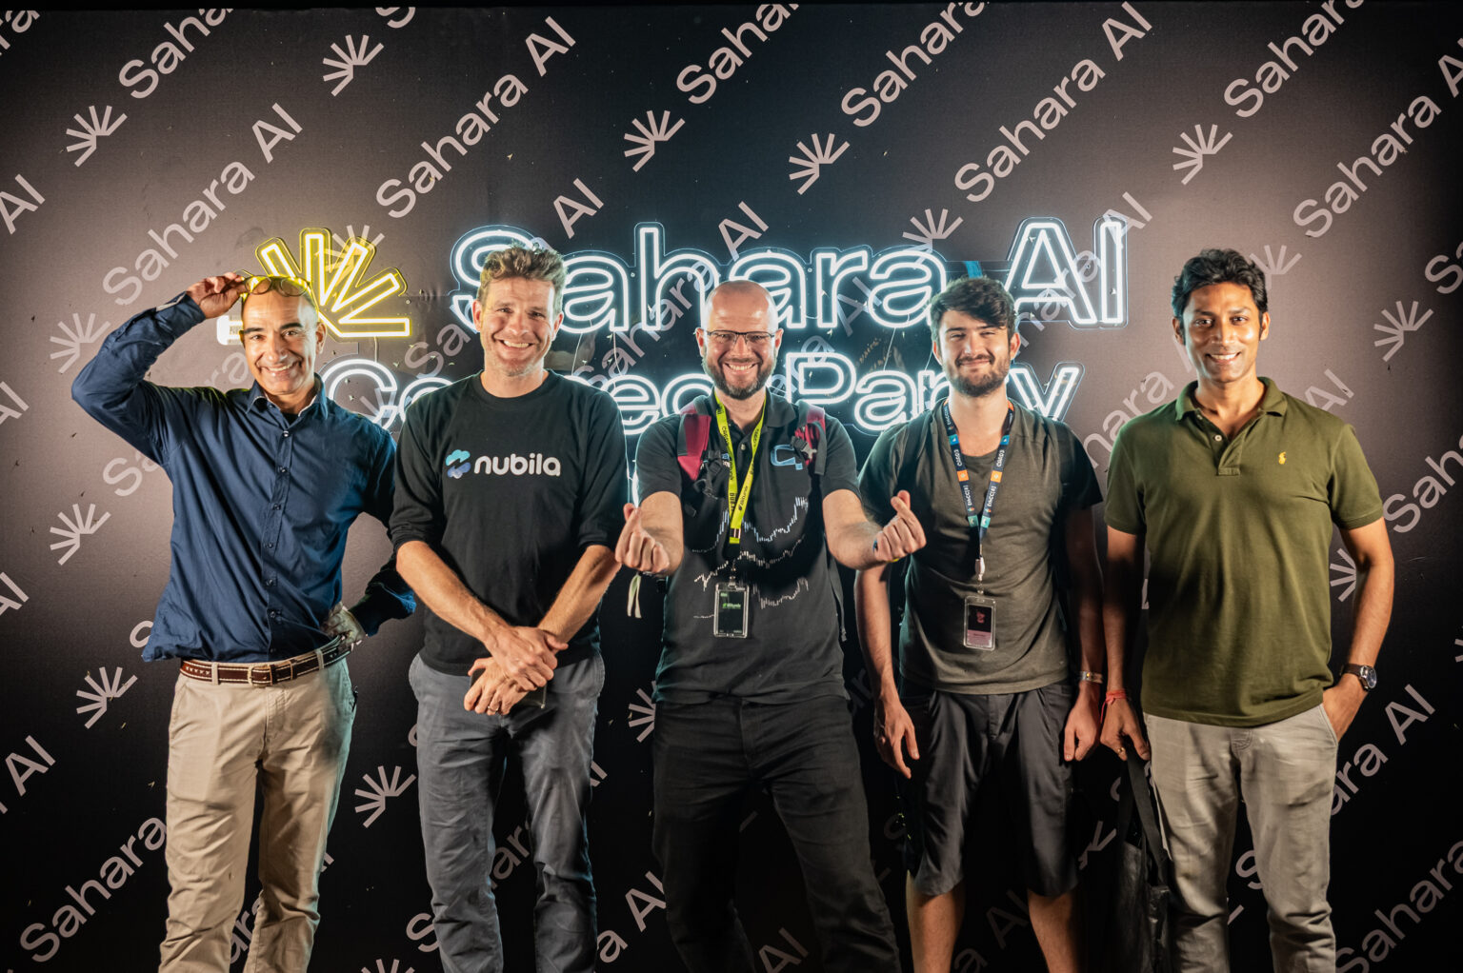
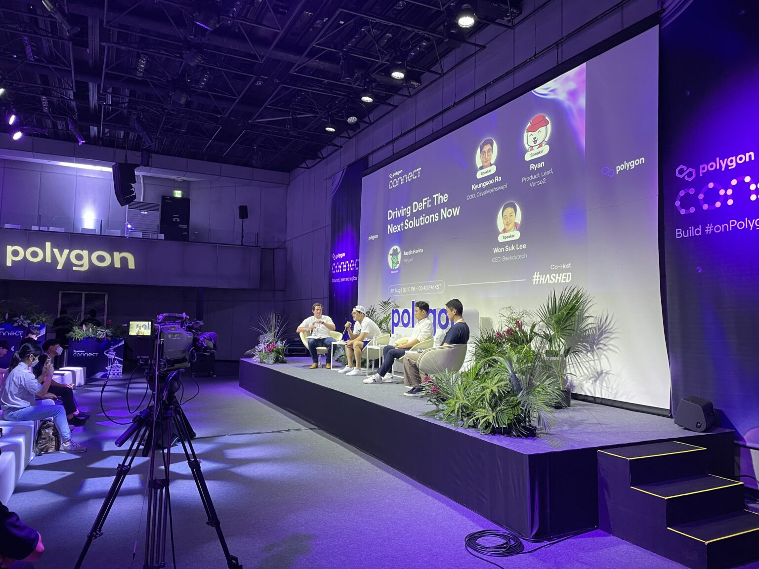
02 — WHAT WE DO
What we do.
01
02
03
04
Conferences & Summits
Side Events & Activations
Private Dinners & VIP
Korea Market Entry
Owned summits (Seoul Meta Week) and full conference production for clients (Polygon).
TOKEN2049, KBW, Polygon. Venue, branding, AV, on-site staffing.
Curated events for investor relations and strategic partnerships.
Full PCO for global Web3 projects entering the Korean market.
PROOF · BY CHRIS & PARTNERS
03

Slide 4
03 — WHY PROOF
Global teams land for the one week that matters — with no ground game.
Seoul, Singapore, Bangkok — the rooms book out, the vendors are spoken for, and the calendar doesn't move. PROOF is the operator that's already there: 150+ events across the region, the venues and suppliers on speed-dial, and the failure points mapped before you brief us.
Local ground ops
Client-first
End to end
Venues, vendors and crew secured in markets you don't operate in.
Your brief, your brand — from a VIP dinner to a full conference.
Brief to on-site — run-of-show, AV, staffing, the variables.
PROOF · BY CHRIS & PARTNERS
04

Slide 5
SELECTED WORK
14 events. Four in depth.
IN DEPTH
ALSO INSIDE
01
Sahara AI Connect Party 2025
Owned flagship
SIDE EVENT
Seoul Meta Week — 5 editions, 2021–2025
02
Aggregation Summit 2024
CONFERENCE PRODUCTION
More client work
IXO — Web3 Roadshow Series · Gensyn — ai(RL) Seoul · Polygon IGNITE · HYCONHACKS · Blockchain Partners Summit 2018
03
Polygon Connect Korea
KOREA MARKET ENTRY
04
BitGo VIP Networking Reception
INVESTOR DINNER
PROOF · BY CHRIS & PARTNERS
05

Slide 6
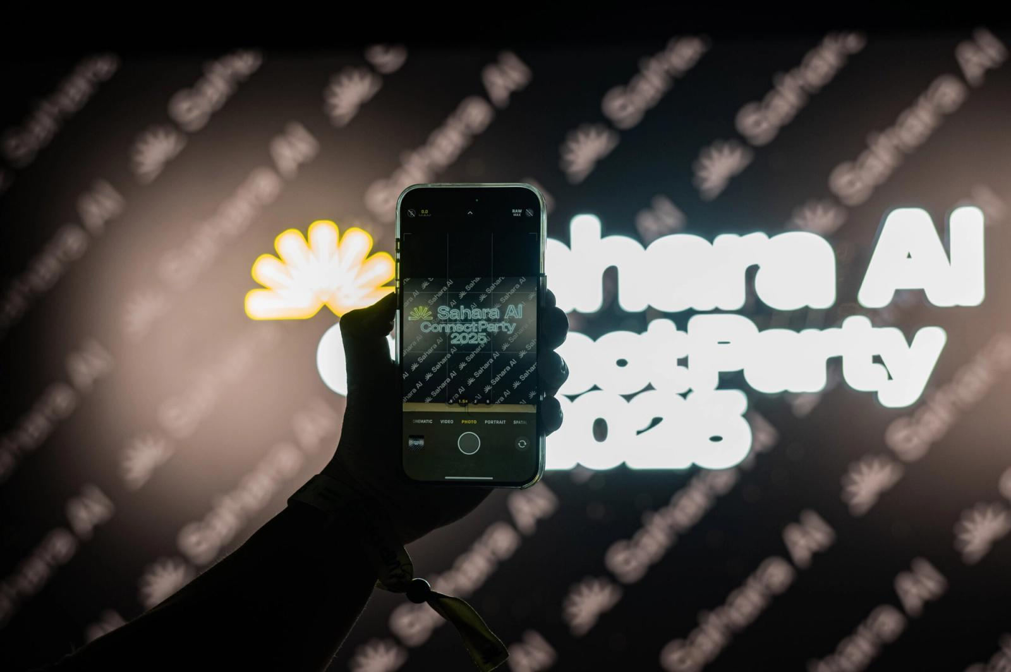
SIDE EVENT
Sahara AI Connect Party 2025
SAHARA AI · SEBIT ISLAND CONVENTION HALL, SEOUL
The opening-night party of Korea Blockchain Week 2025 for Sahara AI — a 1,000-guest global networking event on Seoul's Sebit Island, produced end to end by PROOF.
1,000
KBW 2025
Sep 2025
GUESTS
OPENING NIGHT
SEBIT ISLAND
SCOPE
Venue & production · Run-of-show & pacing · AV, staging & lighting · On-site staffing
CASE 01 / 04
“Three global partners told us it was the best event of the week. That doesn't happen by luck.”
06

Slide 7
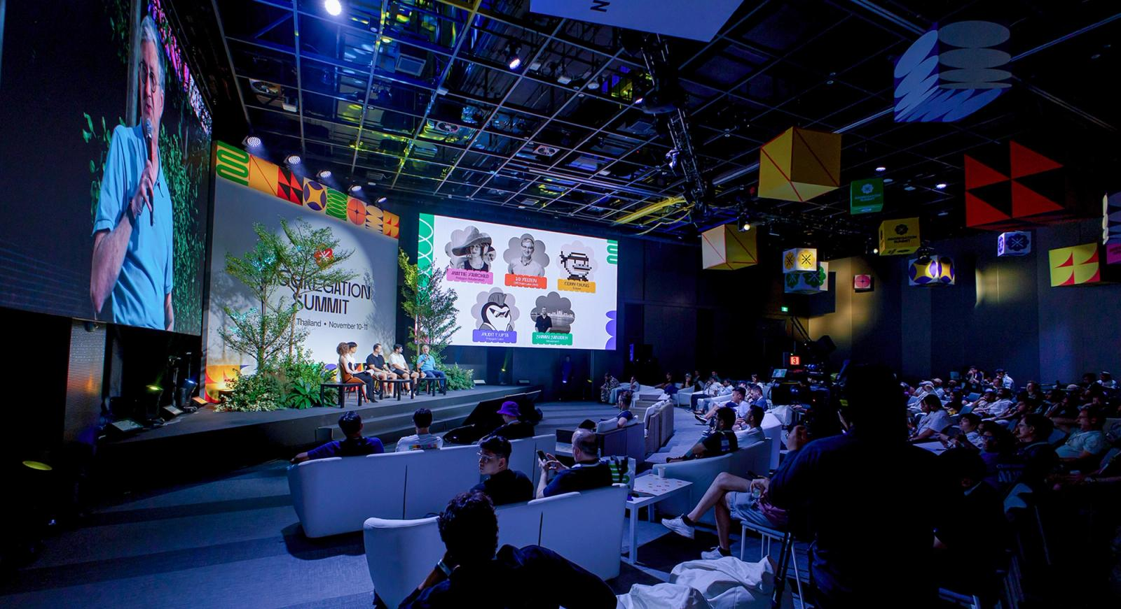
CONFERENCE PRODUCTION
Aggregation Summit 2024
TRUE DIGITAL PARK WEST, BANGKOK
A 1,000+ attendee flagship Web3 summit in Bangkok — PROOF ran it end to end as the APAC event agency, from planning to on-site, across 50+ concurrent programs.
1,000+
50+
2 days
ATTENDEES
PROGRAMS
BANGKOK
SCOPE
Full event production · Multi-track program ops · Sponsor & partner booths · Experience programming
CASE 02 / 04
07

Slide 8

KOREA MARKET ENTRY
Polygon Connect Korea
POLYGON / HASHED · TEXTILE CENTER EVENT HALL, SEOUL
Polygon's Korea market-entry event, co-hosted with Hashed — sessions, business networking and a hip after-party for ~500 on-site guests.
~500
Polygon × Hashed
Aug 2022
ON-SITE GUESTS
CO-HOSTED
SEOUL
SCOPE
Corporate event planning · Hybrid event operation · Venue build & atmosphere · Networking after-party
CASE 03 / 04
08

Slide 9
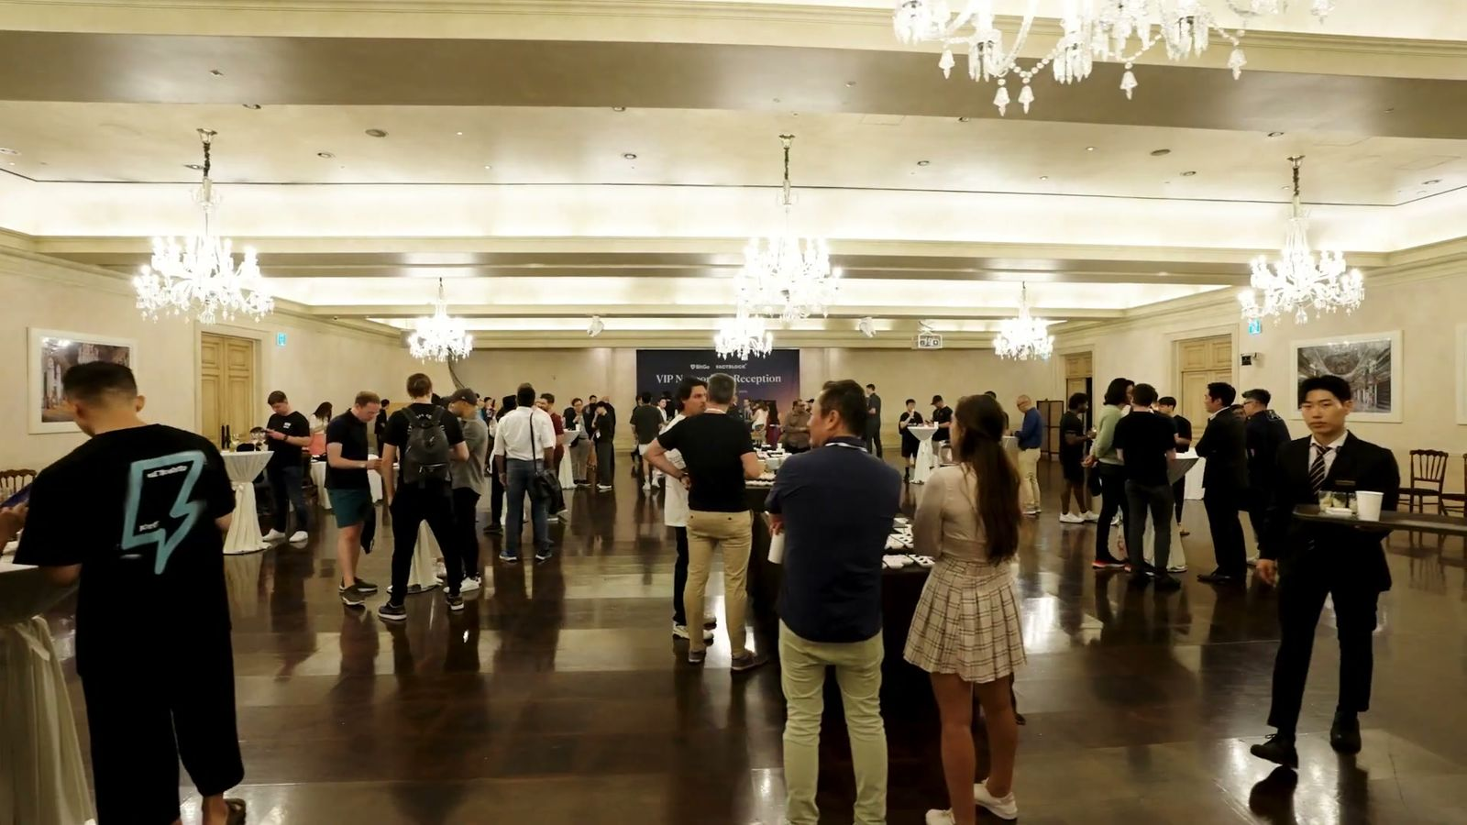
INVESTOR DINNER
BitGo VIP Networking Reception
BITGO / FACTBLOCK · RAUM, SEOUL
A private VIP reception hosted by digital-asset custody leader BitGo during Korea Blockchain Week 2023 — premium networking in Raum's chandelier ballroom, produced by PROOF.
KBW 2023
VIP
BitGo × FACTBLOCK
DURING
INVITE-ONLY
CO-HOSTED
SCOPE
Venue build & styling · Production & direction · Catering & hospitality · On-site operations
CASE 04 / 04
09

Slide 10
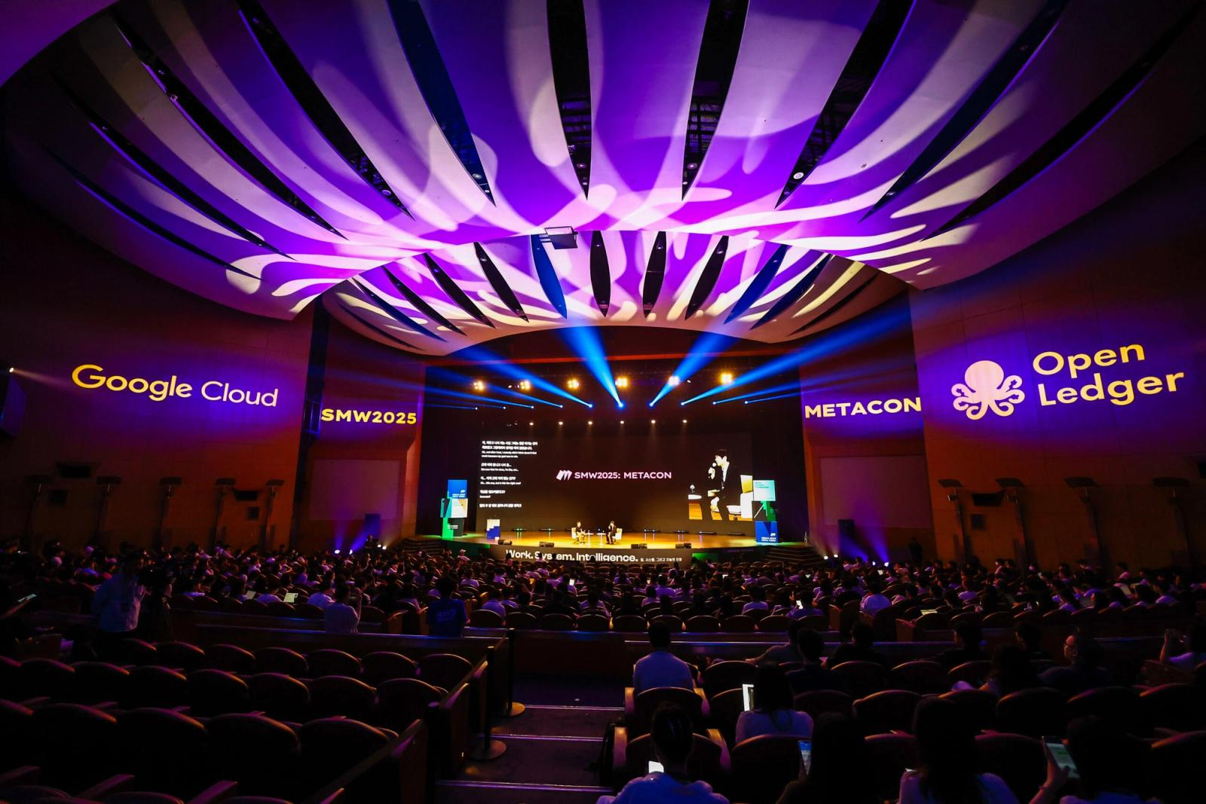
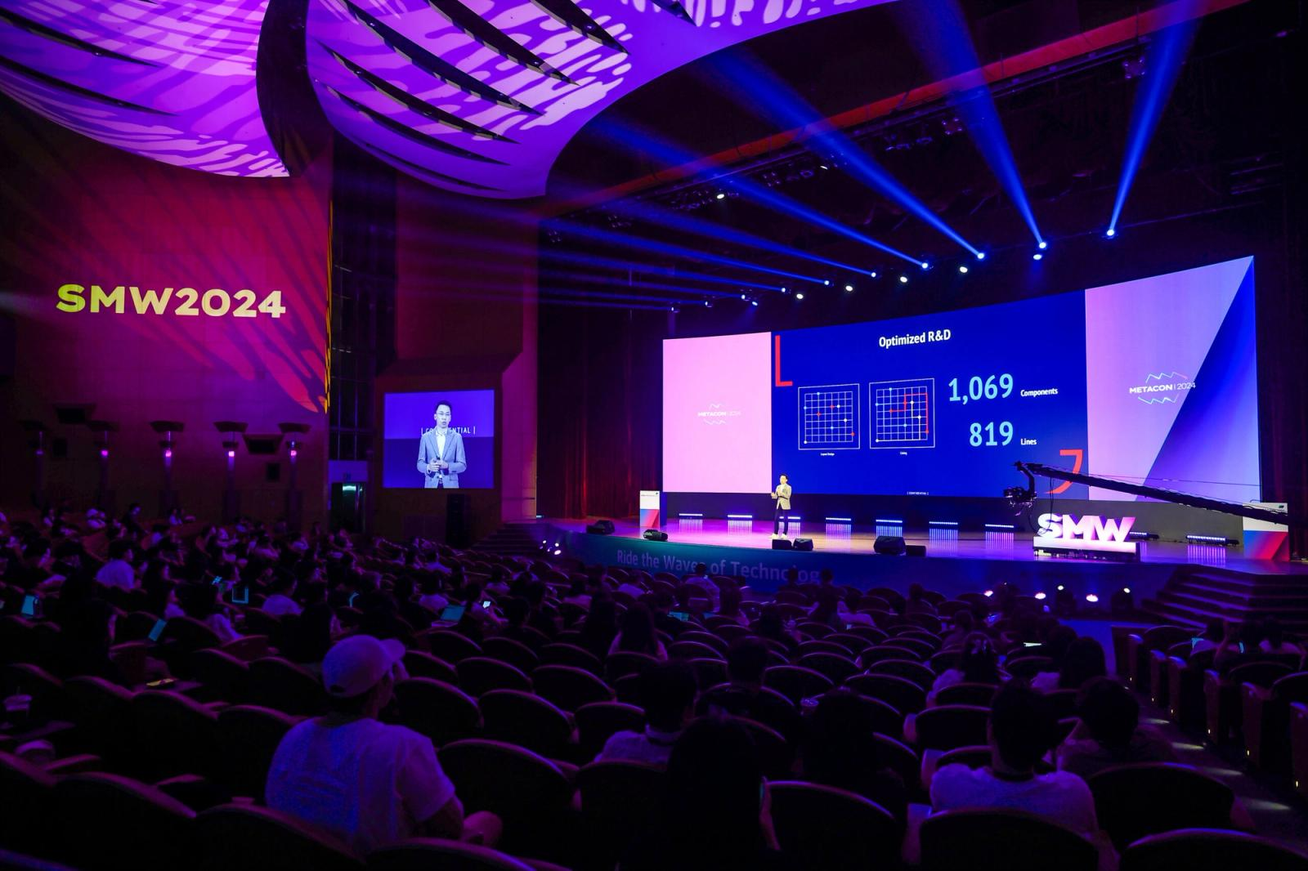
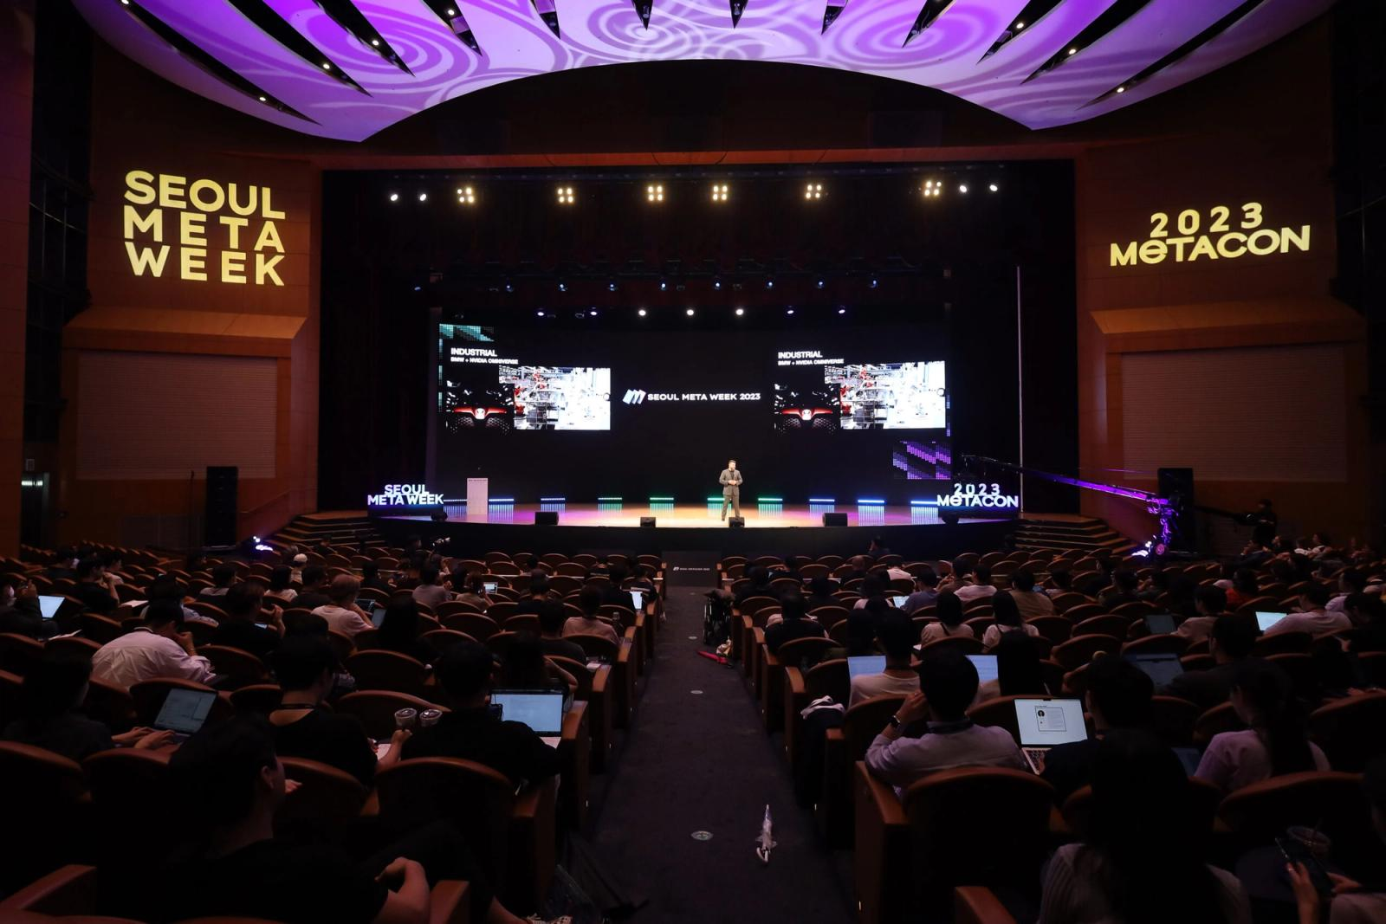
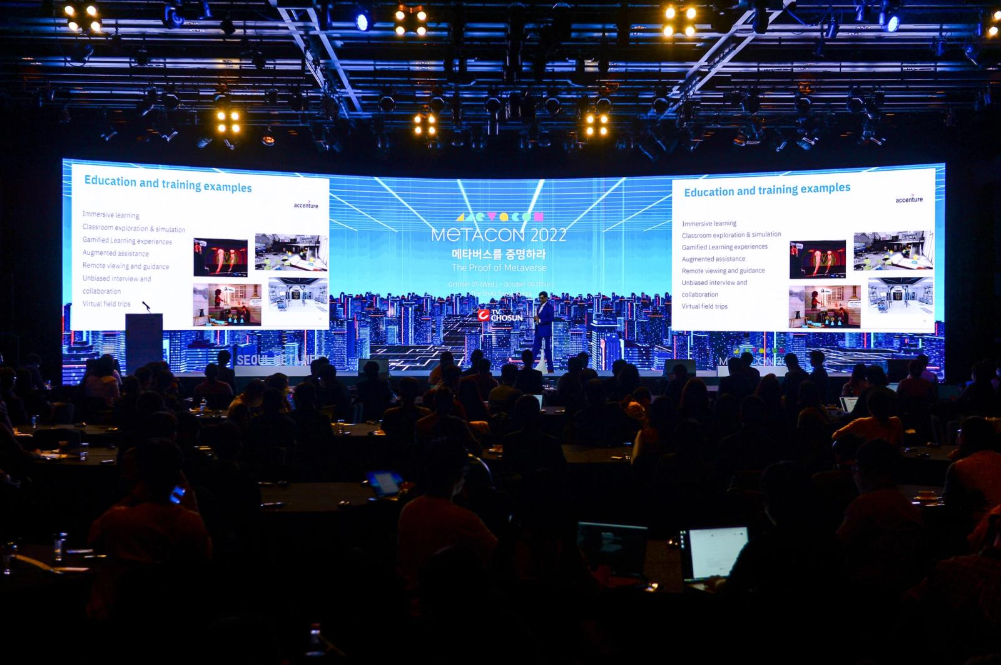
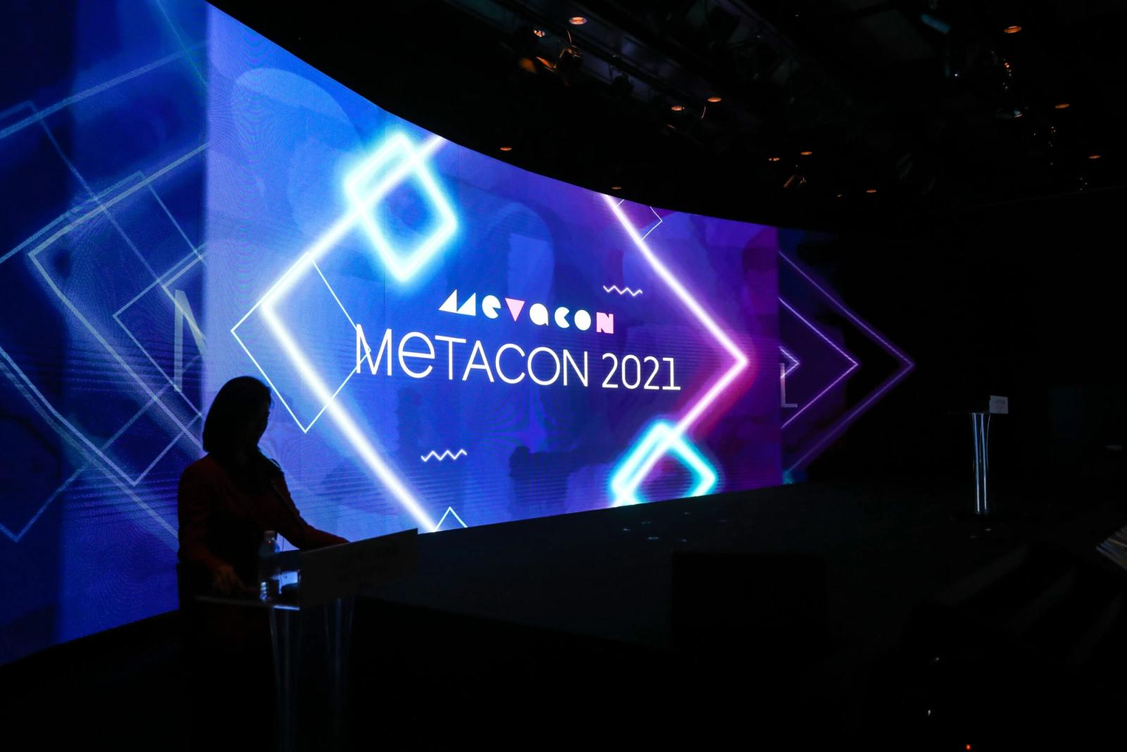
OUR OWN FLAGSHIP
We don't only run clients' events — we built our own.
Seoul Meta Week — 5 editions, 2021–2025. Proof we can produce and scale a 1,500-person summit end to end, not just a side event.
2025
2024
2023
2022
2021
1,500+
1,500+
1,500+
~1,000
12,000
ATTENDEES
ATTENDEES
ATTENDEES
ATTENDEES
VIEWS
PROOF · BY CHRIS & PARTNERS
10

Slide 11
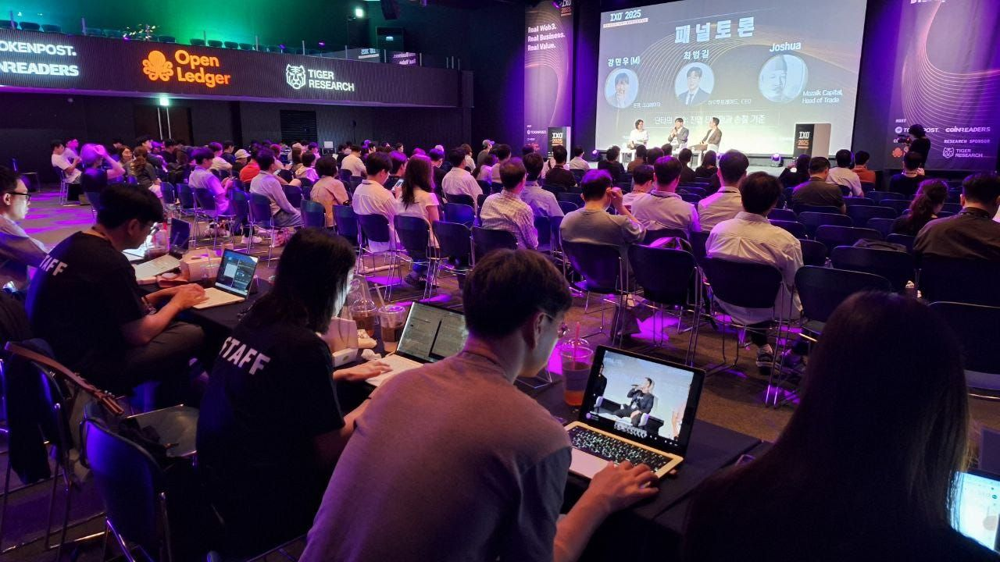
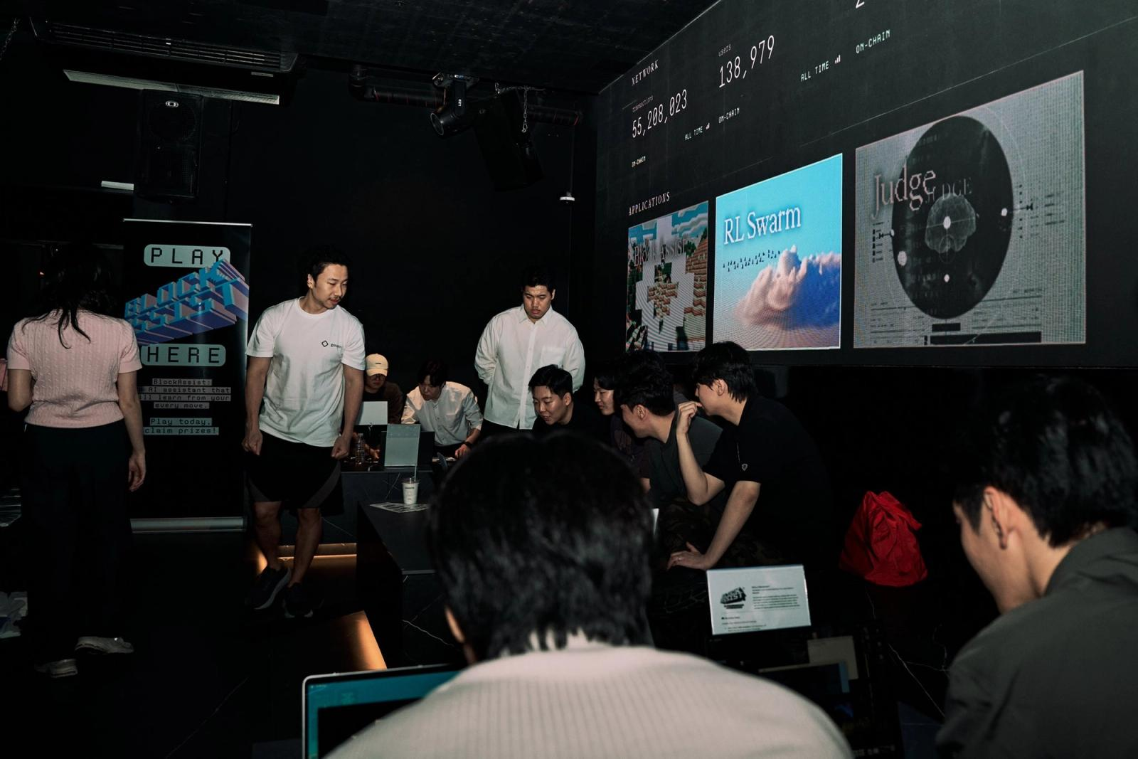
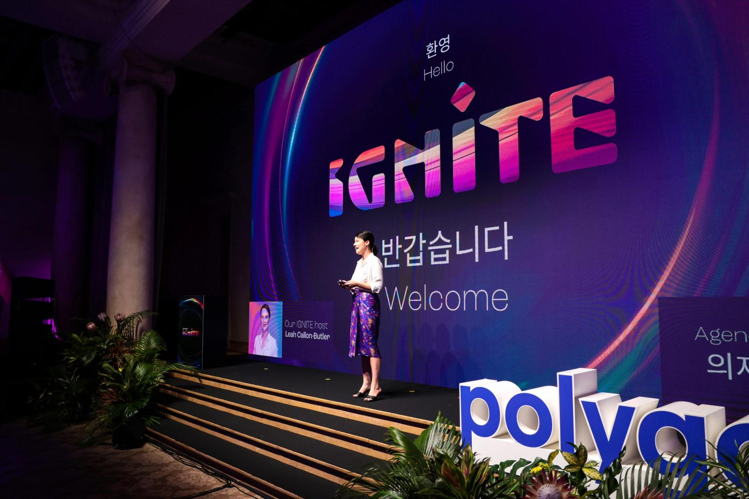
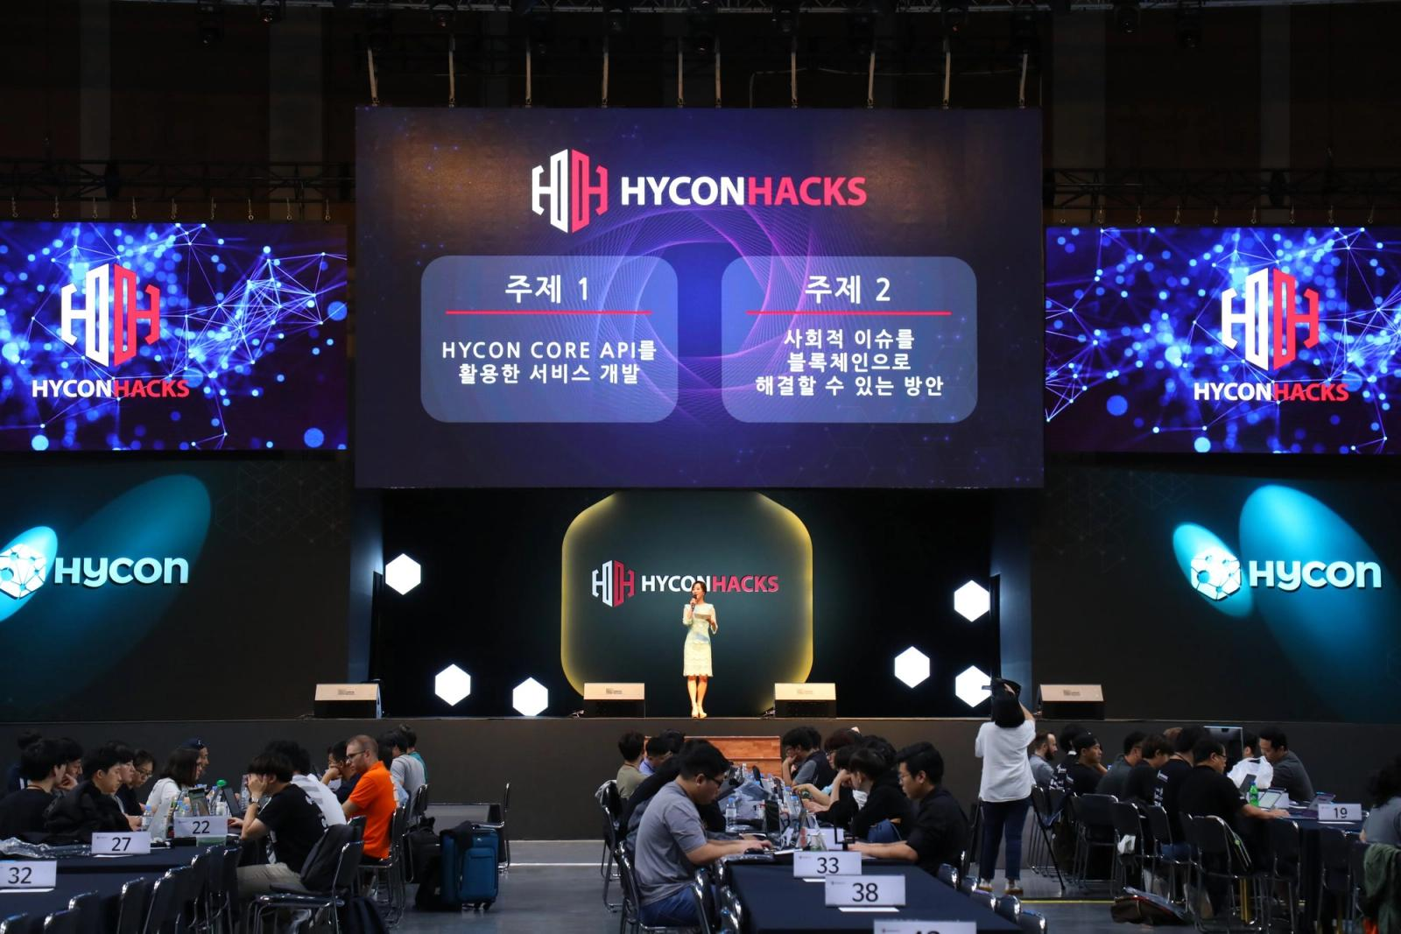
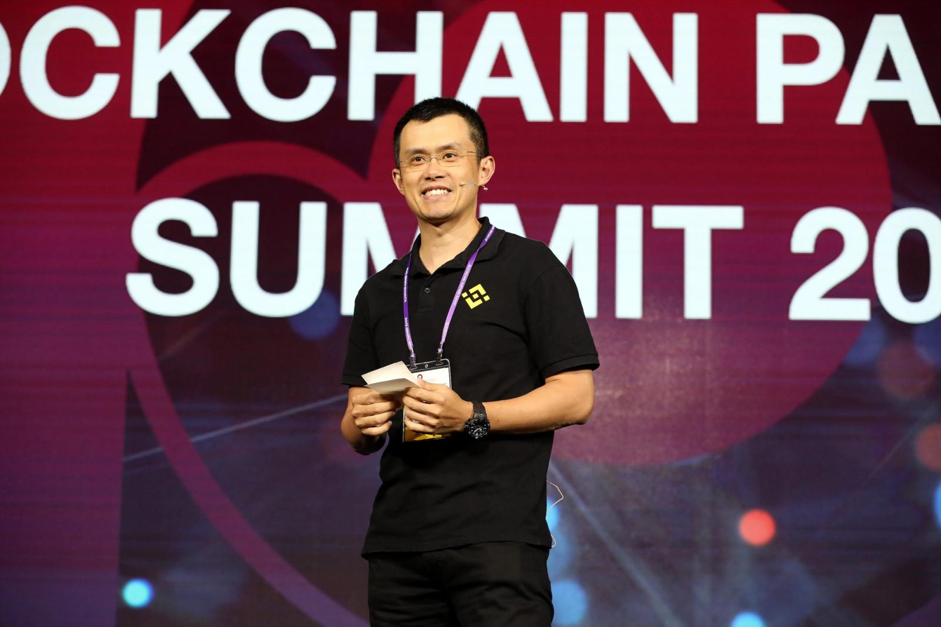
MORE CLIENT WORK
A deeper bench.
Selected from 150+ events — activations, mixers, hackathons and roadshows across the region.
IXO — Web3 Roadshow Series
Gensyn — ai(RL) Seoul
Polygon IGNITE
HYCONHACKS
Blockchain Partners Summit 2018
FULL PRODUCTION
SIDE EVENT
ACTIVATION
ACTIVATION
CONFERENCE PRODUCTION
5,000+ · Cumulative attendees
KBW 2025 · During
800+ · Guests
200+ · Hackers
2018 · Early-era summit
PROOF · BY CHRIS & PARTNERS
11

Slide 12
CLIENTS & PARTNERS
POLYGON
SAHARA AI
BITGO
GENSYN
HASHED
TV CHOSUN
HASHKEY
TOKENPOST
WEMIX
AEON PROTOCOL
SOLANA
GLOSFER
OFFICIAL PARTNER
Korea Blockchain Week — official partner since 2023.
ALSO OPERATING AT
TOKEN2049 ✳ Seoul Meta Week ✳ Aggregation Summit ✳ Polygon Connect ✳ Consensus Asia ✳ EthDenver ✳ DevCon
PROOF · BY CHRIS & PARTNERS
12

Slide 13
WORK WITH US
Four ways to start. Pick your moment.
Private Dinner & VIP Reception
Networking Night / Side Party
Flagship Activation
Conference / Summit Production
$10–25k
$25–50k
$50–100k
$100k+
30–120 GUESTS
150–350 GUESTS
300–800 GUESTS
1,000+ ATTENDEES
An intimate, invite-only evening that turns key relationships into deals.
A branded night everyone's talking about — the must-attend mixer of the week.
Your headline moment of the conference week — full production, programming, overseas-capable.
A multi-day, multi-track flagship — speakers, exhibition, the full machine.
Indicative ranges (USD) · scoped to your brief · à-la-carte add-ons (after-party · hybrid livestream · content & recap · VIP transport). Overseas markets quoted on request.
PROOF · BY CHRIS & PARTNERS
13

Slide 14
PROPOSAL · STARTING POINT
Private Dinner & VIP Reception
$10–25k
An intimate, invite-only evening that turns key relationships into deals.
Curated venue & styling
F&B & hospitality
Production & run-of-show
On-site team
30–120 guests · 3–5 weeks
PROOF — BitGo VIP Reception · KBW 2023
PROPOSAL 01 / 04
14

Slide 15
PROPOSAL · STARTING POINT
Networking Night / Side Party
$25–50k
A branded night everyone's talking about — the must-attend mixer of the week.
Venue & build-out
AV, staging & lighting
Entertainment / DJ
Branding & staffing
150–350 guests · 5–7 weeks
PROOF — Gensyn ai(RL) Seoul · Polygon IGNITE
PROPOSAL 02 / 04
15

Slide 16
PROPOSAL · STARTING POINT
Flagship Activation
$50–100k
Your headline moment of the conference week — full production, programming, overseas-capable.
Marquee venue & full production
Content & programming
Sponsor booth (optional)
Overseas execution & vendors
300–800 guests · 8–12 weeks
PROOF — Sahara Connect Party · TOKEN2049
PROPOSAL 03 / 04
16

Slide 17
PROPOSAL · 04 / 04
Conference / Summit Production
$100k+
A multi-day, multi-track flagship — speakers, exhibition, the full machine.
Multi-track program & speakers
Exhibition & sponsors
Stage, AV & broadcast
End-to-end operations
1,000+ attendees · 3–6 months
PROOF — Aggregation Summit · Seoul Meta Week
17

Slide 18
LET'S TALK
Take your project to the world stage.
hello@chrisandpartners.co
+82-2-375-4620
proof.chrisandpartners.co
PROOF — by Chris & Partners · 5F DSM Square, 45 Dokmak-ro 3-gil, Mapo-gu, Seoul, Republic of Korea

