Slide 1
Medicines
Go
PRESENTED BY WaterFly

Slide 2
Conceptual and
Logical Database Design
PRESENTED BY WaterFly

Slide 3
Part 1 Entity Relationship Diagram
Part 2 Logical Database Design
Content
Part 3 The Identiﬁcation of Data Sources
Part 4 Privacy and Security Risk Management

Slide 4
1
Entity Relationship Diagram (using Dia)

Slide 5
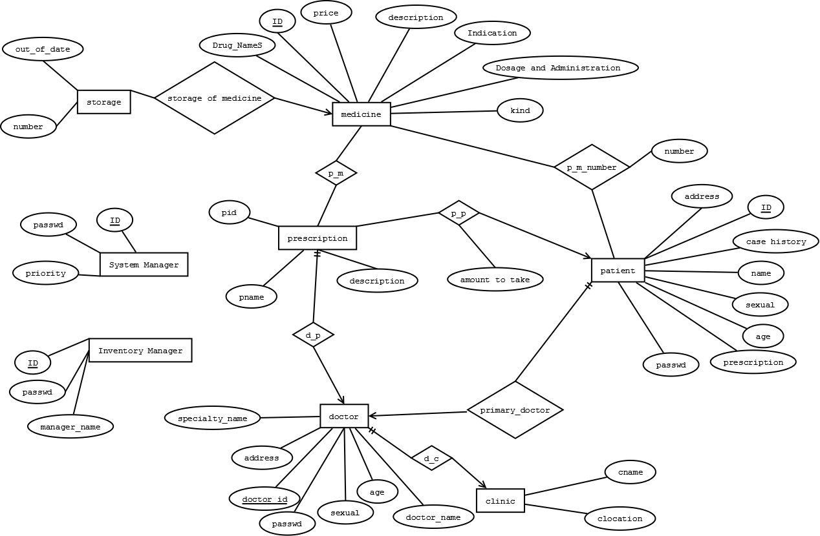
Project General Design

Slide 6
Entity Relationship
entity "medicine" has many kind of information
medicine storage information stores in "storage" entity
patient account medicine amount info show in "p_m_number" relationship
patient take prescription info show in "p_p" relationship
each patient has a primary doctor, show in

Slide 7
Entity Relationship
"primary_doctor" relationship
each doctor have one clinic and one specialty
each "prescription" entity has a relationship among doctor show in "d_p"
we also assume that each prescription can only create for a patient

Slide 8
2
Logical Database Design

Slide 9
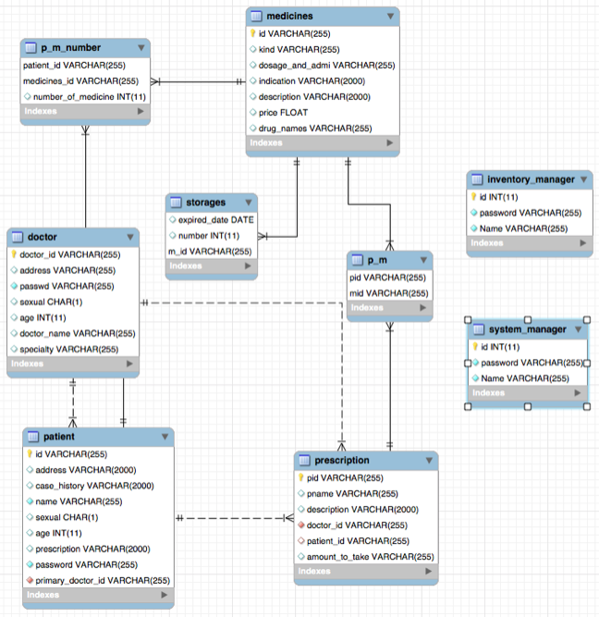
Logical Database Design

Slide 10
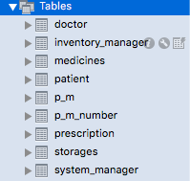
Logical Database Design
Database Schema

Slide 11
3
The Identification of
Data Sources

Slide 12
Resources to obtain data
Hospital
pharmacy
CPI((China pharmaceutical Information))
Drugs.com(http://www.drugs.com)

Slide 13
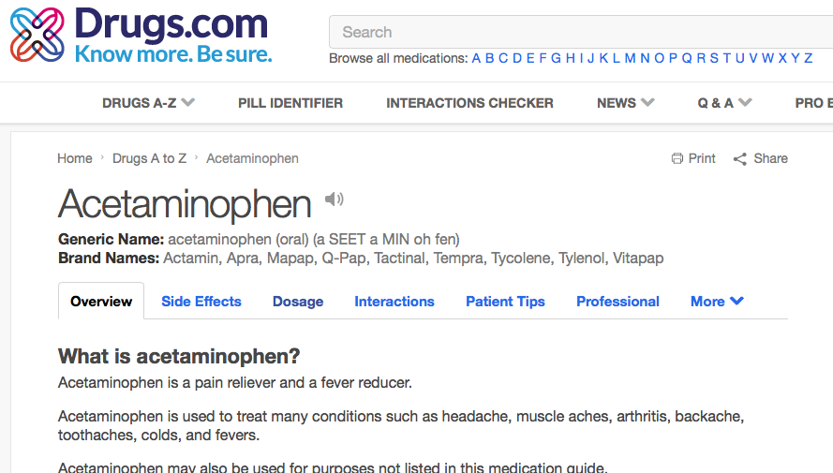
Websites provide rich information we need.
We may use web crawler to obtain them and store them in our database

Slide 14
4
Privacy and Security Risk Management

Slide 15
Privacy and Security Risk
1
main Risks
There is a risk of obtaining information about the database by persons who are not employee of the medical institution.

Slide 16
Reminder for patients
2
solution
create an account for each employee, and each of them will have their own access rights to the system, depending on the requirement and status.

Slide 17
THANK YOU FOR WATCHING
PRESENTED BY WaterFly

