Slide 1
Database Migration from
SQL Server to MariaDB
小蘇
COSCUP 2017/08/05
Open Source Databases Track

Slide 2
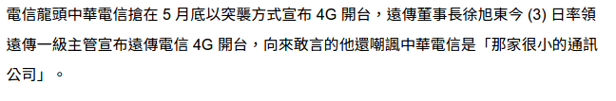
我
一個小公司的偽 DBA
  https://www.nownews.com/news/20140603/1262223
sujunmin@gmail.com
https://github.com/sujunmin
https://sujunmin.github.io/blog/

Slide 3
Agenda
References
Why
環境
資料庫 ACL 與帳號管理
SQL Server Agent 與 MariaDB Event
Audit Plugin 與 Audit Log Parser
Linked Server 與 FederatedX Storage Engine
程式修改

Slide 4
References
https://sujunmin.github.io/blog/tags/MariaDB/
2017 iT 邦幫忙鐵人賽
  http://ithelp.ithome.com.tw/users/20103536/ironman/1085
此投影片網址
  https://goo.gl/6ikuTS

Slide 5
Why
基本上是免費使用
有 Long-Term Support (5 年)
完善的開源社群 (這個真的幫助很大，筆者碰到的問題不管是不是 bug 都能快速且妥善的解決)
資料結構問題 (原來儲存的資料都是簡單的 Log 資料，用不到 SQL Server / Oracle DB 那些強大的功能)
想要擺脫 SQL Server / Oracle DB 權利金的問題
如果需要買 Maintenance Agreement 也是可以買 (如果有經費的話)
大型專案的 Support (Google, Wikimedia Foundation, Taobao...)
專案 AP 開發商的建議
輕量化資料庫服務 (SQL Server / Oracle DB 已是資料庫產品的總稱，不只有資料庫引擎本體)
Cost Down

Slide 6
環境
DB Server
  OS
    Windows 2012 R2
    Cluster Services
  Server Version
    10.1.18
    10.1.25 (Some Replication Slave)

Slide 7
環境
Clients
  MySQL Connector 1.0
    ColdFusion Framework
  MariaDB Connector/ODBC 2.0.11
    Classic ASP
    Delphi
  MariaDB Connector/J 2.0.0
    Tomcat/JSP

Slide 8
資料庫 ACL 與帳號管理
SQL Server
  sujunmin
  domain/sujunmin
MariaDB
  sujunmin@10.10.10.1, sujunmin@10.10.10.2, …
  sujunmin@%
  ...
  同一個帳號會因為host不同而要設定多組密碼

Slide 9
資料庫 ACL 與帳號管理
SQL Server – Logon Trigger + ACL Table
MariaDB – init_connect + ACL Table
  有 SUPER 權限的人無法使用此方法管理
    If a statement has been specified for the init-connect mysqld option, that command will not be executed when a user with SUPER privileges connects to the server.

Slide 10
資料庫 ACL 與帳號管理
ACL Table
  loginmain紀錄帳號，可登入 IP 等資訊
  logindate紀錄可登入時間
init_connect
  init_connect="CALL master.check_login();"
  master.check_login()
    Find Account and IP in loginmain
      SIGNAL SQLSTATE '45000' SET MYSQL_ERRNO=30001, MESSAGE_TEXT='無法在資料庫中找到您的登入帳號、來源IP、或是使用之程式不正確。';
    Find DateTime in logindate
      SIGNAL SQLSTATE '45000' SET MYSQL_ERRNO=30002, MESSAGE_TEXT='您的帳號無法在此時段登入。';

Slide 11
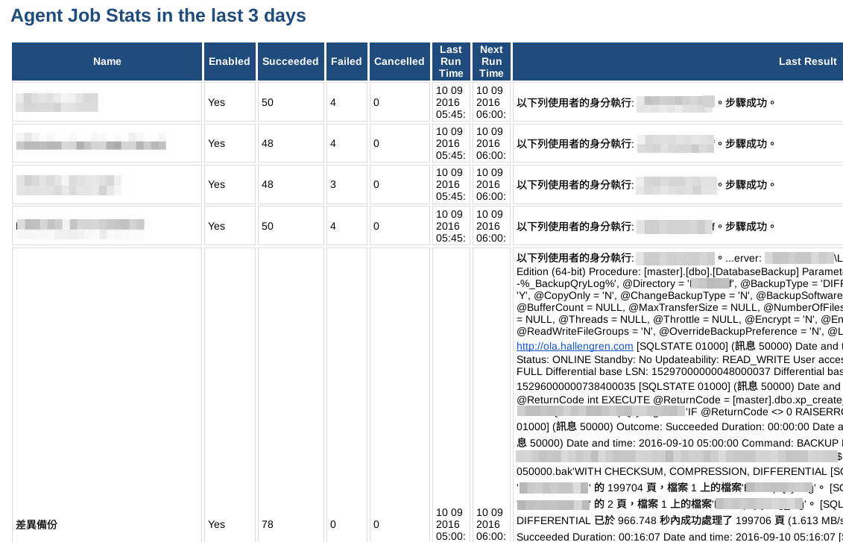
SQL Server Agent 與 MariaDB Event
SQL Server Agent

Slide 12
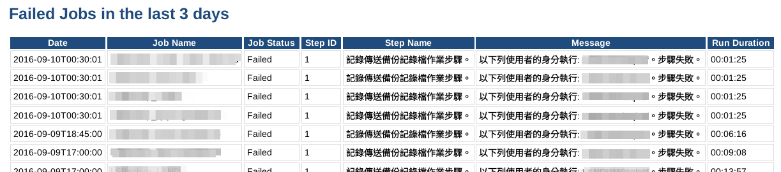
SQL Server Agent 與 MariaDB Event
SQL Server Agent

Slide 13
SQL Server Agent 與 MariaDB Event
MariaDB
  Windows Tasks
    SQL Server 管理方式：資料庫的作業還是在資料庫系統裡完成
    少少的 Log 可以用
  MariaDB Event
    幾乎是射後不理
    不能單靠 Event 來達成需求

Slide 14
SQL Server Agent 與 MariaDB Event
event_history
  紀錄 Event 狀態的詳細執行內容
    mysql.event.db
    mysql.event.name
    開始時間
    結束時間
    Sqlstate
    錯誤代碼
    回傳訊息
    紀錄時間

Slide 15
SQL Server Agent 與 MariaDB Event
proc_for_event_history
  透過此 procedure 執行 event，紀錄相關過程
    HANDLER
      DECLARE EXIT HANDLER FOR SQLEXCEPTION
      BEGIN
      GET DIAGNOSTICS CONDITION 1 @sqlstate = RETURNED_SQLSTATE, @errno = MYSQL_ERRNO, @text = MESSAGE_TEXT;
      select now() into @start from dual;
      insert into master.event_history (db, name, start, end, sqlstate, errno, message_text) values (idb, iname, @start, now(), @sqlstate, @errno, @text);
      END;
    Prepare Statements
      set @sql := sql;
      prepare stmt from @sql;
      select now() into @start from dual;
      set @outs := '';
      execute stmt;
      ...

Slide 16
SQL Server Agent 與 MariaDB Event
To-Do
  Query 正確時的回傳要能抓到
  該次真正開始執行時間
  下一次開始執行時間

Slide 17
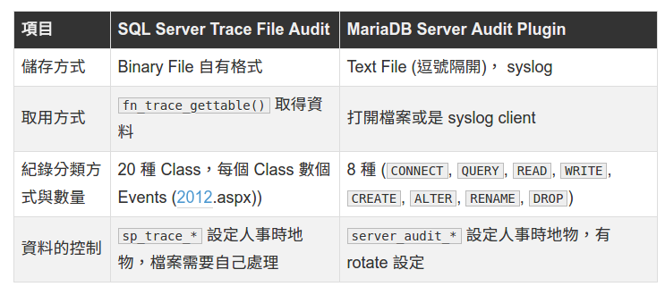
Audit Plugin 與 Audit Log Parser
server_audit.dll
Powershell + Parsing Logs + Archived

Slide 18
Audit Plugin 與 Audit Log Parser
server_audit.dll
  CONNECT, QUERY, READ, WRITE, CREATE, ALTER, RENAME, DROP
  QUERY 包含 DDL, DML, DCL
  必須分開以利後面 Parsing
  修改 server_audit

Slide 19
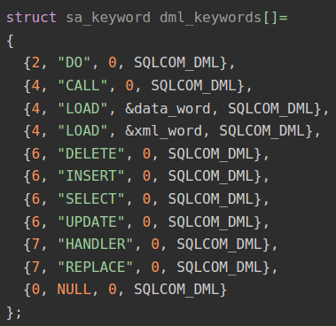
Audit Plugin 與 Audit Log Parser
server_audit.dll
  plugin\server_audit\server_audit.c
  分類
    struct sa_keyword ddl_keywords[]
    struct sa_keyword dml_keywords[]
    struct sa_keyword dcl_keywords[]

Slide 20
Audit Plugin 與 Audit Log Parser
server_audit.dll
  static int log_statement_ex(...)
    char *modtype = type;
    ...
    if (!filter_query_type(query, not_ddl_keywords) &&
    filter_query_type(query, ddl_keywords))
    modtype = "QUERY_DDL";
    if (filter_query_type(query, dml_keywords))
    modtype = "QUERY_DML";
    if (filter_query_type(query, dcl_keywords))
    modtype = "QUERY_DCL";
    if (query && !(events & EVENT_QUERY_ALL) &&
    (events & EVENT_QUERY))
    ...
const char *orig_query= query;
...
...
...
csize= log_header(message, message_size-1, &ev_time,servhost, servhost_len,cn->user, cn->user_length,cn->host, cn->host_length,cn->ip, cn->ip_length, thd_id, query_id, modtype);
...

Slide 21
Audit Plugin 與 Audit Log Parser
Build Plugin
  Visual Studio 2015 Community 版
  Bison (記得路徑不要有空白)
  cmake
  Windows SDK 8.1
  sql\sql_locale.cc 有怪字無法編譯
    開 notepad 然後用 unicode 儲存 (不是 utf-8 喔) 就可以過了

Slide 22
Audit Plugin 與 Audit Log Parser
Audit Log Parser
  https://github.com/sujunmin/MariaDBAuditFileParser
    歡迎 Fork / PR
  SaveTraceFile.ps1
    Archived Log Files
  TraceFileParser.ps1
    Parse Log Files and Save it

Slide 23
Audit Plugin 與 Audit Log Parser
Audit Log Parser
  $timestamp = $line.SubString(0, $submatches[0].Index)
  $serverhost = $line.SubString($submatches[0].Index+1, $submatches[1].Index - $submatches[0].Index-1)
  $username = $line.SubString($submatches[1].Index+1, $submatches[2].Index - $submatches[1].Index-1)
  $hosts = $line.SubString($submatches[2].Index+1, $submatches[3].Index - $submatches[2].Index-1)
  $connectionid=$line.SubString($submatches[3].Index+1,$submatches[4].Index- $submatches[3].Index-1)
  $queryid = $line.SubString($submatches[4].Index+1, $submatches[5].Index - $submatches[4].Index-1)
  $operation = $line.SubString($submatches[5].Index+1, $submatches[6].Index - $submatches[5].Index-1) $database = $line.SubString($submatches[6].Index+1, $submatches[7].Index - $submatches[6].Index-1)

Slide 24
Audit Plugin 與 Audit Log Parser
Audit Log 放在網路磁碟機的問題
  Server hang at NO Errors in error logs
    https://jira.mariadb.org/browse/MDEV-13025
    audit plugin blocks for the entire duration of "auditing()" . It waits on a internal lock.I cannot comment whether this decision is wise, but as it stands , I would do is to try to avoid long running operations inside the auditing(), since one thread can run it at the same time. It looks like the writes to network drive take a long time in your environment
    It was definitely not designed for the network access in mind. If I was doing it, I would implement it to write file locally, and maybe have a batch job scheduled periodically to transfer new records to some network place.
    I cannot tell why it is randomly happens for you. Network access is something where every failure is seemingly random. Again, I doubt service_audit was written to function reliably with networking file systems.

Slide 25
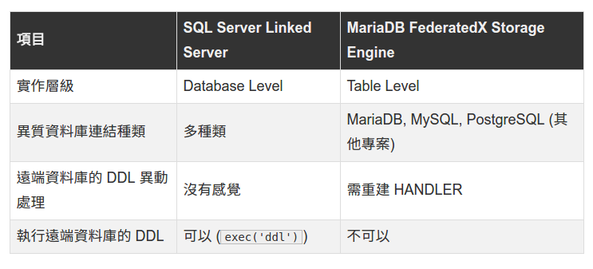
Linked Server 與 FederatedX Storage Engine
Linked Server
  Different Sites
  Different Databases
  Connect and Use as Local Databases
FederatedX Storage Engine
  Do as Linked Server
  Something Different

Slide 26
Linked Server 與 FederatedX Storage Engine
FederatedX Storage Engine
  CREATE SERVER First
  CREATE TABLE A ENGINE=FEDERATED CONNECTION=’SiteA/table’
  Will not create frm file, and can not be replicated
  遠端的 Table Schema 改變
    SQL錯誤（1031）：Storage engine FEDERATED of the table b_db.a_table doesn't have this option

Slide 27
Linked Server 與 FederatedX Storage Engine
斷線問題
  https://jira.mariadb.org/browse/MDEV-11276
  感謝神人不厭其煩的解說
  wait_timeout 問題

Slide 28
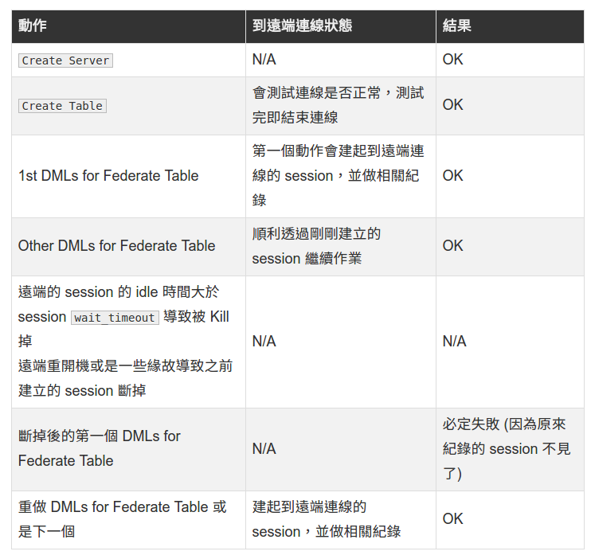
Linked Server 與 FederatedX Storage Engine
斷線問題
  比較跟 Linked Server
  不一樣的想法

Slide 29
程式修改
語法問題
Invalid string or buffer length 錯誤
  Data provider or other service returned an E_FAIL status
  沒有其他的報錯訊息
  https://jira.mariadb.org/browse/ODBC-52
  在 2.0.12 修正

Slide 30
Thank You!

