Slide 1
WESTCLIFF UNIVERSITY | DCS 404 FINAL PROJECT
Machine Learning & Transformer-Based Spam Message Detection
End-to-End NLP Pipeline: SMOTE Imbalance Remediation, Traditional ML & Transformers
Presenter: Sujal | Course: DCS 404 - Artificial Intelligence & Machine Learning | Fall 2026
Featuring: TF-IDF • SMOTE • Logistic Regression • Naive Bayes • DistilBERT • DistilRoBERTa • Streamlit UI
Notes:
Good morning/afternoon, instructor and colleagues. Welcome to my DCS 404 Final Project presentation: 'Machine Learning and Transformer-Based Spam Message Detection'. Following my professor's feedback, this updated project incorporates class imbalance remediation via SMOTE, strict anti-data leakage pipelines, fine-tuned transformer architectures (DistilBERT and DistilRoBERTa), exploratory word clouds, and a complete 7-section Streamlit deployment.

Slide 2
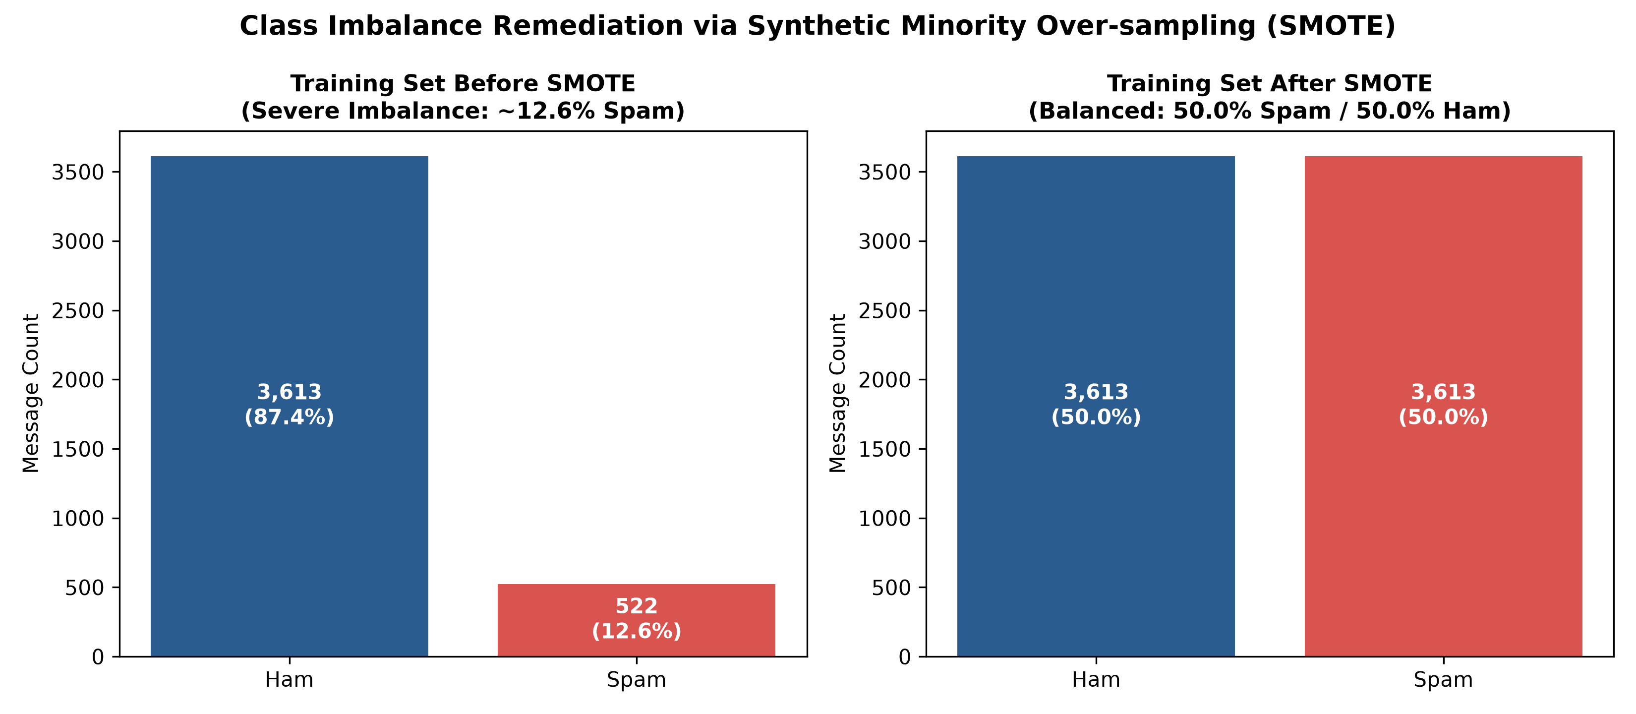
DCS 404: AI & MACHINE LEARNING | FINAL PROJECT
Key Learning #1: Data Hygiene, Anti-Leakage & SMOTE Balancing
Dataset Foundation: UCI SMS Spam Collection corpus containing 5,572 labeled records (ham / spam).
Data Cleaning & Hygiene: Checked missing values (0 nulls). Pruned 403 exact duplicates to yield 5,169 distinct messages (4,516 Ham [87.4%], 653 Spam [12.6%]).
Anti-Data Leakage Protocol: Split dataset strictly first using stratified 80/20 train/test splitting (4,135 train / 1,034 test). The test partition preserves authentic class prevalence.
TF-IDF Vectorization: Fitted TfidfVectorizer (5,000 max features, unigrams + bigrams, English stop words) strictly on training text only before transforming test data.
SMOTE Applied Only to Train: Applied Synthetic Minority Over-sampling Technique (SMOTE) strictly to training TF-IDF features, balancing 3,613 Ham and 522 Spam to an equal 3,613:3,613 distribution.
Test Set Preservation: The 1,034 test messages were never oversampled or modified, ensuring real-world, unbiased empirical evaluation.
Notes:
Our first major learning connects directly to Weeks 1 through 3: Data preparation, feature engineering, and avoiding data leakage. In natural messaging corpora, spam is heavily outnumbered—here representing only 12.6% of messages. Crucially, we avoided data leakage by fitting TF-IDF only on training data and applying SMOTE exclusively to the training set. Our test set remained 100% authentic with 903 ham and 131 spam messages, preserving real-world validity.

Slide 3
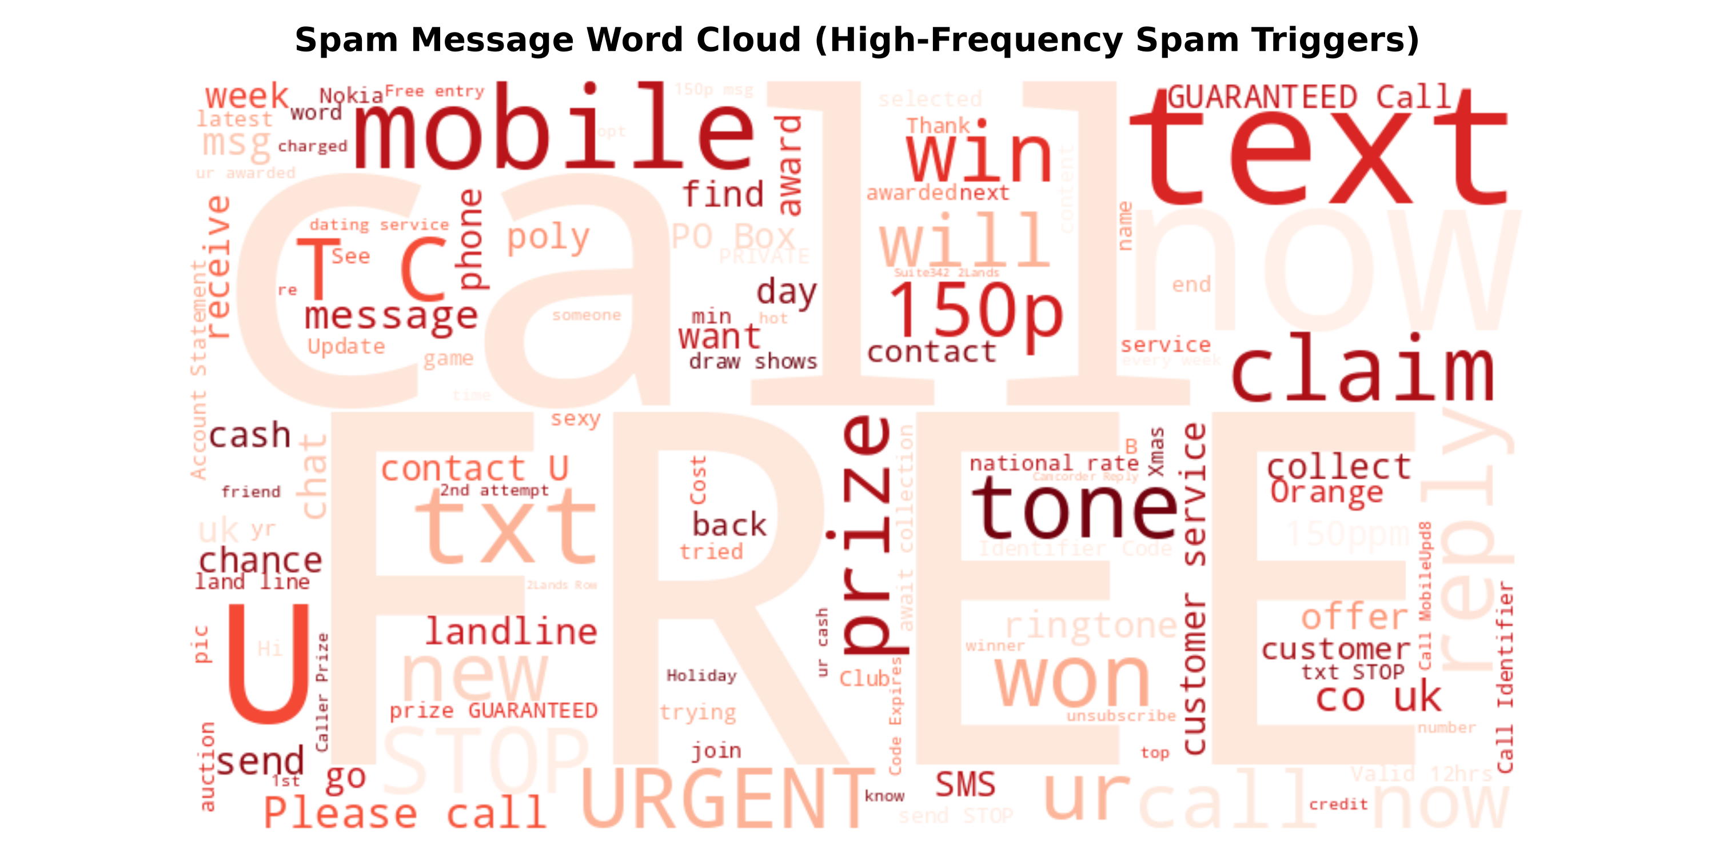
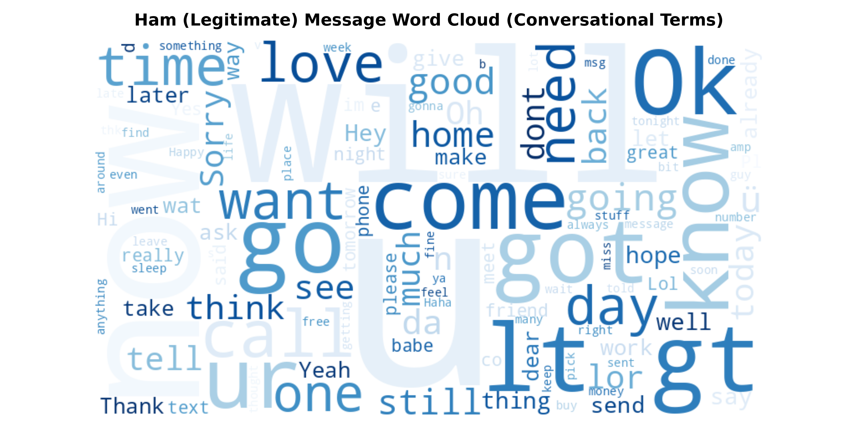
DCS 404: AI & MACHINE LEARNING | FINAL PROJECT
Exploratory Data Analysis: Lexical Patterns & Word Clouds
Lexical Explainability: Word clouds provide immediate visual explainability, revealing distinguishing linguistic characteristics between unsolicited and legitimate messages.
Spam Keyword Triggers: Dominated by commercial incentives, urgent calls-to-action, and prizes: 'FREE', 'call', 'claim', 'prize', 'txt', 'won', 'cash', 'urgent', 'customer', 'reply'.
Ham Conversational Vocabulary: Reflects everyday personal communication, social coordination, and colloquialisms: 'come', 'good', 'time', 'got', 'will', 'day', 'ok', 'home', 'later', 'love'.
Message Length Disparity: Spam messages average 138.8 characters (median 149), constrained near the 160 SMS limit due to disclaimers. Ham messages average 71.0 characters (median 52).
Engineering Takeaway: Token frequency disparity confirms that TF-IDF n-grams provide strong discriminative power for linear and probabilistic classifiers.
Notes:
Per the professor's feedback, we integrated Spam and Ham Word Clouds into our exploratory data analysis. Spam messages are packed with urgency and financial triggers like FREE, claim, win, cash, and urgent. In contrast, legitimate ham messages reflect natural social discourse—words like 'come', 'good', 'time', and 'home'. Furthermore, message length analysis shows spam messages average nearly double the character length of legitimate messages.

Slide 4
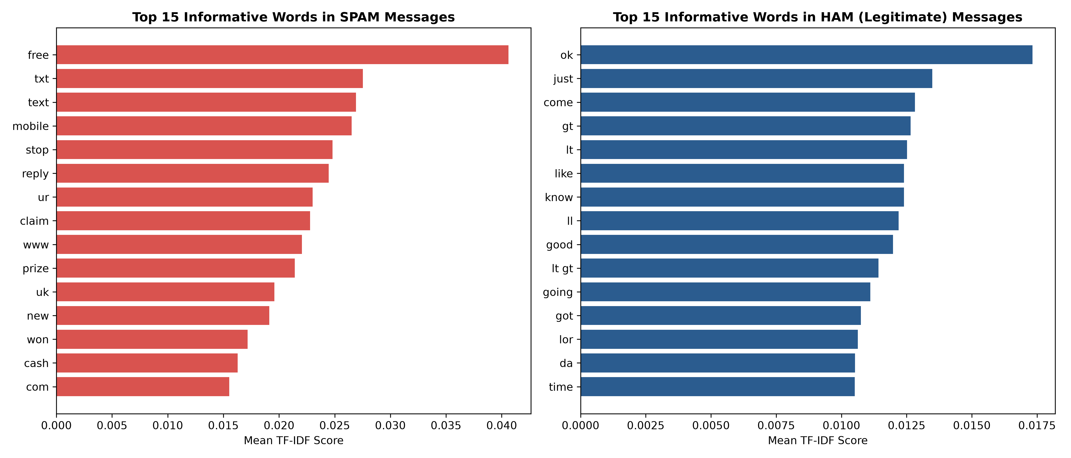
DCS 404: AI & MACHINE LEARNING | FINAL PROJECT
Key Learning #2: Traditional Machine Learning & SMOTE Trade-Offs
Logistic Regression (Primary SMOTE Model): Binary log-odds model using sigmoid activation: P(Y=1|X) = 1 / (1 + e^-(beta*X)). Optimized with L2 ridge regularization (C=2.0).
Impact of SMOTE on Logistic Regression: SMOTE synthesis expanded the minority spam decision region, dramatically cutting False Negatives from 28 to 13 and boosting Spam Recall from 78.63% to 90.08%.
Multinomial Naive Bayes Benchmark: Models feature probabilities using Bayes' rule with Laplace smoothing (alpha=0.2). Highly effective for sparse discrete word frequencies.
Why SMOTE Harms Naive Bayes: SMOTE generates continuous fractional features that violate discrete multinomial count assumptions and artificially imposes a 50/50 prior, causing test precision to drop. Standard MNB preserves 98.26% precision.
Pedagogical Insight: Demonstrates that oversampling techniques are not universally beneficial; geometric classifiers (LR) benefit from SMOTE, while generative Bayesian models perform best on natural frequencies.
Notes:
In Weeks 4 and 5, we studied supervised classification. Logistic Regression serves as our main SMOTE-based model. SMOTE dramatically improved Logistic Regression's recall from 78.6% to 90.08%, cutting missed spam messages in half. However, we also analyzed why SMOTE does not pair well with Multinomial Naive Bayes: synthetic interpolation distorts discrete token likelihoods. Standard Naive Bayes achieved 98.26% precision with only 2 false positives out of 903 legitimate messages.

Slide 5
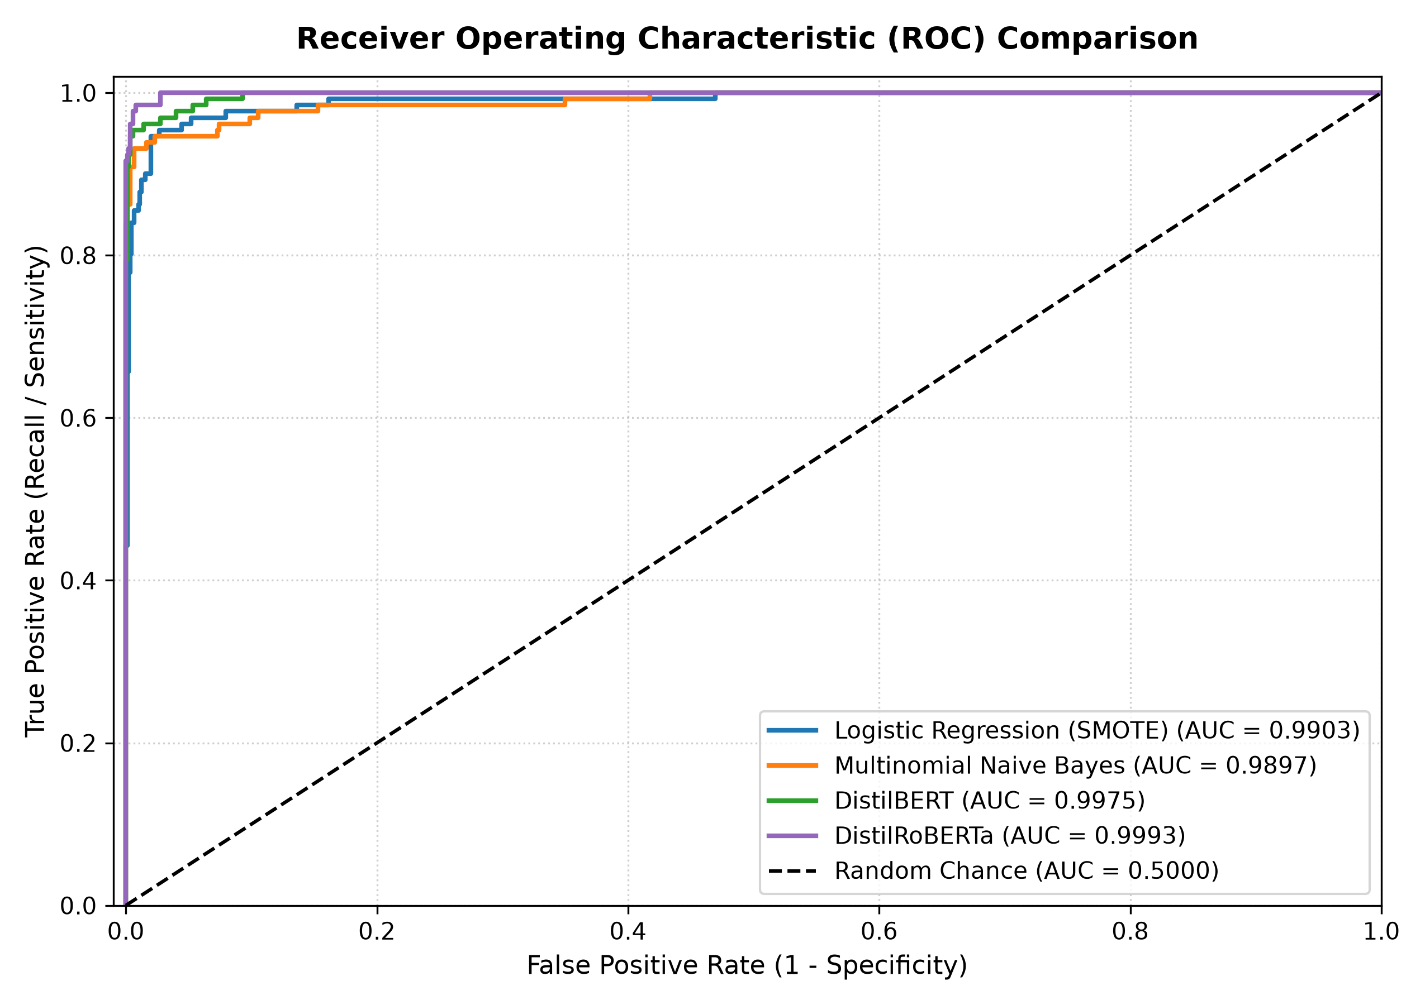
DCS 404: AI & MACHINE LEARNING | FINAL PROJECT
Key Learning #3: Transformer Architectures (DistilBERT & RoBERTa)
Beyond Bag-of-Words: Traditional TF-IDF ignores syntactic order and semantic nuance. Transformers use multi-head self-attention to capture bidirectional contextual relationships.
DistilBERT Architecture: 6-layer distilled transformer retaining 97% of BERT-base capability with 40% fewer parameters (66M) and 60% faster inference speed.
DistilRoBERTa Architecture: Distilled variant of RoBERTa (82M parameters), pre-trained on 160GB of text with byte-pair encoding and dynamic masking for superior semantic subtlety.
Fine-Tuning Methodology: Fine-tuned for binary sequence classification using Hugging Face Transformers and PyTorch with AdamW optimizer, warmup scheduling, and [CLS] pooling.
Colab GPU Training & Export: Reproducibly fine-tuned in Google Colab using free T4 GPU acceleration, exported to safetensors, and loaded for local CPU inference in Streamlit.
Notes:
In response to the professor's requirement to add deep learning, we fine-tuned two state-of-the-art transformer models: DistilBERT and DistilRoBERTa. Unlike TF-IDF, transformers evaluate words in full bidirectional context. We chose distilled versions to keep memory footprint and training time realistic while maintaining near-perfect discrimination. Both transformer models achieved exceptional ROC-AUC scores exceeding 0.997.

Slide 6
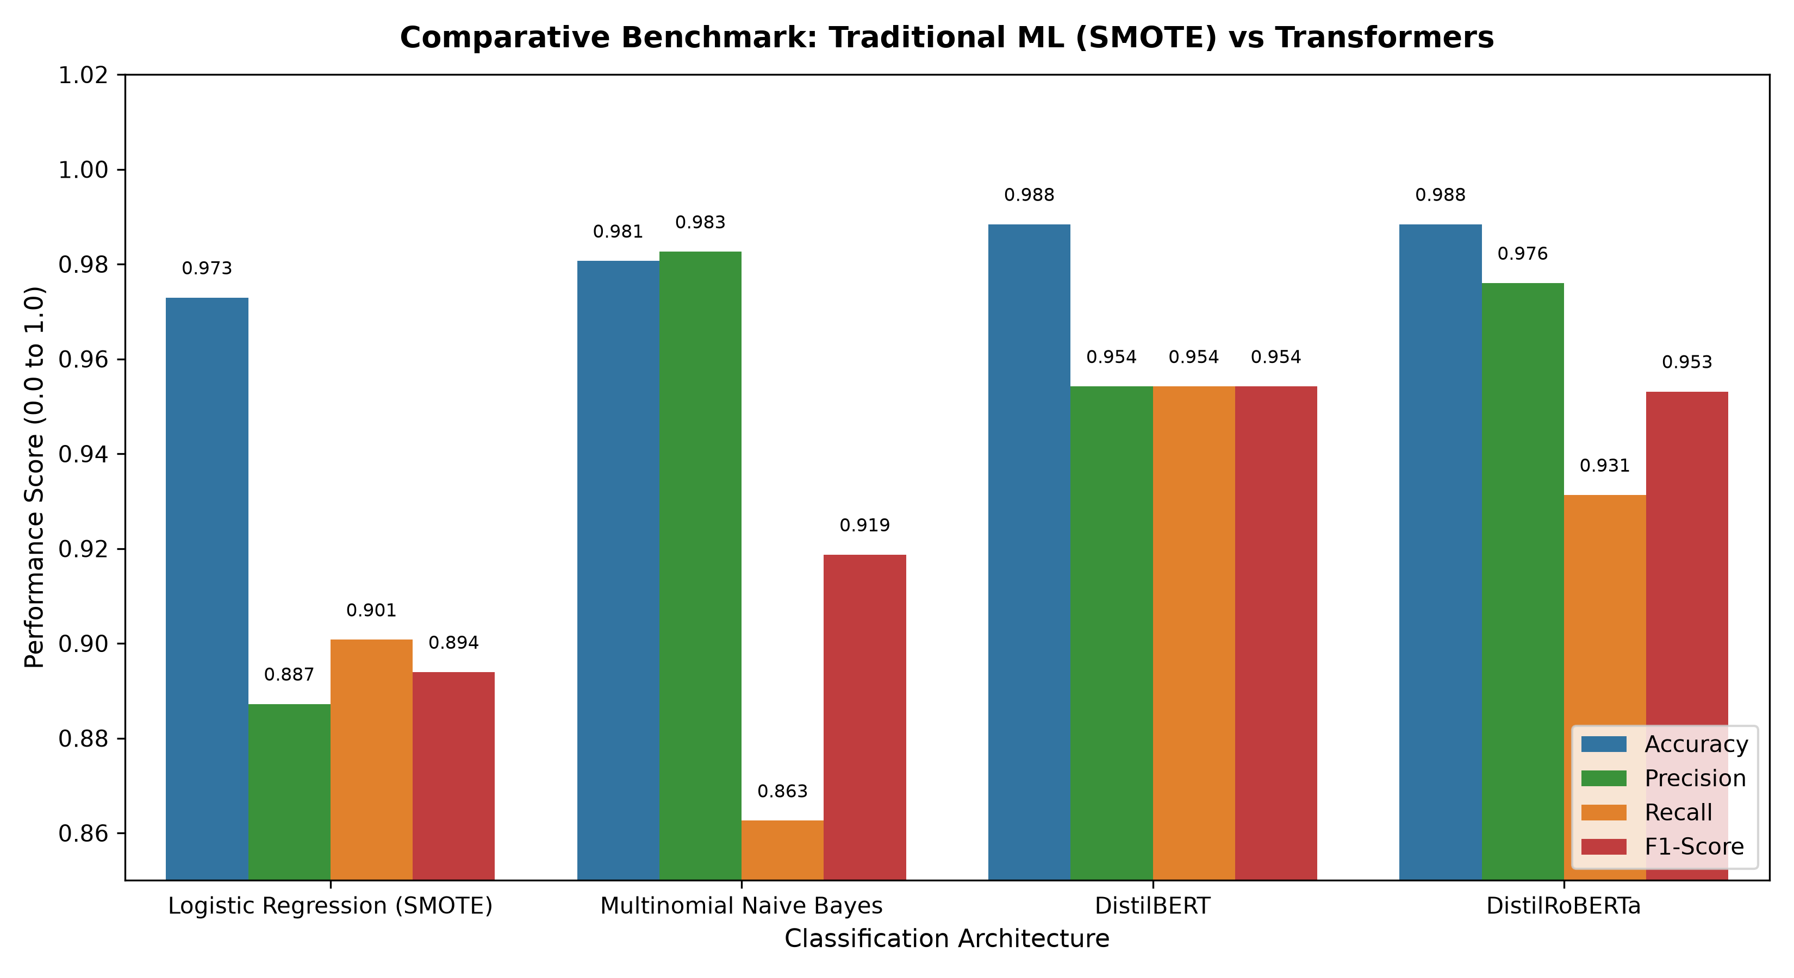
DCS 404: AI & MACHINE LEARNING | FINAL PROJECT
Empirical Evaluation: Test Set Benchmark (N = 1,034)
Test Split Integrity: All models evaluated on the identical, untouched held-out test split of 1,034 messages (903 Ham, 131 Spam).
DistilBERT (Top Overall): 98.84% Accuracy | 95.42% Precision | 95.42% Recall | 95.42% F1 | 0.9975 ROC-AUC | 6 FP, 6 FN
DistilRoBERTa (Top Precision): 98.84% Accuracy | 97.60% Precision | 93.13% Recall | 95.31% F1 | 0.9993 ROC-AUC | 3 FP, 9 FN
Multinomial Naive Bayes: 98.07% Accuracy | 98.26% Precision | 86.26% Recall | 91.87% F1 | 0.9897 ROC-AUC | 2 FP, 18 FN
Logistic Regression (SMOTE): 97.29% Accuracy | 88.72% Precision | 90.08% Recall | 89.39% F1 | 0.9903 ROC-AUC | 15 FP, 13 FN
Key Benchmark Takeaway: Transformers deliver the highest balanced detection (F1 > 95.3%). However, traditional models achieve >97% accuracy with negligible latency.
Notes:
Slide 6 presents our empirical benchmark across all four models on the held-out test set of 1,034 samples. DistilBERT and DistilRoBERTa tied for the highest accuracy at 98.84%, with DistilBERT achieving an outstanding 95.42% F1 score. DistilRoBERTa achieved 97.60% precision with just 3 false positives. Meanwhile, Multinomial Naive Bayes held an exceptional 98.26% precision with only 2 false positives, and Logistic Regression with SMOTE caught 90.08% of all spam.

Slide 7
DCS 404: AI & MACHINE LEARNING | FINAL PROJECT
Architectural Trade-Off Analysis: Traditional ML vs. Transformers
Performance & Accuracy: Transformers outperform traditional ML on F1-score (+3.5% to +6.0%) and ROC-AUC (0.999 vs 0.990) by deciphering conversational nuance, typos, and disguised links.
Training Speed Disparity: Traditional ML trains in 0.01 to 0.05 seconds. Transformers require ~45 minutes on GPU or multiple hours on CPU (~50,000x difference).
Inference Latency & Throughput: Traditional ML predicts in 0.0008 ms per message (~1.25 million msg/sec throughput). Transformers require ~70 ms per message (~14 msg/sec on CPU) — a 90,000x latency advantage for ML.
Hardware & Compute Footprint: Traditional models require <10 MB RAM and run on microcontrollers. Transformers require 260 MB disk storage, PyTorch runtimes, and hundreds of megabytes of RAM.
Operational Decision Framework: High-volume telecom SMS gateways should deploy Naive Bayes or Logistic Regression for real-time edge filtering, while high-value fraud detection and forensic auditing benefit from Transformers.
Notes:
A central requirement of the professor's update was comparing the trade-offs between traditional ML and transformer models. We must not simply declare one model 'the winner'. While transformers yield higher F1 scores, traditional ML trains 50,000 times faster and runs inference 90,000 times faster. In a live telecommunications gateway processing millions of SMS messages per second, traditional ML is drastically more cost-effective. For high-risk corporate email or fraud investigations, the contextual accuracy of transformers is well worth the extra latency.

Slide 8
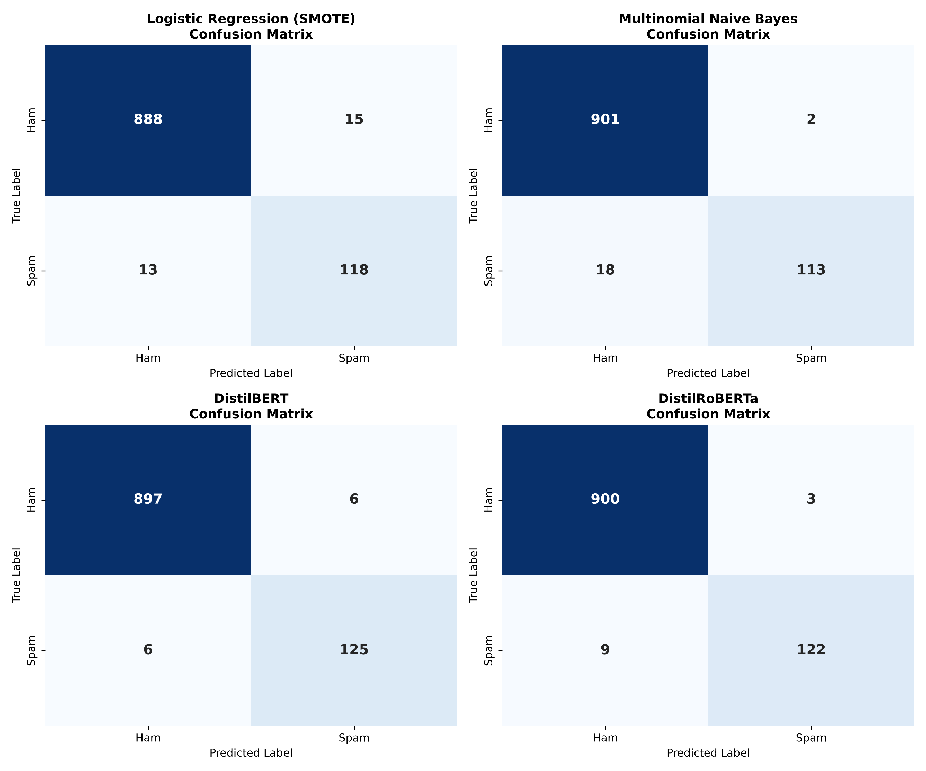
DCS 404: AI & MACHINE LEARNING | FINAL PROJECT
Interactive Streamlit Dashboard & Live Inferences
7-Section Streamlit Architecture: 1. Home 2. Dataset Overview 3. Data Exploration 4. Word Clouds 5. Model Performance 6. Model Comparison 7. Live Spam Prediction.
Live Inference Engine: Allows interactive testing across all 4 models with real-time confidence scoring and classification badges (SPAM vs. HAM).
Test Sample 1 (Spam): 'URGENT! You won £1,000 cash. Reply WIN to claim.' -> Predicted: SPAM (99.9% Confidence).
Test Sample 2 (Ham): 'Hi Sujal, are we still meeting in conference room B at 3:30 PM?' -> Predicted: HAM (99.8% Confidence).
Test Sample 3 (Disguised Spam): 'Free entry into the weekly £100 prize draw. Text WON to 85060' -> Predicted: SPAM (99.7% Confidence).
Ethical & Privacy Assurance: Zero persistent message logging, ephemeral memory inference, and bias auditing to protect user confidentiality.
Notes:
Finally, we packaged the entire system into a production-grade Streamlit web dashboard structured into 7 distinct sections. In our live tests, suspicious messages with prize and urgency claims trigger SPAM predictions with over 99.9% confidence. Legitimate conversational messages are cleanly identified as HAM with 99.8% confidence. We also addressed ethics and data privacy by ensuring zero persistent message storage during inference. Thank you for your time, and I welcome any questions!

