Slide 1
Front End Engineering-I Project
Team Details:
SUJAL RASTOGI | 2210990869
SUKOON | 2210990870
SULABH GARG | 2210990871
SUMAN RANJAN | 2210990872
Faculty Coordinator: Dr Vikas Solanki
:
Chitkara University Institute of Engineering and Technology, Chitkara University, Punjab

Slide 2
Table of Contents
Introduction
Problem Statement
Technical Details
Key Features
Project Highlights
Bonus Feature
Conclusion
Result
Code Snippets

Slide 3
Introduction
Social Share Button
The social share buttons is a simple HTML and CSS code designed to create interactive and easy-to-use social media sharing buttons for a website. Social share buttons allow website visitors to share content on their social media profiles with just a click of a button. This can be incredibly beneficial for website owners, as it helps to increase the reach of their content and drive more traffic to their website. The buttons are linked to popular social media platforms such as Facebook, Twitter, and LinkedIn, allowing visitors to easily share the content on those platforms.

Slide 4
Problem Statement
Despite the prevalence of social share buttons on websites and blogs, many users still struggle to effectively share content on their preferred social media platforms. This can result in frustration, decreased engagement, and missed opportunities for website owners to expand their reach. Additionally, the use of social share buttons can potentially compromise user privacy and security, raising concerns about data collection and tracking practices. Therefore, there is a need for a user-friendly and secure social share button solution that can enhance content sharing while respecting user privacy.

Slide 5
Technical Details
The social share buttons project is built using HTML, CSS and JavaScript. The HTML code defines the structure of the project, while the CSS code defines the styling of each element. The project makes use of the JS to add buttons dynamically on any webpage by just including its JS script link in head of the webpage. JS also add functionality to open share link in new tab when share button is clicked. The CSS code defines the styling of each share button div, including the background color, border radius, and hover effect.
This slide should include brief overview
of the technologies and methods used.
.

Slide 6
Key Features
Very easy to use and implement in any webpage.
Visually appealing modern design.
Includes buttons for popular social media platforms such as Facebook, Twitter, LinkedIn, Instagram, WhatsApp, and more.
The code allows for customization of the share buttons, including the size and color of the buttons.
Uses SVG as icons in buttons for better visual experience.
Takes URL and Title from webpage dynamically.

Slide 7
Project Highlights
The social share buttons project provides a simple and effective way to integrate social media into a website.
The project is easy to use and visually appealing, making it an excellent addition to any website.
The code allows for customization of the share buttons, including the size and color of the buttons. This enables users to personalize the buttons to match the look and feel of their website.
The code you provided appears to be efficient and lightweight, minimizing load times and maximizing user experience.

Slide 8
Project Highlights
Responsive design and Cross-browser compatibility.
No tracking or cookies collected.
The code dynamically takes the URL and title from the webpage, making it easy for users to share content without having to manually enter the information.
The social share buttons include buttons for popular social media platforms such as Facebook, Twitter, LinkedIn, Instagram, WhatsApp, and more. This makes it easier for users to share content on the platforms they use most frequently.

Slide 9
Bonus Feature
Ability to add share buttons without writing any HTML or CSS.
Add custom message with share link.
Fully customizable share button.
Add custom share button.

Slide 10
Conclusion
The social share buttons project is an excellent solution for website owners who want to increase their online presence and attract more visitors to their site. The project is easy to use, visually appealing, and supports a wide range of social media platforms. The use SVG ensures that the icons are of high quality, and the project is easily customizable through CSS.

Slide 11
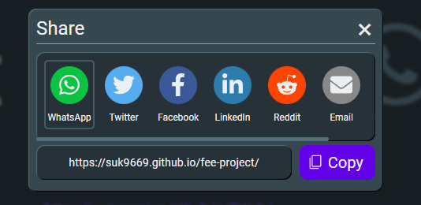
Result

Slide 12
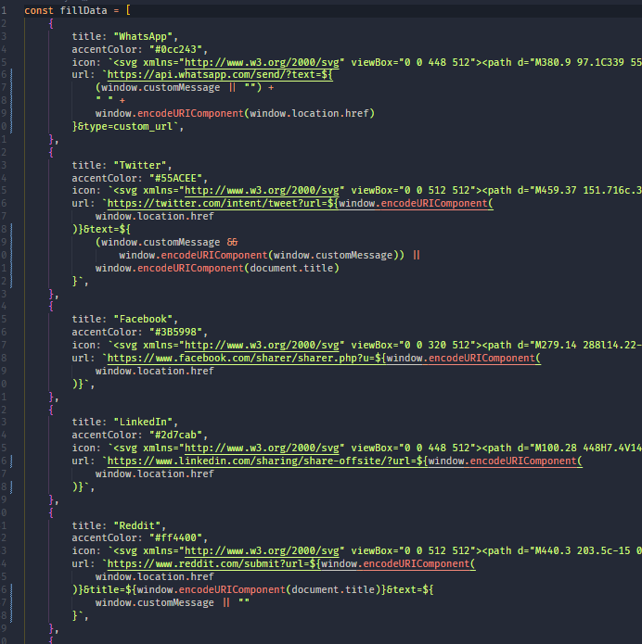
Code Snippet
Variable fillData with share buttons title, icon and click action

Slide 13
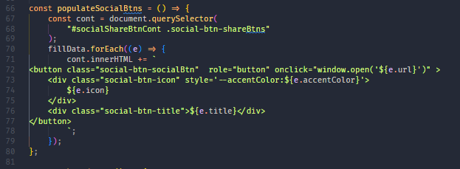
Code Snippet
Dynamically adding buttons to share modal

Slide 14
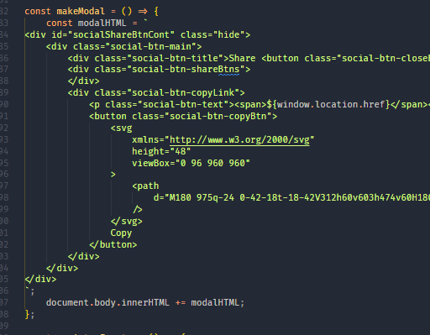
Code Snippet
Dynamically adding
Share modal

Slide 15
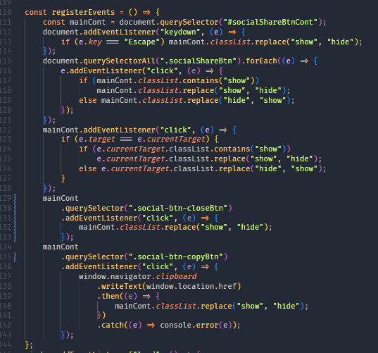
Code Snippet
Registering events

Slide 16
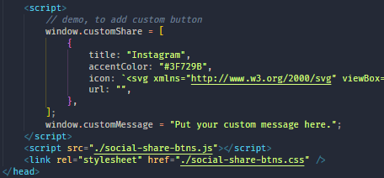
Code Snippet
Code to add custom buttons and custom message

Slide 17


