Slide 1
Scandinavian Flair in English-Language Travel Content
Examples Describing Sweden

Slide 2
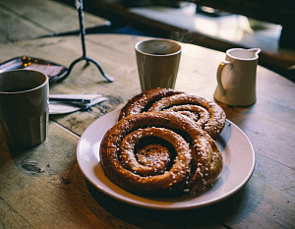
Scandinavian Flair in Tourism Content
Scandinavian flair plays a central role in how Sweden is portrayed in English-language tourist content. From serene landscapes and innovative design to cultural traditions and progressive values, Sweden is often idealized as a perfect blend of nature, modern living, and timeless folklore.

Slide 3
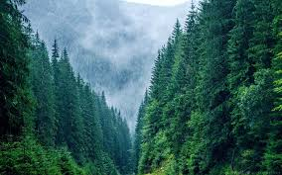
One of the most common themes is minimalism and design aesthetics. Sweden is frequently highlighted as a country where simplicity meets sophistication. Travel blogs and guides often feature photos of sleek interiors, eco-friendly architecture, and stylish cafes in cities like Stockholm and Gothenburg. Swedish design, characterized by functionality and beauty, reinforces the country’s image as clean, organized, and forward-thinking.

Slide 4
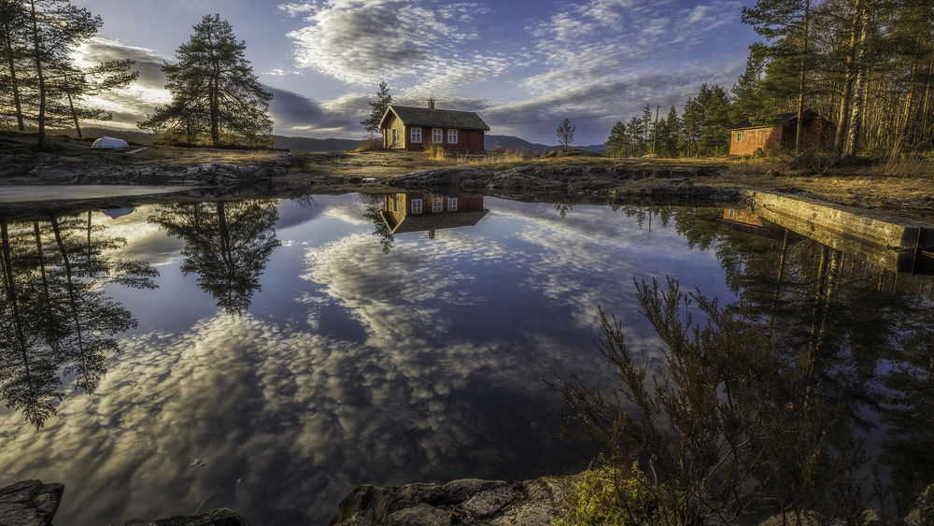
Another key element is nature. Sweden is presented as a land of unspoiled wilderness, with thousands of lakes, dense forests, and the Arctic north offering views of the Northern Lights. Tourist content emphasizes sustainability and eco-tourism, inviting travelers to experience the country’s deep connection to the environment. The principle of “Allemansrätten”, or the Right of Public Access, is commonly mentioned — it allows anyone to roam freely through the countryside, camp in nature, and pick wild berries and mushrooms.

Slide 5
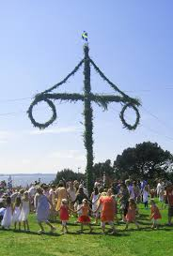
Swedish cultural customs are also prominently featured. One of the most endearing is “fika” — a daily ritual of enjoying coffee and pastries with friends or colleagues. Fika is more than just a coffee break; it's presented as a symbol of Swedish work-life balance and a slower, more meaningful lifestyle. For many tourists, experiencing fika is an essential part of immersing themselves in Swedish life.

Slide 6
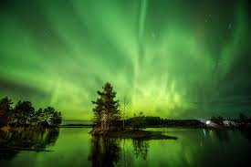
Seasonal traditions are another source of fascination. Midsummer, for instance, is described with vivid imagery: flower crowns, maypole dancing, traditional songs, and long evenings under the midnight sun. In winter, Christmas markets, cozy cabins, and snowy landscapes evoke a Nordic fairytale atmosphere. These celebrations create a magical contrast between the seasons and contribute to the emotional pull of Sweden as a travel destination.

Slide 7
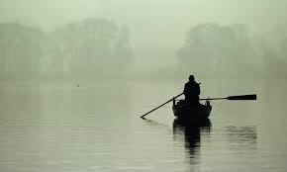
The historical and mythical dimensions are often woven into the narrative as well. Viking heritage, medieval castles, and rune stones are presented not only as historical facts but also as part of the romantic identity of the country. Many guides include tales of Norse mythology, making the past feel alive and accessible.

Slide 8
Overall, the tone of this content tends to be calm, poetic, and slightly idealized. Sweden is painted as a land of harmony — between people and nature, tradition and progress, simplicity and richness of experience. This romanticized image appeals especially to travelers seeking authenticity, wellness, and a slower pace of life.

