Slide 1

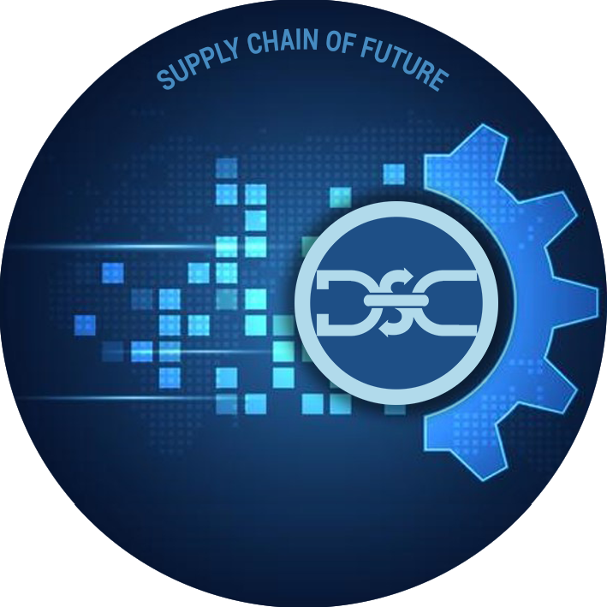
ML-OPS : DevOps for ML System

Slide 2
Adopting ML-OPS
Enables automation and monitoring at all steps of ML system construction, including integration, testing, releasing, deployment and infrastructure management.
Consists of continuous integration (CI), continuous delivery (CD), and continuous training (CT).
Components of a mature ML-OPS system –

Slide 3
How It Is Different From DEVOPS
Experimental Development: Trying out different features, algorithms, modeling techniques, and parameter configurations. Challenge is tracking what worked and what didn't, and maintaining reproducibility while maximizing code reusability.
Testing: In addition to unit and integration tests requires data validation, trained model quality evaluation, and model validation.
Deployment: Deployment isn’t just deploying an offline-trained ML model as a prediction service. Requires you to deploy a multi-step pipeline to automatically retrain and deploy model which add complexity in achieving full automation without errors.
Performance Monitoring in Production: Models can decay in more ways than conventional software systems. need to track summary statistics of your data and monitor the online performance of your model to send notifications or roll back when values deviate from your expectations.
CI is no longer only about testing and validating code and components, but also testing and validating data, data schemas, and models.
CD is no longer about a single software package or a service, but a system (an ML training pipeline) that should automatically deploy another service (model prediction service).
CT is a new property, unique to ML systems, that's concerned with automatically retraining and serving the models.

Slide 4
Present State of MLOPS (as-is)
Manual Process
Disconnect between Development & Operations
No CI / CD / CT
Infrequent release iteration
No active performance monitoring and re-training trigger

Slide 5
Next Step – Automated Testing and Retraining (CT)
Rapid experiment based on new data and retraining, *Continuous delivery of model, *Pipeline Deployment,
Metadata management of pipeline and model, *Active performance monitoring

