Slide 1
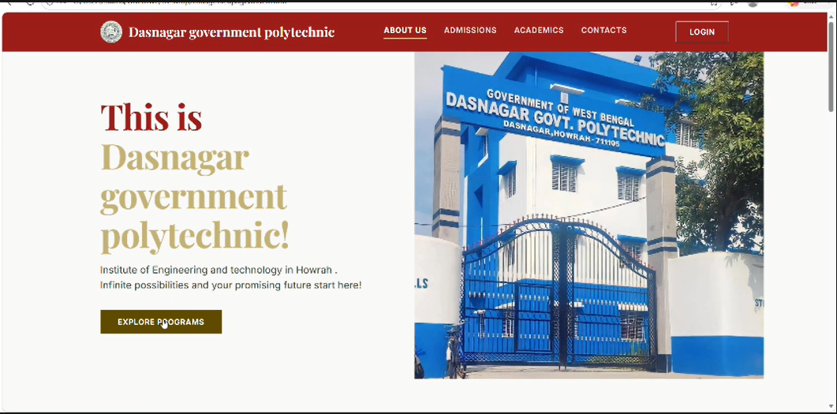
About Our College — Dasnagar Govt. Polytechnic

Slide 2
ACKNOWLEDGEMENT
I express my sincere gratitude to MS PUSPITA MANNA and SHRI ACHINTYA GOPAL MONDAL of the Department of Information Technology and Engineering, DASNAGAR GOVT. POLYTECHNIC, for extending their valuable time to help me take up this problem as a project.
This presentation is based on the project “Evaluation of Academic Performance of Students,” carried out by Soumacharyya Paul, Debargho Pramanik, Kaustab Jana, Tuhin Sadhukhan, Sukanya Maji, Mahi Gupta, Piyali Majhi and Salma Khatun, students of the Diploma 4th Semester 2025-2026 batch, Department of Information Technology and Engineering, Dasnagar Govt. Polytechnic.

Slide 3
SL NO. | INDEX PAGE | PAGE NO.
1. | Problem Statement
2. | Objective
3. | Technology Use
4. | Project Work Flow
5. | Output Screenshot

