Slide 1
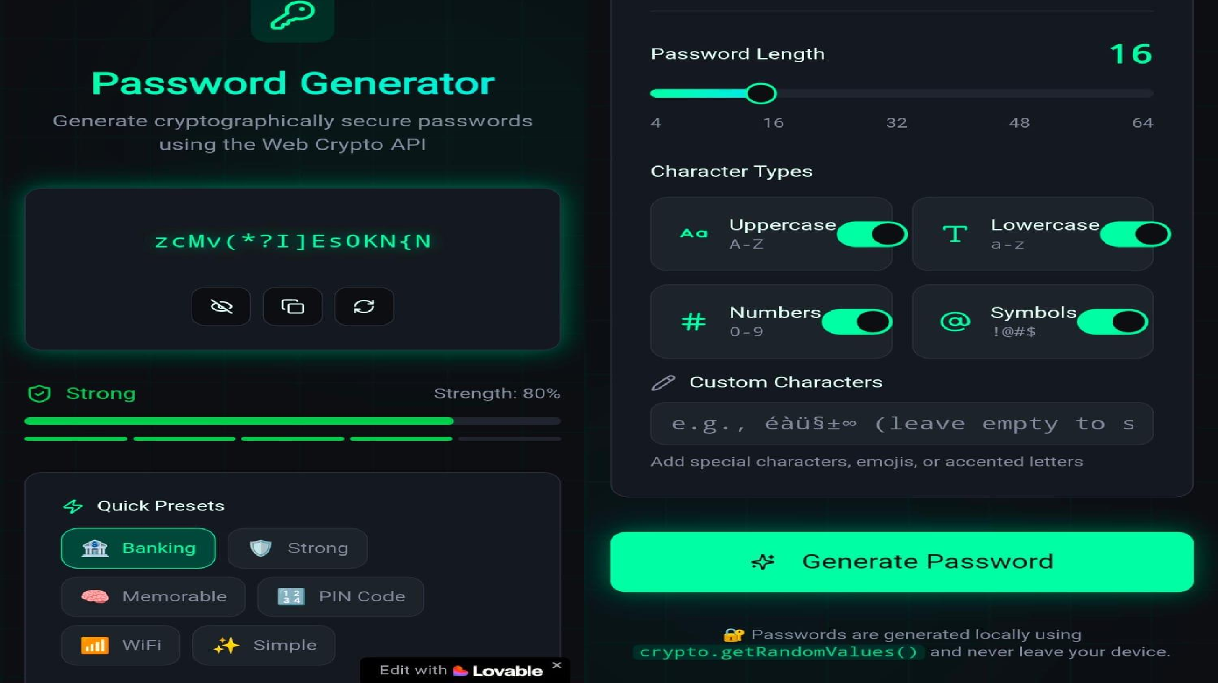

Slide 2

P.B.R Visvodaya Engineering College
Project Name: Password Generator
Language: Python
Class / Subject: 3rd year Linux

Slide 3
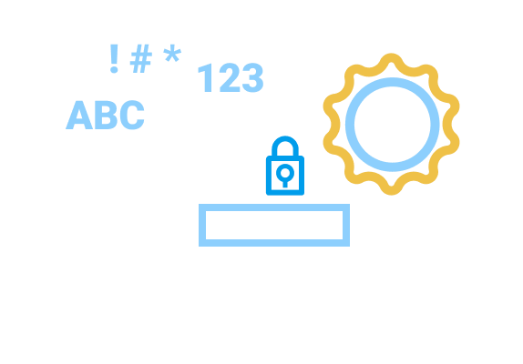
Introduction:-
Passwords protect personal and sensitive data
Weak passwords are easy to guess or hack
This project generates strong, random passwords using Python
Helps users create secure passwords quickly

Slide 4
Problem Statement:-
Users often create simple and predictable passwords
Remembering strong passwords is difficult
Manual password creation is time-consuming
Need an automated and secure solution

Slide 5
Objective of the Project:-
Generate strong and random passwords
Allow user to choose password length
Include letters, numbers, and symbols
Improve online security

Slide 6
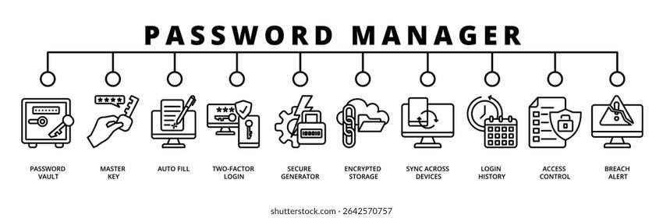
Tools & Technologies Used:-
Programming Language: Python Libraries Used:
random string
Platform: Loveable

Slide 7
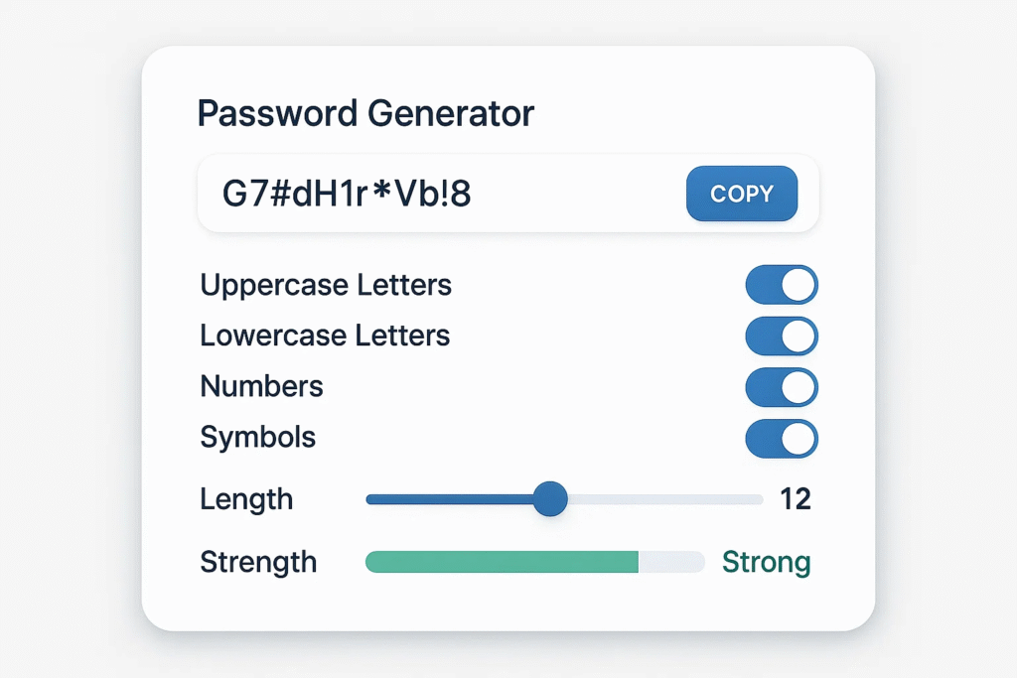
Working of the Project:-
User enters desired password length Program selects:
Uppercase letters Lowercase letters Digits
Special characters
Characters are randomly shuffled
Strong password is generated and displayed

Slide 8

Advantages:-
Generates strong passwords
Easy to use
Saves time
Reduces risk of hacking
Customizable password length

Slide 9
Applications:-
Email accounts
Social media accounts
Online banking
Websites and apps
Personal security systems

Slide 10
Conclusion:-
Password Generator improves digital security Python makes implementation simple and efficient Useful for students and general users
Encourages use of strong passwords

Slide 11


