Slide 1

upGrad Data Science Capstone Project
Shopping Recommender
- Sukanya Sadhu

Slide 2

Project Target:
Recommend products to customers based on their historical purchase data and browsing behavior.
Enhance the customer shopping experience by providing personalized and relevant product suggestions.
Increase customer engagement and satisfaction by accurately predicting products of interest.
Tools used:
Jupyter Notebook
Python Libraries :
numpy
Pandas
scikit-learn
Seaborn
matplotlib

Slide 3
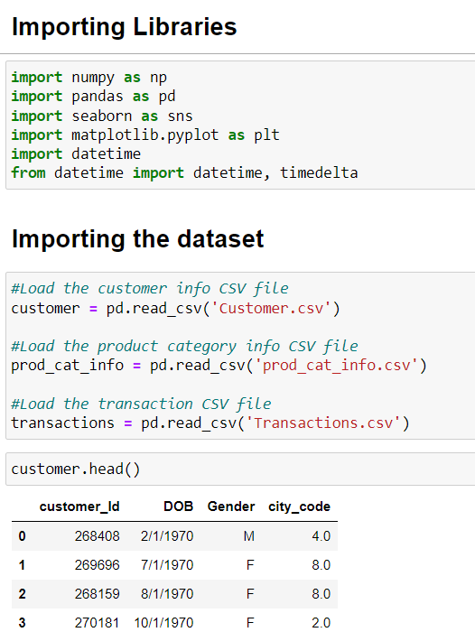
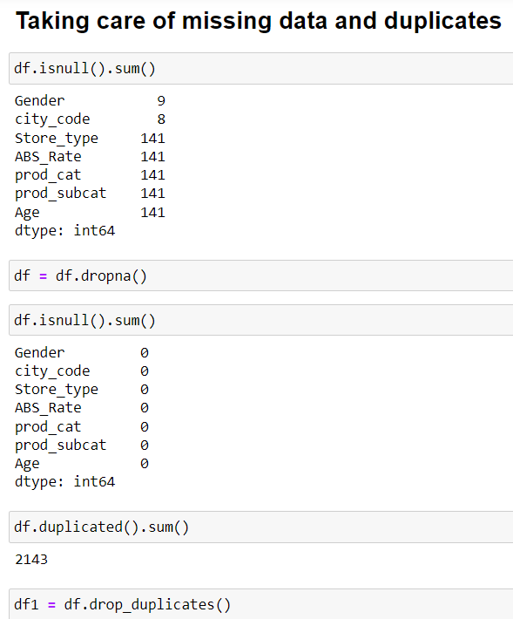

Slide 4

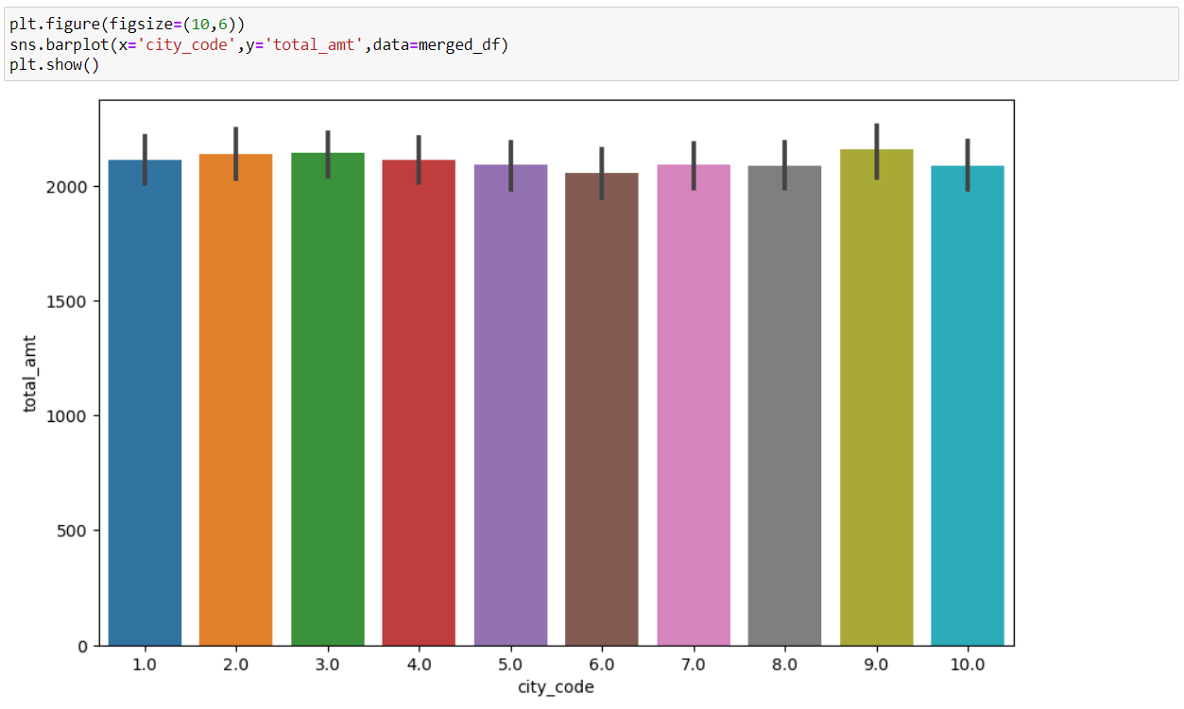

Slide 5
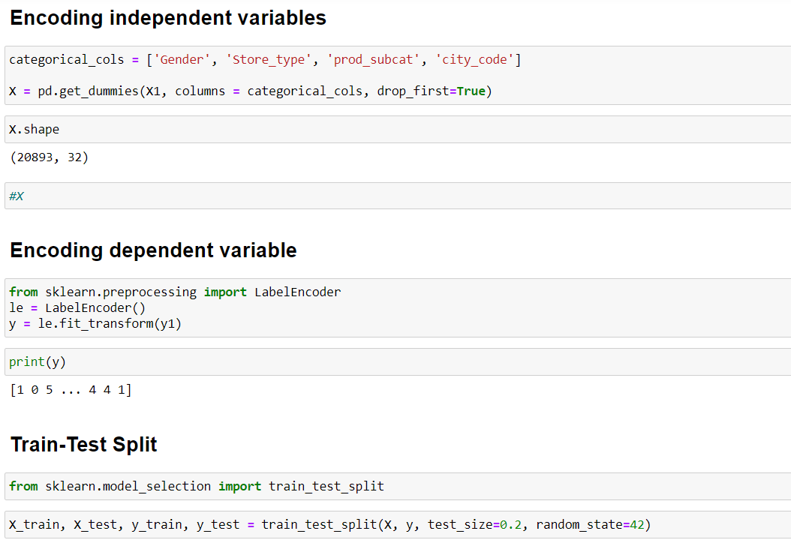

Slide 6

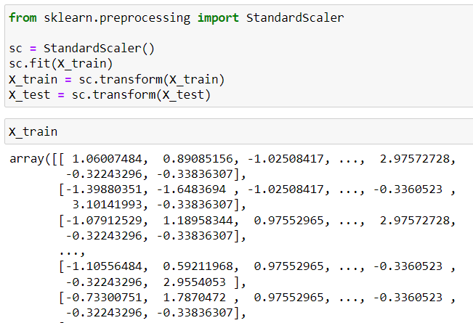

Slide 7
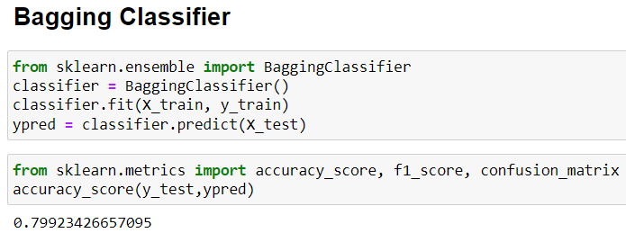
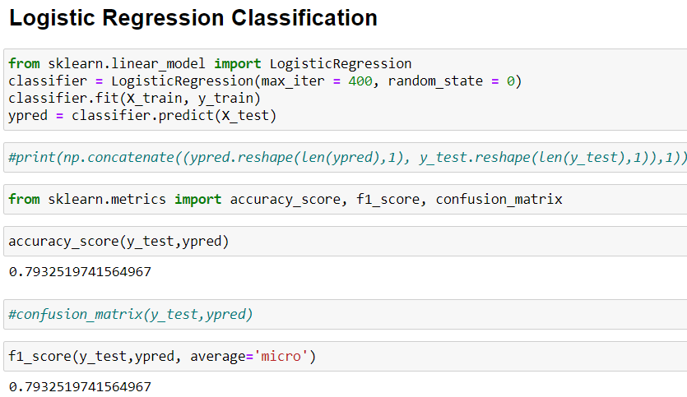
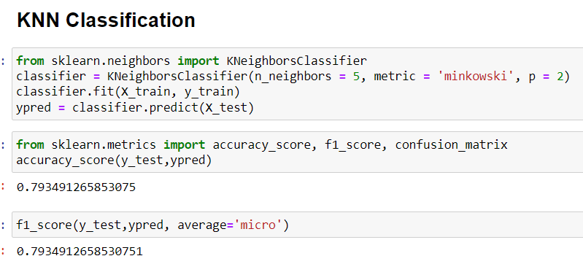
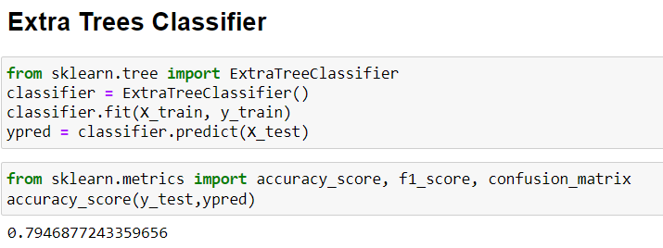
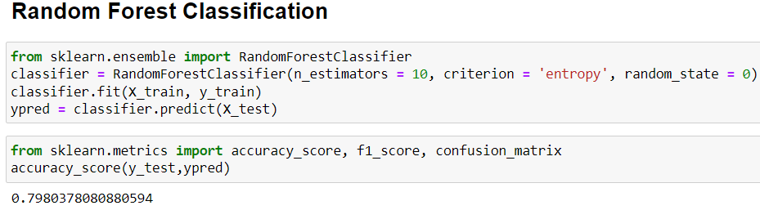

Slide 8

Challenges and Summary:
The dataset was challenging because it has multiple categorical features. So, the first important step was to use feature-selection to choose the important features and one-hat encoding to convert the categorical data to numerical.
The dataset contained few missing values but it was less than 10% so the rows containing missing values were dropped.
The dataset contained few duplicate values which were also dropped.
‘Age’ column was created using the DOB and purchase date columns.
I have used 10 different classification models e.g. Logistic Regression, KNN, random forest, decision trees etc. Highest accuracy was achieved by Bagging Classifier (79.9%) and Random Forest (79.8%).

