Slide 1
Search Engine and Revenue
Sukanya De
August 12 2022

Slide 2
Objective
How much revenue is the client getting from external Search Engines, such as Google, Yahoo and MSN, and which keywords are performing the best based on revenue?
Optimize the solution for large file sizes- over 10 GB per file uncompressed.

Slide 3
My Approach:
Find out the columns which needed for the solution:
The following columns were dropped from the original dataset:
hit_time_gmt , date_time , user_agent , event_list ,geo_city , geo_region , geo_country
This would help in optimizing for larger datasets.
Find the Search Engine:
For the purchases from Search Engines, the link in the Page_URL didn’t match with the Referrer link. So, for all hits to the Search engine, filtered the “ip” and corresponding “Search Engine Name”

Slide 4
My Approach contd…
Find the Search Keyword - In the sample dataset, all search strings started with “p=“ or “q=“
Get the list of products for Each Purchase
For each product, find the product name and the revenue from its attributes and also IP from which the purchase was made
Lookup the Search Engine dataset by “IP” and check if the Product name matches with the search keyword
Find Sum of revenue group by Search Engine Domain and Search Keyword

Slide 5
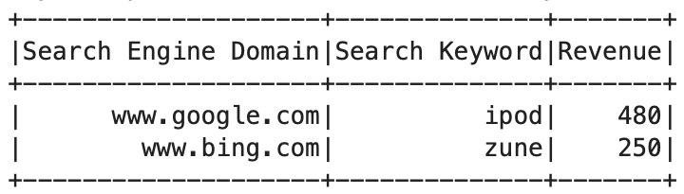
Results

Slide 6
Version Control
Github has been use for Version Control:
Repo link: https://github.com/sukanyade/Adobe
Source Control Process:
Create a master branch
Create a fork for individual developers
Create a new branch for each feature
Run unit testcases after completing each feature
Create a Pull Request to merge with the master branch
Deploy the code from master branch to the right environment

Slide 7
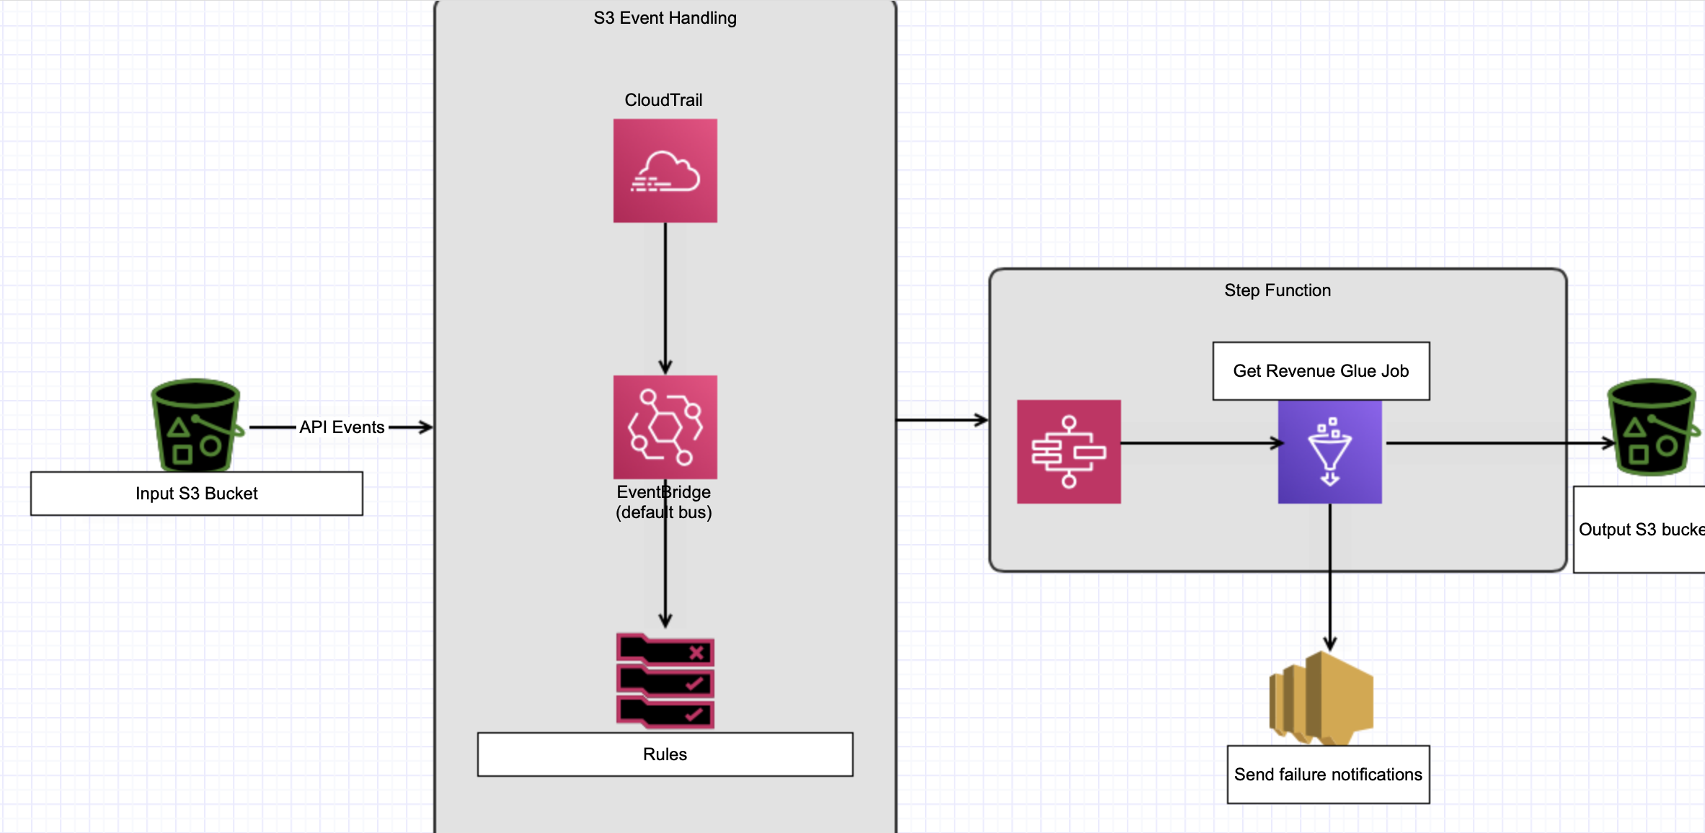
Solution Design

Slide 8
DEMO

Slide 9
Current Job Performance
Sample data volume size – 6KB
Run on Glue
Worker type – G1.X(4vCPU and 16 GB RAM)
Number of workers – 2
Glue 3.0 with optimizes cost and resource usage by dynamically scaling the number of workers during execution
Execution time – Less than a minute

Slide 10
Next Steps
Implement CI/CD for automating deployment process.
Configure AWS Localstack for running unit cases without consuming AWS resources.
Configure Spark UI for monitoring job performance and further optimizing Spark configurations.

