Slide 1

WOMEN SAFETY WITH LOCATION TRACKING &
EMERGENCY ALERTS
by
M.SUKANYA
Roll No. 224G1A05A8
G.NANDINI
Roll No. 224G1A0557
V.AKHILA
Roll No. 224G1A0503
Under the guidance of
Dr. T. Venkata Naga Jayudu, M.Tech., Ph.D
Professor
Department of Computer Science and Engineering
Srinivasa Ramanujan Institute of Technology
Autonomous
Rotarypuram Village, B K Samudram Mandal, Ananthapuramu – 515701.
2025-2026
B - 14
Dept. of Computer Science and Engineering
Srinivasa Ramanujan Institute of Technology
1

Slide 2
Contents
Women Safety with Location Tracking & Emergency Alerts
Title Justification
Abstract
Problem statement
Objectives of Project
Literature survey for objectives
Proposed Work -(Methods to be followed for proposed system)
References
GitHub Link
Queries
Srinivasa Ramanujan Institute of Technology

Slide 3
Title Justification
Women Safety with Location Tracking & Emergency Alerts
The title “Women Safety with Location Tracking and Emergency Alerts” clearly represents the purpose of the project.
It focuses on providing instant help to women by enabling SOS alerts and real-time location tracking.
The title highlights- both safety and technology, making the project goal simple and understandable.
Srinivasa Ramanujan Institute of Technology

Slide 4
Abstract
Women Safety with Location Tracking & Emergency Alerts
Women’s safety is a major concern in today’s society due to increasing incidents of harassment, stalking, and emergency situations. This project proposes a mobile and web-based system that enables women to quickly send an emergency alert through a one-tap SOS button or shake gesture. The system automatically shares the user’s live location with trusted contacts and the nearest police station. A web dashboard is used to monitor real-time movement and alert status. The objective is to reduce response time, improve safety, and ensure immediate support using GPS, cloud communication, and automated notification technologies.
Srinivasa Ramanujan Institute of Technology

Slide 5
Problem Statement
Women Safety with Location Tracking & Emergency Alerts
• Many women face unsafe situations such as harassment, kidnapping, and emergency situations where they cannot call for help.
• Family members and police often do not know the exact location of the victim during the emergency.
• Delayed communication and lack of real-time tracking reduce the chances of receiving quick help.
• There is a need for an easy, reliable system that instantly sends alerts and shares live location to trusted contacts and nearby police.
Srinivasa Ramanujan Institute of Technology

Slide 6
Objectives of Project
Women Safety with Location Tracking & Emergency Alerts
Objective 1:
To develop a platform that allows women to trigger an emergency alert instantly using a mobile application.
Objective 2:
To provide real-time live location tracking and automatically notify emergency contacts and the nearest police station for faster response.
Srinivasa Ramanujan Institute of Technology

Slide 7
Women Safety with Location Tracking & Emergency Alerts
Literature Survey
Existing safety apps such as Raksha, Himmat, and SOS features in smartphones provide alerts but lack continuous location tracking or police integration.
Research papers highlight the need for real-time tracking, multi-level alerting, and faster response mechanisms.
Studies show that emergency communication should be automated rather than requiring manual calling.
Based on this, the project focuses on improving alert speed, accuracy, and connectivity with contacts and police.• Existing safety apps such as Raksha, Himmat, and SOS features in smartphones provide alerts but lack continuous location tracking or police integration.
• Research papers highlight the need for real-time tracking, multi-level alerting, and faster response mechanisms.
• Studies show that emergency communication should be automated rather than requiring manual calling.
• Based on this, the project focuses on improving alert speed, accuracy, and connectivity with contacts and police.
B-14

Slide 8
Proposed System
Women Safety with Location Tracking & Emergency Alerts
• The user registers in the mobile application and adds trusted emergency contacts.
• During an unsafe situation, the user triggers SOS through a button, shake detection, or hardware key press.
• The app sends the user’s GPS coordinates to the backend server.
• The server identifies the nearest police station using stored latitude–longitude and distance calculation.
• Alerts are sent to contacts and police through SMS/Email/Notification with a live location link.
• A web dashboard tracks the user’s movement in real time until the user marks themselves safe.
Srinivasa Ramanujan Institute of Technology

Slide 9
References
Women Safety with Location Tracking & Emergency Alerts
[1] Google Maps API Documentation, “Geolocation and Mapping Services,” 2024.
[2] Firebase Realtime Database, “Live Data Synchronization,” Google Developers, 2023.
[3] K. Sharma, “Women Safety Application using GPS Tracking,” IEEE Conference, pp. 1–4, 2021.
[4] Twilio, “SMS Alert API Documentation,” 2024.
Srinivasa Ramanujan Institute of Technology

Slide 10
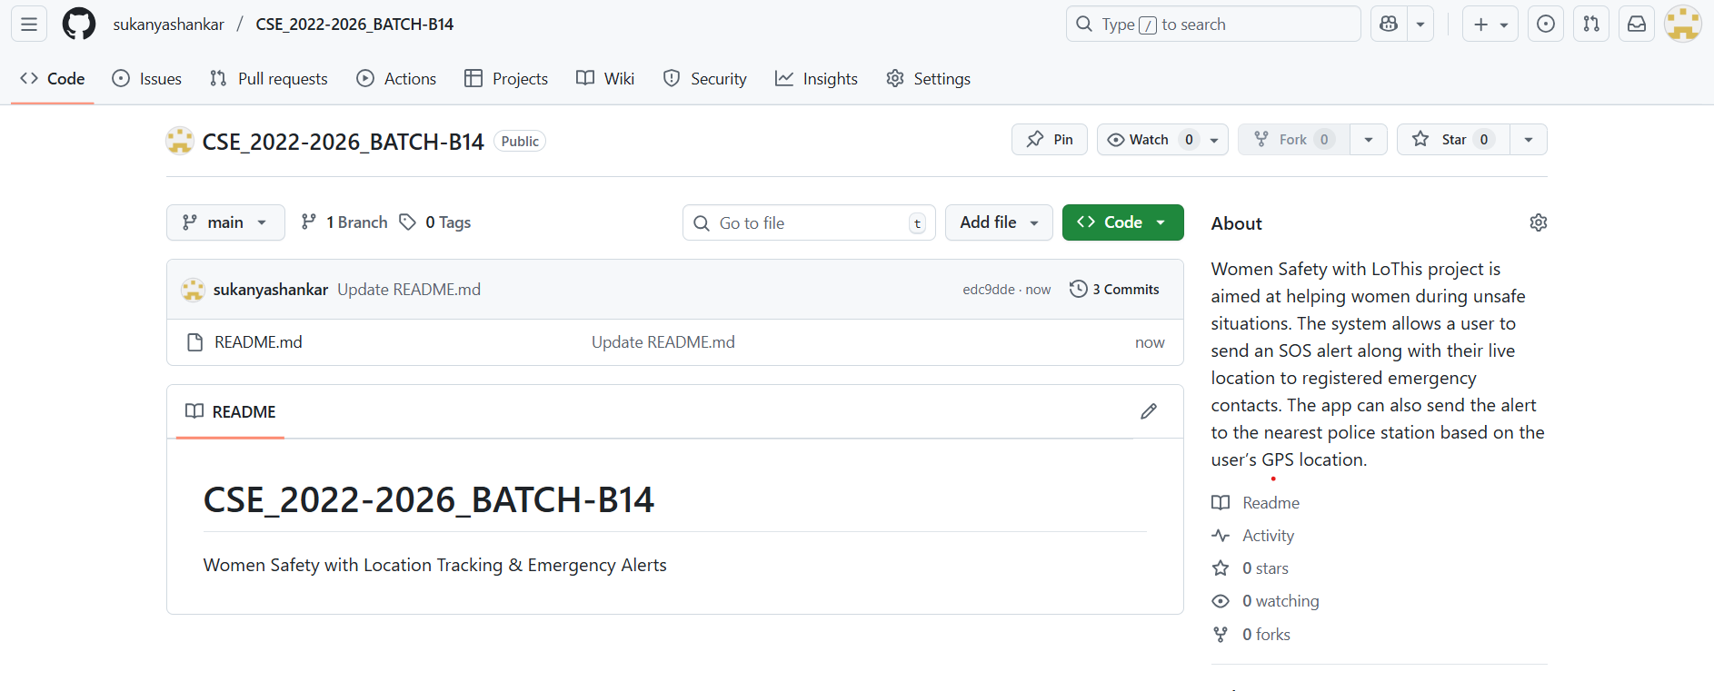
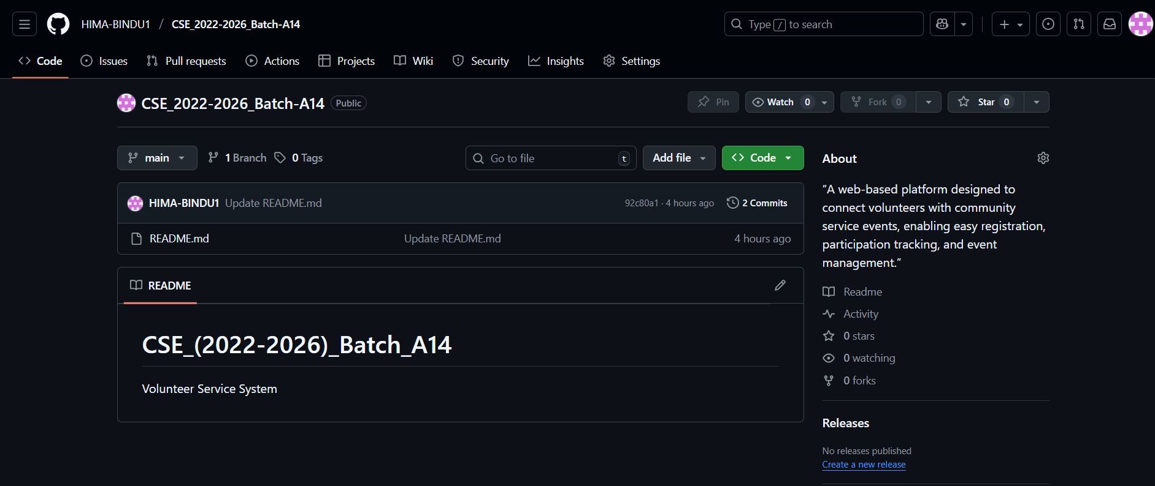
Git Hub Dashboards of each student
Women Safety with Location Tracking & Emergency Alerts
link of the Github : https://github.com/sukanyashankar/CSE_2022-2026_BATCH-B14
Srinivasa Ramanujan Institute of Technology

Slide 11
Any Queries?
Women Safety with Location Tracking & Emergency Alerts
Srinivasa Ramanujan Institute of Technology

