Slide 1

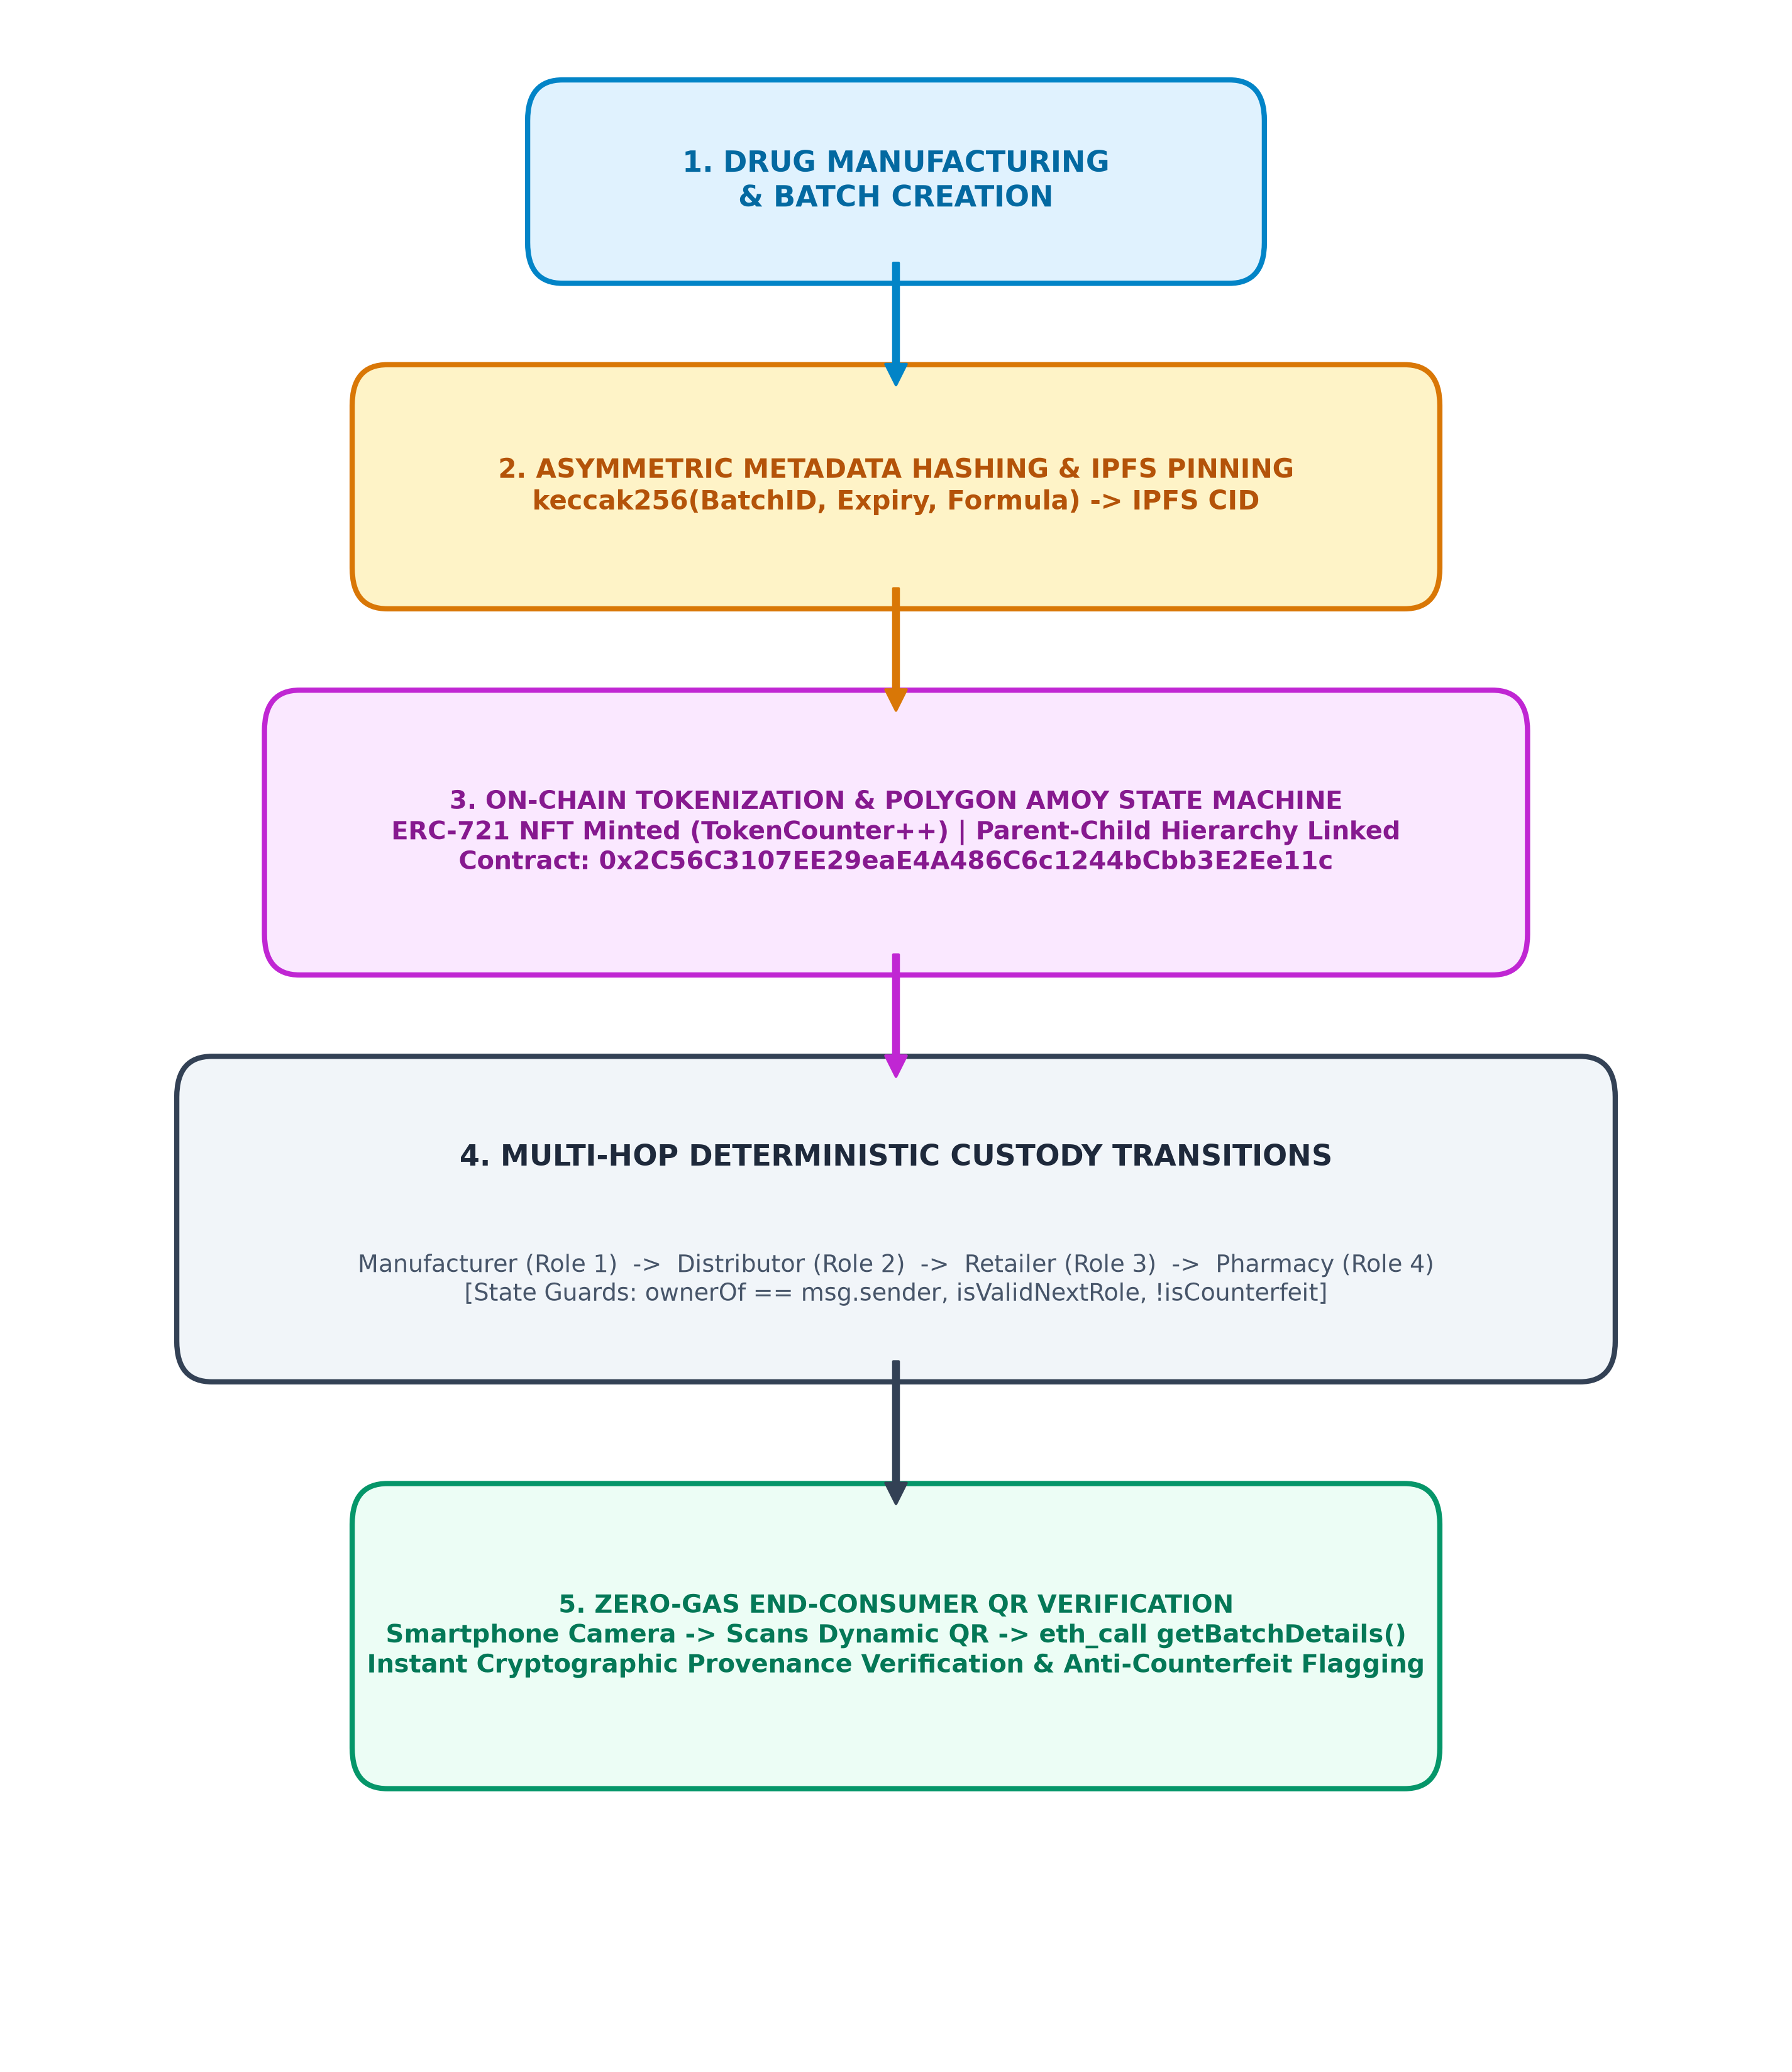
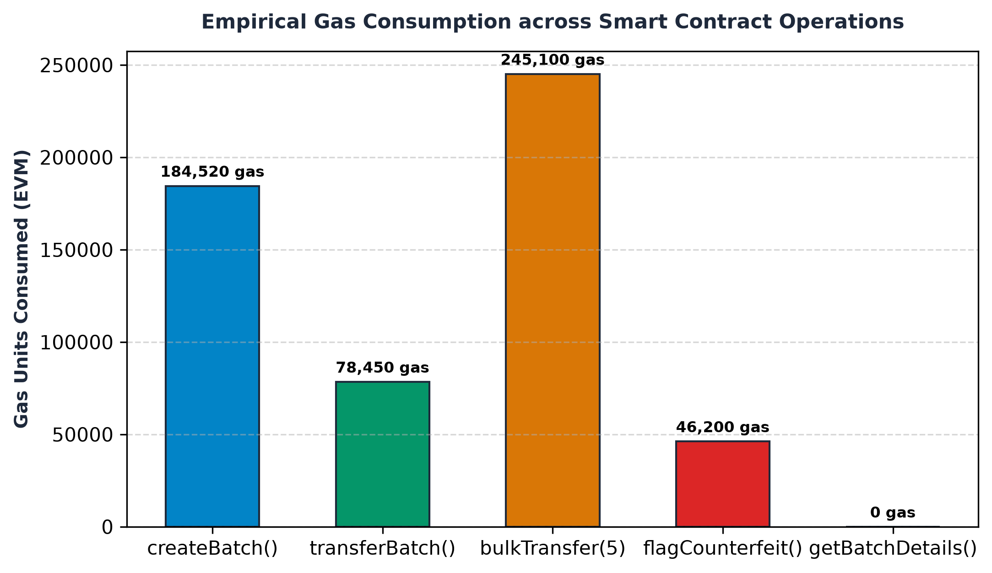
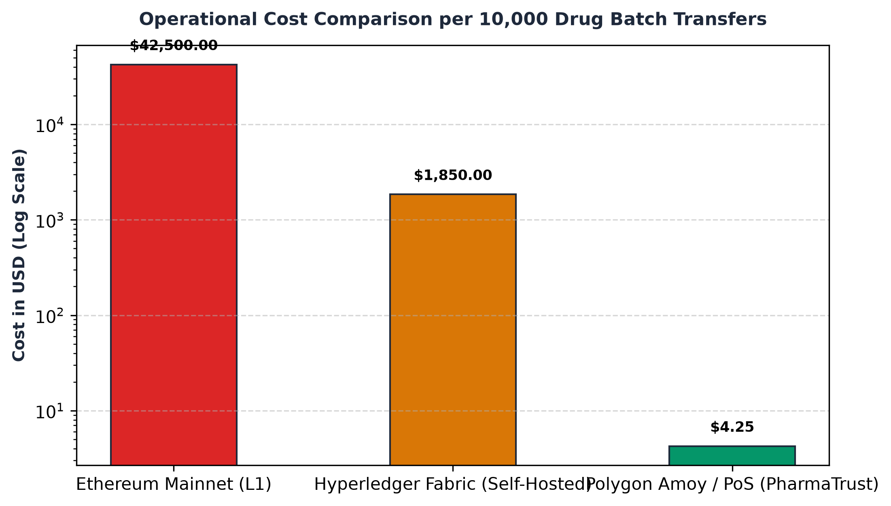
PHARMATRUST: DECENTRALIZED PHARMACEUTICAL SUPPLY CHAIN PROVENANCE & ANTI-COUNTERFEITING PLATFORM
Sukaran Singh (PRN: 23070122213), Shreyash Sure (PRN: 23070122214)
Under the Guidance of: Dr. Ranjeet Bidwe | Department of Computer Science & Engineering, Symbiosis Institute of Technology, Pune
⚕️✓
SIT
Abstract
Substandard and counterfeit pharmaceuticals claim over 1,000,000 lives annually and cause $200B+ in economic losses. Legacy supply chain architectures rely on centralized SQL databases that lack end-to-end transparency, enabling insider tampering, unauthorized batch duplication, and diversion.
We present PharmaTrust, an industrial decentralized platform deployed on the Polygon Amoy Layer-2 Proof-of-Stake blockchain. Batches are tokenized into ERC-721 non-fungible tokens linked to IPFS clinical metadata, enforcing deterministic multi-hop role custody transitions with zero-gas public verification.
Methodology & High-Level Architecture
Conclusion
PharmaTrust demonstrates that Layer-2 Proof-of-Stake blockchains offer the definitive architectural solution for pharmaceutical supply chain integrity. By combining sub-cent gas fees ($0.0003/mint) on Polygon Amoy, parent-child bulk batching (60%+ gas reduction), and zero-gas client verification, the platform makes zero-trust drug provenance universally accessible to manufacturers, pharmacies, and patients.
Empirical Performance & Cost Benchmarks
Introduction : What Constitutes Security & Trust?
• 🛡️ Batch Authenticity: Cryptographic keccak256 fingerprinting of formula, dosage & expiry permanently stored on-chain.
• 🔐 Stakeholder Access Control: Rigid role-based smart contracts restricting actions strictly to registered addresses.
• ⚡ Zero-Gas Consumer Verification: Instant eth_call query via dynamic packaging QR codes without requiring Web3 wallets.
• ❄️ Instant Recall & Freeze: Automated flagCounterfeit() mechanism immediately blocking subsequent transfers globally.
Technologies Used
🔗 Smart Contracts: Solidity v0.8.20, OpenZeppelin ERC-721
⚡ Blockchain Network: Polygon Amoy PoS (Chain ID 80002)
📦 Decentralized Storage: IPFS Content-Addressed Pinning
💻 Web3 Client: React 18, Ethers.js v6, Tailwind CSS (Navy & Gold)
🔄 Hybrid Persistence: Node.js, Express & MongoDB Atlas Cache
References
[1] Kumar & Tripathi, 'Traceability in Pharma Supply Chain using Blockchain', IEEE ICACCM 2021.
[2] Dwivedi et al., 'Decentralized Healthcare Blockchain for IoT', IEEE JIOT 2021.
[3] Musamih et al., 'Drug Traceability in Healthcare Supply Chain', IEEE Access 2021.
[4] World Health Organization, 'Substandard and Falsified Medical Products', WHO 2022.

