Slide 1

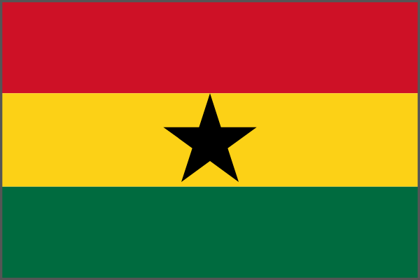
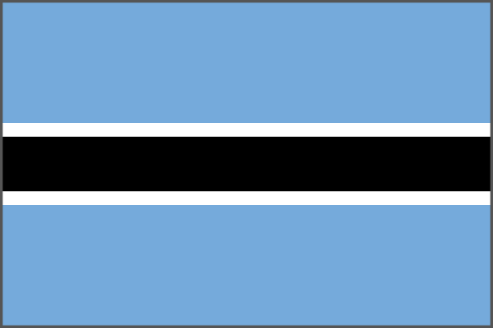
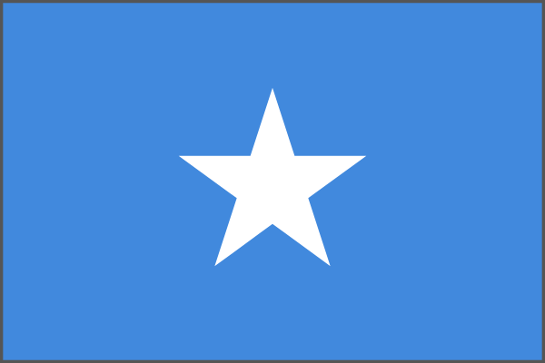
African flags
Look at the flags. Say the country names together.
Nigeria
Ghana
Botswana
Somalia
Nigeria, Ghana, Botswana and Somalia are countries in Africa.

Slide 2
Our flag picture key
Look at the colours, stripes and stars.
Nigeria
Ghana
Botswana
Somalia

Slide 3
1. Find Nigeria
Listen to the country name. Point to its flag.
Left
Right

Slide 4
Nigeria
The right flag is Nigeria.
Green, white and green stripes

Slide 5
2. Find Ghana
Listen to the country name. Point to its flag.
Left
Right

Slide 6
Ghana
The left flag is Ghana.
Red, yellow and green with a black star

Slide 7
3. Find Botswana
Listen to the country name. Point to its flag.
Left
Right

Slide 8
Botswana
The right flag is Botswana.
Blue with a black stripe edged in white

Slide 9
4. Find Somalia
Listen to the country name. Point to its flag.
Left
Right

Slide 10
Somalia
The left flag is Somalia.
Blue with a white star

Slide 11
Colours and stars
Which flag has a black star? Point to a flag with blue.
Nigeria
Ghana
Botswana
Somalia
Which flag is your favourite?

Slide 12
Colours and stars answers
Ghana has a black star.
Black star
Blue
Blue
Botswana and Somalia both have blue on their flags.

