Slide 1
Intraday Stock Price Analysis
Project 1 - Group 5
By Puja, Sukarno and Ajay

Slide 2
Project Context & Goals
Objective
Stock Market Investing is a tough job for retail investors. You can either rely on Fund Managers or do your own analysis to find the right stocks. With this project we want to provide insights to investors to make better investing/trading decisions.
Consumers
Retail Investors and Data analysts are able to pull the data from AWS Services like RDS and S3.

Slide 3
Dataset
The source of dataset is sourced from IEX Cloud API.
https://iexcloud.io/console/home
IEX Cloud provides real time prices, volume, and quotes for all NMS US securities.
https://iexcloud.io/docs/api/#intraday-prices
Datasets are updating every minute. The data set is delayed by 15 minutes for free accounts.

Slide 4
Solution Architecture Diagram
Extract
Transform
Load
Pipeline
Parquet
Docker
Postgres
AWS RDS
ECR
ECS + CRON

Slide 5
Extract
Real world API's are utilised in extracting data. The data contains per minute stock analysis from different stock code.The data can be accessed from
passing parameters as to get requests from API
params = {
"token" : iex_api_key
}
where, iex_api_key is the secret key.
base_url = f"https://cloud.iexapis.com/stable/stock/{stock_ticker}/intraday-prices"
In the base url, stock ticker is taken config_stock_code.yaml file , which is user configurable.Stock code can changed according to user's preferences.

Slide 6
Extract
The extraction part takes out table with columns as json file:
x = { "date": "2017-12-15", "minute": "09:30", "label": "09:30 AM", "marketOpen": 143.98,
"marketClose": 143.775, "marketHigh": 143.98, "marketLow": 143.775, "marketAverage": 143.889,
"marketVolume": 3070, "marketNotional": 441740.275, "marketNumberOfTrades": 20, "marketChangeOverTime": -0.004,
"high": 143.98, "low": 143.775, "open": 143.98, "close": 143.775,
"average": 143.889, "volume": 3070, "notional": 441740.275, "numberOfTrades": 20,
"changeOverTime": -0.0039
}
Note:The above "x" doesn't contains stock_code, so in the final extracted data "stock_code" for each "x" is appended.So,the each row contains columns "stock_code" as extra element.

Slide 7
Transform
Transformations are made in aim to convert per minute data to per day data for per stock.
The following transformations are applied to the data to transformed table as stocks_intraday:
#Renaming
df = df.rename(columns={
"numberOfTrades": "numberoftrades"
})
#Adding column datetime that includes date and time both. Conversion of minutes into 24-hours format.
df["datetime"] = pd.to_datetime(df["minute"])
#Droping columns "date", "minutes" and labels, added datetime in prior step.
df = df.drop(df.columns[[0,1,2]],axis=1)
#Difference between open and close value across rows.
df["difference"] = (df["close"]-df["open"])

Slide 8
Transform
#Creation of new dataframe to analyse the raw dataframe for per day stock vlues.
df1 = pd.DataFrame()
# max() and min() of OPEN , CLOSE, HIGH, LOW value on per stock and applying LAMBDA function.
df1["max_open_value_per_day"] = df.groupby('stock_code').apply(lambda df: df["open"].max())
df1["min_open_value_per_day"] = df.groupby('stock_code').apply(lambda df: df["open"].min())
df1["max_close_value_per_day"] = df.groupby('stock_code').apply(lambda df: df["close"].max())
df1["min_close_value_per_day"] = df.groupby('stock_code').apply(lambda df: df["close"].min())
df1["max_high_per_day"] = df.groupby('stock_code').apply(lambda df: df["high"].max())
df1["min_high_per_day"] = df.groupby("stock_code").apply(lambda df: df["high"].min())
df1["max_low_per_day"] = df.groupby('stock_code').apply(lambda df: df["low"].max())
df1["min_low_per_day"] = df.groupby("stock_code").apply(lambda df: df["low"].min())

Slide 9
Transform
# Difference sum for per stock
df1["status_difference"] = df.groupby("stock_code").apply(lambda df: df["difference"].sum())
#mean() value for trades and volume on per stock by grouby() function and lambda mapping.
df1["trades_mean"] = df.groupby("stock_code").apply(lambda df: df["numberoftrades"].mean())
df1["volume_mean"] = df.groupby("stock_code").apply(lambda df: df["volume"].mean())

Slide 10
Incremental Staging on transformations
Applying incremental staging on transformed data to take out columns only that is required in everyday trading by taking four important columns from "stocks_intraday"(transformed in prior step) through jinja file.
( select
stock_code,
status_difference,
trades_mean,
volume_mean
from stocks_intraday
{% if table_exists %}
where
max_open_value_per_day > '{{ max_volume }}'
{% endif %} );

Slide 11
Load
In loading the database to the pgadmin,tables need to be loaded. If tables are first time loaded then new table is inserted in the pgadmin. If new data from website comes in "Upsert" function is utilised.
For staging transformational loading(staging_stock) , it is sourced from newly upserted transformed table(stocks_intraday) loaded in pgadmin.

Slide 12
Pipeline
ETL pipeline is executed from metadata logging initialisation and logging.info for keeping the history as coded in utility folder as "metadata_logging.py" and extracting the log through initialising the "log_table: "pipeline_logs" on config.yaml file.
Extract, Transform and Load are performed to get final loaded on pgadmin as "stocks_intraday" , "staging_stocks" and "pipeline_logs".

Slide 13
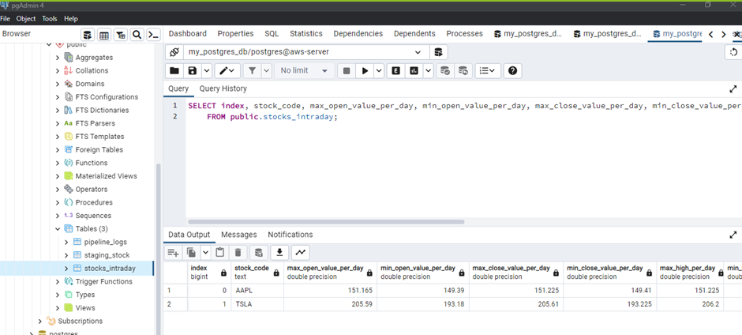
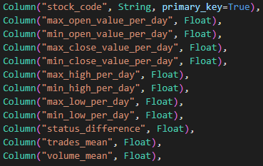
stocks_intraday table

Slide 14
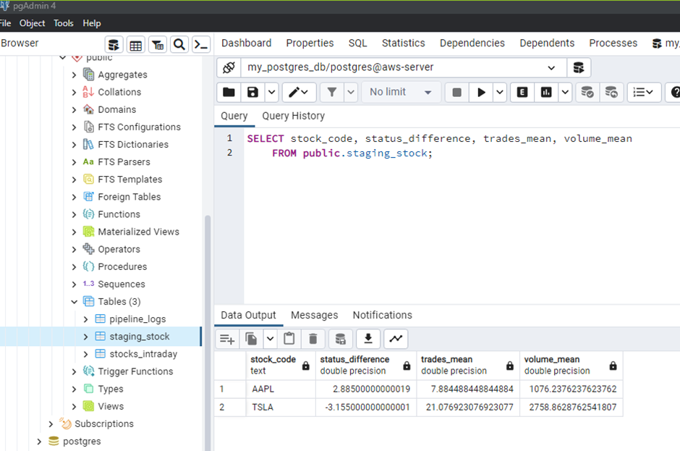
staging_stock table

Slide 15
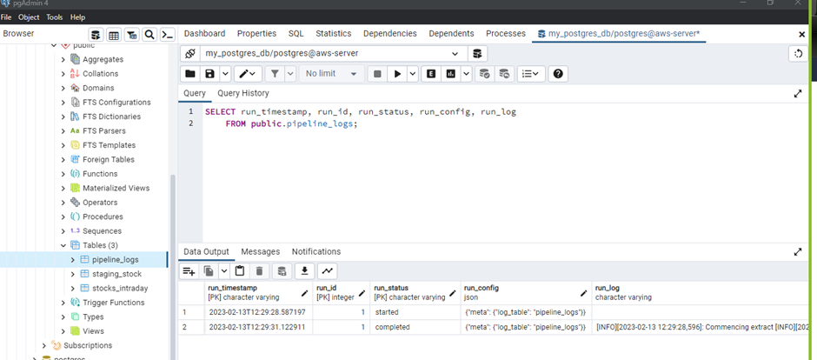
pipeline_log table

Slide 16
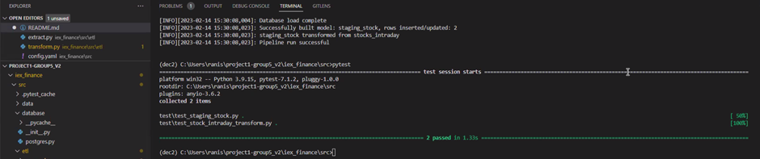
Pytest
Two unit testings are done stocks_intraday and staging_stock through mock table creation on transformation stage.Jinja sql used create mock tables.

Slide 17
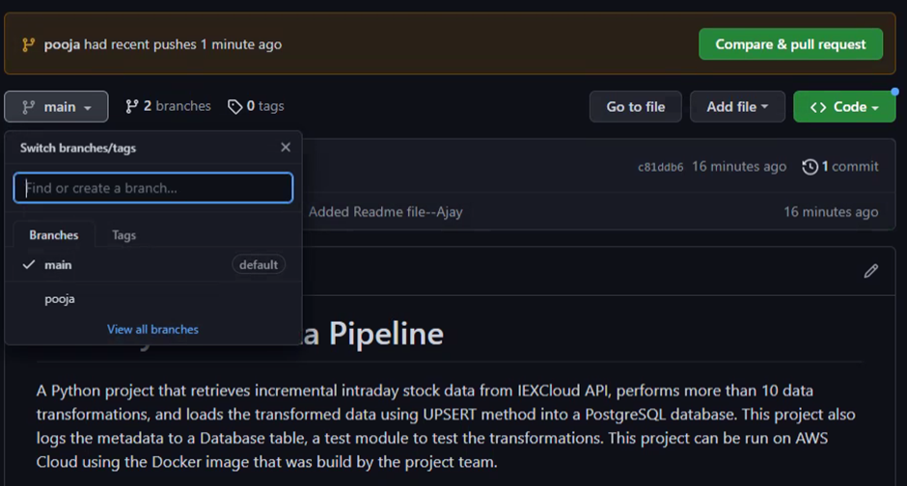
Github - Pull Request

Slide 18
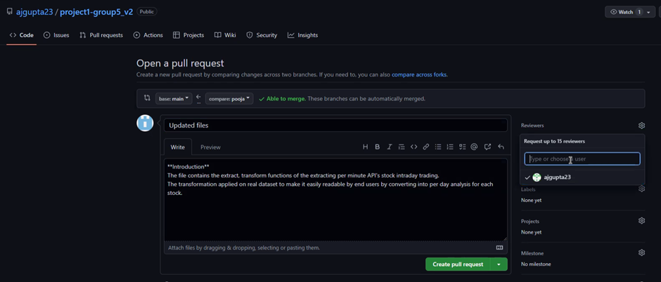
Github - Pull Request

Slide 19
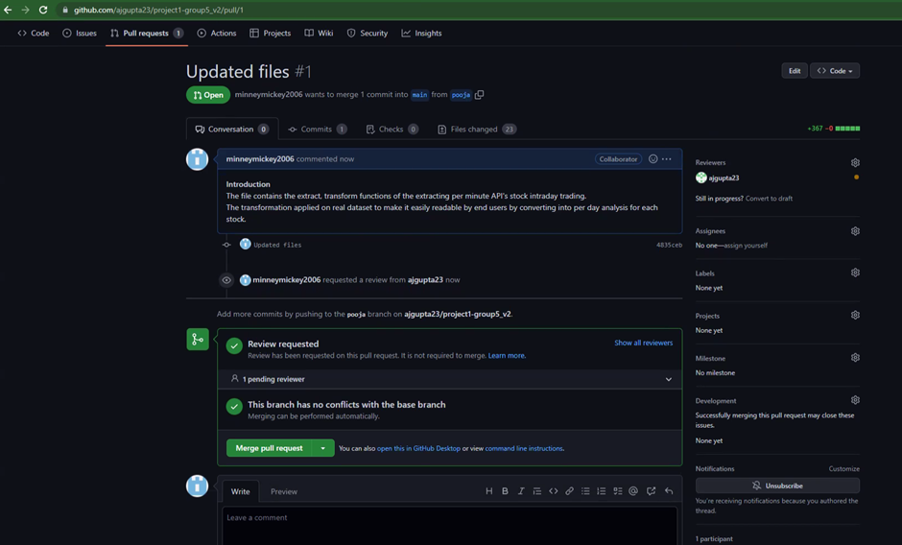
Github - Pull Request

Slide 20
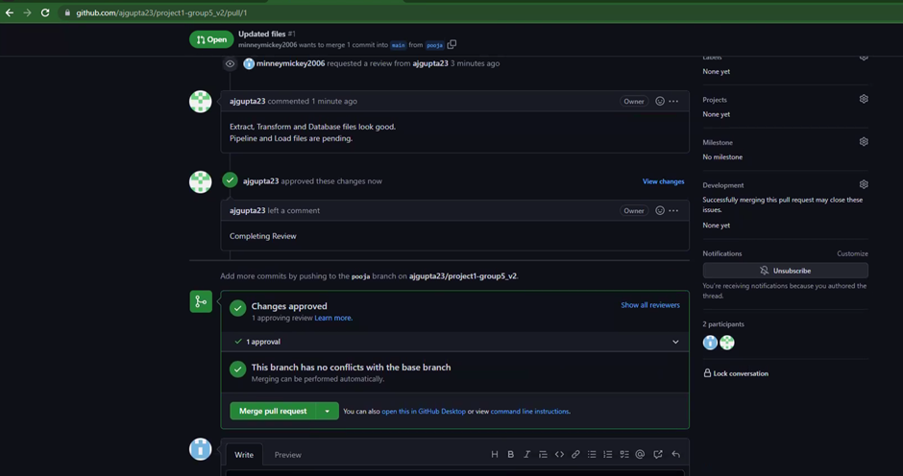
Github - Pull Request Approved

Slide 21
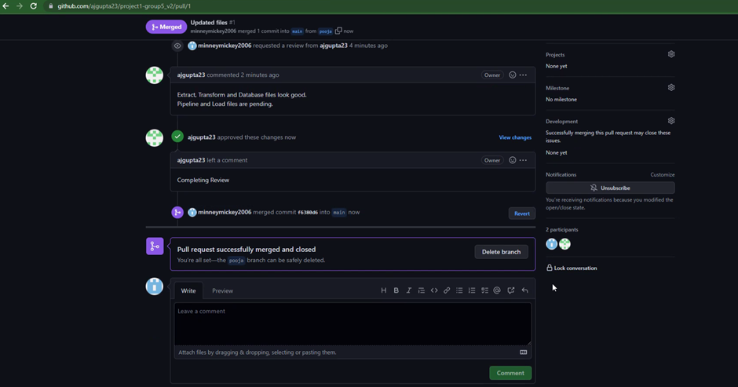
Github - Pull Request Merged

Slide 22
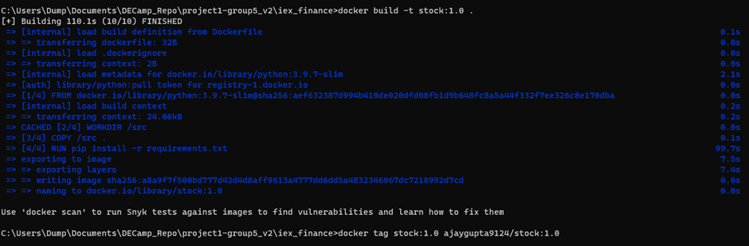
Docker - Build and Tag

Slide 23
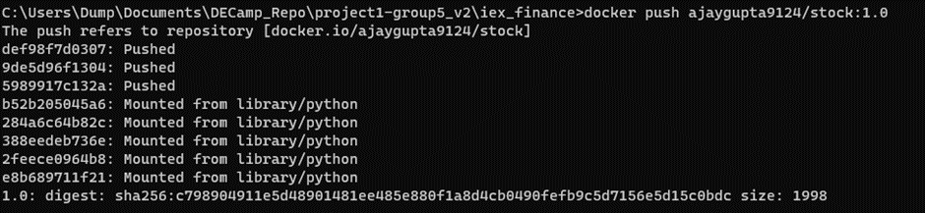
Docker - Push

Slide 24
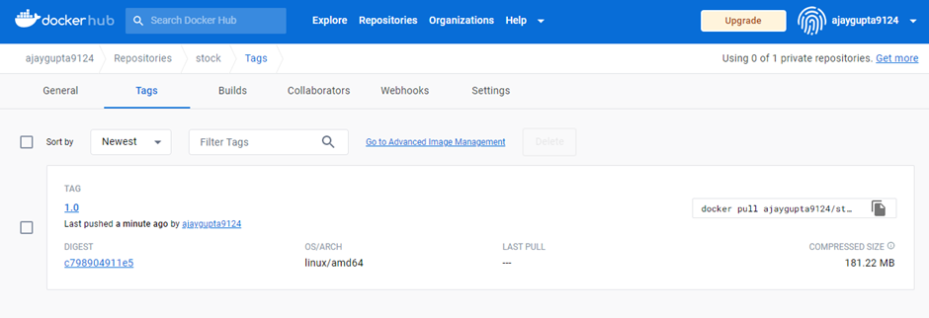
Dockerhub

Slide 25
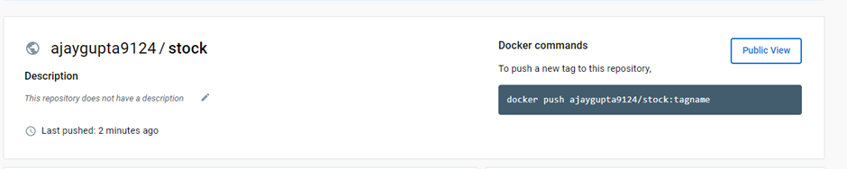
Dockerhub

Slide 26
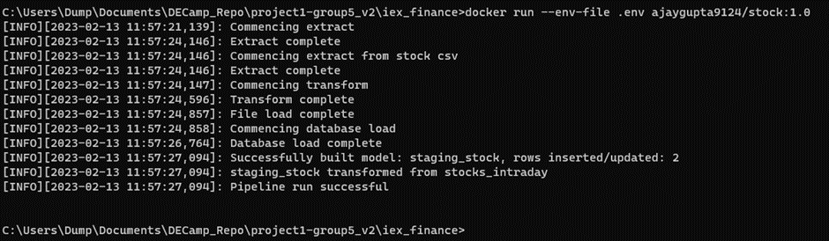
Docker - Run

Slide 27
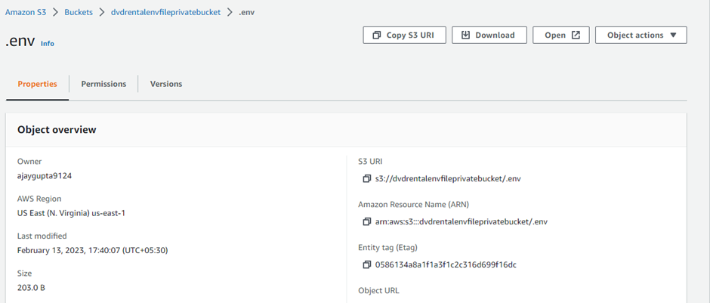
AWS - env file

Slide 28
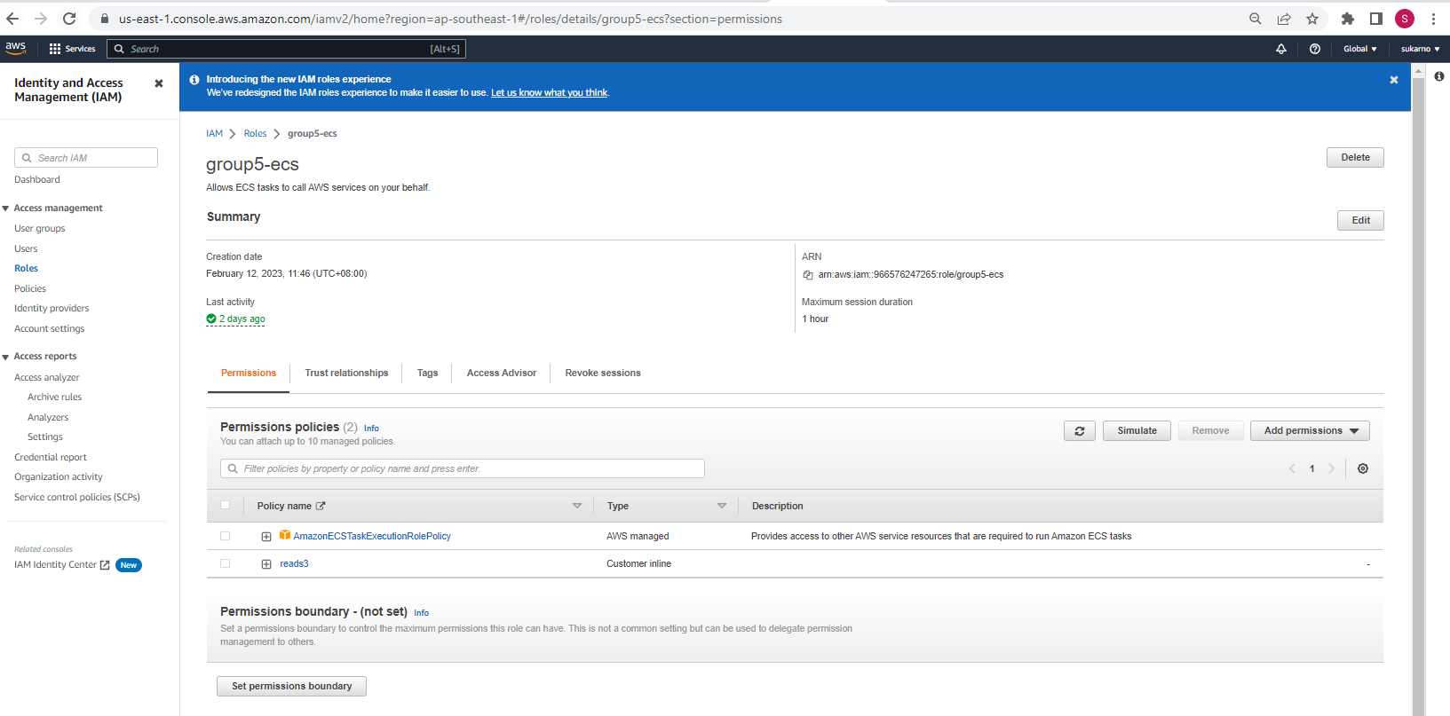
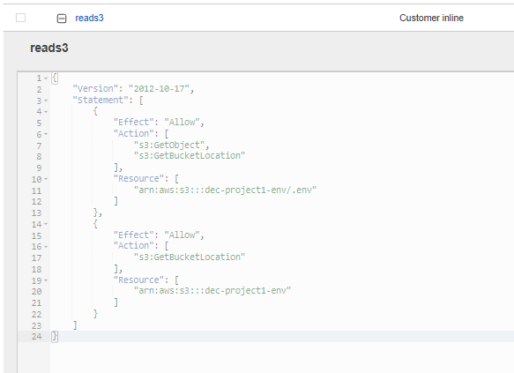
Create New Role To Allow ECS to Access S3 Bucket

Slide 29
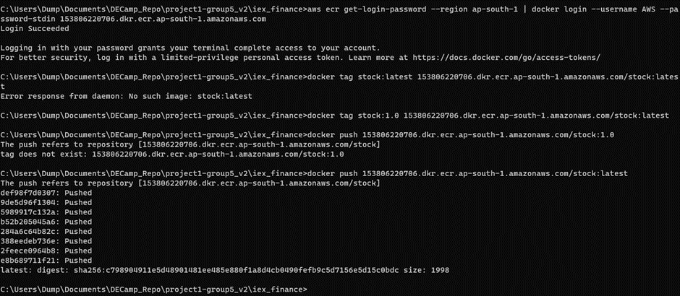
AWS - ECR

Slide 30
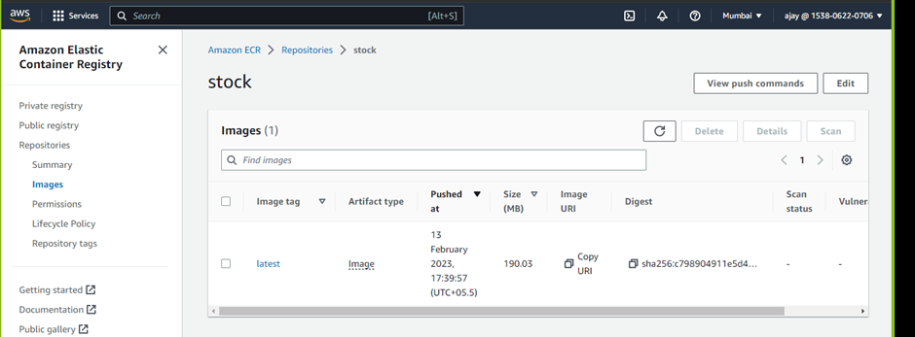
AWS - ECR

Slide 31
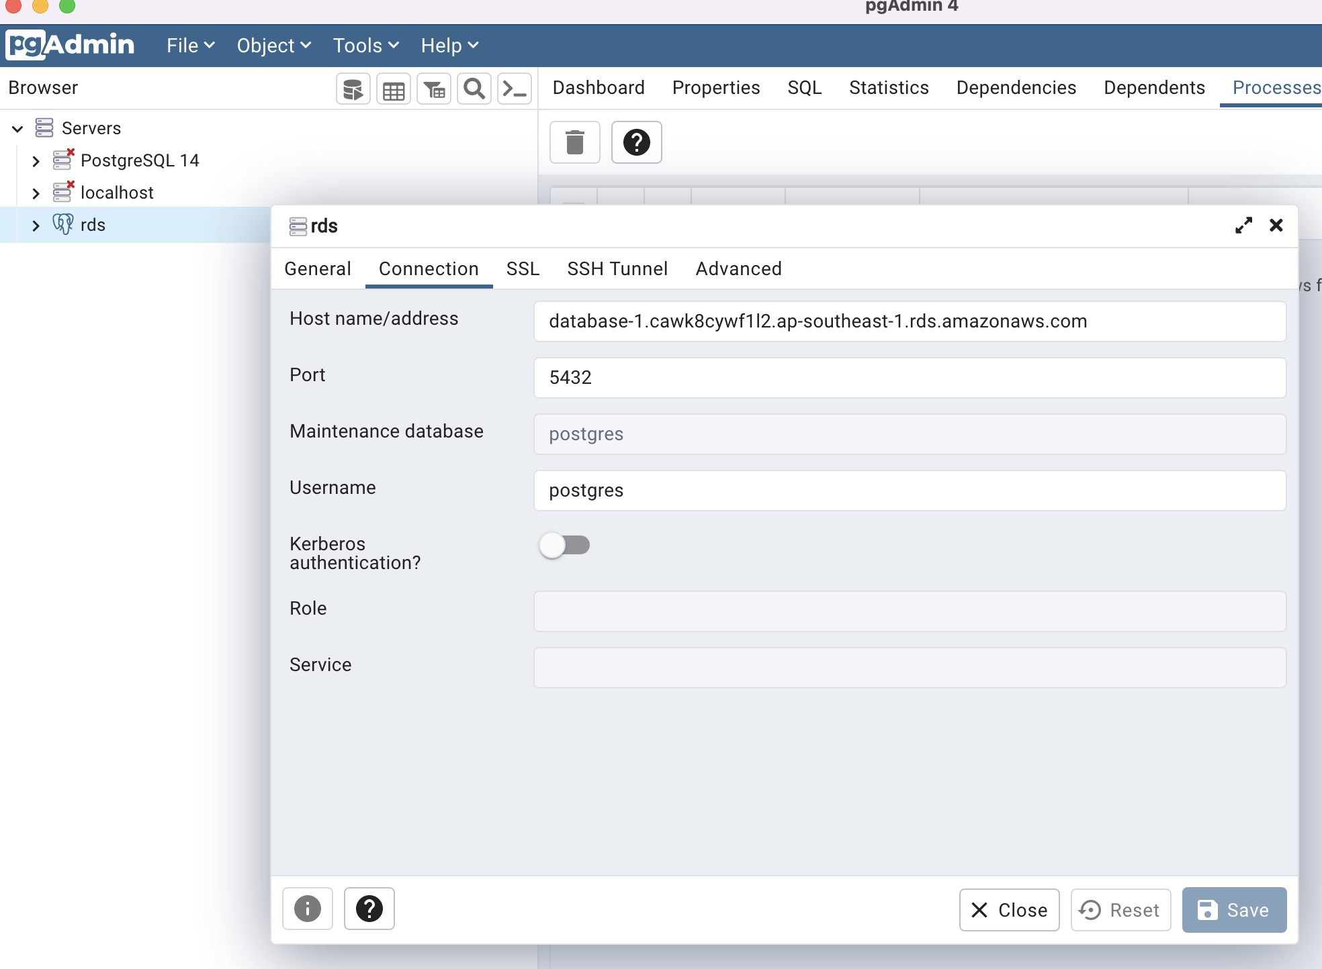
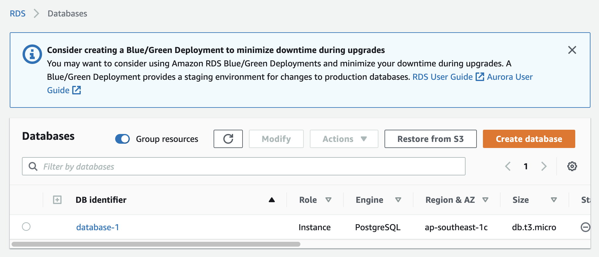
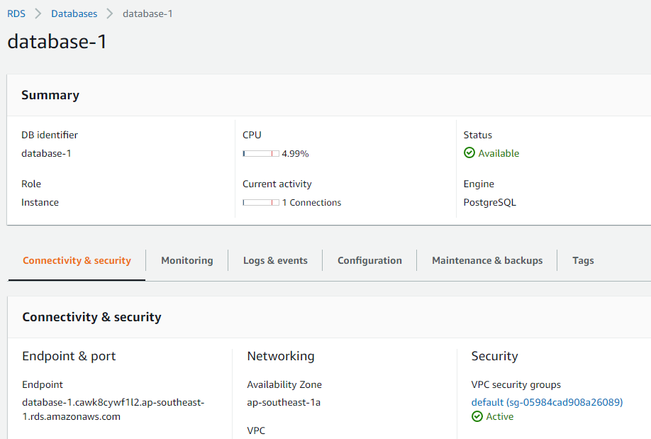
PGAdmin to AWS RDS

Slide 32
AWS - RDS

Slide 33
AWS - RDS

Slide 34
AWS - RDS

Slide 35
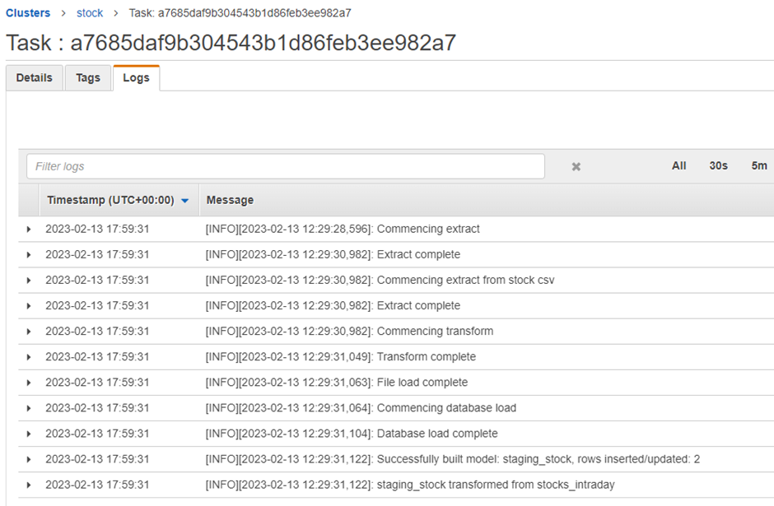
AWS - ECS Single Task Run

Slide 36
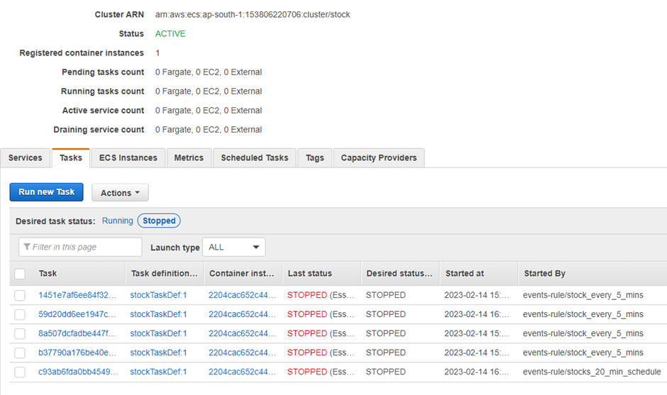
AWS - Scheduled Task - First Run

Slide 37
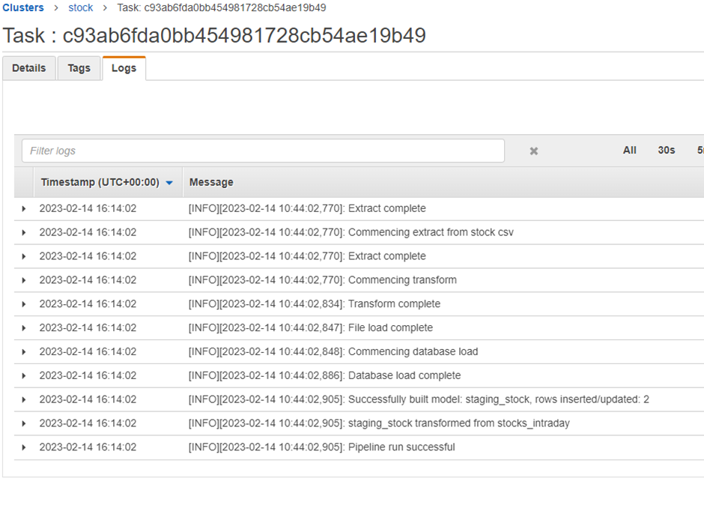
AWS - Scheduled Task - First Run

Slide 38
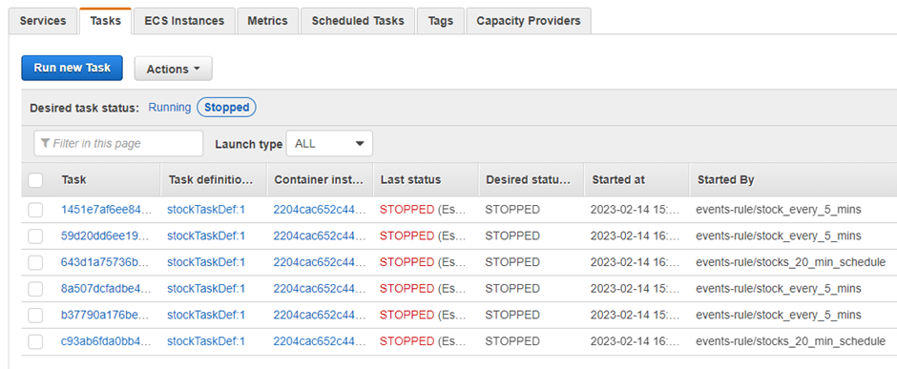
AWS - Scheduled Task - Second Run

Slide 39
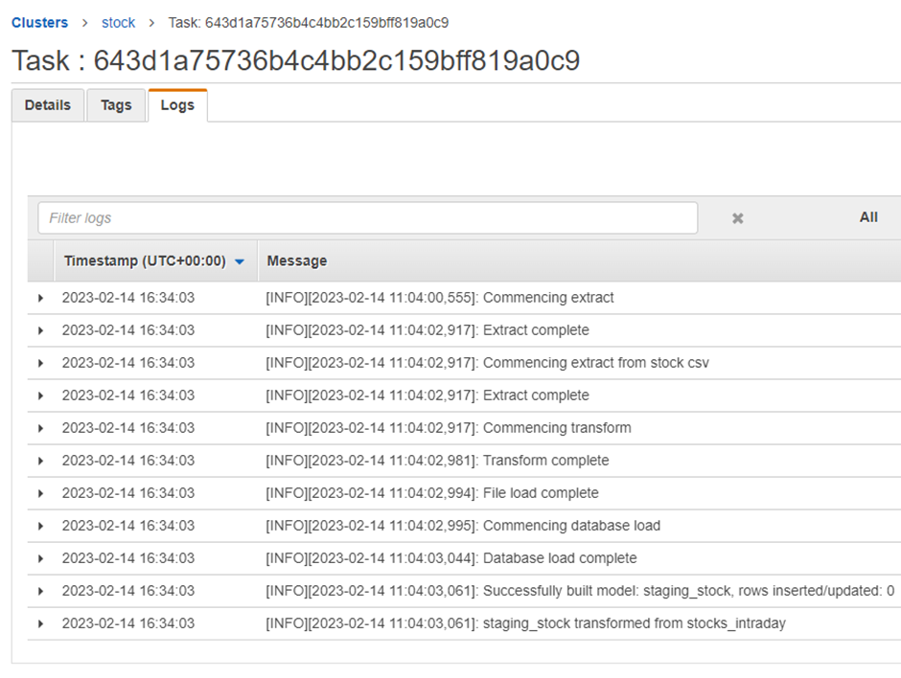
AWS - Scheduled Task - Second Run

Slide 40
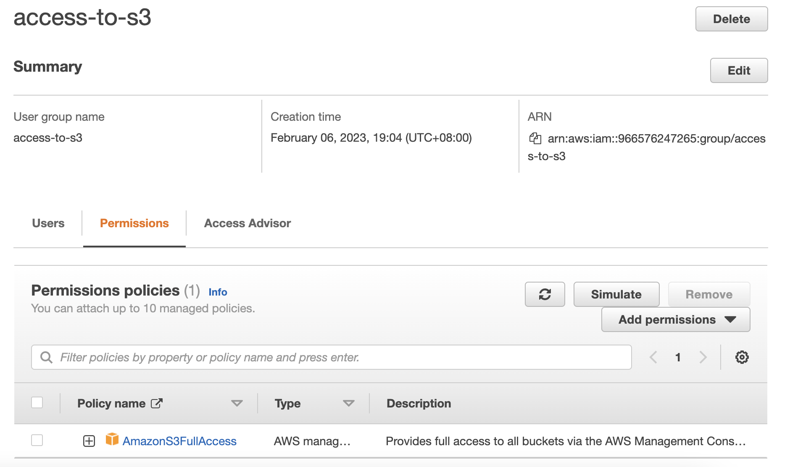
IAM User Group

Slide 41
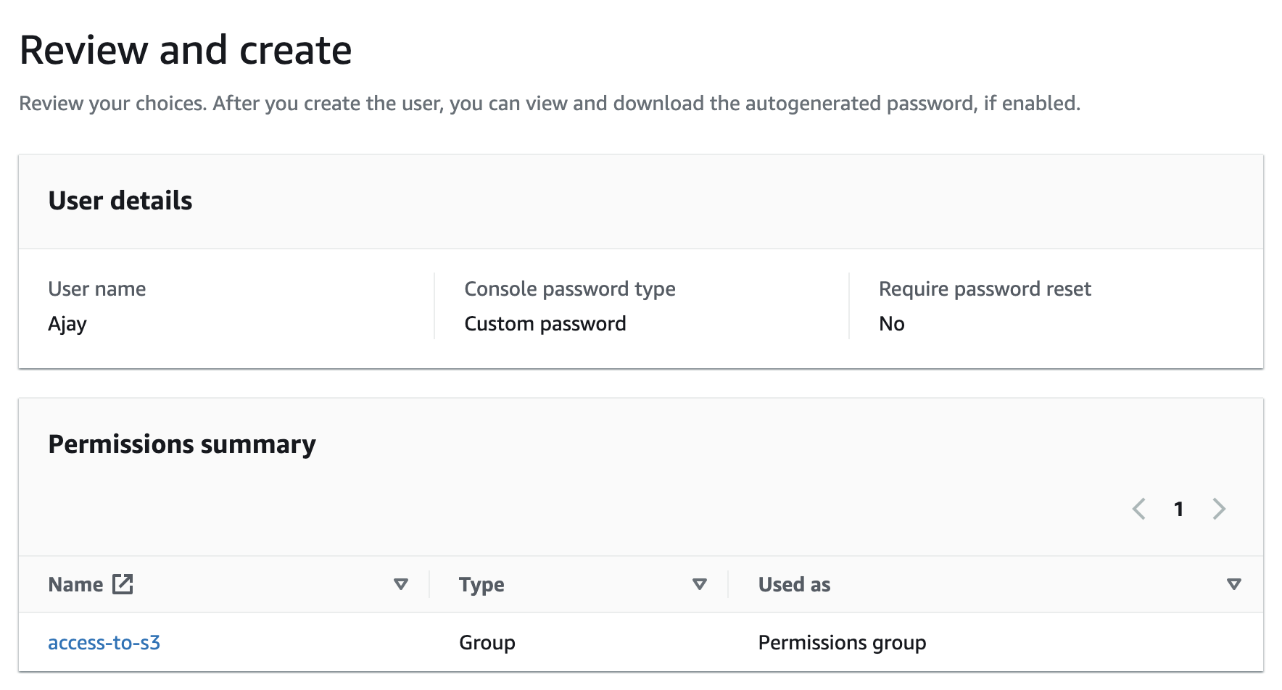
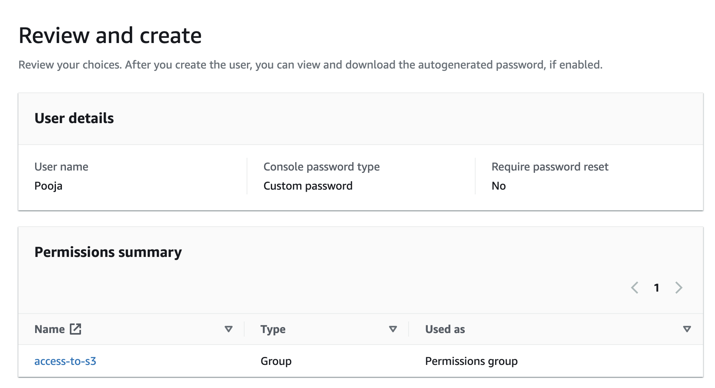
IAM Users
Ajay
Puja

Slide 42
Lesson Learnt
Learn to manage API’s in real world datasets and make it functional.
ETL process optimisation in terms of space and time complexity.
Learnt to manage work sharing and ideas brainstorming.
Understanding each person’s skill in area of specialization in group project.

