Slide 1
Adventure Work Analysis
Project 2 - Group 1
By Puja, Sukarno and Ajay
Notes:
Ajay

Slide 2
Project Context & Goals
Objective
Find effectiveness of different tables of sales, customer, product, employee based on different parameters to provide meaningful insights to boost sales.
Consumers
Investors and Data analysts are able to pull the data from Snowflake and visualise data in Preset.
Notes:
Ajay

Slide 3
Dataset
The source of dataset is sourced from adventure_works.
https://github.com/Data-Engineer-Camp/2023-01-bootcamp/tree/main/09-project-2/adventure_works
Adventure works is sample database provided by Microsoft for online transaction processing (OLTP).
Notes:
Ajay

Slide 4









Solution Architecture Diagram
Extract & Load
Visualisation
Transformation,
Dimensional Modelling
Notes:
Ajay

Slide 5
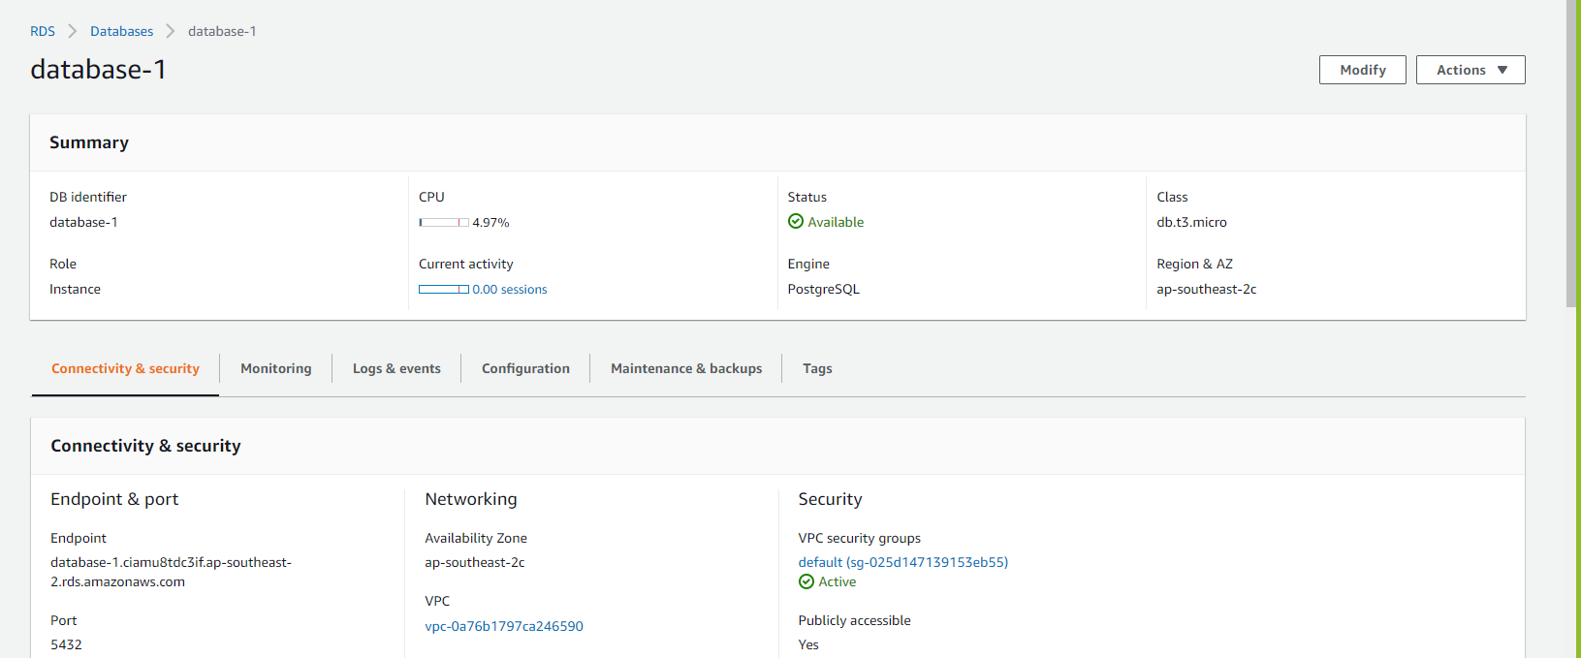
AWS RDS (Connection)
Notes:
Ajay

Slide 6
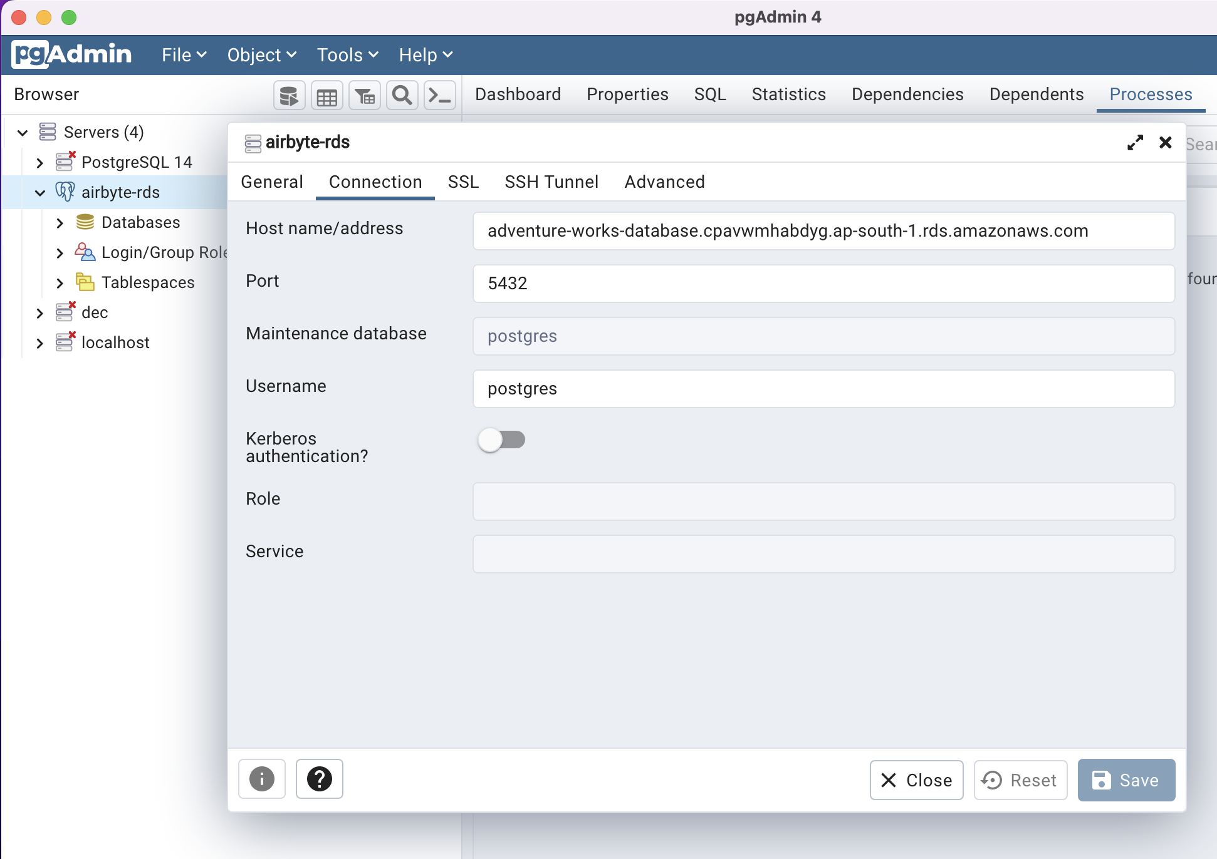
PgAdmin to AWS RDS (Connection)
Notes:
Ajay

Slide 7
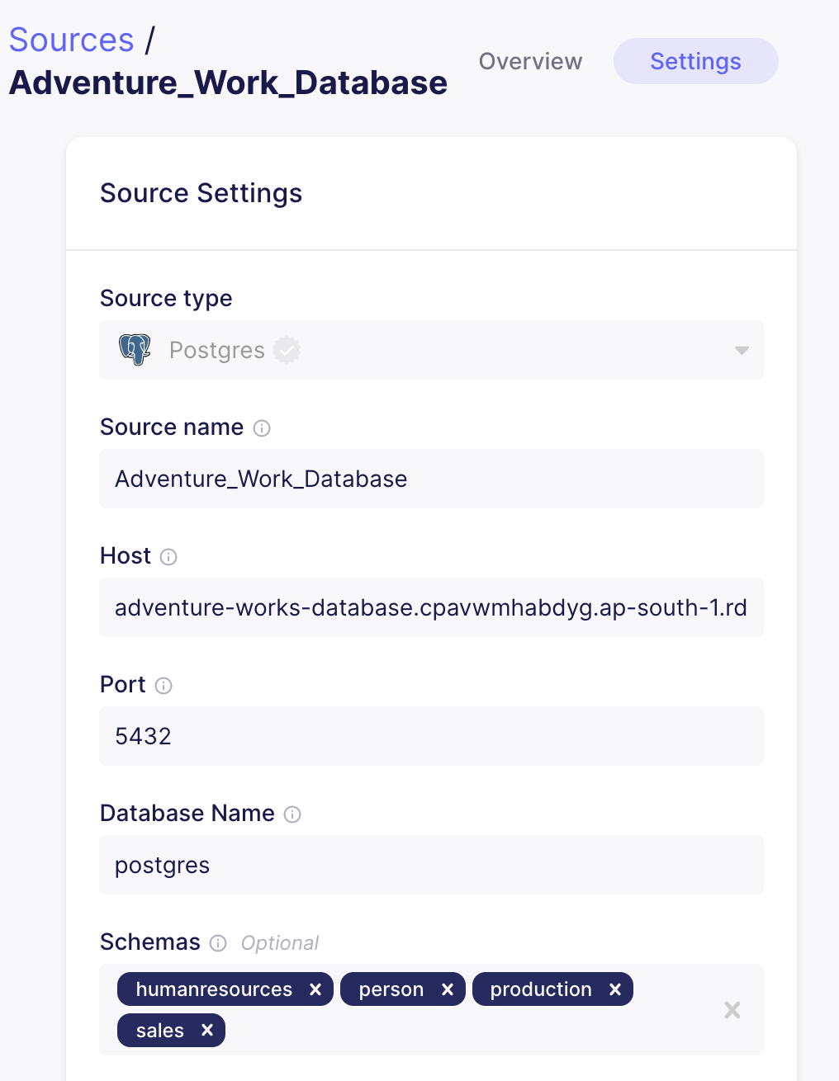
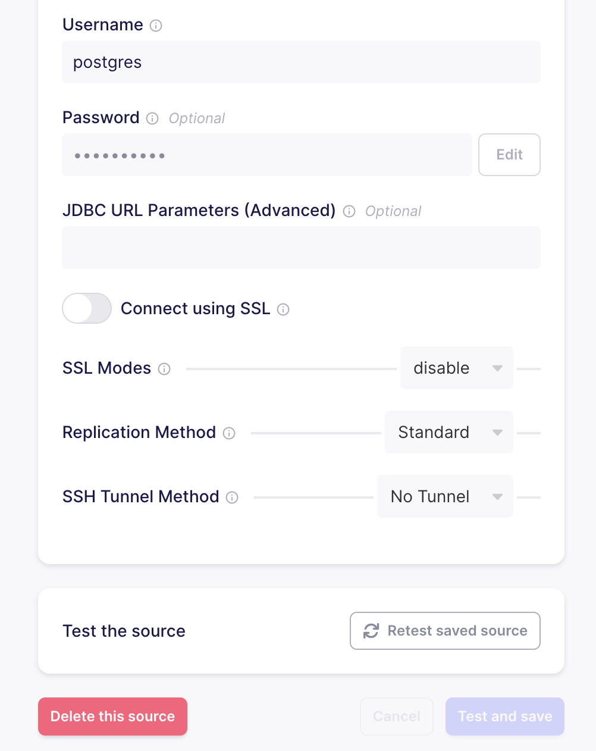
Extract (Airbyte Source)
Notes:
Sukarno

Slide 8
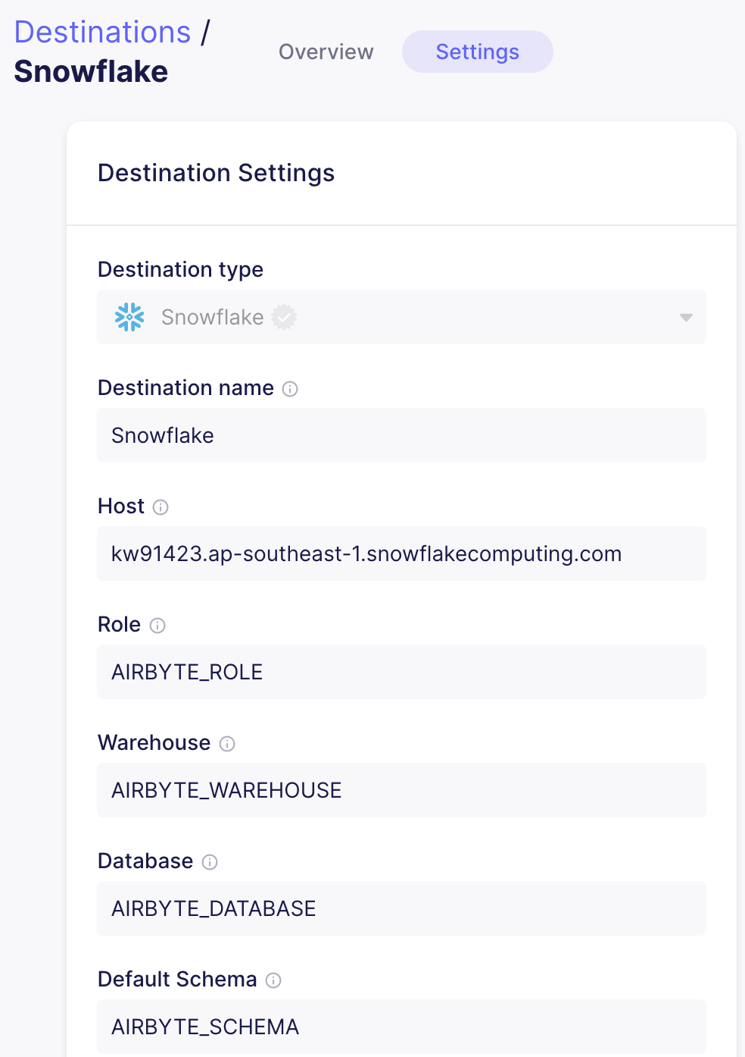
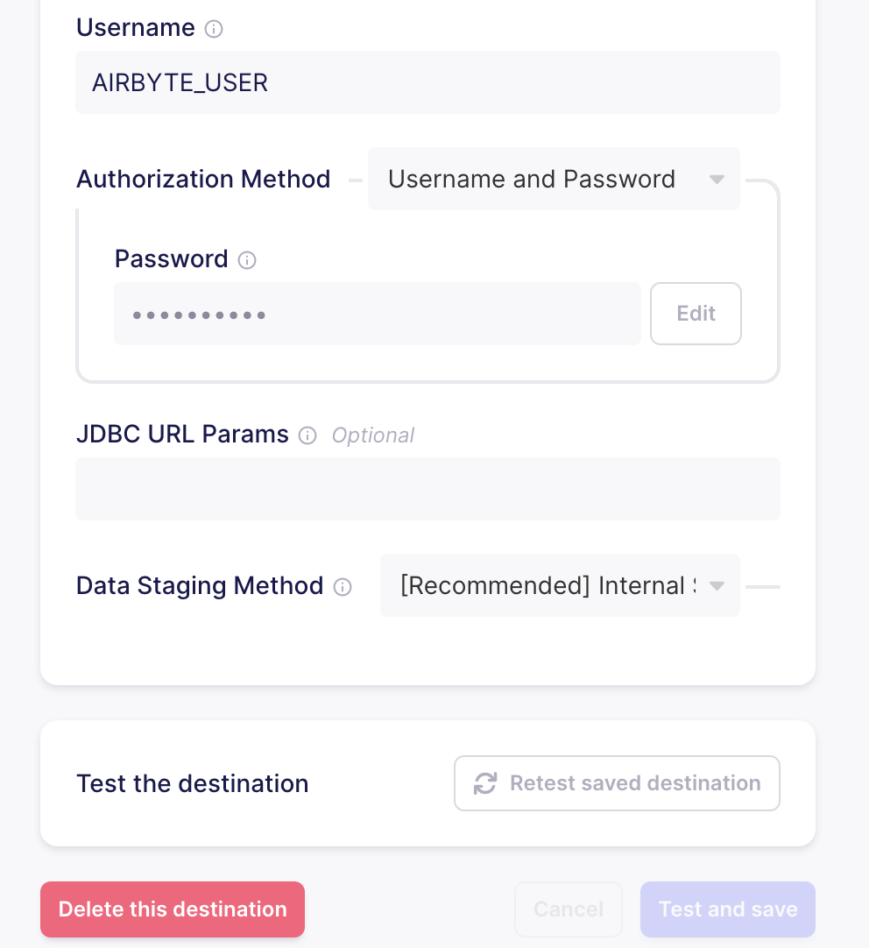
Load (Airbyte Destination)
Notes:
Sukarno

Slide 9
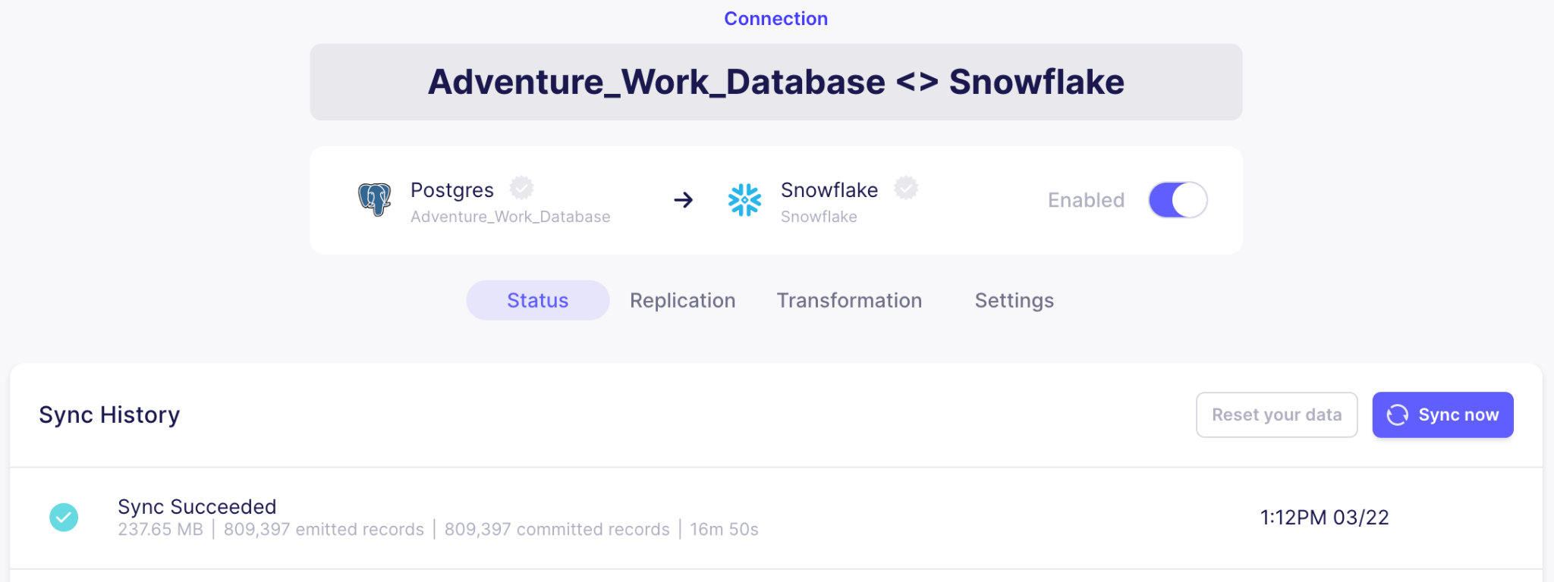
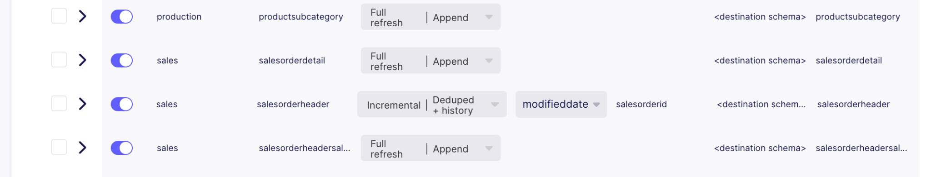
Connection (Airbyte)
Notes:
Sukarno

Slide 10
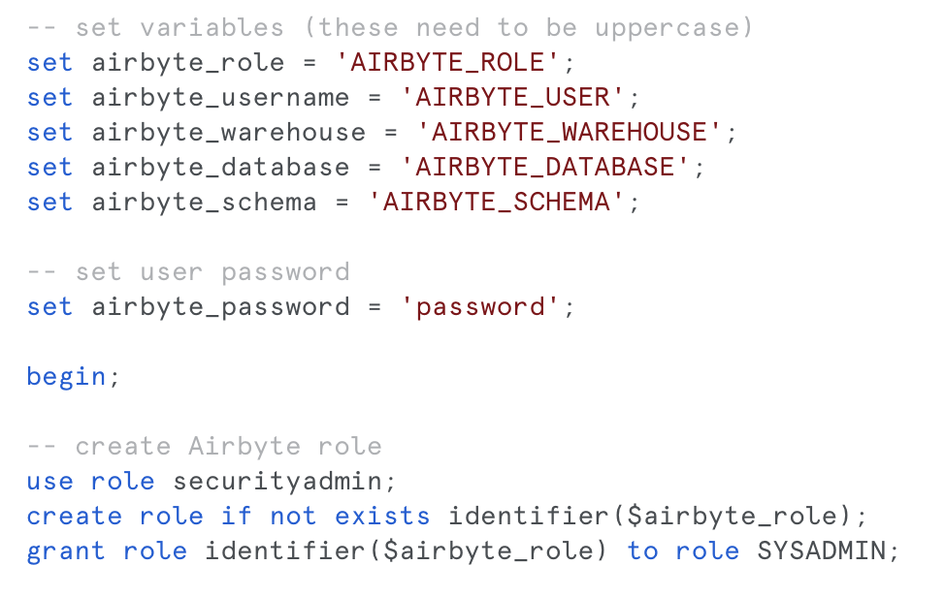
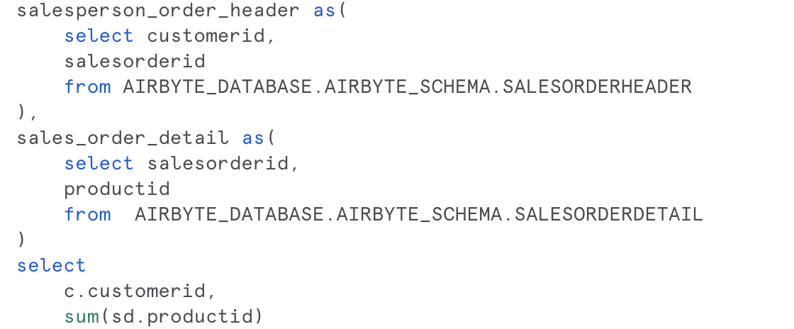
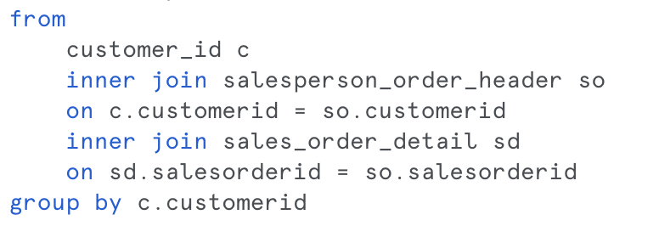
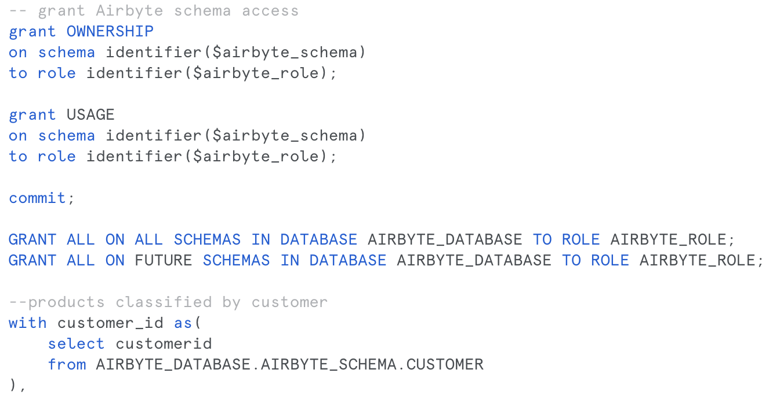
Snowflake (Connection)
Notes:
Puja

Slide 11
Transform (DBT)
After extraction and loading of database in Snowflake, transformations have been applied on tables for better insights for sales, customer, product and employee.
The various transformations applied are:
(a) count
(b) alias
(c) inner join operation
(d) group by
(e) sum
(f) where
(f) Macro definition
Notes:
Puja

Slide 12
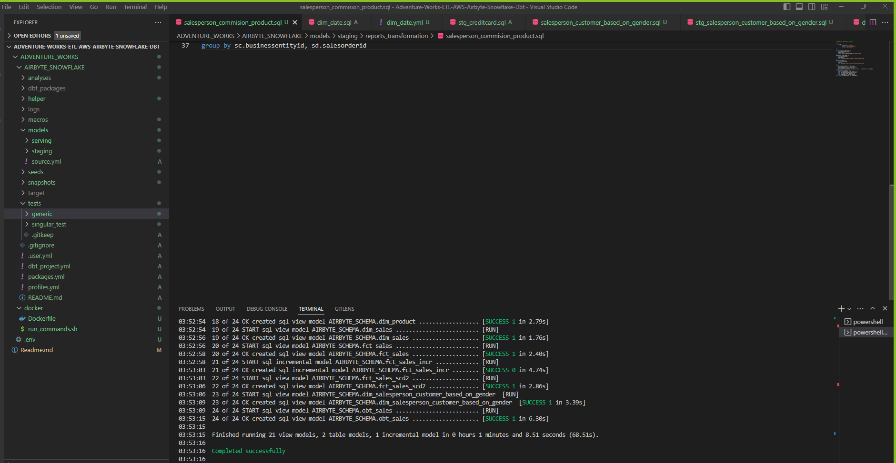
Notes:
Puja

Slide 13
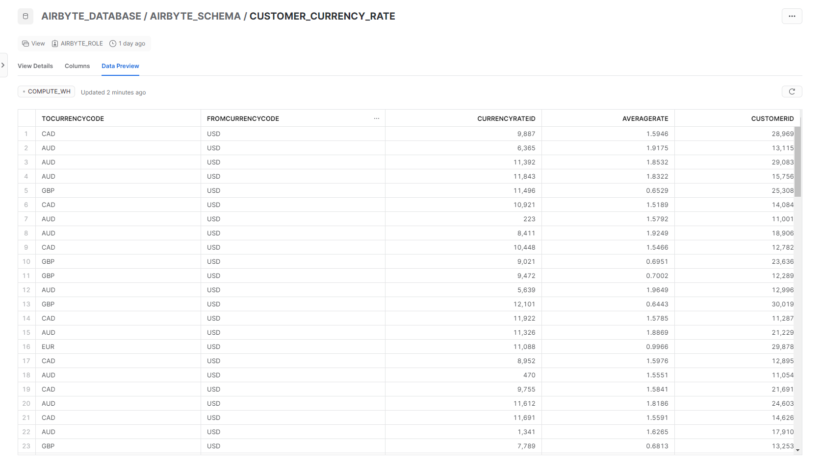
Notes:
Puja

Slide 14
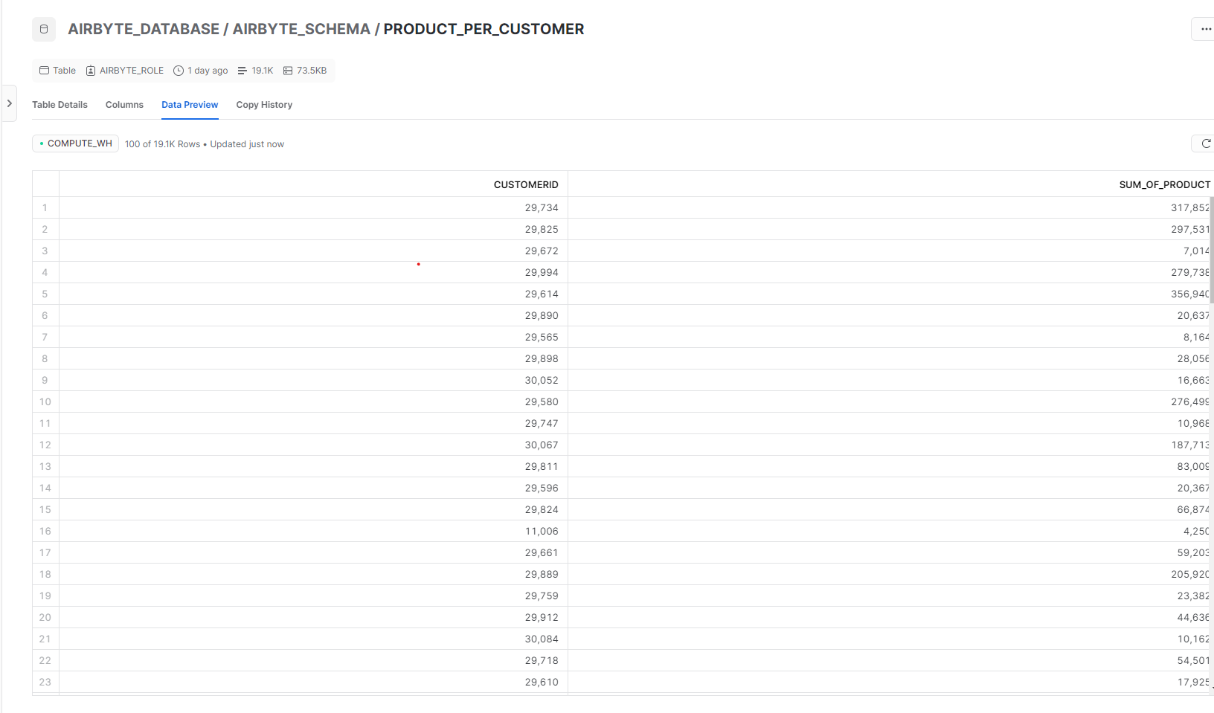
Puja
Notes:
Puja

Slide 15
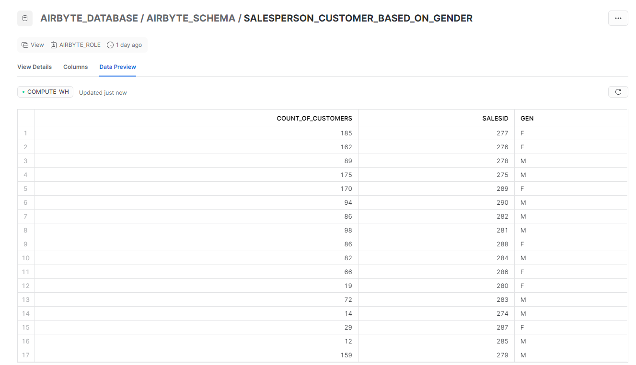

Slide 16
Dimensional Modelling Technique
## Dimension and Facts table Generation
The different dimension techniques are developed for product, customer, employee and sales to get dimension in correlation with join operation with fct_sales table for better business context.
Here, use of reference from staging tables and surrogate key usage for generation dimension and facts table.
## Snapshots
In customer and product “Check” on all columns are applied across columns.
In salesorderheader and salesorderdetail “modifieddate” on “timestamp” basis to capture slow changing dimension.
## Facts and dimension Table generation for Slow Changing Dimension
Facts and dimension tables generation from snapshots by addition “dbt_valid_to” and “dbt_valid_from” to surrogate key.
Notes:
Puja

Slide 17
DBT Tests
Different tests are performed to test the models
Generic Tests applied across generalised column
Singular customised Tests
NULL
UNIQUE
NOT_NULL

Slide 18
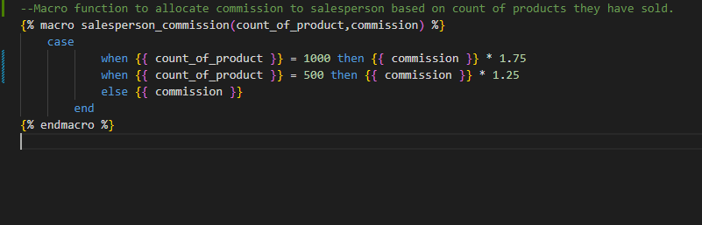
Macro Definition

Slide 19
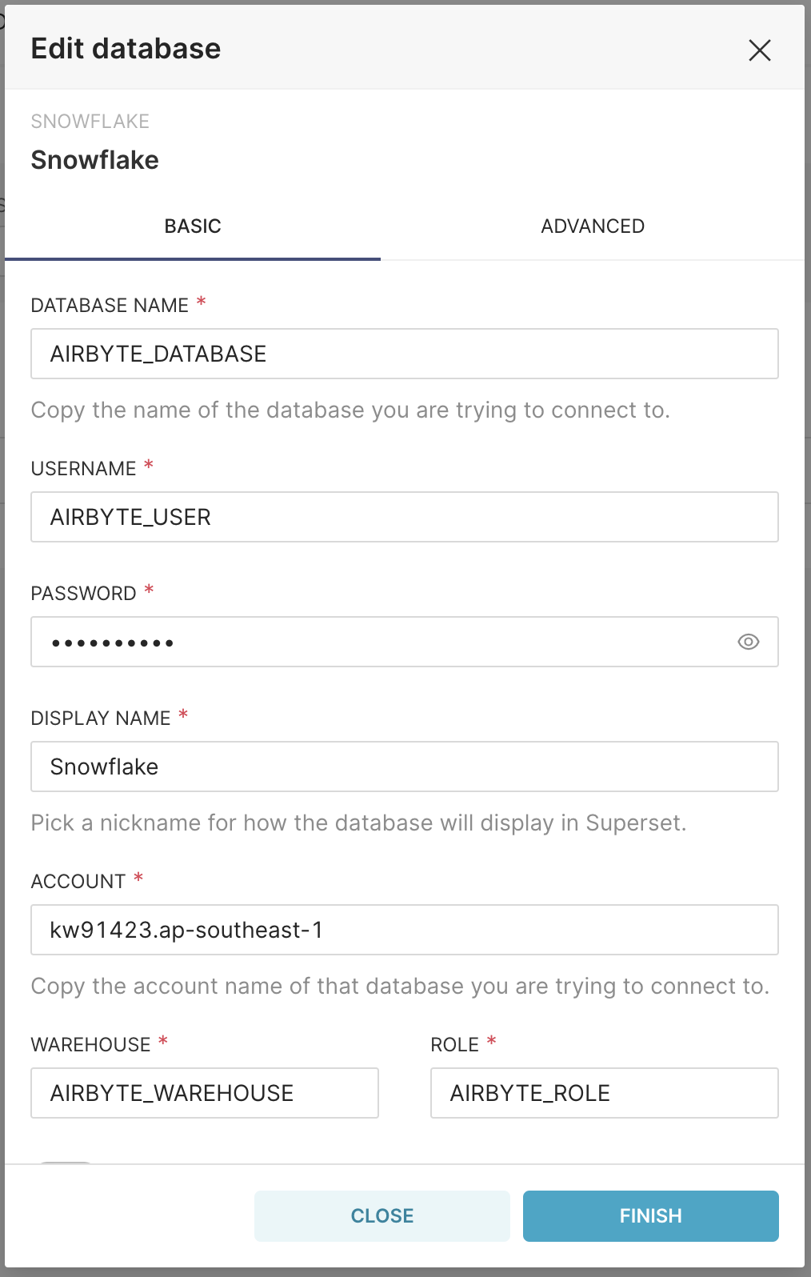
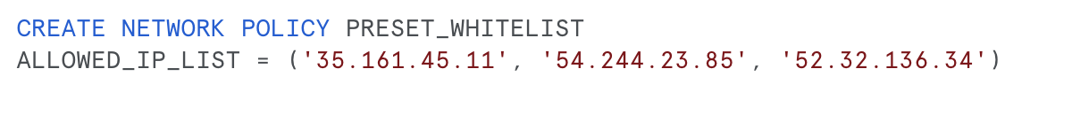
Preset (Connection)
Snowflake Network Policy
Snowflake Network Policy
Notes:
Puja

Slide 20
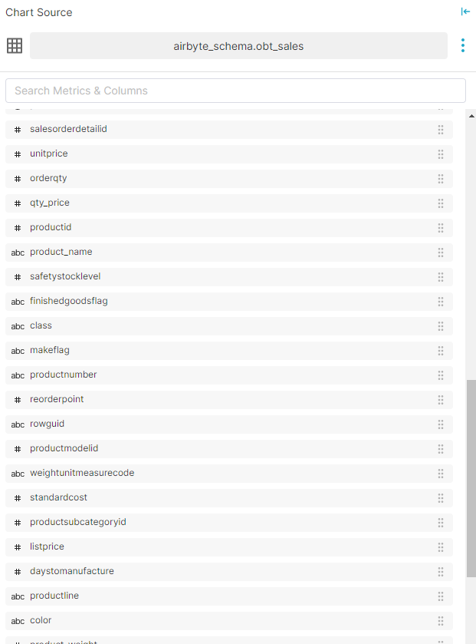
Preset (Visualisation) through One big Table
Notes:
Sukarno

Slide 21
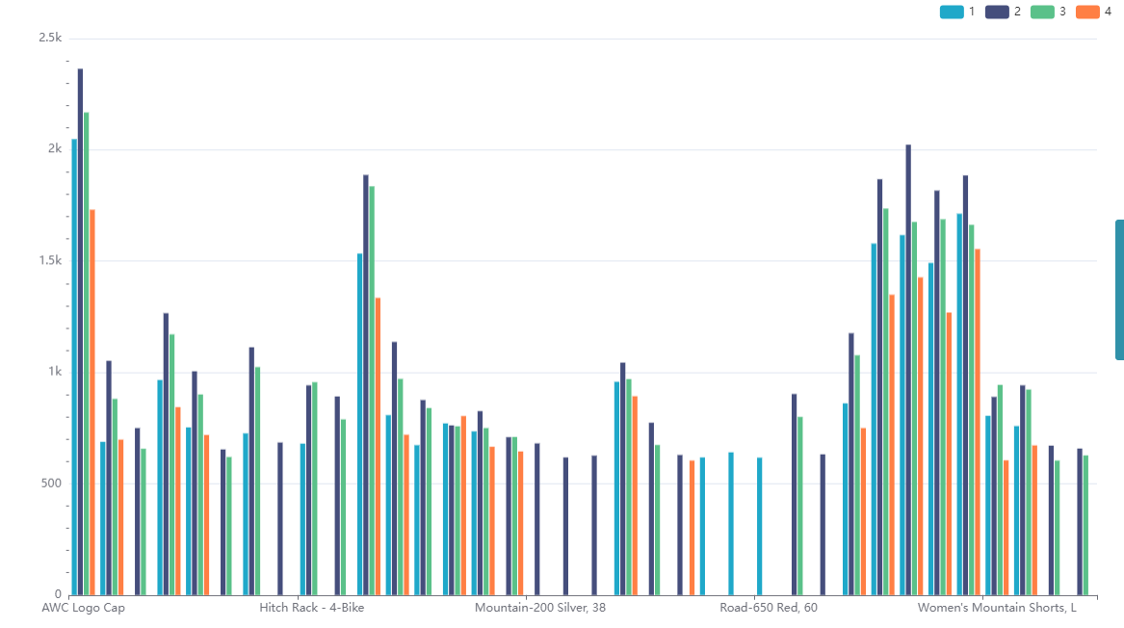
Sales of Product by Quarter of the Year
Quarter
No of Sales of Products
Products Name
Notes:
Sukarno

Slide 22
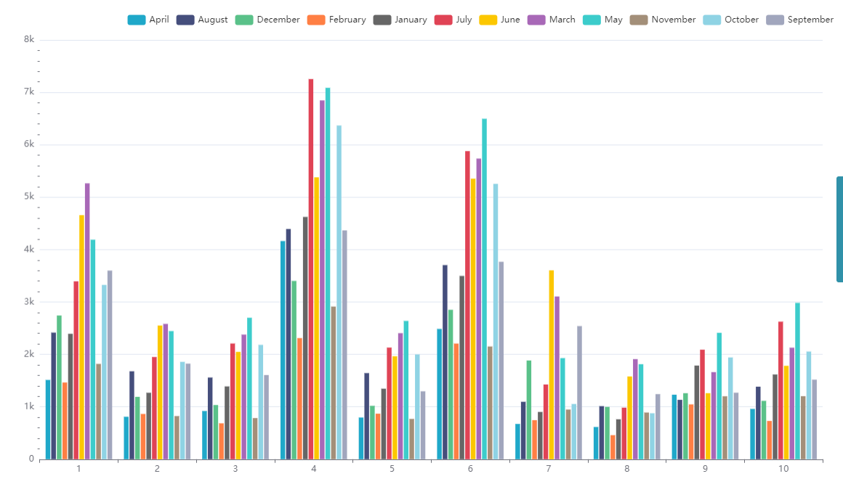
Sum of Order in different Territory ID by Months
Month
Sum of Orders
Products Name
Notes:
Sukarno

Slide 23
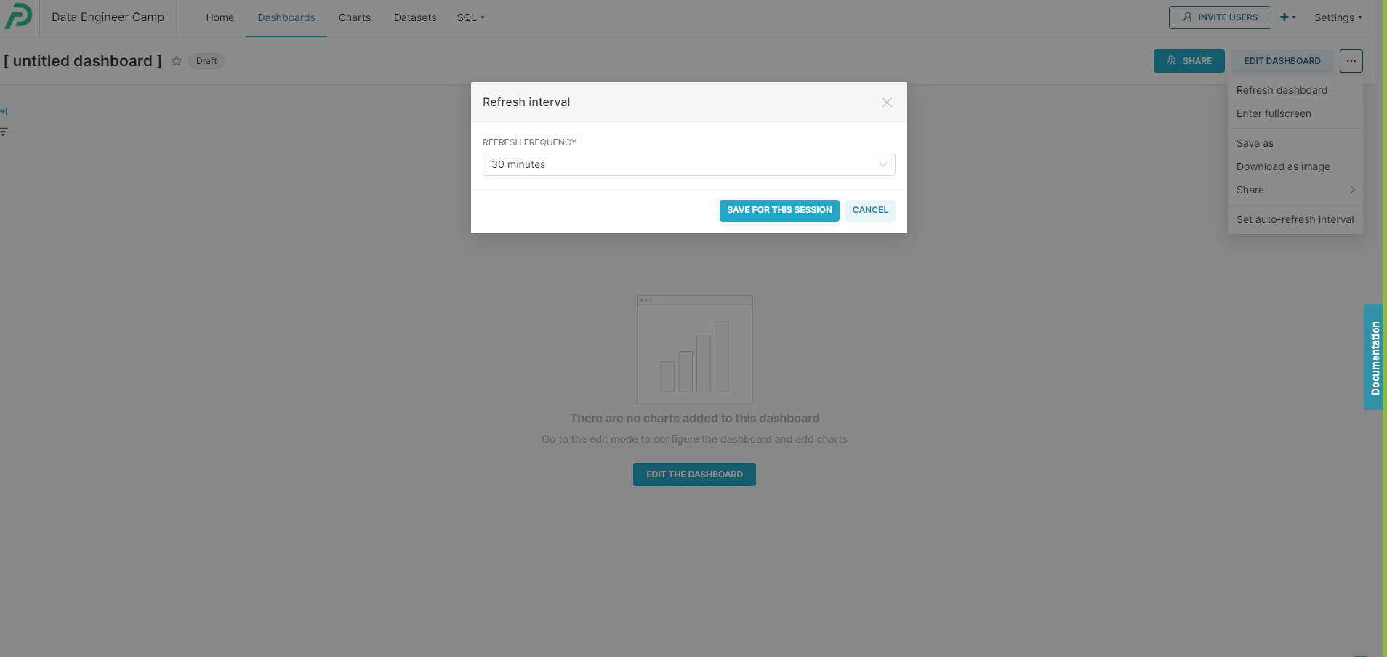
Dashboard Refresh Settings
Notes:
Sukarno

Slide 24
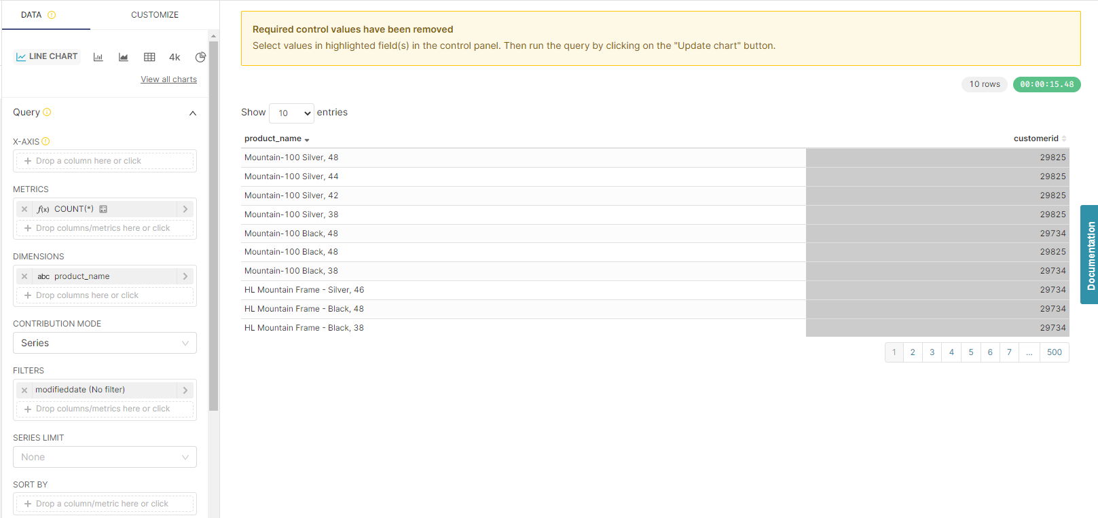
Notes:
Sukarno

Slide 25
To Build & Push Docker File to ECR
cd ..
docker build -t dbtbuild -f docker/Dockerfile .
docker run -it --entrypoint bash dbtbuild
docker run --env-file .env dbtbuild
docker tag dbtbuild:latest 966576247265.dkr.ecr.ap-southeast-1.amazonaws.com/group1:latest
docker images
aws ecr get-login-password --region ap-southeast-1 | docker login --username AWS --password-stdin 966576247265.dkr.ecr.ap-southeast-1.amazonaws.com/group1
docker push 966576247265.dkr.ecr.ap-southeast-1.amazonaws.com/group1:latest
Notes:
Sukarno

Slide 26
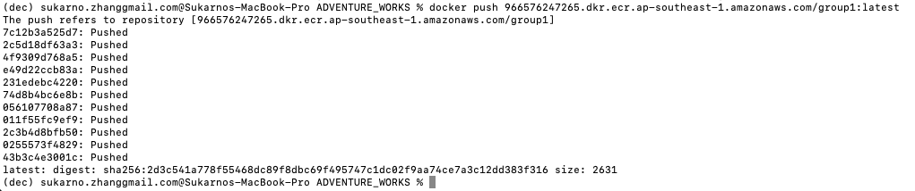
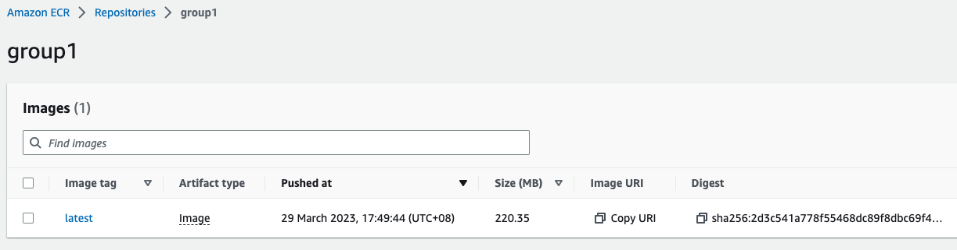
To Push Docker File to ECR
Notes:
Sukarno

Slide 27
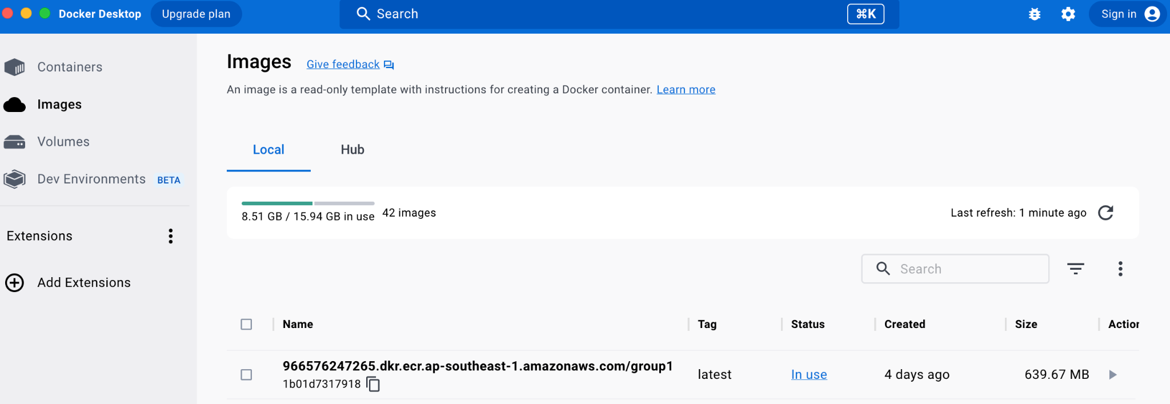
Docker Image
Notes:
Sukarno

Slide 28
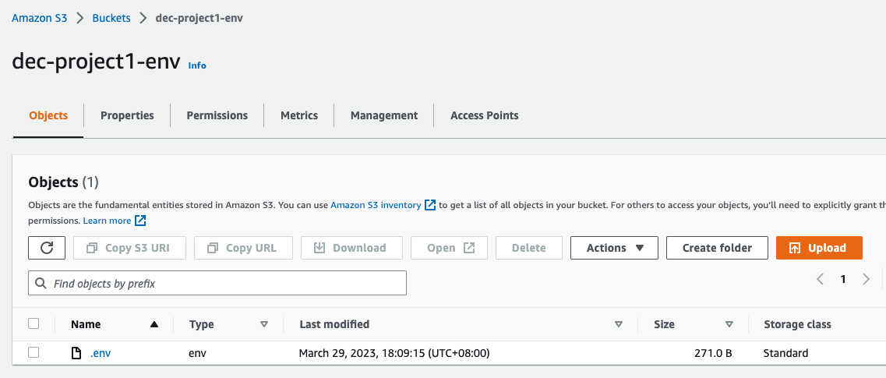
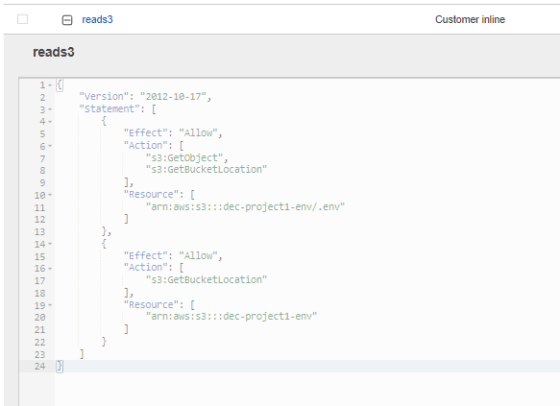
S3 Buckets to Contain .env file
IAM Role
Notes:
Sukarno

Slide 29
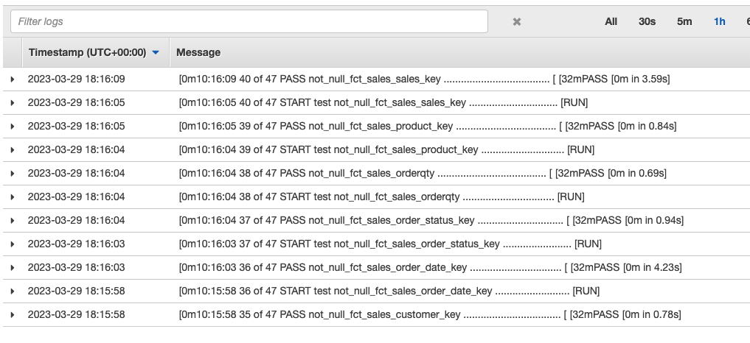
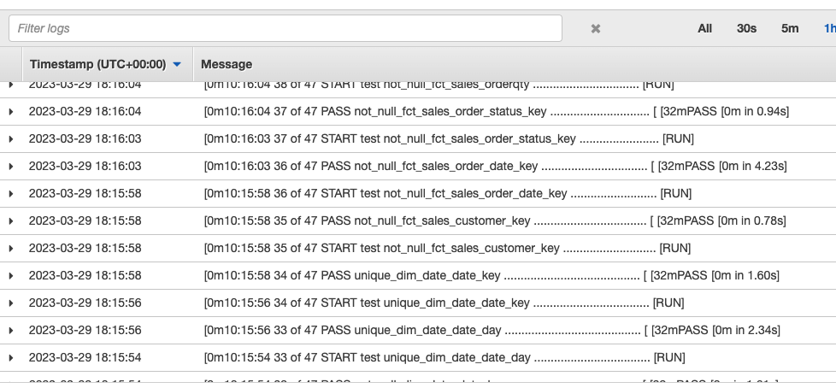
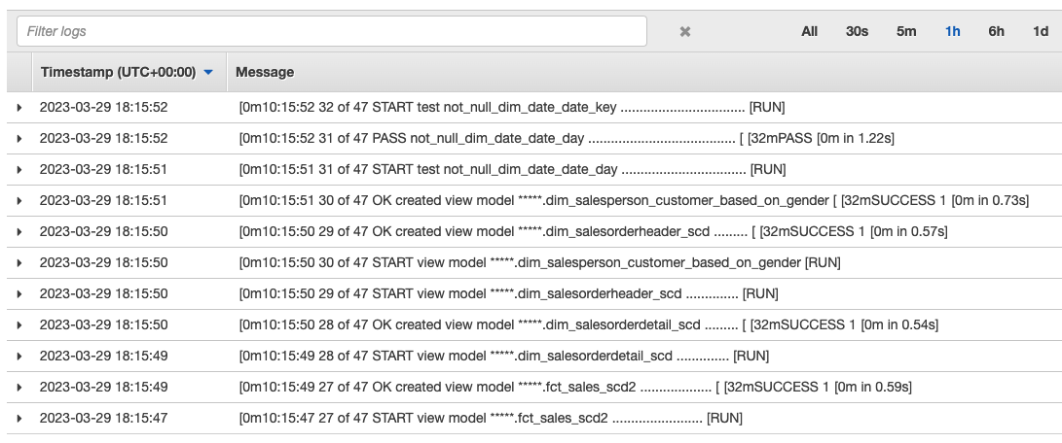
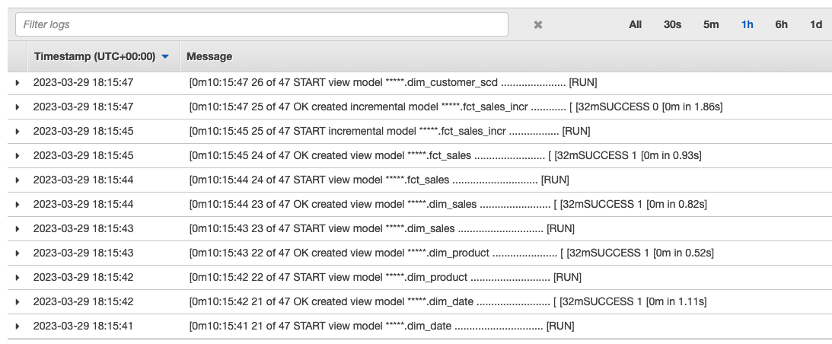
AWS - ECS Single Task Run (page 1)
Notes:
Sukarno

Slide 30
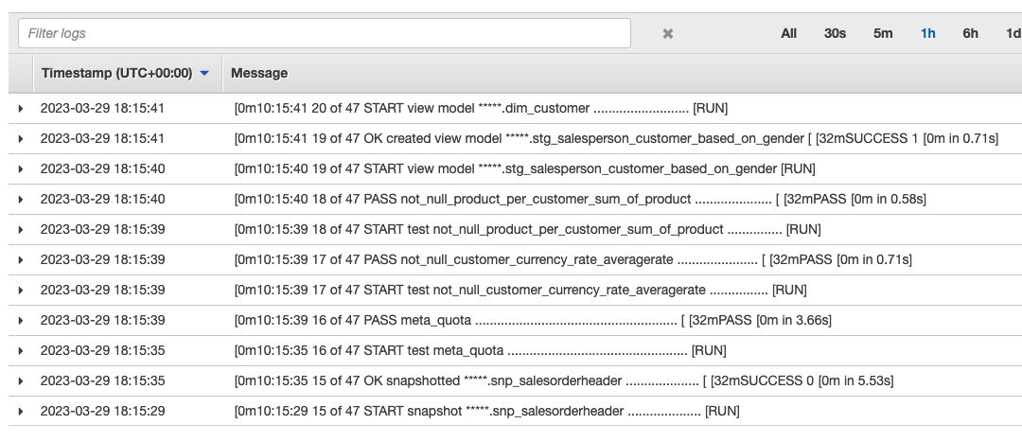
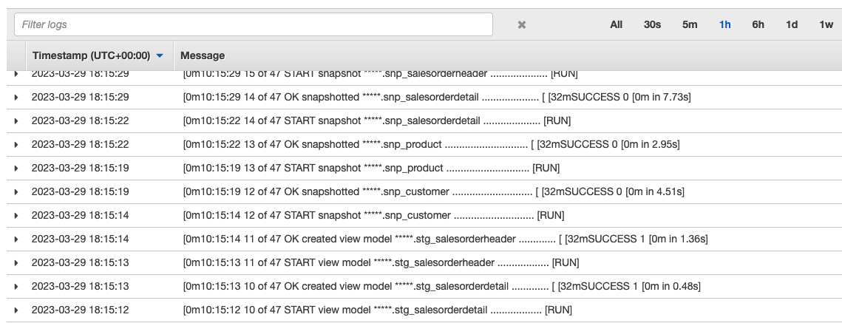
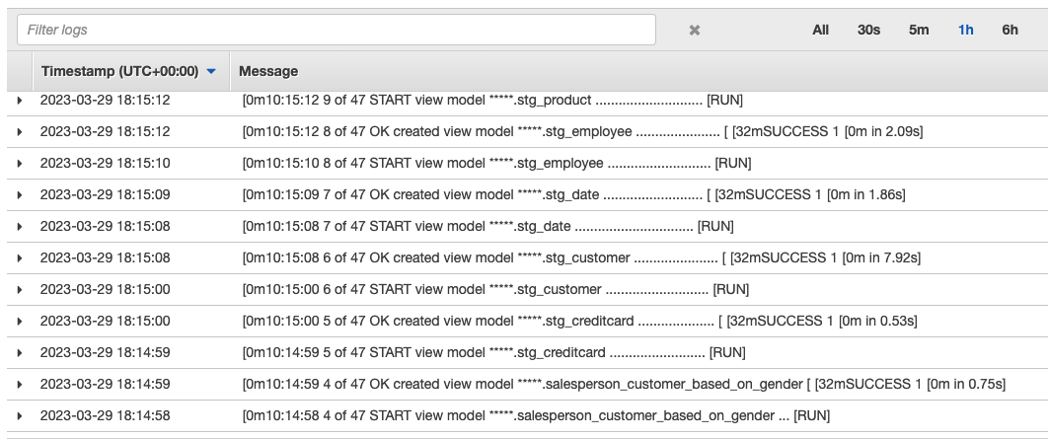
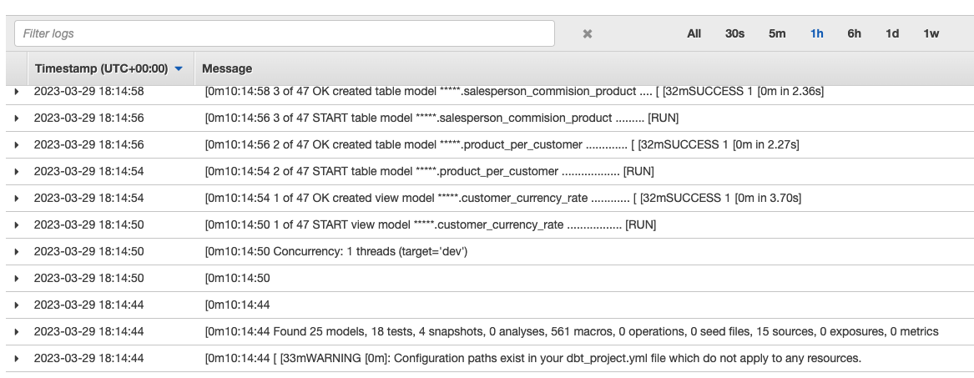
AWS - ECS Single Task Run (page 2)
Notes:
Sukarno

Slide 31
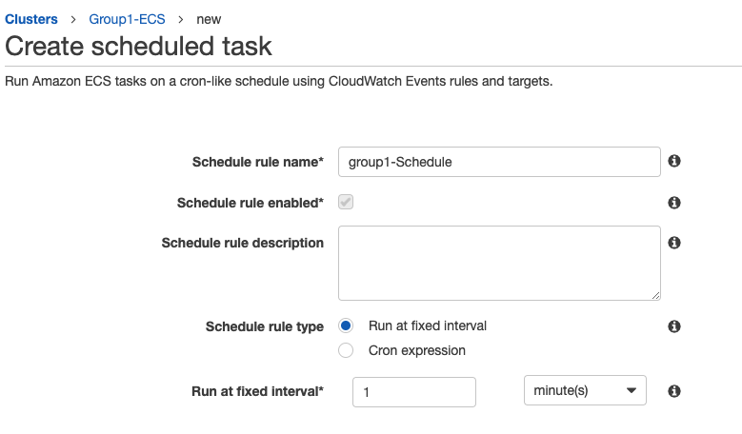
AWS - ECS Scheduled Tasks
For every 1 Minute
Notes:
Sukarno

Slide 32
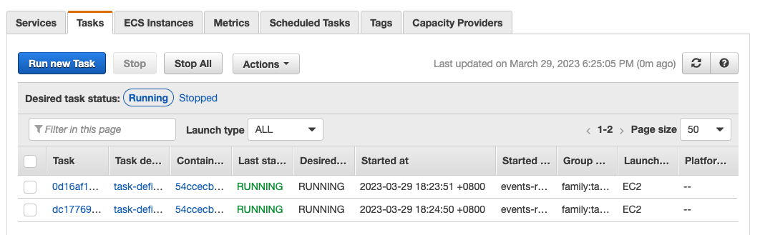
AWS - Scheduled Tasks
Notes:
Sukarno

Slide 33
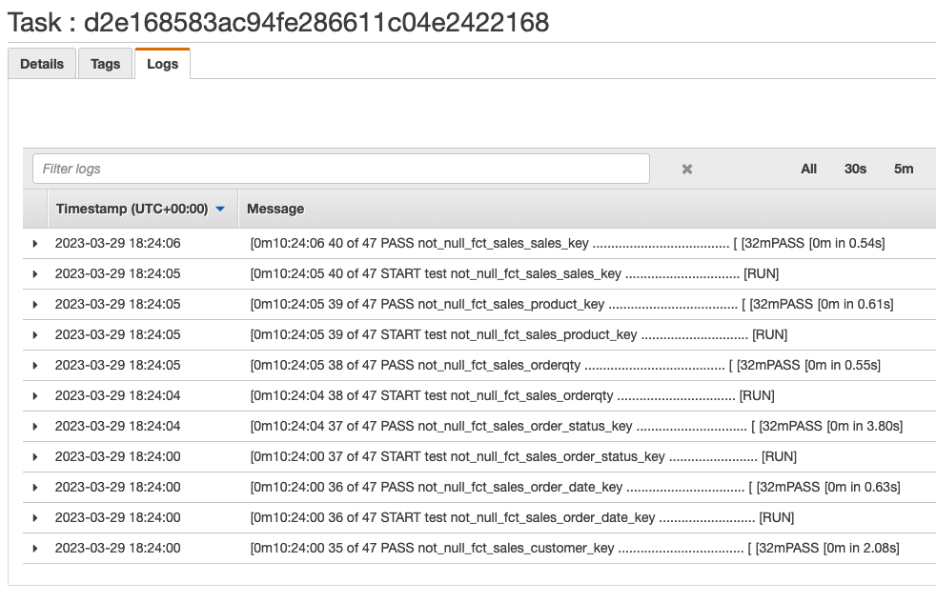
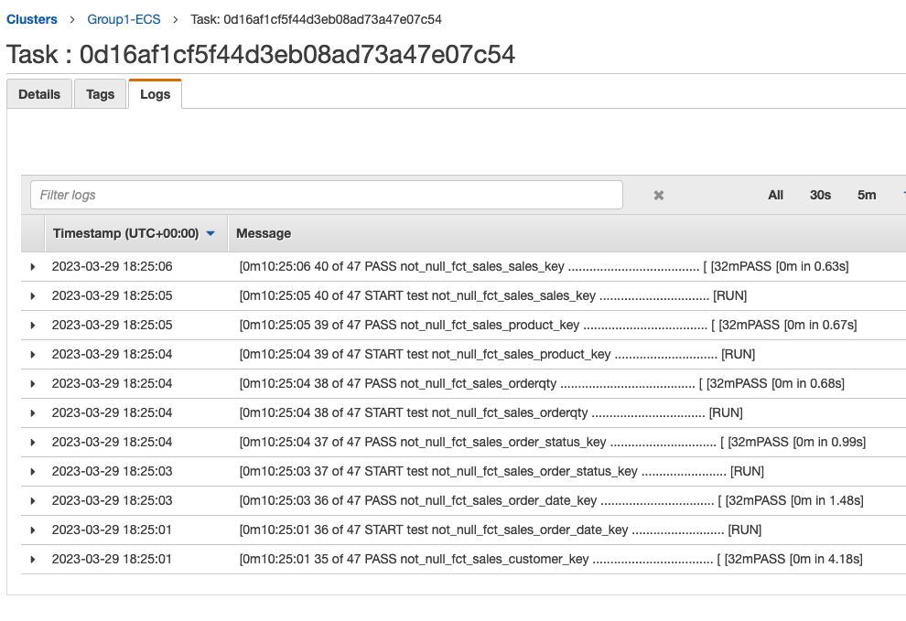
AWS - Scheduled Tasks
Task 1
Task 2
Notes:
Sukarno

Slide 34
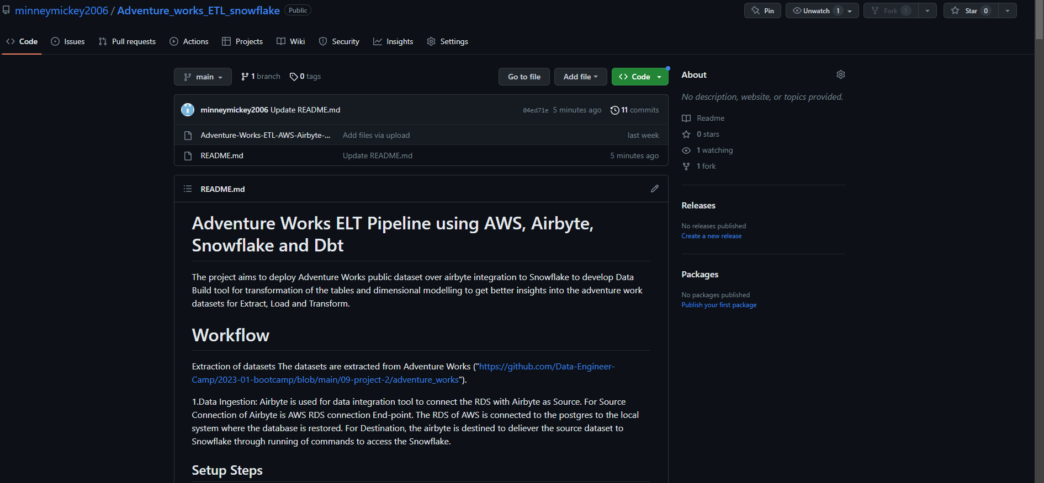
Github

Slide 35
Lesson Learnt
Learn to manage real world datasets and make it functional.
ELT process optimisation in terms of space and time complexity.
Learnt to manage work sharing and ideas brainstorming.
Understanding each person’s skill in area of specialization in group project.
Notes:
Puja

