Slide 1
Weather API
Analysis
Capstone Project - Group 1
By Puja, Sukarno and Jason
Notes:
Sukarno

Slide 2
Project Context & Goals
Objective
To provide meaningful insights to weather changes based on different parameters such as humidity, temperature,weather descriptions, pressure and wind speed.
Consumers
Data analysts or weather specialists are able to pull the data from Snowflake and visualise data in Power BI/Preset.
The dataset is sourced from :https://weatherstack.com/documentation
Notes:
Sukarno

Slide 3









Solution Architecture Diagram
Visualisation
Weatherstack API
Extract & Load
Transformation,
Dimensional Modelling
Orchestrate
Notes:
Sukarno

Slide 4
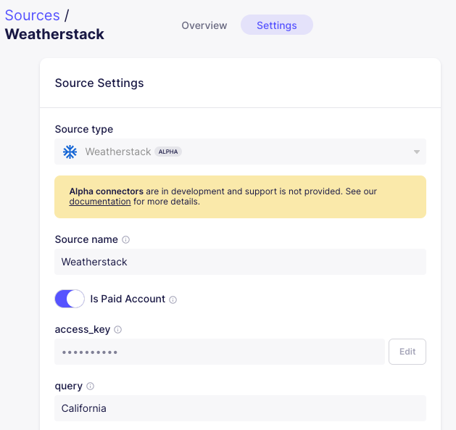
Extract (Airbyte Source)
Notes:
Sukarno

Slide 5
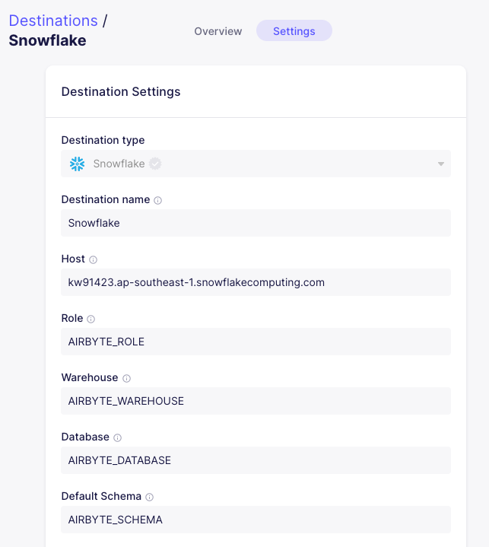
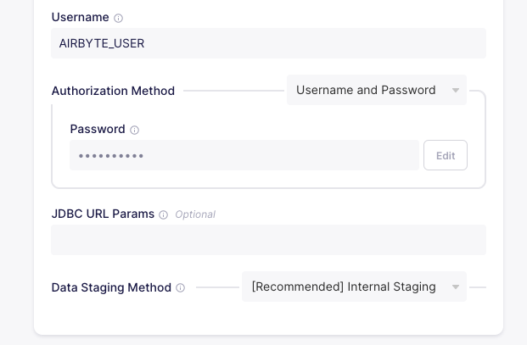
Load (Airbyte Destination)
Notes:
Sukarno

Slide 6
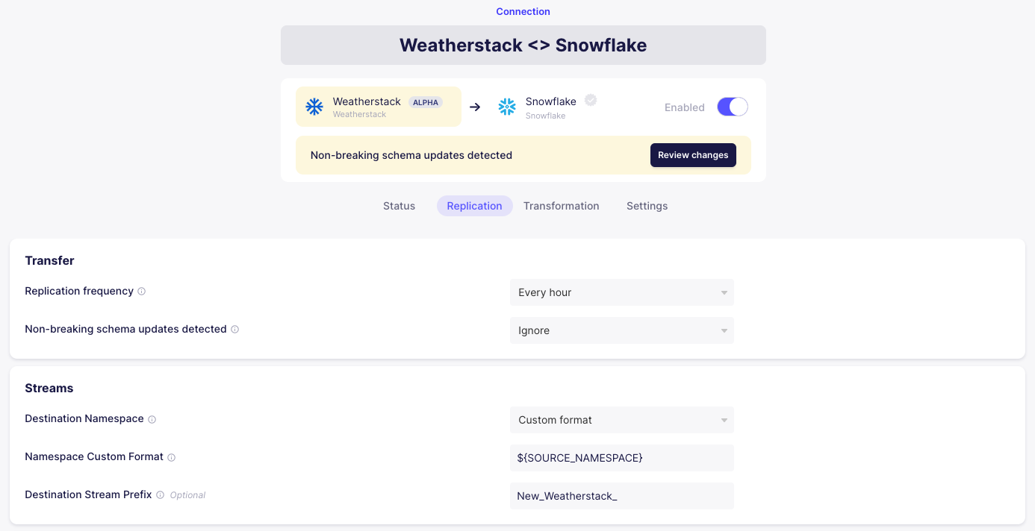
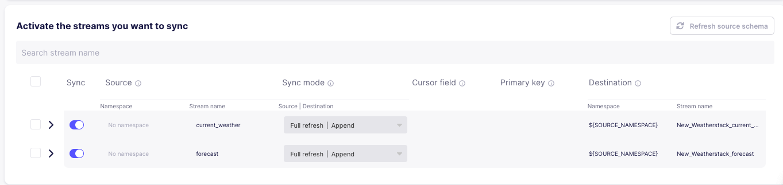
Connection (Airbyte)
Notes:
Sukarno

Slide 7
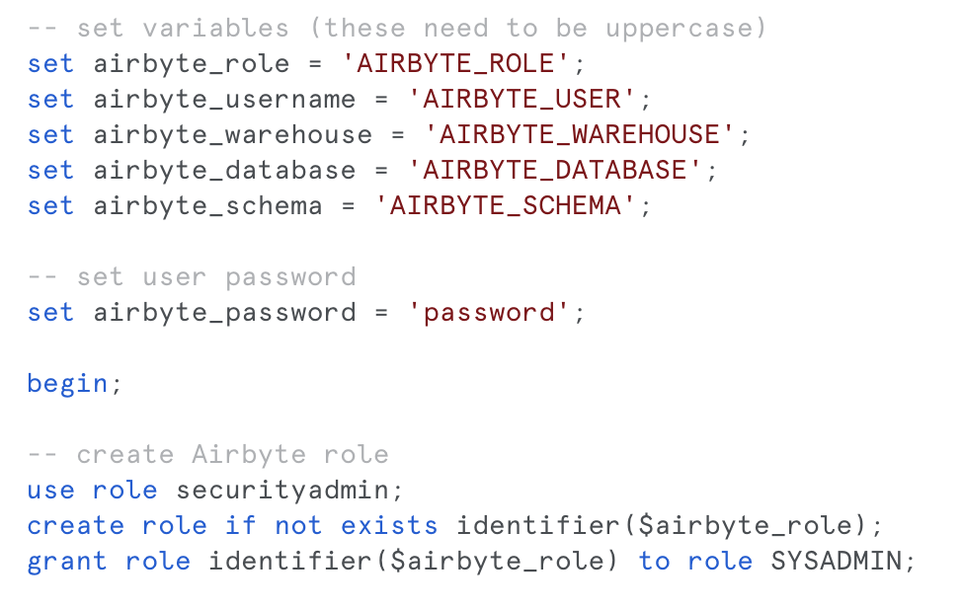
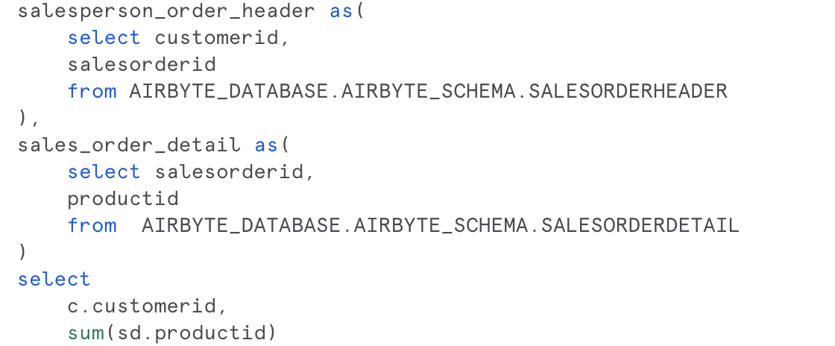
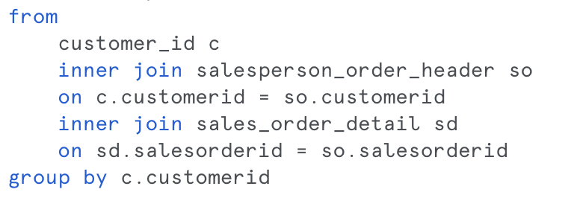
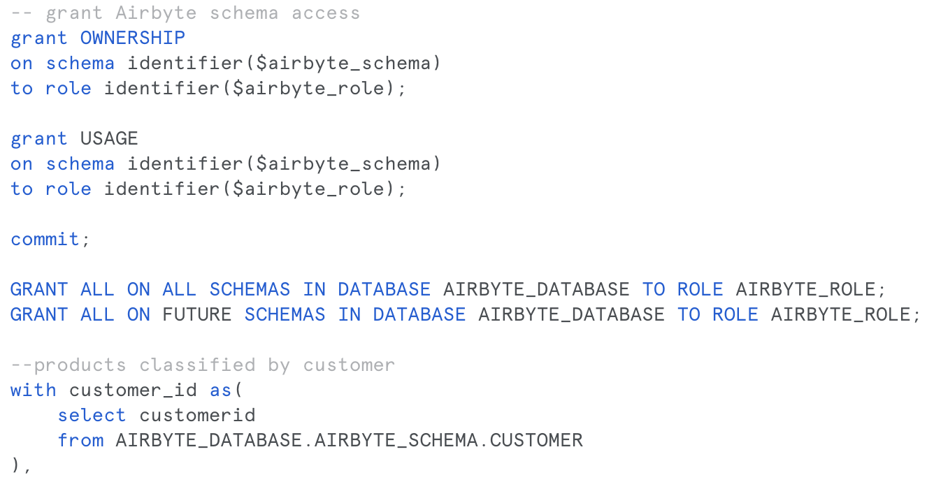
Snowflake (Create Role, Warehouse, DB, Schema)
Notes:
Puja

Slide 8
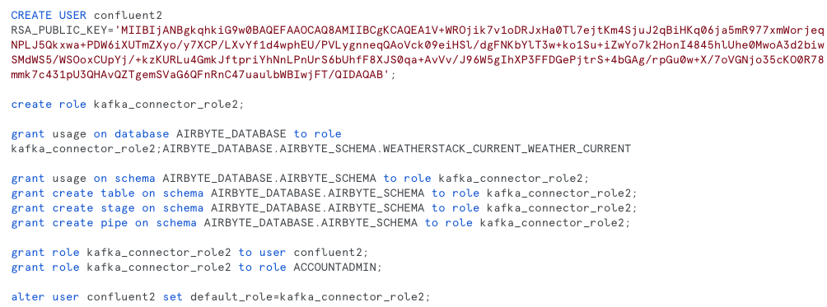
Snowflake (Create User for Confluent)
Notes:
Puja

Slide 9
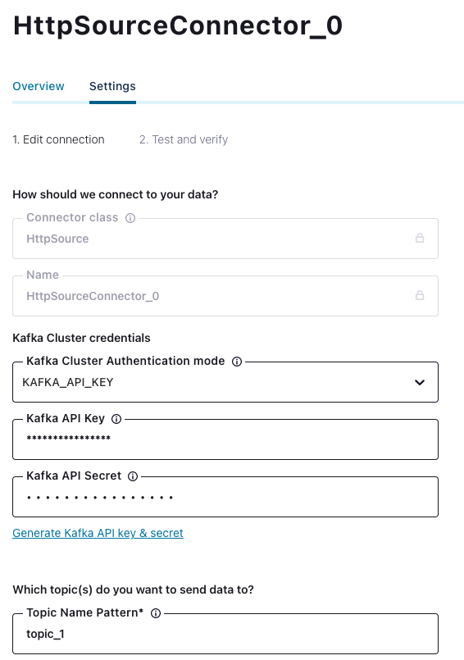
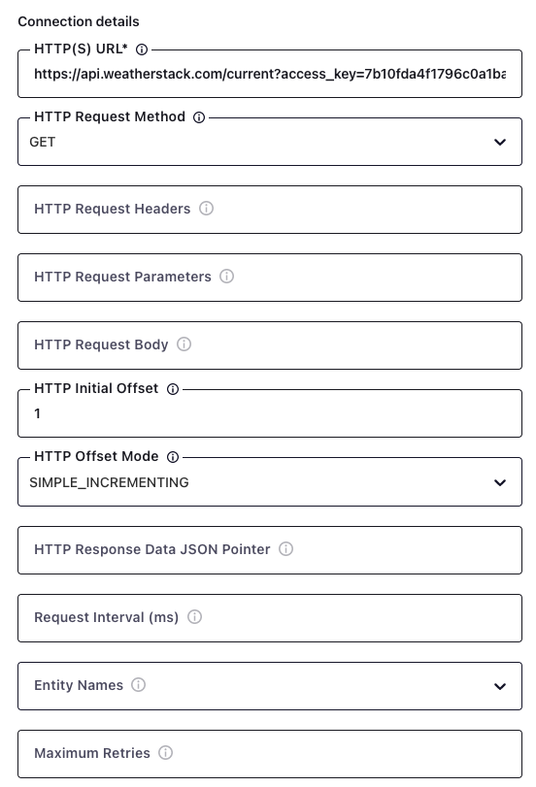
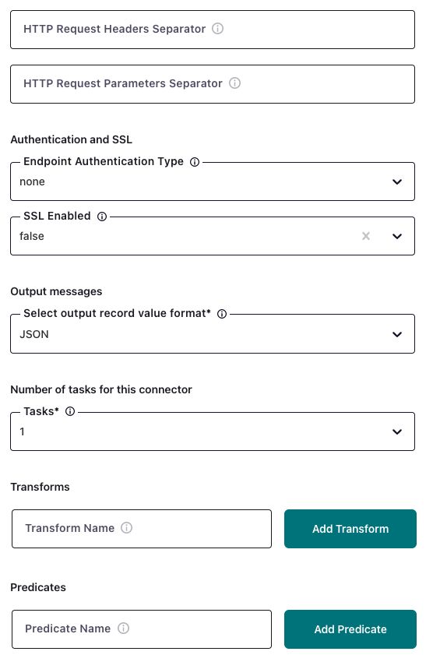
Kafka (Source)
Notes:
Puja

Slide 10
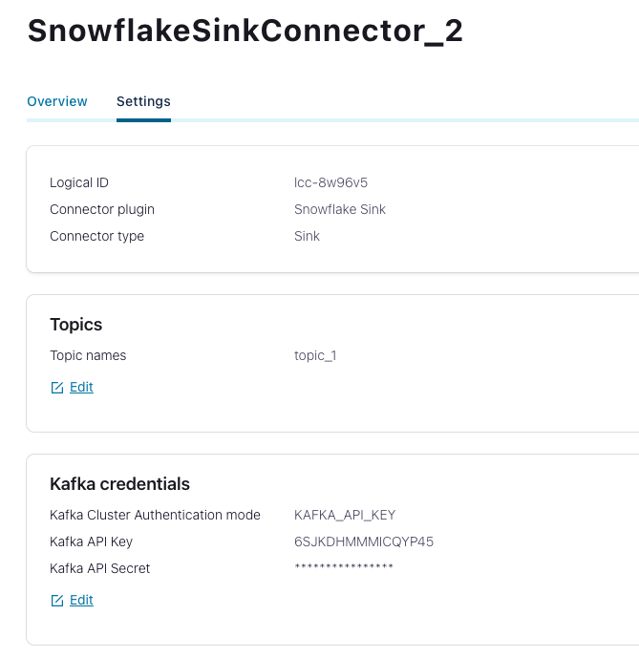
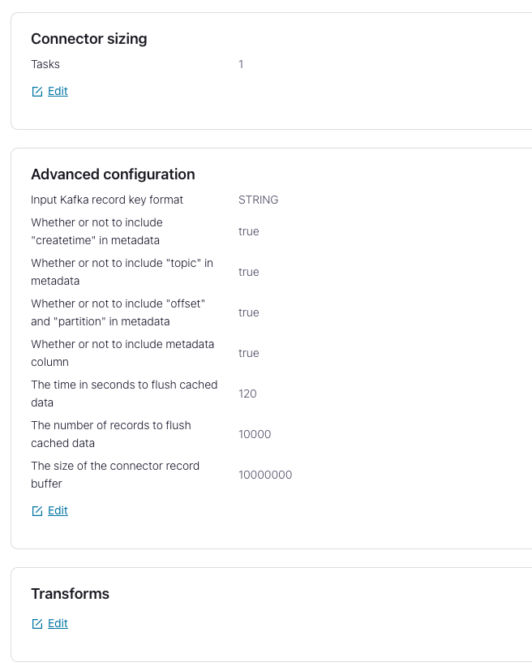
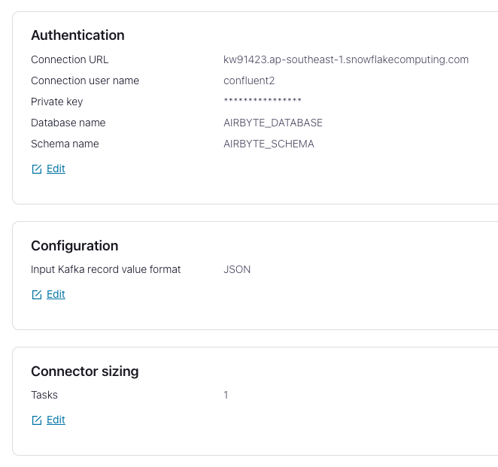
Kafka (Sink)
Notes:
Puja

Slide 11
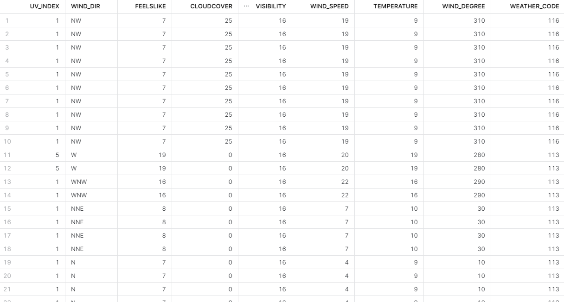
Current Weather (AIRBYTE)

Slide 12
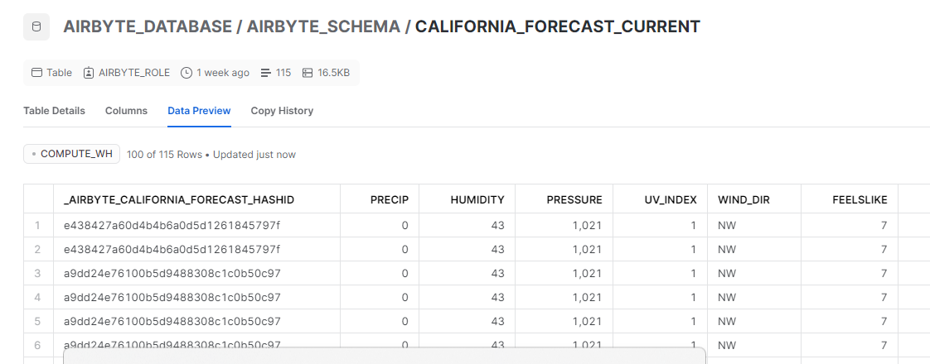
Forecast

Slide 13
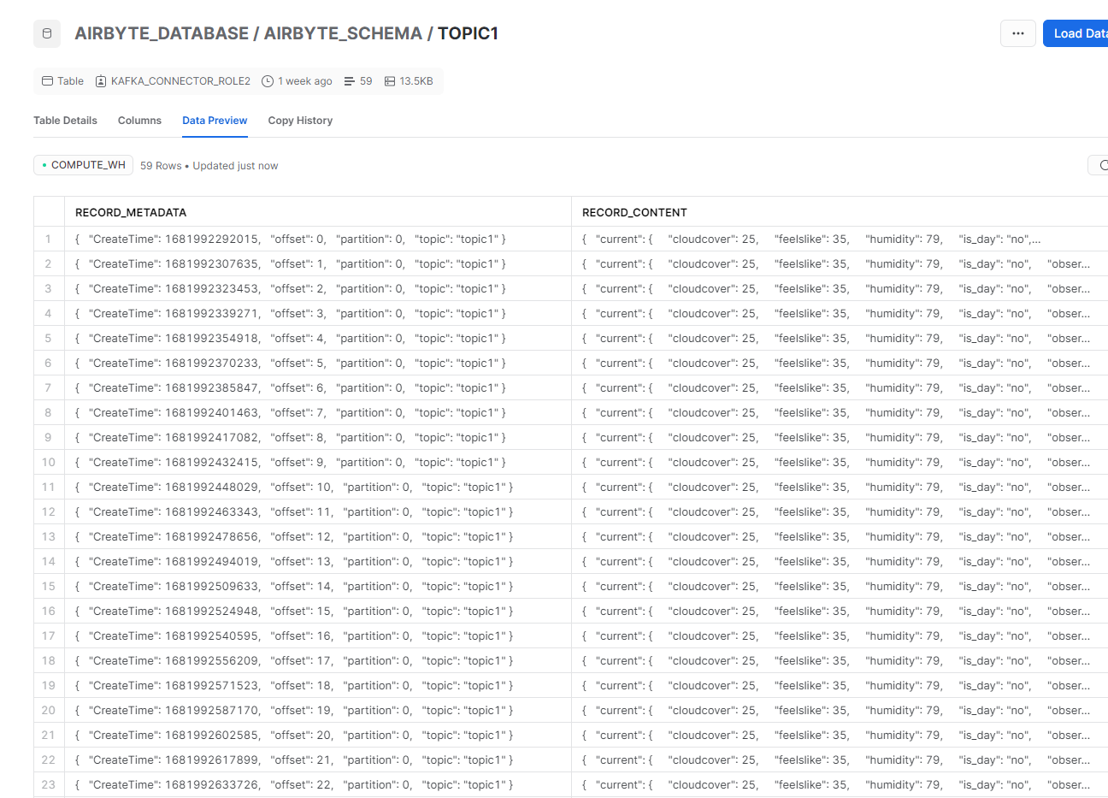
Kafka

Slide 14
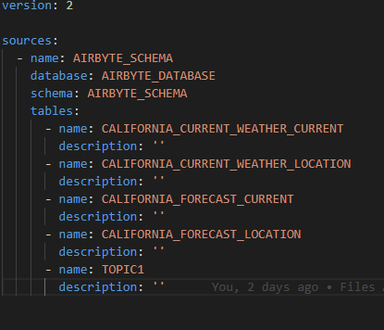
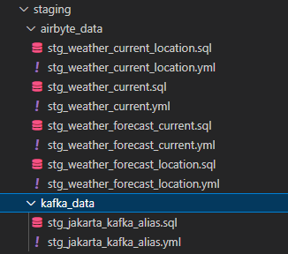
Data Build Tool(DBT)
SOURCE
STAGING

Slide 15
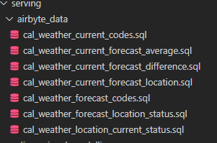
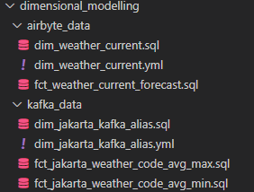
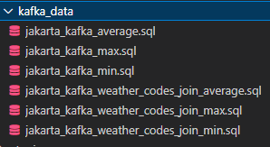
SERVING

Slide 16
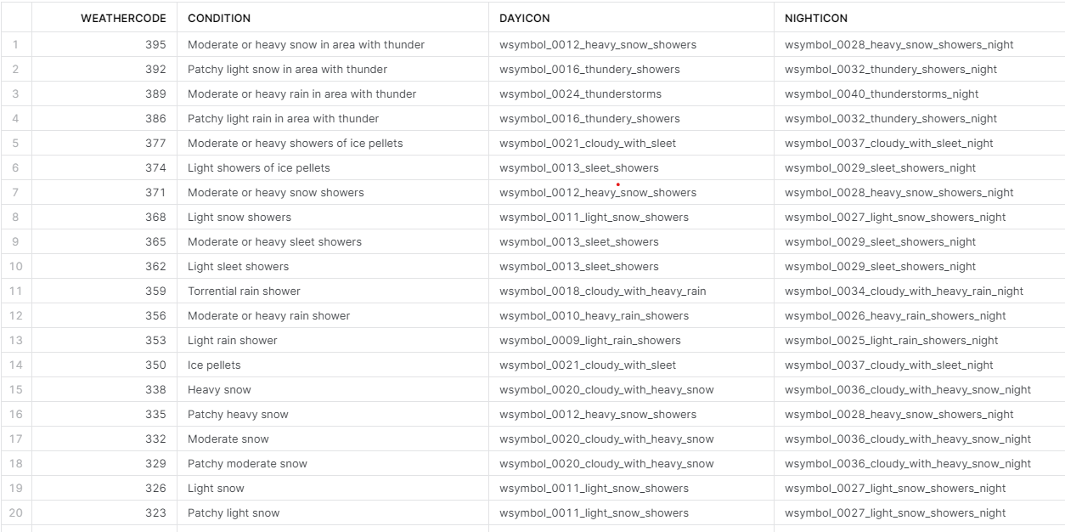

DBT Seeds

Slide 17

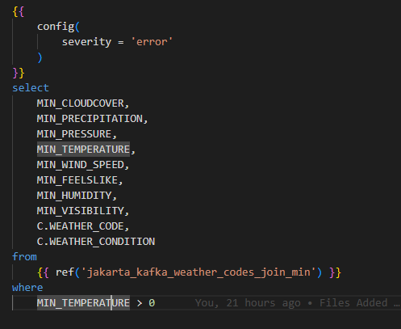
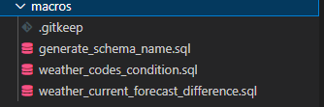
NNULL
UNIQUE
SNAPSHOT
TESTS
MACROS

Slide 18
Transformations
ALIAS
INNER JOIN
CROSS JOIN
DISTINCT
WHERE
MAXIMUM
MINIMUM
AVERAGE
DIFFERENCE

Slide 19
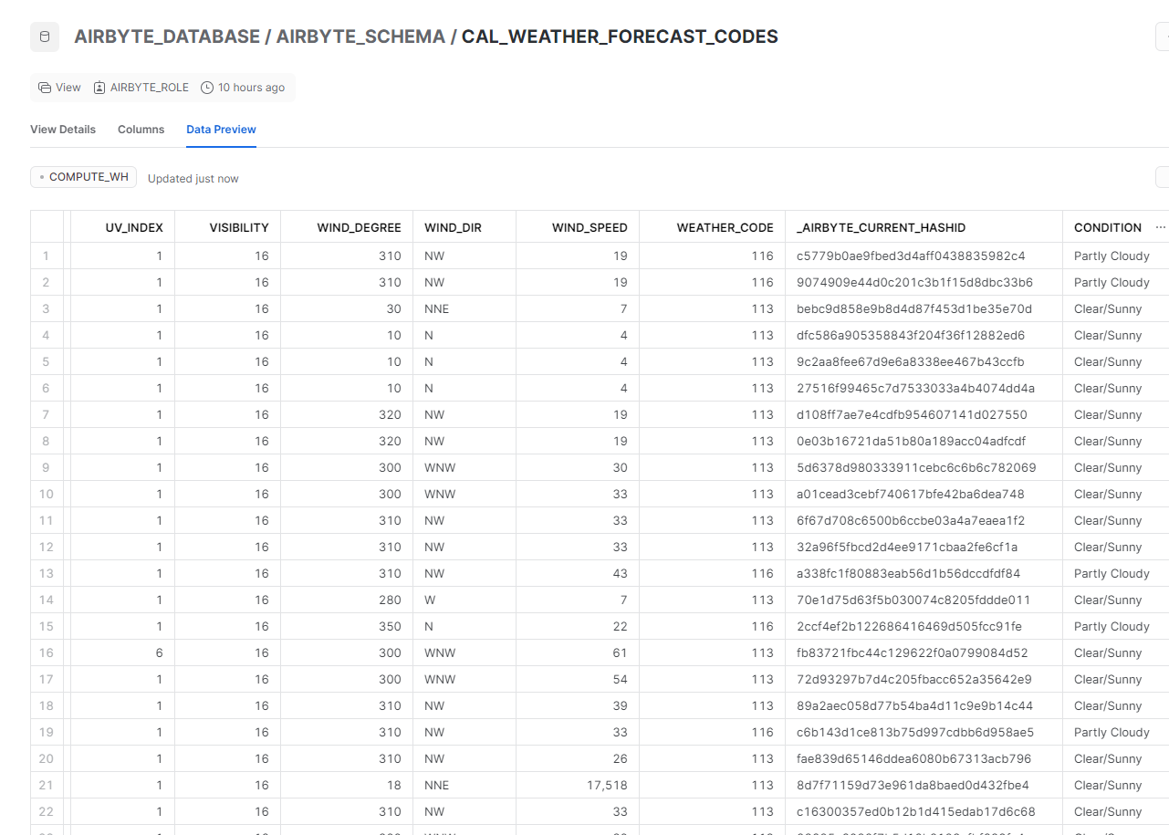
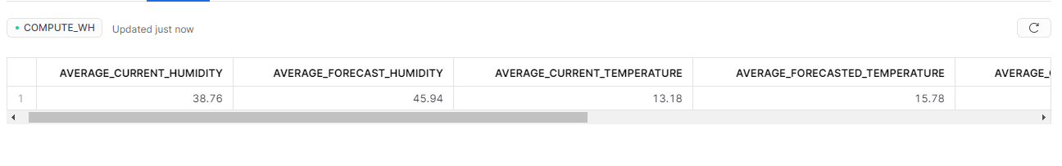
Current and Forecasted Parameters for California

Slide 20
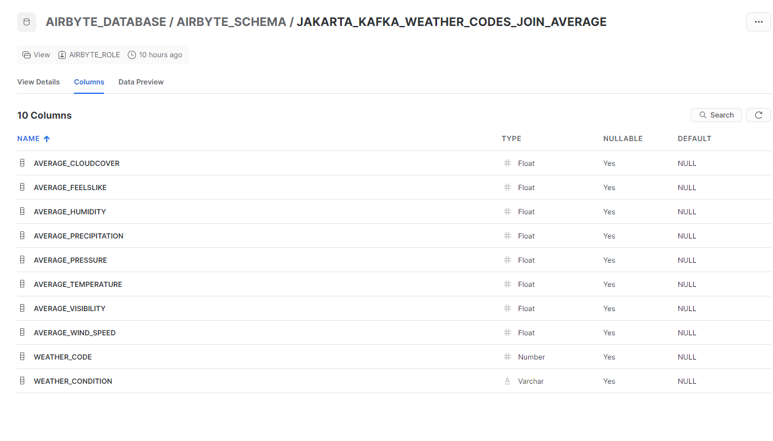
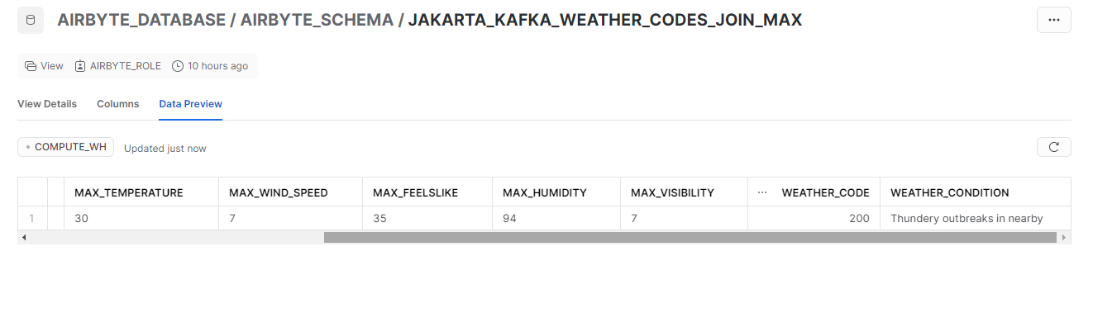
Jakarta(Kafka) Transformations

Slide 21
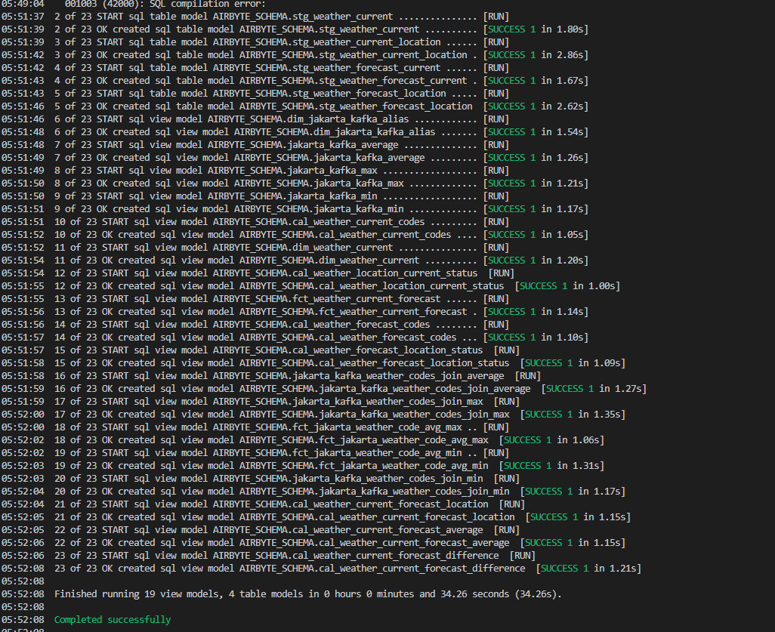
DBT Run

Slide 22
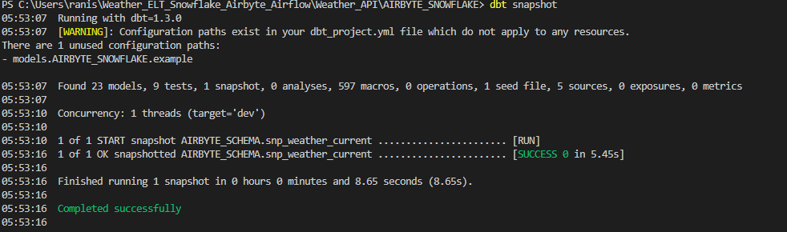
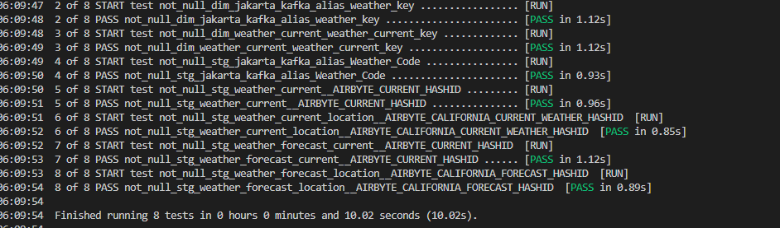
DBT Snapshot AND Tests

Slide 23
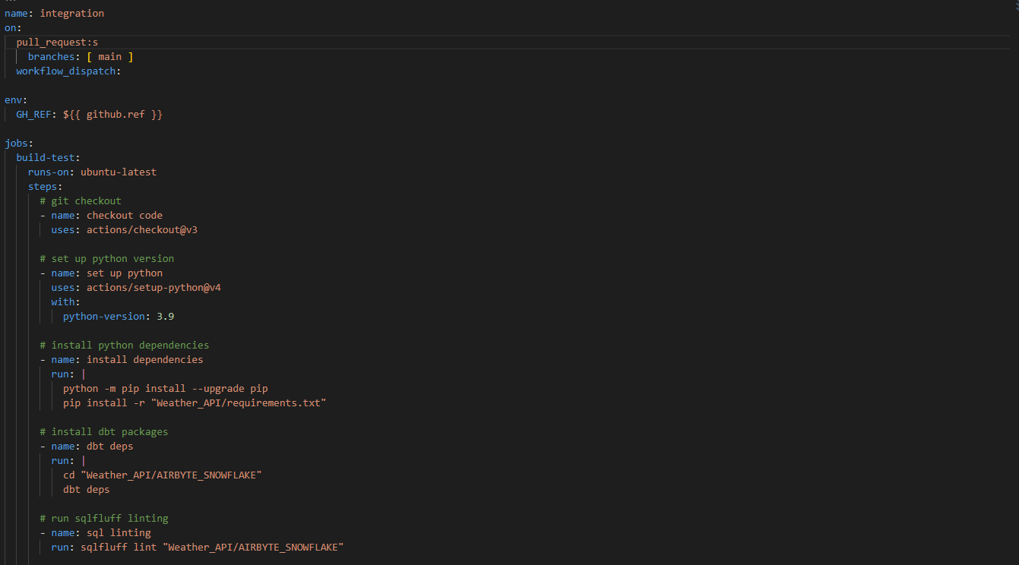
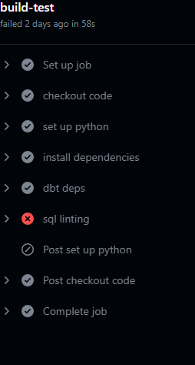

Continuous Integration(CI)

Slide 24
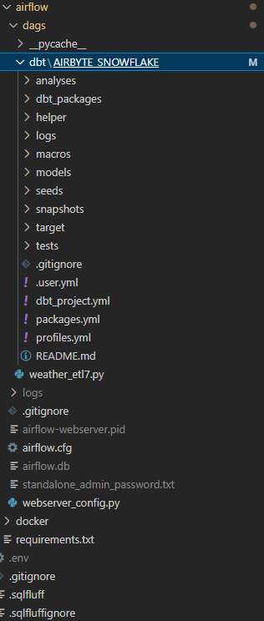
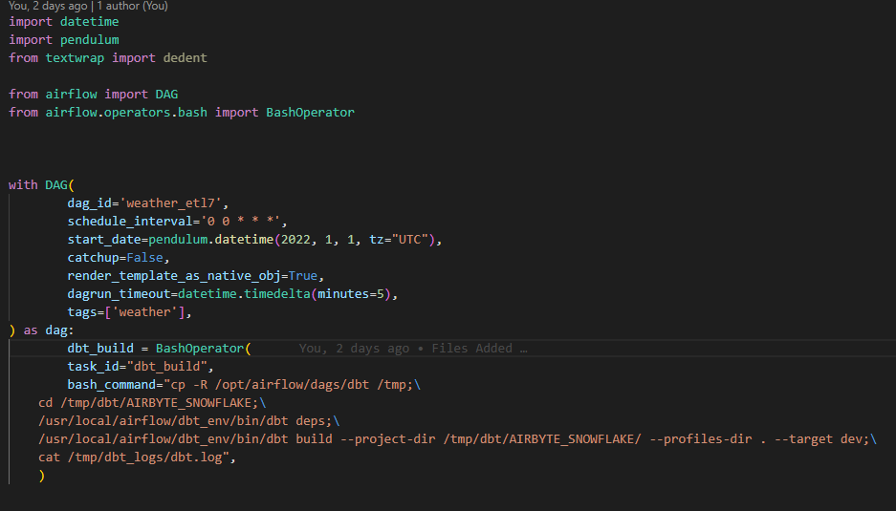
Orchestration on Airflow

Slide 25
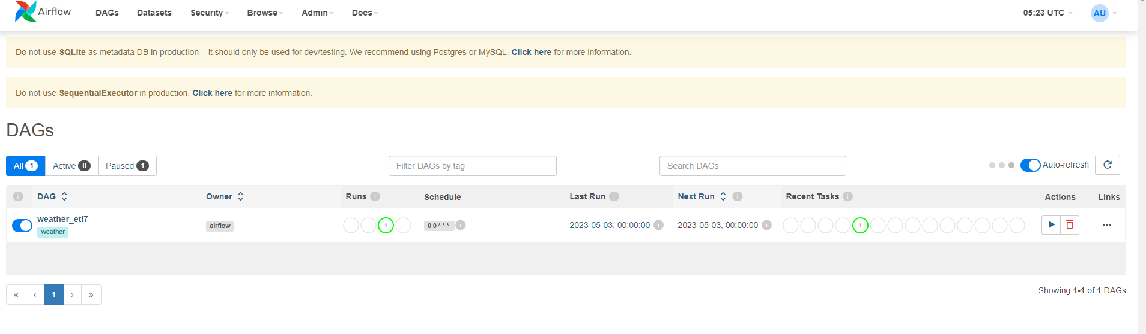
Airflow deployment through Docker
Notes:
Puja

Slide 26
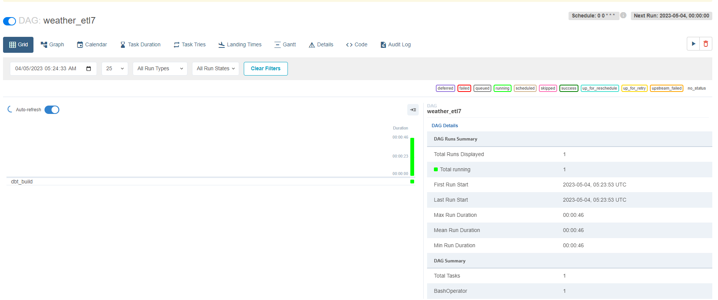
Airflow Running

Slide 27
Visualisations

Slide 28
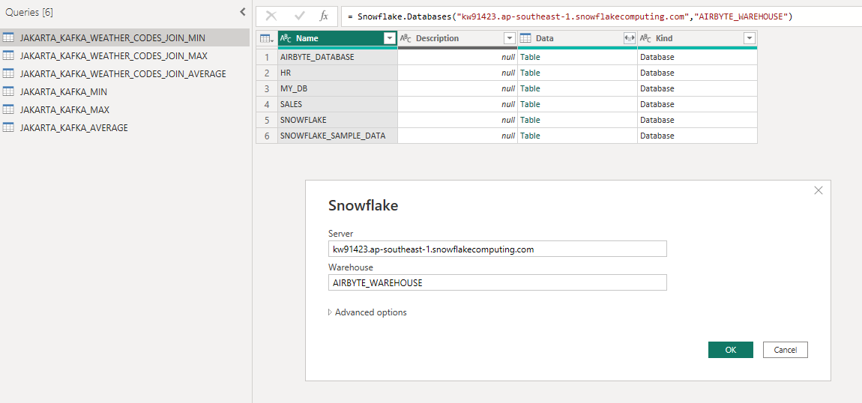
PowerBI (Connection)
Connecting to Snowflake Database
Notes:
Jason

Slide 29
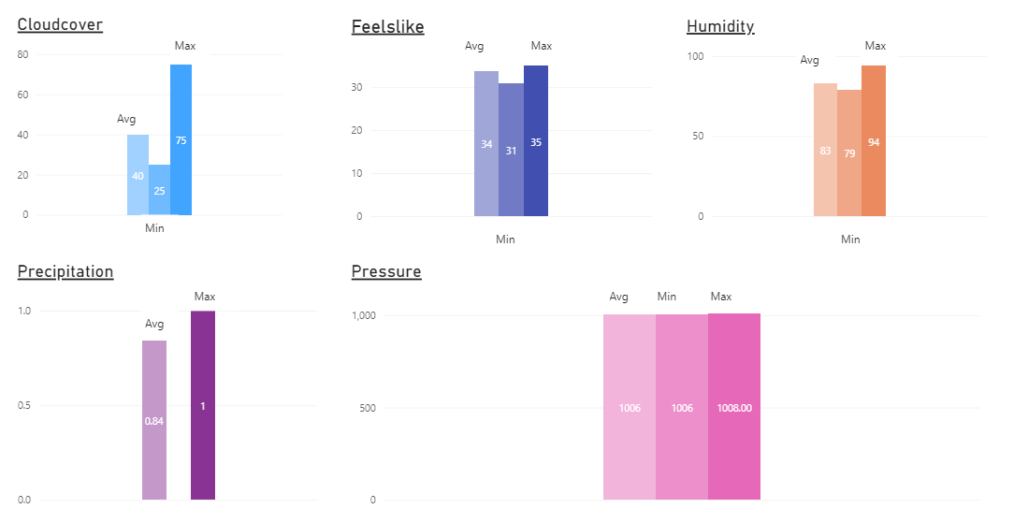
PowerBI (Visualisation)
Average, Min & Max measures for 8 measures
Notes:
Jason

Slide 30
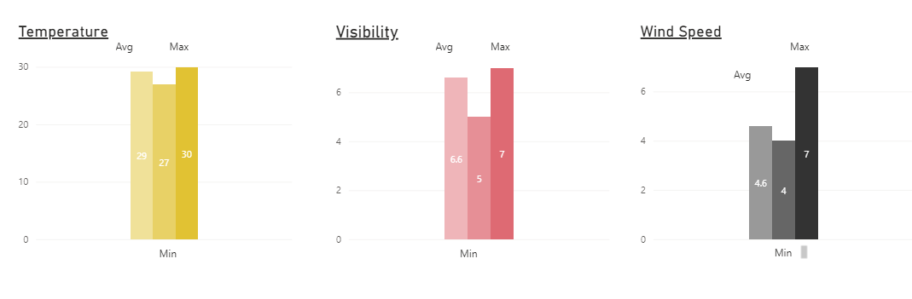
PowerBI (Visualisation cont.)
Average, Min & Max measures for 8 measures
Notes:
Jason

Slide 31
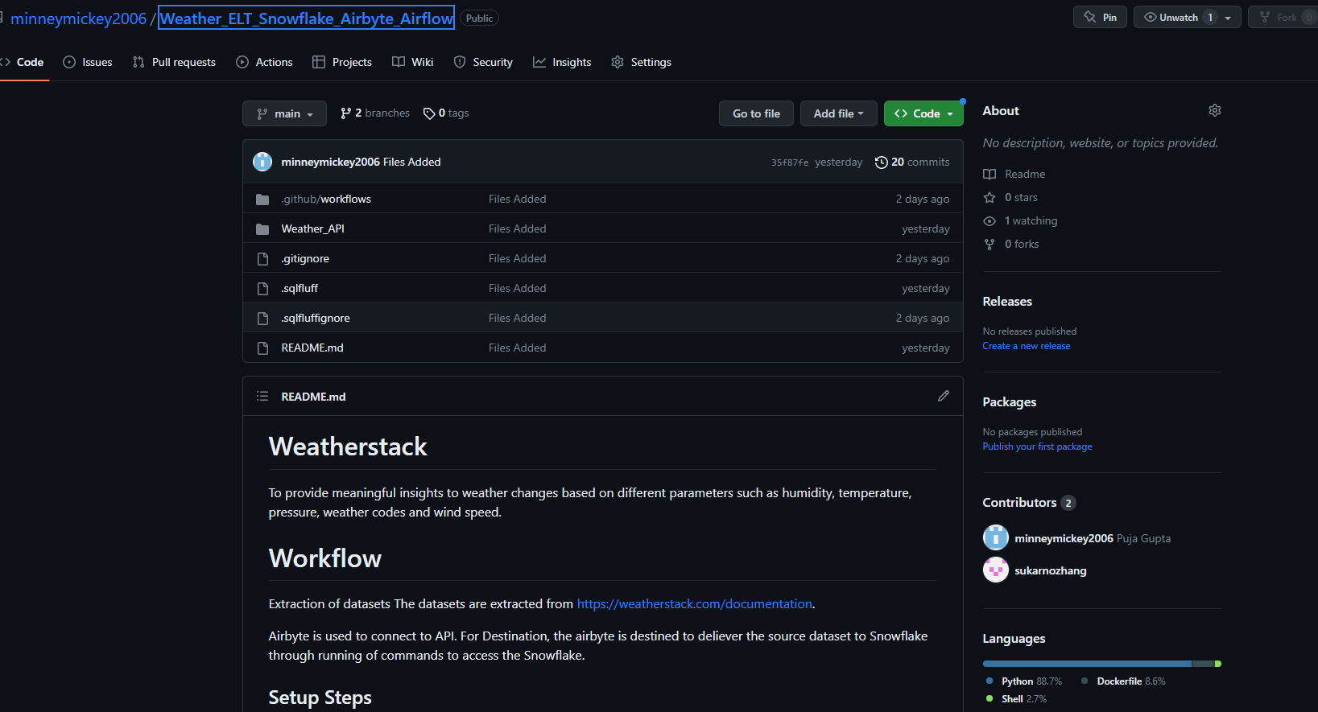
Github

Slide 32
Lessons Learnt
Learn to manage real world datasets and make it functional.
ELT process optimisation in terms of space and time complexity.
Learnt to manage work sharing and ideas brainstorming.
Understanding each person’s skill in area of specialization in group project.
Notes:
Jason

Slide 33
THANK YOU!!!!!

