Slide 1
MICROCONTROLLERS AND ENBEDDED SYSTEMS – ECE3031 PROJECT REVIEW -3
Project by:
Kishan Dadhania – 18BML0012
Sukarn Pahuja – 18BML0048
Milli Saklani – 18BML0078
Submitted to:
Prof. Sumit Kumar Jindal

Slide 2


Rescue management and emergency tracking system

Slide 3

ABSTRACT
It is crucial to keep track of disaster victims at the time of rescue operation. The operation may involve multiple hops between multiple towns in order to reach the victim to a caretaker/nurse. We propose to build a 8051 based wearable that can detect body vitals and position of the victim and send the data to a caretaker. This includes an RFID tag that links the patient to a particular nurse/caretaker and enables the nurse to identify the victim. This enures tracking of the rescue operation and safe recovery of the disaster victim from the point of accident to a home/hospital. Pulse Count Sensor will be used to monitor the heart rate of the victim and those who require immediate attention will be separated out.

Slide 4
INTRODUCTION
Natural disasters, as an unexpected event, cause damage and destruction of human life and health. The injured person, without others’ assistance are not able to meet their needs. Most of the Natural disasters in India are related to the climate of India which causes massive losses of life and property.
The literature was searched on the role of RFID technology in improving patient safety with the help of libraries, books, conference proceedings, databases, and also search engines available at Google, Google Scholar. In our searches, we employed the following keywords and their combinations; RFID, victim, disaster, rescue, and earthquake in the searching areas of titles, keywords, abstracts, and full texts in the searching areas. More than 60 articles were collected and assessed, and 39 of them were selected based on their relevancy. This was published in the International Journal for Health and disaster management

Slide 5
PROBLEM STATEMENT
The aim of the project is to use a microcontroller to regulate the transfer of human victims from point to point. Multiple points in the locality will have RFID based device that can record the detected tag information and its related vitals. The victim’s body will be scanned at multiple points in the journey. Any point that doesn’t show a consistent vital can be attended to by calling emergency doctors at that point. If the patient is trafficked or any one point doesn’t show RFID reading, there will be a police inspection on that patient’s current location based on last scanned location. This will avoid the slightest chances of a mishap.

Slide 6
THEORY
Human RFID Tracking System is used to track the activities of the particular person in an organization, school or University. Our system operates through the help of Radio Frequency Identification technology. With this Human RFID Tracking System unit it is possible to document and keep track of daily arrival and leaving times of the employees anytime and anywhere as well as with the help of optional GPS receiver it is also possible to determine the location of the device where it is installed. This efficient and compact time registration system is a perfect solution for any type of organizations, and can be installed very easy and super-fast. Employees simply clock in and out by holding their RFID card next to the device. This data is transmitted through TCP/IP over GPRS to a remote server, and you will have the essential details allowing you to optimally structure your business processes.

Slide 7
Extending this existing systems to have an interface of sensors that gives information of body vitals leads to a powerful use case, as demonstrated in our project.
Radio-frequency identification (RFID) uses electromagnetic fields to automatically identify and track tags attached to objects. An RFID tag consists of a tiny radio transponder; a radio receiver and transmitter. When triggered by an electromagnetic interrogation pulse from a nearby RFID reader device, the tag transmits digital data, usually an identifying inventory number, back to the reader.
During a disaster, there are a lot of barriers such as network disconnection, fix phone and cell phone unavailable, to track and find victims. Therefore, to rescue victims who had the RFID tags before a calamity or not, it would be useful to rescue them by using this technology. Therefore, the aim of this study was to introduce the RFID technology and explain how it can rescue victims who saved from collapsed building after an earthquake.

Slide 8
COMPONENTS USED
8051 MICROCOTROLLER
8051 microcontroller is designed by Intel in 1981. It is an 8-bit microcontroller. It is built with 40 pins DIP (dual inline package), 4kb of ROM storage and 128 bytes of RAM storage, 2 16-bit timers. It consists of are four parallel 8-bit ports, which are programmable as well as addressable as per the requirement. An on-chip crystal oscillator is integrated in the microcontroller having crystal frequency of 12 MHz
RFID READER
EM-18 RFID reader module uses a RFID reader that can read 125 KHz tags. So, it can be called as a low frequency RFID reader. It gives out a serial output and has a range of about 8-12 cm. There is a built-in antenna and it can be connected to the PC with the help of RS232. (continued….)

Slide 9
EM18 module radiates out 125 KHz through the coils. When a 125 KHz RFID passive tag is bought to the field module will get energized from the field. By the change in modulation current through the coils, the tag will be sending the information back to the program memory array.
RFID TAG
An RFID tag works by transmitting and receiving information via an antenna and a microchip — also sometimes called an integrated circuit or IC. The microchip on an RFID reader is written with whatever information the user wants. There are two main types of RFID tags: battery-operated and passive. As the name suggests, battery-operated RFID tags contain an onboard battery as a power supply, whereas a passive RFID tag does not, instead working by using electromagnetic energy transmitted from an RFID reader. Battery-operated RFID tags might also be called active RFID tags.
LCD (16x2) SCREEN
This is a peripheral that can display text and cursor in two lines. Programmable using the 8051 output pins. It has multiple options to display text.

Slide 10
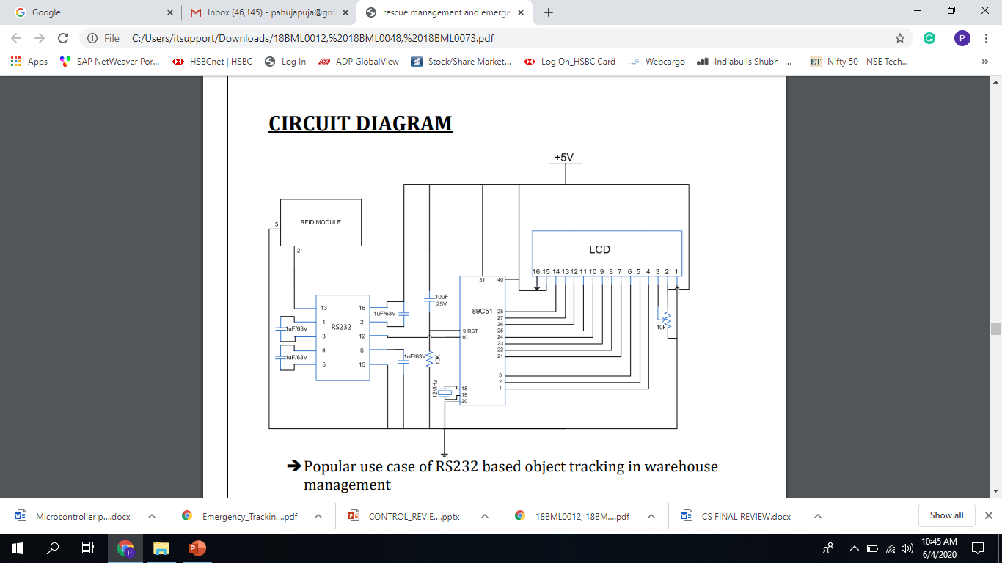
CIRCUIT DIAGRAM

Slide 11
WORKING
The RFID reader (used for reading the RFID sensors) are placed at different localities of the building where employees pass through.
Also, they are located at all entrances and exits.
Whenever there is natural disaster and immediate rescue is required, this project locates all the employees in the building.
Every employee has a RFID sensor tag containing their information.
Whenever the evacuation of the building is required, the RFID sensors senses these RFID tags that they are wearing.
As soon as one passes through the RFID tag reader, the reader senses the tag and thus the information about the employee is gathered and displayed on the LCD screen
This keeps the count of the employees in the building and thus helps in finding the missing people during the disaster.

Slide 12
RESULT
As our main objective of tracking people is successfully implemented as result the death toll will decrease by huge amount. We will be able to rescue more people trapped under fallen building with the help of their unique RFID tags. It is also feasible as it is cost effective and can be implemented in places where there are frequent earthquakes.

Slide 13
ADVANAGES
DISADVANTAGES
Reduce time and cost by using RFID in the process of victims tracking.
Reduce errors to recognize and track victims by using RFID.
Localize the victims in shelters and rescue victims faster.
Give better services to victims.
Decrease wasting time to rescue victims making mistakes through data collection.
Improve victims' logistics for tracking and servicing.
It is not possible to browse wet tag
Vulnerability tags; once they get wet
Tags and reader interaction
The issue of safety (lower security than the barcode)
Economic issues thanks to the high price with the RFID
Hardware RFID problems.

Slide 14
CONCLUSION
The RFID technology automates data collection and vastly reduces human effort and error. RFID supports tag reading with no line-of-sight or item-by-item scans required
RFID readers can read multiple RFID tags simultaneously, offering increases in efficiency. All RFID tags within range can be detected instantly and matched with information in your database RFID can be integrated with active scanning and fixed readers for a totally automated tracking solution.
The major disadvantage of the system is that it cannot send Realtime patient information to cloud for global immediate response diagnosis. This system is makes the middle point doctors more responsible and accountable than a single end point service doctor.

Slide 15
REFRENCES
Pharmaceutical RFID pilot finds promise, problems. In RFID Upsdate, Nov. 15th, 2006, http://www.rfidupdate.com
Wal-Mart details RFID requirement. In RFID Journal, Nov. 6, 2003, http://www.rfidjournal.com.
J. Brusey, C. Floerkemeier, M. Harrison, and M. Fletcher. Reasoning about uncertainty in location identification with RFID. In Workshop on Reasoning with Uncertainty in Robotics.
S. Inoue, D. Hagiwara, and H. Yasuura. Systematic error detection for RFID reliability.
https://circuitdigest.com/microcontroller-projects/lcd-interfacing-with-8051-microcontroller-%2089s52
https://www2.camcode.com/asset-tags/what-are-rfid-tags/

