Slide 1
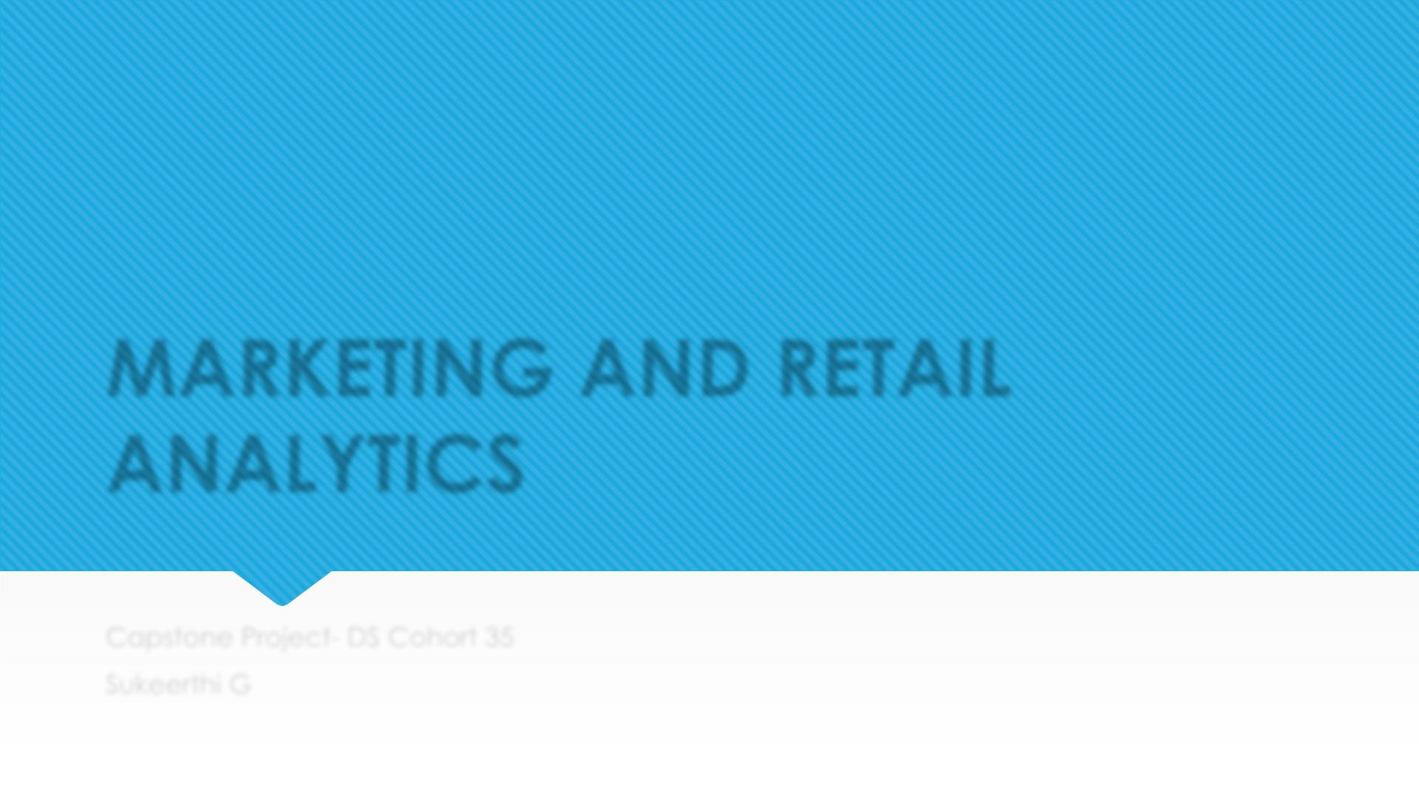
MARKETING AND RETAIL
ANALYTICS
Capstone Project- DS Cohort 35
Sukeerthi G

Slide 2

Agenda
 Background
 Objective
 Key Findings
 Recommendations
 Appendix:
a. Data Source
b. Data Methodology
c. Data Model Assumptions

Slide 3
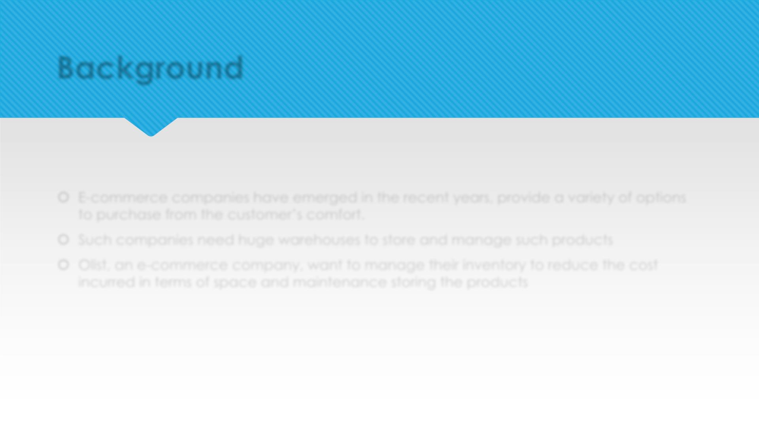
Background
 E-commerce companies have emerged in the recent years, provide a variety of options
to purchase from the customer’s comfort.
 Such companies need huge warehouses to store and manage such products
 Olist, an e-commerce company, want to manage their inventory to reduce the cost
incurred in terms of space and maintenance storing the products

Slide 4
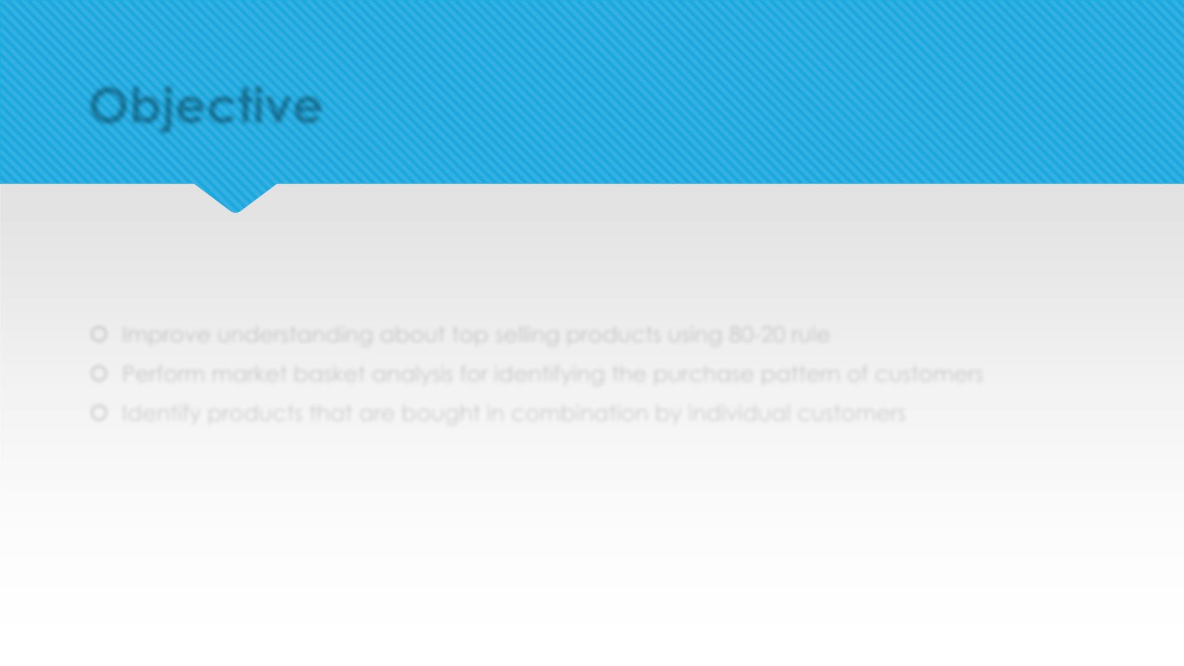
Objective
 Improve understanding about top selling products using 80-20 rule
 Perform market basket analysis for identifying the purchase pattern of customers
 Identify products that are bought in combination by individual customers

Slide 5
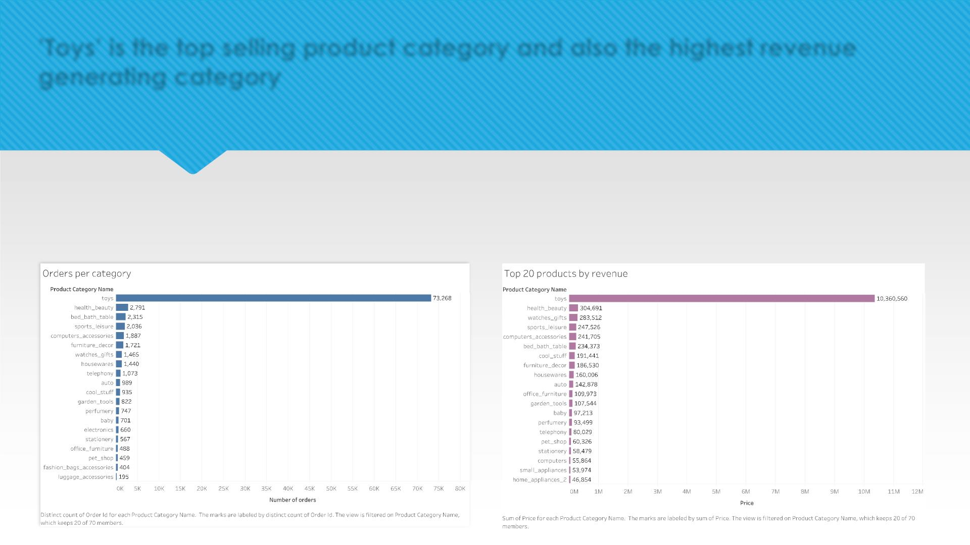
’Toys’ is the top selling product category and also the highest revenue
generating category
• Toys alone were ordered more than all the categories combined and also generated more
revenue than other categories combined.
• Number of toys ordered were 73,268 and revenue generated was $10,360,560

Slide 6
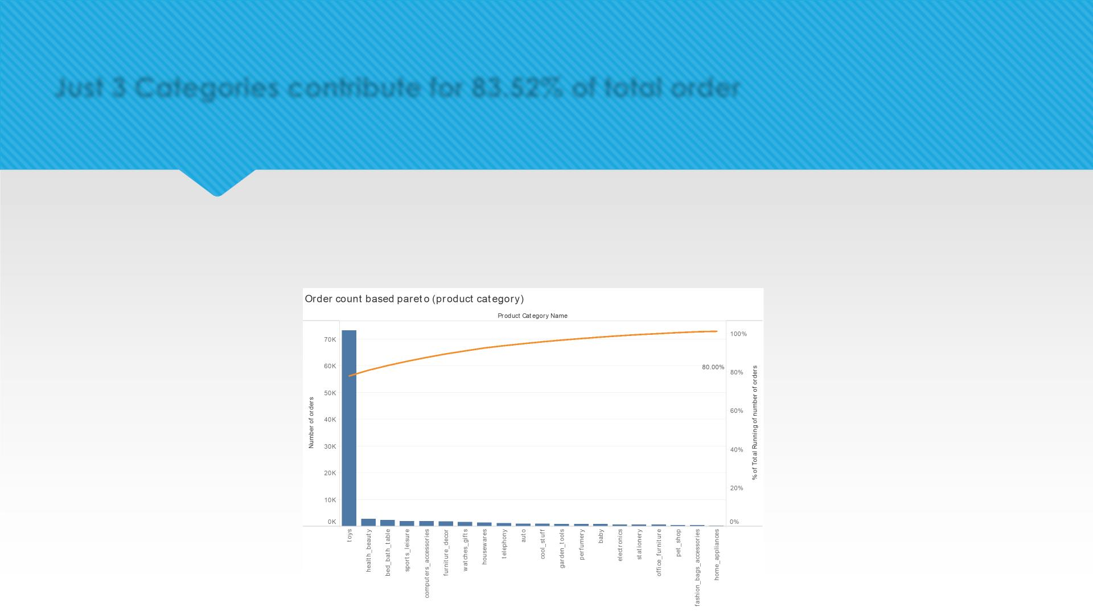
Just 3 Categories contribute for 83.52% of total order
• Toys, Health_beauty and Bed_bath_towel products contribute for 83.52% of total order
• Toys alone contribute 78.08% of total orders to Olist

Slide 7
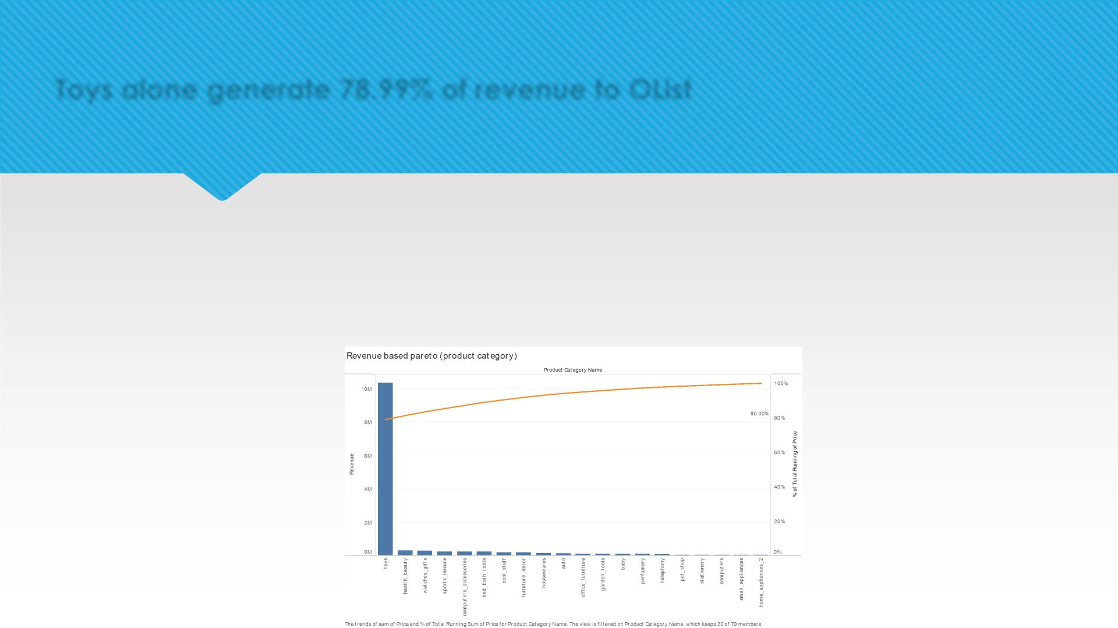
Toys alone generate 78.99% of revenue to OList
• Toys, Health_beauty and Watches_gifts products contribute for 83.47% of total revenue
• Though watches_gifts is the 7th highest sold product category, it is the 3rd highest revenue
generating category
• Hence, analyzing products that are top sold and high revenue generating helps in effective
warehouse maintenance

Slide 8
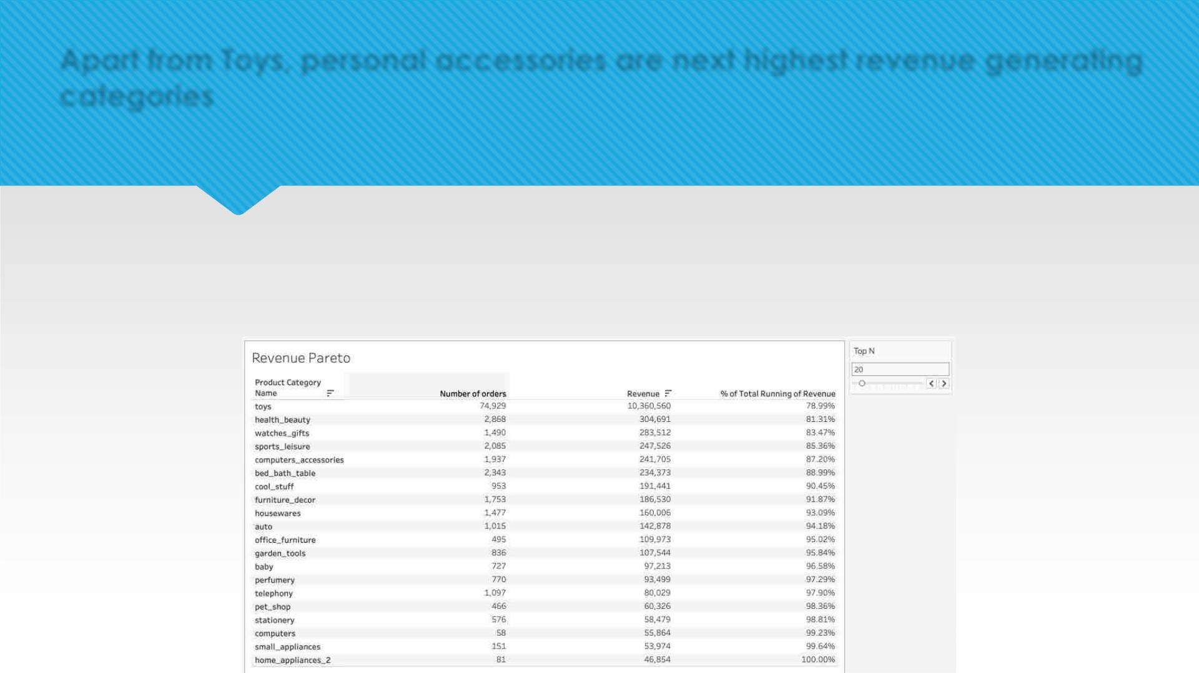
Apart from Toys, personal accessories are next highest revenue generating
categories
• Personal accessories- health_beauty, watches_gifts, sport_leisure and bed_bath_table are top
revenue generation after Toys
• These product categories account for 88.99% of total sales.

Slide 9
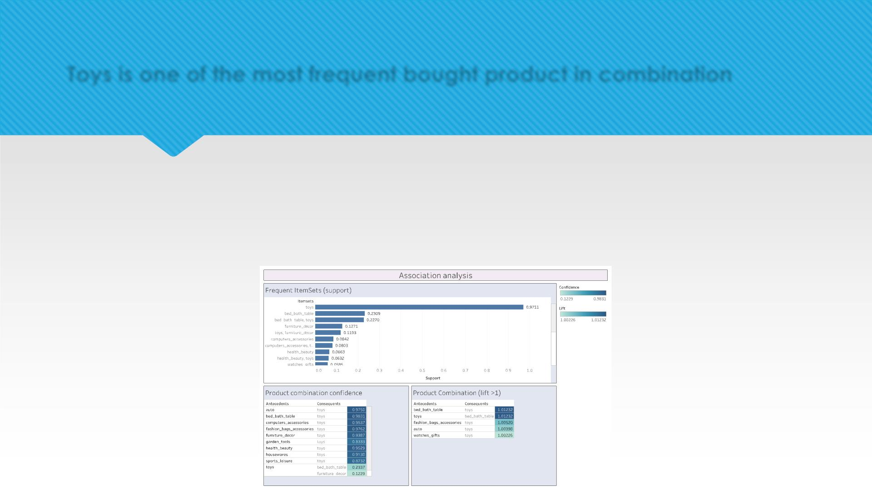
Toys is one of the most frequent bought product in combination
• Toys is the most purchased product with a support value of 0.97
• Lift>1 indicates that toys are bought frequently along with either of these: bed_bath_table,
fashion_bag_accessories, auto and watches_gifts
• This can also be confirmed by high confidence of toys with all the other categories

Slide 10
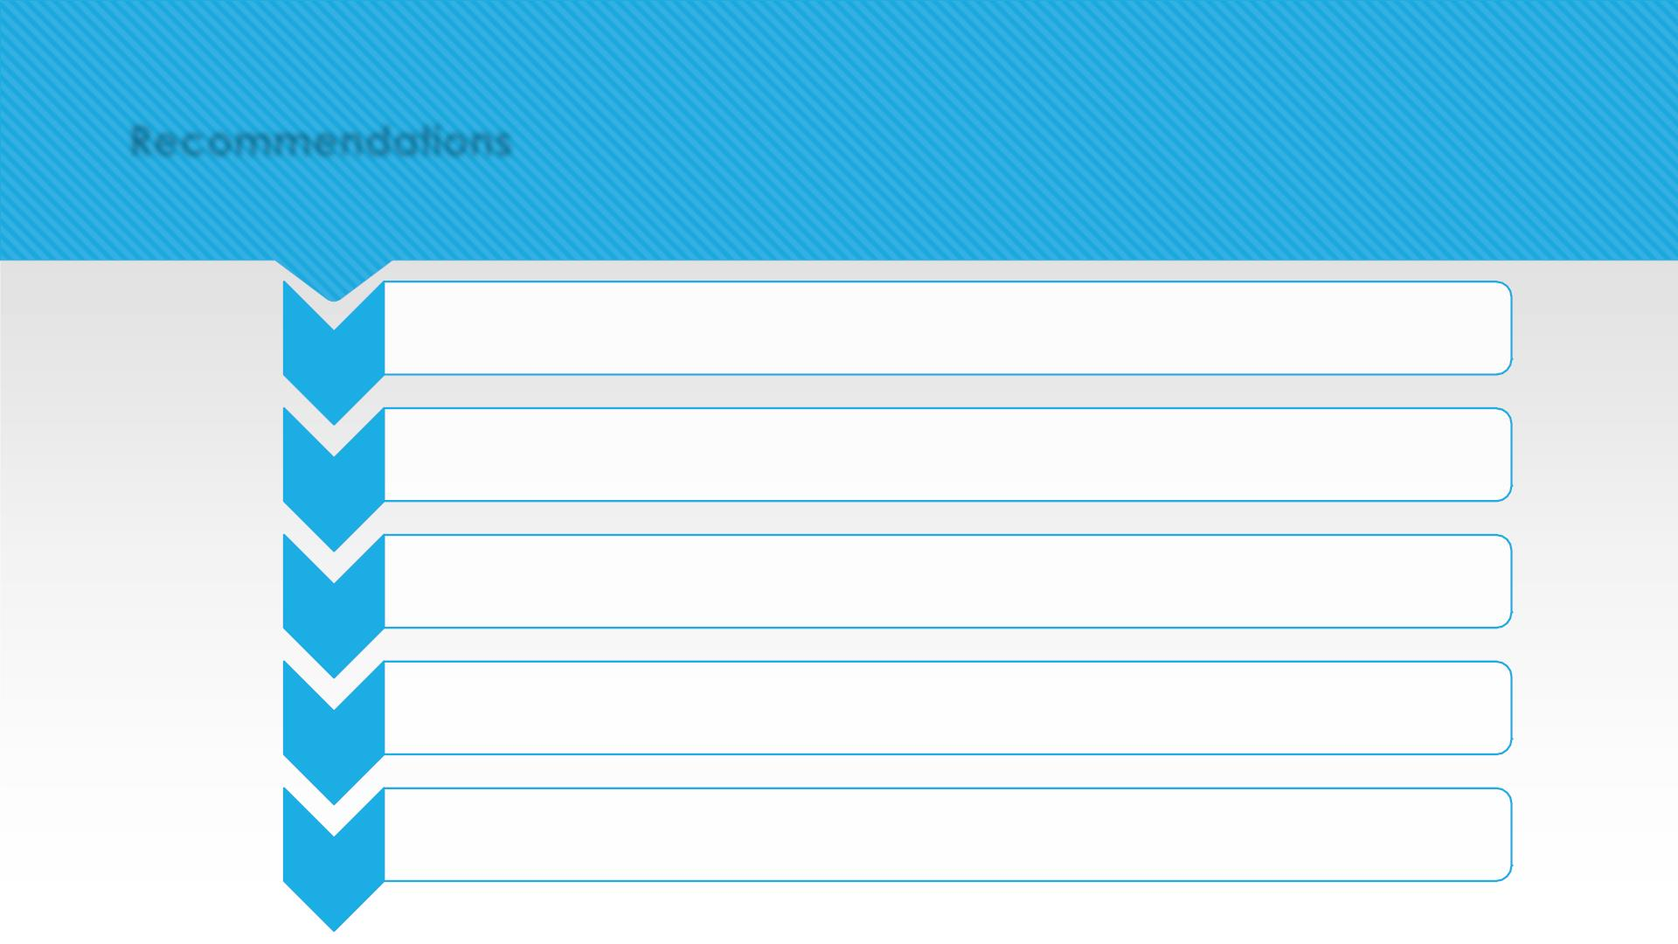
Recommendations
•Pareto analysis based on 80-20 rule shows us toys contribute close to 80% of revenue. Hence
Pareto
Analysis
stocking toys in advance is highly recommended.
•Health_beauty, watches_gifts, sport_leisure and bed_bath_table are sold the next highest
and generates higher revenues compared to other categories along with combination of
toys. Hence, stocking these products in proximity to toys in warehouse is important.
Product
Combination
•Provide offers and discounts on products that are frequently bought together like toys-
bed_bath_table, toys-health_beauty.
Offers
•Stock up personal accessories products compared to others more as they are the highly
ordered products
Products to
focus
•Try to identify the slow moving products and create combo offers of these with fast moving
products like toys, watches_gifts etc. to keep the warehouse fresh.
Slow moving
products

Slide 11
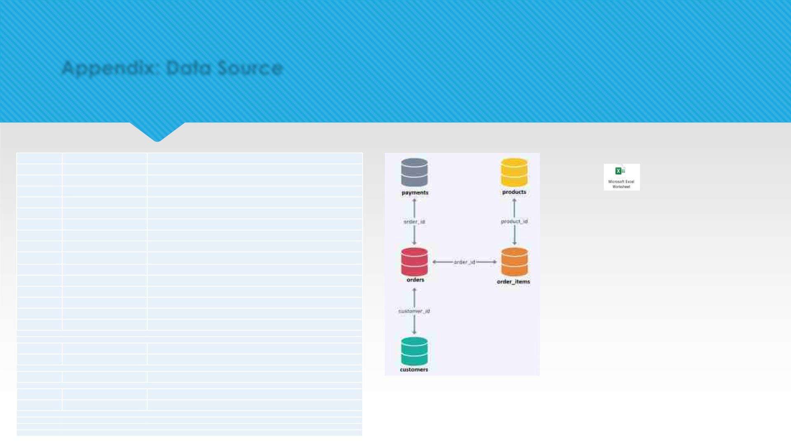
Appendix: Data Source
Dataset name
orders
Column Name
Description
order_id
Unique identifier for an order, acts as the primary key of this table
Unique identifier for a customer, however, this table wont be unique at this level
Indicates the status of an order, for example: delivered, cancelled, processing etc.
Timestamp when the order was made from the customer
Timestamp when the order was approved from the sellers' side
Timestamp when the order was delivered at customer's location
Estimated date of delivery shared with the customer while placing the order
orders
customer_id
orders
order_status
orders
order_purchase_timestamp
order_approved_at
order_delivered_timestamp
order_estimated_delivery_date
order_id
orders
orders
orders
Retail Dataset
Cleaned
order_items
Unique identifier for an order
order_items
order_items
order_items
order_items
order_items
customers
order_item_id
product_id
seller_id
Item number in each order. Order_id along with this column acts as the primary key of this
table
Unique identifier for a product
Unique identifier for the seller
price
selling price of the product
shipping_charges
customer_id
charges associated with the shipping of the product
Unique identifier for a customer, acts as the primary key of this table
customers
customers
customers
customer_zip_code_prefix
customer_city
customer_state
Customer's Zip code
Customer's Zip city
Customer's Zip state
Entity
payments
order_id
Unique identifier for an order, this table can have duplicates in this column
Relationship
Diagram
payments
payments
payment_sequential
payment_type
Povides the info of the sequence of payments for the given order
Type of payment like credit_card, debit_card etc.
payments
payments
payment_installments
payment_value
Payment installement number in case of credit cards
Trasaction value
products
product_id
Unique identifier for each product, acts as the primary key of this table
products
products
products
products
products
product_category_name
product_weight_g
product_length_cm
product_height_cm
product_width_cm
Name of the category the product belongs to
Product weight in grams
Product length in centimeters
Product height in centimeters
Product width in centimeters
Data dictionary

Slide 12

Appendix: Data Methodology
 Data understanding and cleaning
 Exploratory data analysis using the Python Libraries (MatplotLib and Seaborn) in
Jupyter Notebook.
 Selecting orders that were of status ’Delivered’ for the further analysis
 Market basket analysis using Machine learning Extension – mlxtend
 Product combination analysis using Apriori technique

Slide 13
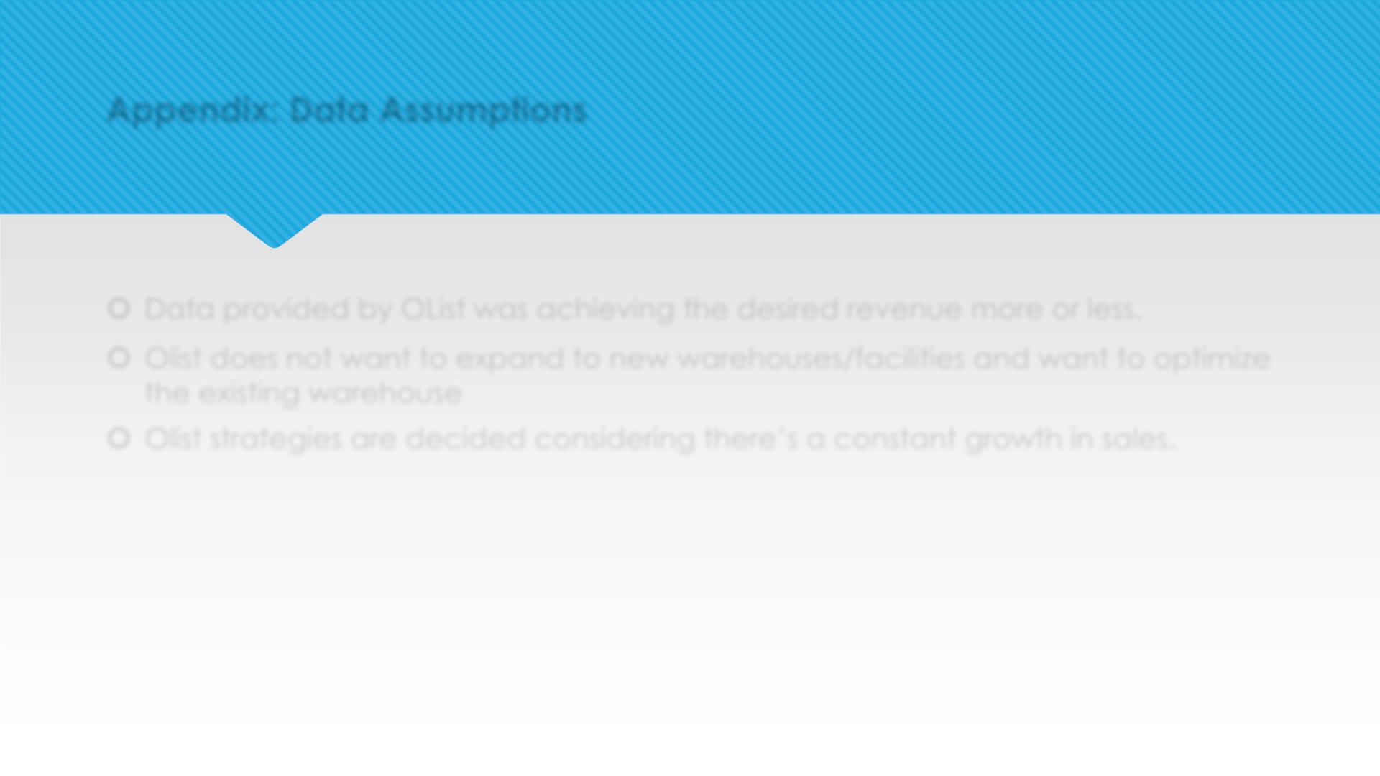
Appendix: Data Assumptions
 Data provided by OList was achieving the desired revenue more or less.
 Olist does not want to expand to new warehouses/facilities and want to optimize
the existing warehouse
 Olist strategies are decided considering there’s a constant growth in sales.

