Slide 1
Workflow vs. Agent Integration in DevOps: A CI/CD Pipeline Case Study
Exploring automation approaches through fixed workflows and dynamic agents.
Objective:
Compare fixed workflows and agent-based approaches.
Understand their strengths, limitations, and appropriate use cases in DevOps.

Slide 2
Fixed Workflow for CI/CD Deployment Process
Code Commit – Developer pushes code to a repository.
Pipeline Trigger – CI/CD tool (e.g., Jenkins, GitHub Actions) starts automatically.
Automated Testing – Unit and integration tests run.
Staging Deployment – Code is deployed to a staging environment.
Staging Tests – Functional/integration tests executed.
Production Deployment – Code moves to production if all tests pass.

Slide 3
Fixed Workflow for CI/CD Deployment
Code
Code Commit
Trigger
Trigger CI/CD
Run
Run Tests
Deploy
Deploy to Staging
Run
Run Staging Tests
Deploy
Deploy to Prod

Slide 4
Agent Actions May Include:
Selecting test suites based on code coverage analysis.
1
Choosing between canary/staging/blue-green deployments.
2
Integrating with toolchains based on project type (e.g., Docker, Kubernetes, Serverless).
3
Deciding rollback or approval flows based on performance metrics and logs.
4

Slide 5
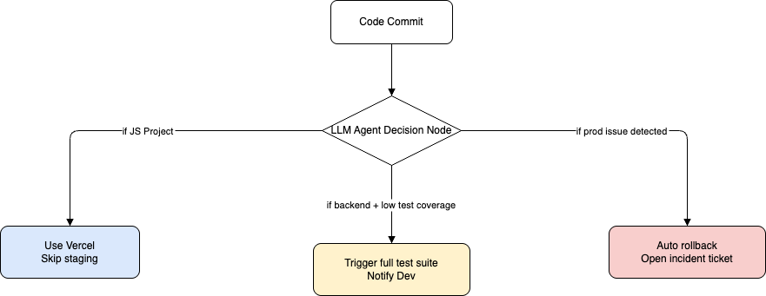
Agent-Based CI/CD Deployment with LLM Integration

Slide 6
Workflow vs. Agent: Feature-by-Feature Comparison
Criteria | Fixed Workflow | Dynamic Agent-Based Workflow
Predictability | High Same steps every time | Medium Varies based on context
Complexity Handling | Low Struggles with edge cases | High Adapts to different scenarios
Debugging | Easier Known flow and logs | Harder Requires traceable decisions
Tool Integration | Static Predefined tools | Dynamic Picks tools as needed
Speed/Flexibility | Moderate Linear execution | High Skips/reorders intelligently
Best For | Stable pipelines, low change rates | Multi env, high-frequency deployments

Slide 7
Conclusion: When to Use What?
Use Fixed Workflows When:
You need compliance and predictable releases
Your project is stable with known patterns
You prioritize simplicity and auditability
Use Agent-Based Workflows When:
Your environment is dynamic, with frequent changes
You need smart tool selection or error handling
You want to optimize for performance and agility

Slide 8
Thank You
- Sukesh

