Slide 1


SERS-Based
Nanobiosensor Workflow for Sepsis Diagnostics

Slide 2




Clinical Urgency of Sepsis
Approximately 49 million sepsis cases globally (2020) with -11 million deaths.
Early detection and treatment are critical; delays increase mortality.
Sepsis is a major contributor to hospital fatalities and ICU burden.
Limitations of Current Diagnostics
Antibiotics
Increases antimicrobial resistance
Infrastructure Dependent
PCR
Requires specific lab capabilities
Inconclusive Clinical Scores
Lacks definitive diagnostic power
-s ,ifi(..
a ei
Difficult to confirm bacterial cause
Slow Blood Cultures
Delays actionable treatment
decisions

Slide 3



Why Bacterial- Specific Biomarkers?
Early diagnosis and improved clinical outcomes.
Directly indicate the presence of bacteria (not just host inflammation).
Enable Gram classification. Reduce unnecessary broad-spectrum antibiotic use and combat AMR.
Traditional Approach
Bacterial Specific Marker
Host response detection Delayed immune activation Non-specific inflammation Cannot guide antibiotics Incremental improvement
Direct bacterial detection Immediate bacterial identification Bacterial specific marker
Enables targeted therapy Paradigm shift

Slide 4


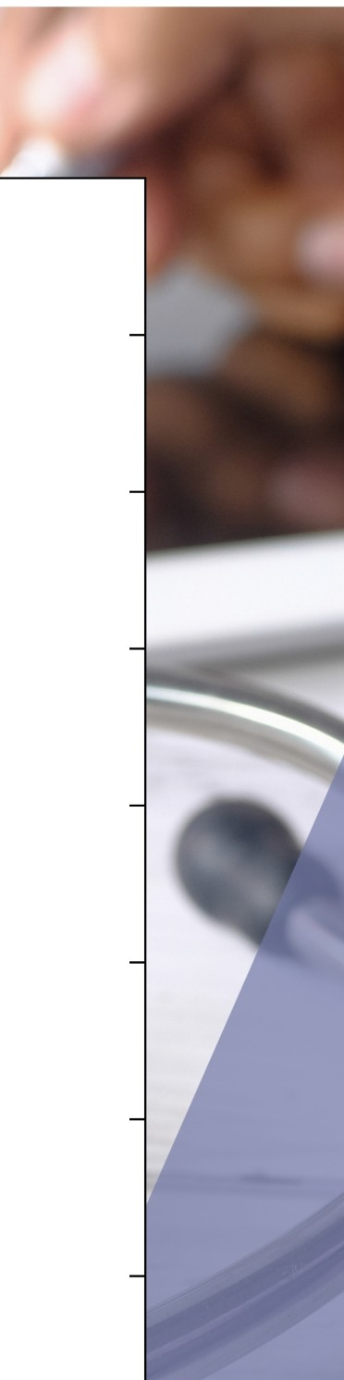


v
Difference
Gram-Positive
Gram-Negative
Clinical Significance
Reference
Cell Wall Structure
Thick peptidoglycan (20-80 nm)
Thin peptidoglycan + outer membrane
Determines antibiotic penetration and SERS targeting strategy
Silhavy et al. Cold Spring Harb Perspect Biol 2010;2(5):a000414
Peptidoglycan Content
90% of cellwall mass
5-10% of cell wallmass
Major structural target for - Lactam antibiotics and detection
Vollmer et al. FEMS Microbiol Rev 2008;32(2) :149-167
Outer Membrane
Absent
Present (barrier function)
Primary resistance mechanism; barrier to drugs and immune system
Nikaido H. Microbiol Mol Biol Rev 2003;67(4):593-656
Lipopolysaccharide (LPS)
Absent
Present (endotoxin component)
Major sepsis mediator; triggers cytokine storm and shock
Raetz & Whitfield. An nu Rev Biochem 2002;71:635-700
Gram Staining
Purple/Violet (retains stain)
Pink/Red (loses stain)
Primary Laboratory identification method (95% accuracy)
Gram HC. Fortschr Med 1884;2:185-189
Antibiotic Susceptibility
Generally, more susceptible
More resistant (outer membrane)
Guides empirical antibiotic selection in sepsis management
Delcour AH . Biochim Biophys Acta 2009;1794(5) :808-816
Endotoxin Production
No endotoxin
Lipid A endotoxin present
Key pathophysiology difference in sepsis severity and outcomes
Rietschel et al. FASEB J
1994;8(2):217-225
Clinical Presentation
Device infections, pneumonia
UTI, septic shock, HAI
Influences infection source, severity, and treatment approach
Martin et al. N Engl J Med 2003;348(16):1546-1554

Slide 5






v . v • , .
'
ProoseEI Bacterial Biomarkers panel
O o
Universal Bacterial Detection: Peptidoglycan fragments (N- acetylmuramic acid)
Reason : Present in ALL bacteria, absent in viruses/fungi/ parasites . Direct bacterial confirmation.Unique to bacterial peptidoglycan only.
Gram-negative: Lipopolysaccharide (LPS) - lipid A & 0-antigen .
Reason :present Only in Gram-negative bacteria, absent in all other organisms.Strong enhancement, endotoxin correlation
Gram-positive: Lipoteichoic acid (LTA) and wall teichoic acids (WTA). Reason : present Only in Gram-positive bacteria , surface accessibility

Slide 6
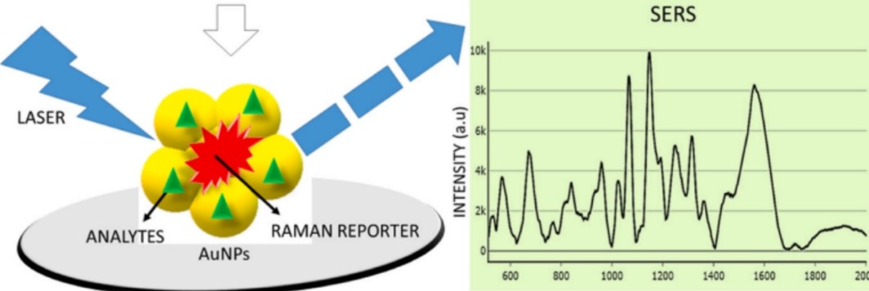
SERS Nanobiosensor: Overview
·SER S = Surface-Enhanced Raman Spectroscopy; provides molecular fingerprints.
Plasmonic nanostructures (Ag/Au) create strong local fields (hotspots).
Combine SER S substrate with capture probes (aptamers/antibodies) for selectivity.
SERS Fundamentals
,,,_ - - --
Raman scattering measures vibrational modes; specific peaks = molecule signature.
Electromagnetic enhancement f rom plasmon resonanee seales..
/'
;
....
'
I
'I BIO- RECOGNITION
I
\
'.... .... ..... _ _ _ _
I ELEMENTS
I
;
"
Hotspots enhancement; possible.
(nanogaps) give the largest single-molecule sensitivity
SUBSTRATE
RAMAN SHIFT Cm·l

Slide 7

Nanomaterials & Substrate Design
Choice of metal (Ag stronger SERS; Au more stable) affects resonance.
Particle geometry (stars, rods,gaps) tunes hotspot intensity.
Substrate unif ormity & reproducible fabrication are essential for clinical use.
Excitation Wavelength & Practical Considerations
Common lasers: 532 nm (resonant dyes), 633 nm,785 nm (bio­ f riendly), 1064 nm (high autof luorescence samples).
Balance: stronger scattering (shorter i\) vs.
f luorescence/ background and sample heating.
Laser power and exposure time must be optimized for clinical samples.

Slide 8
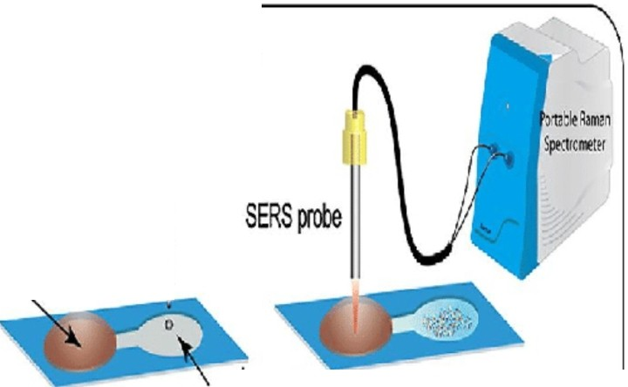

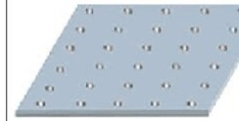
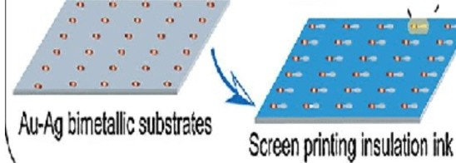
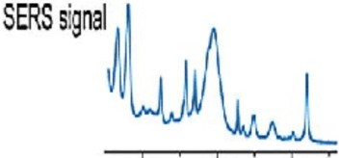
Objective: To develop a reproducible plasmonic substrate with strong Raman enhancement for bacterial biomarker detection ( LPS, LTA, PGN).
Nanosensor Substrate Fabrication Process
Deposition Technique
Drop-casting, spin-coating, or electrochemical deposition for uniform layer formation
Substrate Selection
Choosing the base material for the substrate (glass, silicon, or polymer base)
A B
c
Outcome
Achieving a stable and enhanced substrate
Wast11aler
Pa er
-· 8
I
.6JJ-ft/J bimetamc ·, I
sensors , ,
Screen prinling Ag k
tio ne
caiiillary act n
(. SCleen prting
.6Jl iri
Nanoparticle Synthesis
Gold and silver nanoparticles (AuNPs/AgNPs) via chemical reduction
Surface Functionalization
Attaching biorecognition probes to the surface
500 1000 1500
Raman Shift (err!)

Slide 9


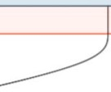
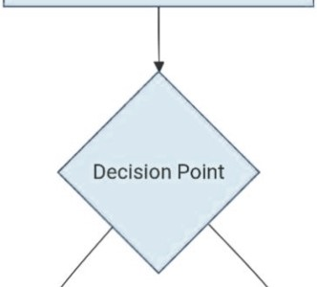

LV
•
--............. _
'
Raw Clinical Sample
e.g., Blood, Urine
+
Step 1:Sample Pre-­ processing Centrifugation & Lysis
Treated Sample
Workflow Pipeline:
Choose One Method
Filtration
Density Centrifugation
lmmunomagnetic
Separation
Concentrated Bacterial Pellet
Step 3: SJgnal Acquisition Mix with SERS Substrate
Universal Detection Direct Fingerprinting
Specific Detection Pathogen ID
Label-Free SERS
Label-Based SERS
Step 4: Data Analysis
Al/ Ml Processing
Result: Pathogen ID

Slide 10



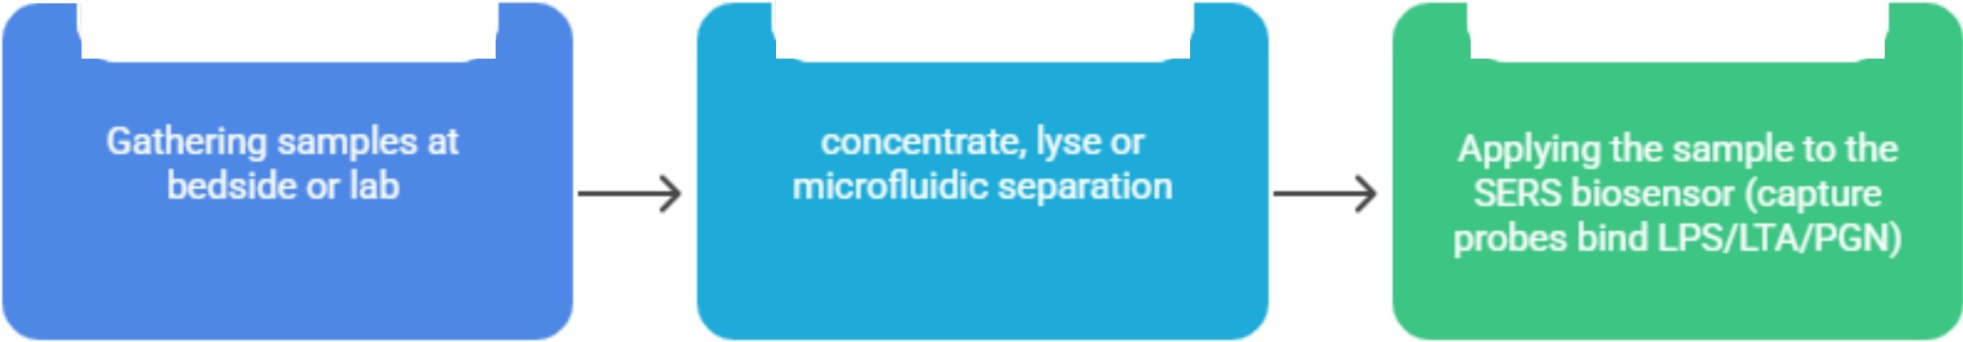
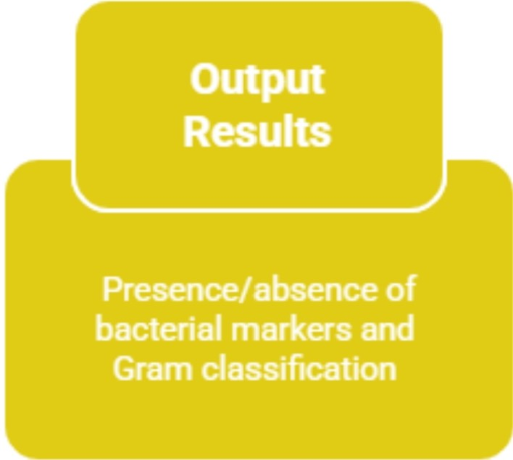

v . V I '
Diagnostic Workflow {Patient
Oo
Answer)
+
 | Sampl |  | e
Co |  | llection
 | Sampl | e
Preparati |  |  | on
Appl | y to
Biosensor
l
(

Slide 11
Competitive Advantage & Market Differentiation :
Feature | Blood Culture | PCT/CRP Tests | Our SERS Biosensor
Time-to-Result | 24-72 hours | -1hour | < 30 MINUTES *
Pathogen Specificity | Yes | No | YES (Bacterial & Gram-Type)
AMR Guidance | Delayed | No | IMMEDIATE
Platform | Central Lab | Point-of-Care | POINT-OF-CARE
Key Message: With the help of this project we envision to bridge the gap between speed and specificity

Slide 12

Clinical Utility & Impact
Rapid Gram-level info enables earlier targeted antibiotics (improves survival) .
Less empiric broad-spectrum use -7 supports antimicrobial stewardship.
Portable SERS devices can enable near-patient, point-of-care testing in
ED/ICU.
Challenges & Roadmap
Extensive literature review done and finalization of biomarker process .
SERS simulations initiation to optimize spectral response and substrate design.
Next: experimental validation of simulation results using standard samples.
Prototype fabrication and spectral benchmarking planned in next phase.
Key challenges: ensuring signal reproducibility, substrate uniformity, and
scaling for real-world use.
Long-term goal: translate optimized SERS workflow into a portable sepsis diagnostic device.

Slide 13
References
l. Singer M. et al.,The Third International Consensus Definitions for Sepsis and Septic Shock (Sepsis-3). JAMA. 2016.
Kundu A. et al.,SER S detection of sepsis biomarkers on Ag-BP platform. Sensors/Diagnostics, 2022.
Hung S. K. et al.,Current Evidence and Limitations of Biomarkers for Detecting Sepsis. Biomedicines, 2020.
Hassan M. et al.,Advances in Bacterial Detection Using SER S. Biosensors (2024).
Raetz CRH,Whitfield c.,Lipopolysaccharide endotoxins. Annu Rev Biochem. 2002.
NICE Guideline NG51,Sepsis: recognition,diagnosis and early management. 2017.
Recent reviews on sepsis biomarkers and SER S-based diagnostics (2023-2025). 8.Evans L, et al. Crit Care Med. 2021;49(ll):el063-ell43.
He R-R, et al. Sepsis biomarkers: advances and applications. IJMS 2024 9.Wang A, et al. Chem Soc Rev. 2024;53:1108-1132.
Langer J, et al. ACS Nano. 2019;14(1):28-117.
12,Karmacharya et al.,"Nanoplasmoni c SERS on Fidget Spinner for Digital Bacterial Identification," Microsyst. Nanoeng.,2025
13.Kundu A. et al.,"Ultrasensitive and Label-Free Detection of Prognostic and Diagnostic Biomarkers of Sepsis on a AgNP-laden Black Phosphorus-Based SER S Platform," Sensors & Diagnostics, 2022.

Slide 14





an
OU

