Slide 1
Time Series- POC

Slide 2
Basic Procedure:
Data collection
Data cleaning
Outliers – smoothing
Identifying the appropriate model to fit
Fit the model
Predict – test data
Evaluate

Slide 3
Approach to the problem:
Any commodity time series deals with predicting the next day’s closing price of any commodity.
A time series is a collection of data points at constant time intervals
In this scenario, commodity daily closing price.
ARIMA , Auto ARIMA, Facebook Prophet etc..,

Slide 4
Background
Every business time series is kind of a wave
Times series is a mix different patterns.
We can decompose them, to know the patterns in it.
Every business could have following in its time series:
Trend
Seasonality
Cycle
Irregular remainder (noise, randomness)

Slide 5
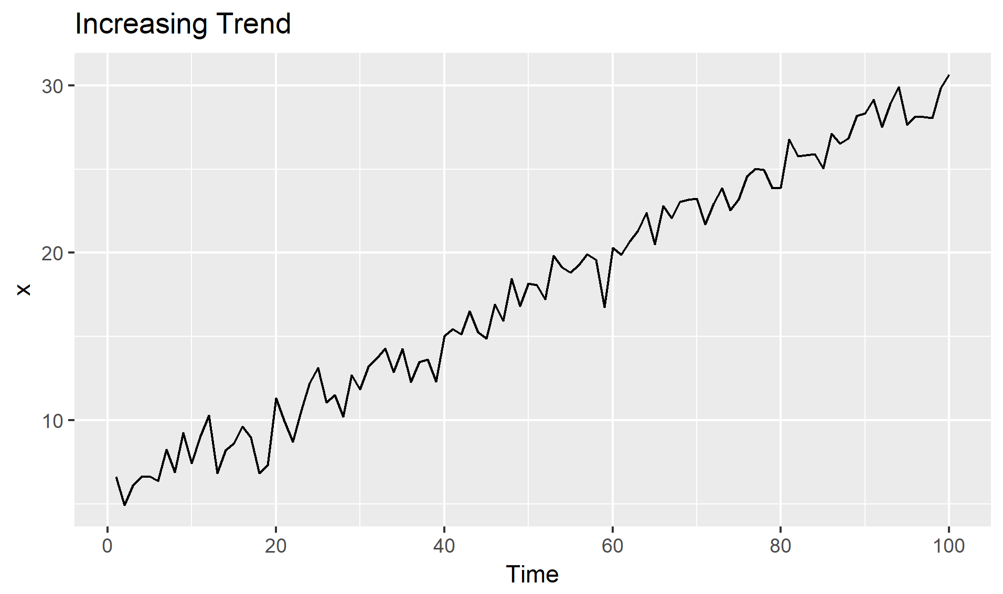
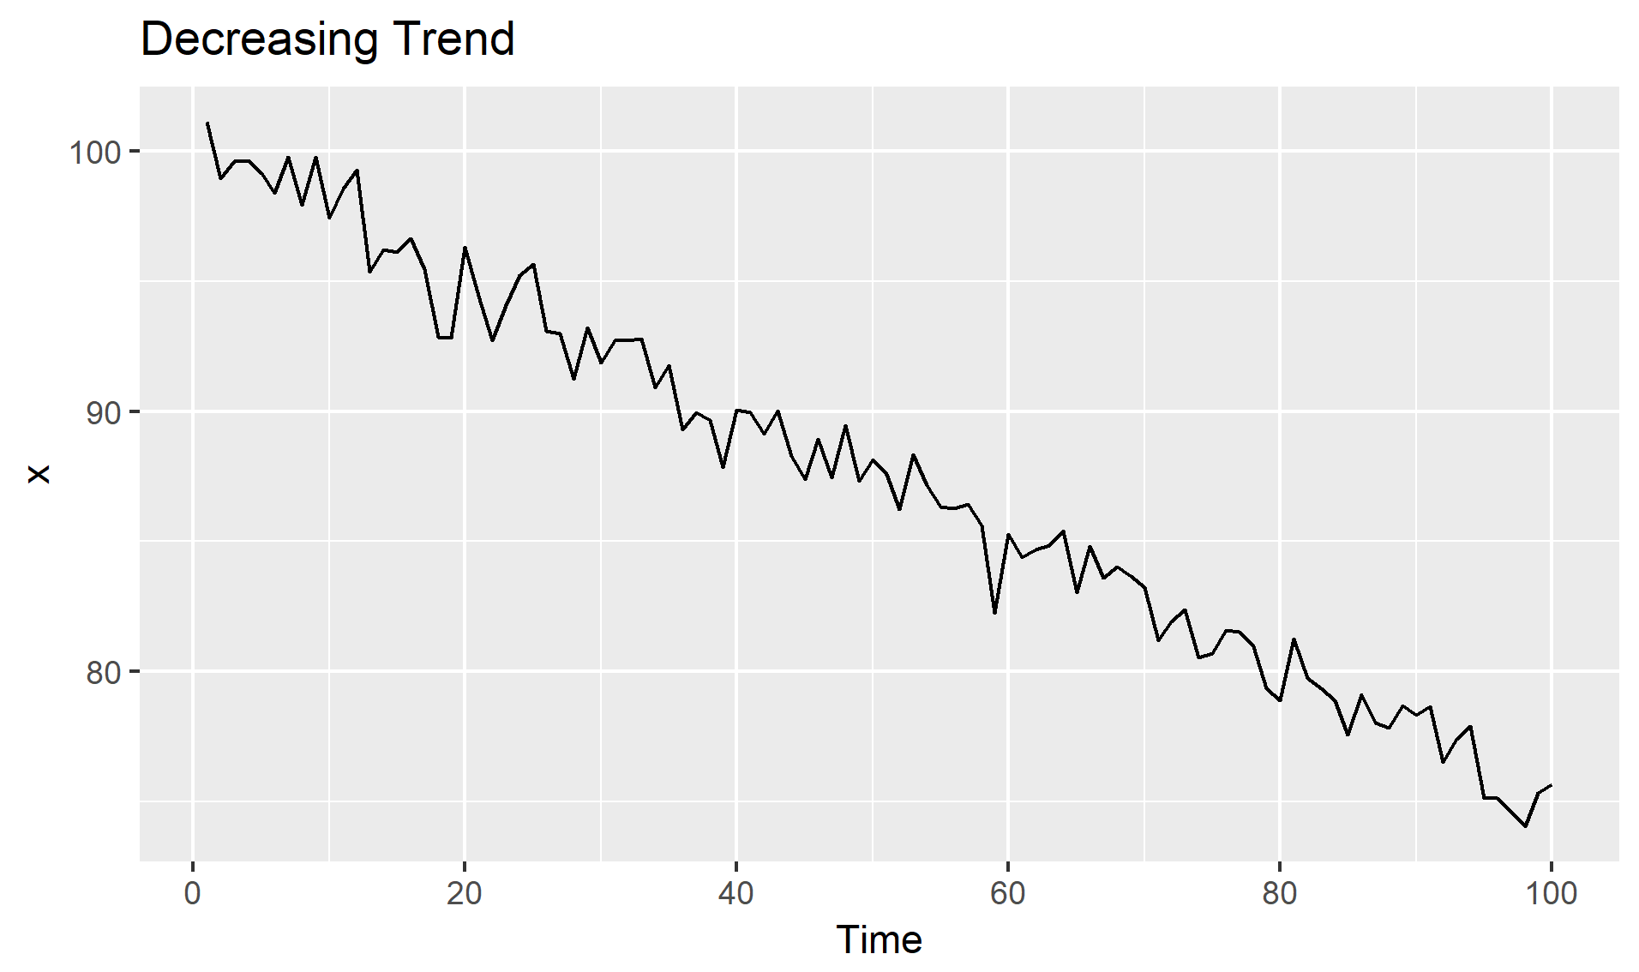
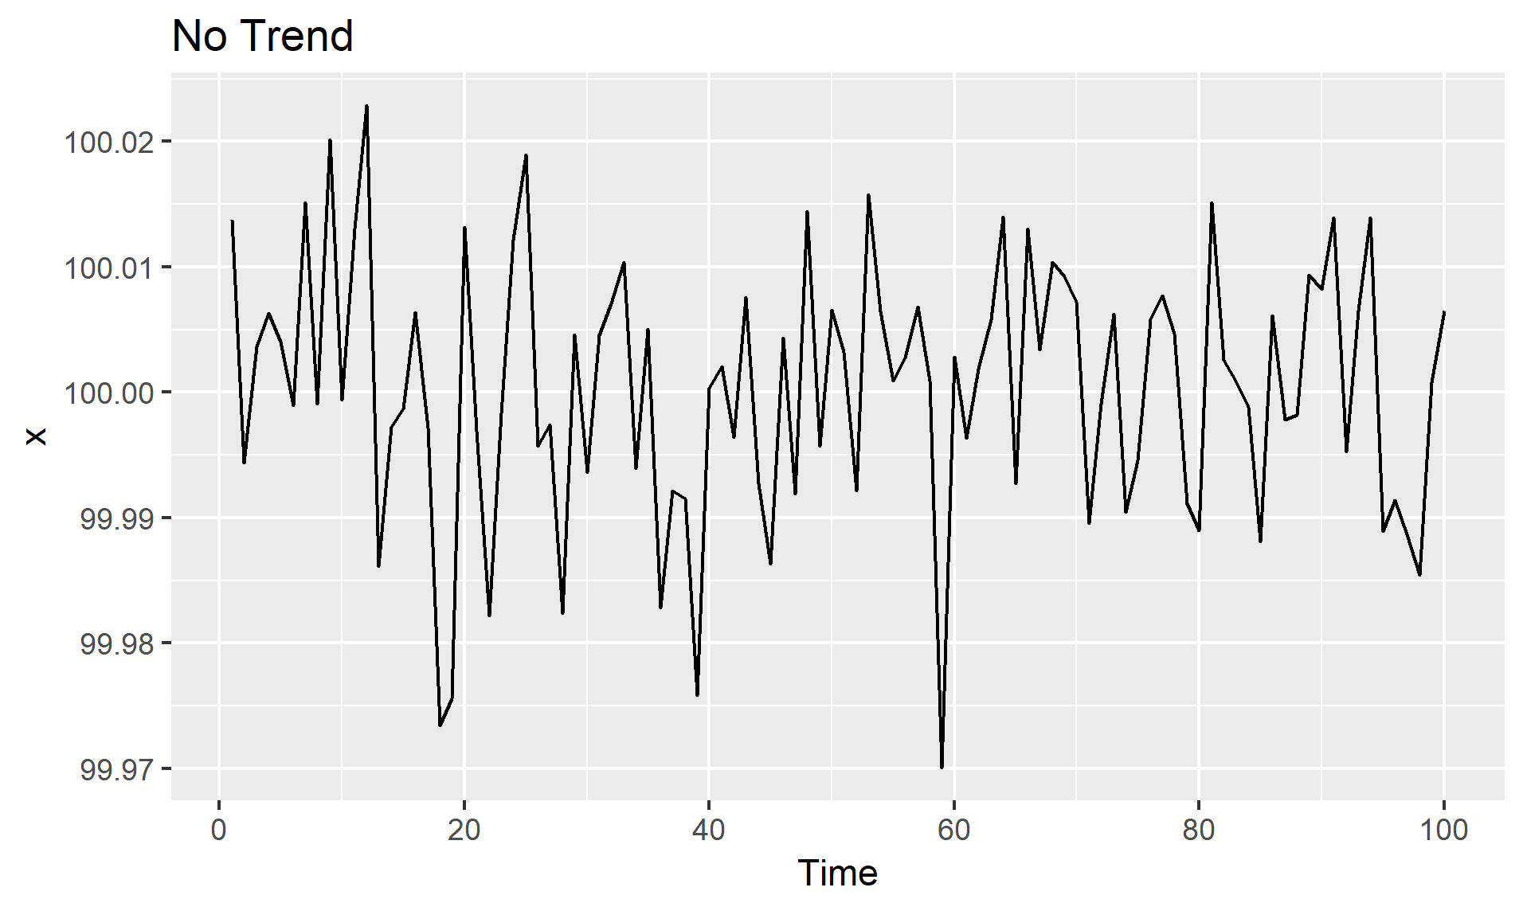
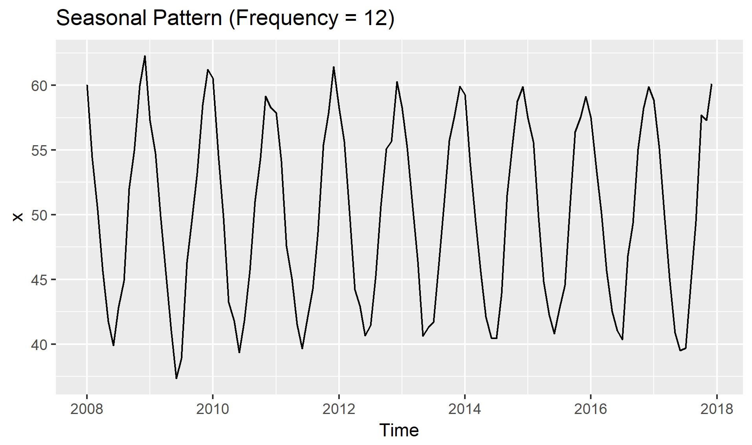
Different patterns

Slide 6
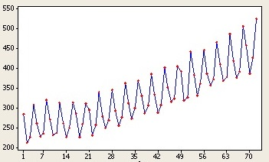
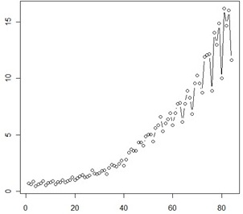
Multiplicative and additive
Additive: addition of trend , seasonality , noise
Multiplicative: multiplication of trend , seasonality, noise

Slide 7
Data Collection and cleaning to build POC:
Good data set for this problem - Stock market data set
VISA – stock market dataset of 3 years is collected using python Quandl API
As the data from this API is well cleaned – saved time for cleaning data.

Slide 8
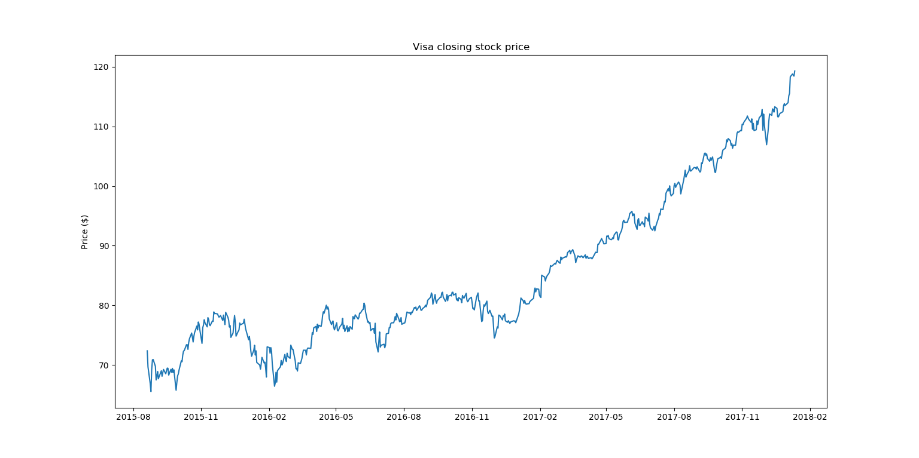
Visualizing the data:

Slide 9
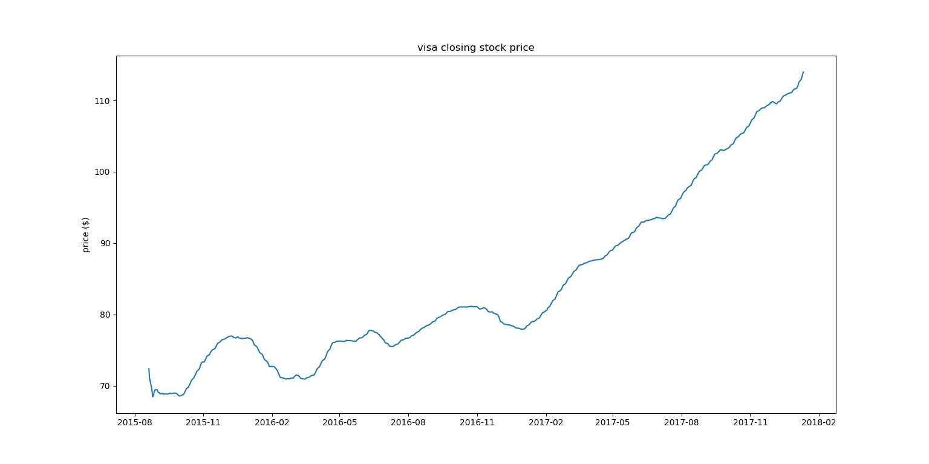
Smoothing the data – removing outliers
EWMA (Estimated Weighted Moving Average)

Slide 10
Fitting to a model (fbprophet, multiplicative)
The visa stock time series looks like multiplicative.
Prophet is procedure open sourced by facebook to forecast time series data.
Non linear trends can fit with yearly, weekly and seasonality, holidays
Prophet is robust to missing values, shifts in trend, and large outliers
Accurate, fast, tunable, fully automatic forecasts

Slide 11
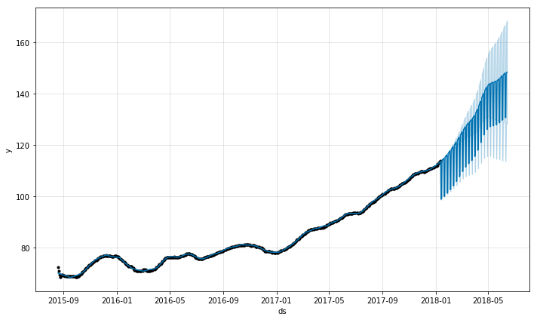
Predicting test data - evaluation
Data is divided by 80- 20 % as train and test.
Fbprophet as default functions to visualize the model results
Its give the confidence levels (bounds) of the prediction along with the prediction .

Slide 12
Results/future improvements
RMSE – train set - 4.84 , test set – 9.26
According to the commodity data we could fine tune the models to get good results.
Could apply some deep learning techniques to improve the results.
Creating a API to tract the news which could impact commodity price,
This could be given as an feature to the model.

Slide 13
References:
https://towardsdatascience.com/time-series-analysis-in-python-an-introduction-70d5a5b1d52a
http://ucanalytics.com/blogs/forecasting-time-series-analysis-manufacturing-case-study-example-part-1/
https://www.analyticsvidhya.com/blog/2015/12/complete-tutorial-time-series-modeling/
https://facebook.github.io/prophet/docs/quick_start.html
https://medium.com/mlreview/a-simple-deep-learning-model-for-stock-price-prediction-using-tensorflow-30505541d877
https://arxiv.org/ftp/arxiv/papers/1302/1302.6613.pdf
https://media.readthedocs.org/pdf/prophet/v0.1.0/prophet.pdf
https://www.datascience.com/blog/time-series-forecasting-machine-learning-differences

