Slide 1
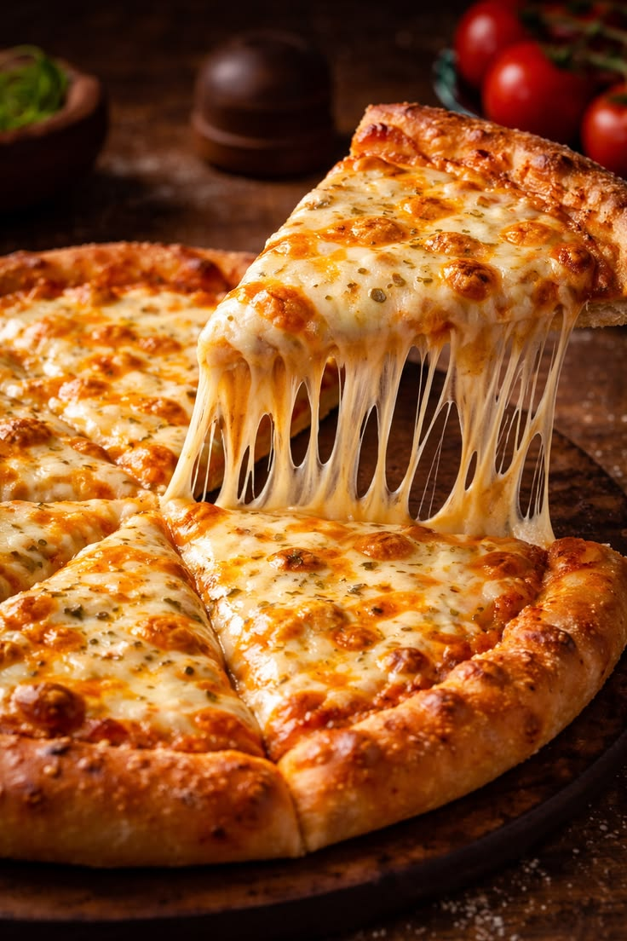

Pizza Company Performance Analysis
Business Intelligence Using SQL Server
Leveraging SQL Analytics to Drive Business Growth
Prepared by: Sukhada Kulkarni
Date : July 2026

Slide 2



Executive KPI Dashboard
Total Revenue
$817.9K
Total Orders
21.35K
Pizzas Sold
49.6K
$
Avg Order Size
2.0
Peak Hours
12:00PM
Best-Selling Size
Large
Key Insight: Large-sized pizzas generated the highest revenue ($817.9K) across 21.35K orders, making them the strongest revenue driver.

Slide 3
Revenue Leaders & Laggards
Top 5 Revenue Generating Pizzas
Lowest Revenue Generating Pizzas
Rank | Pizza Name | Revenue
1 | Thai Chicken Pizza (Large) | $29.3K
2 | Five Cheese Pizza (Large) | $26.1K
3 | Four Cheese Pizza (Large) | $23.6K
4 | Spicy Italian Pizza (Large) | $23.0K
5 | Big Meat Pizza (Small) | $23.0K
Rank | Pizza Name | Revenue
1 | Greek Pizza (XXL) | $1.06K
2 | Calabrese Pizza (Small) | $1.59K
3 | Chicken Alfredo Pizza (Small) | $1.69K
4 | Green Garden Pizza (Large) | $1.71K
5 | Mexicana Pizza (Small) | $1.75K
Recommendation : Focus promotions on Large pizzas while testing bundle offers for XL/XXL sizes

Slide 4
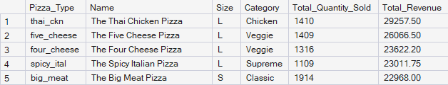
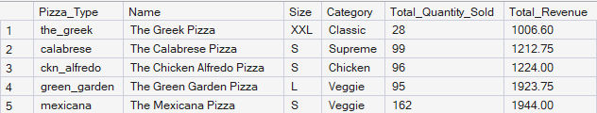
Revenue Leaders & Laggards
Top 5 Revenue Contributors
Bottom 5 Revenue Contributors
Recommendation : Focus promotions on Large pizzas while testing bundle offers for XL and XXL sizes.

Slide 5




Customer Purchase Patterns
Highest order volume occurs between 12 PM –1 PM and 5 PM – 7 PM
Wednesday records the highest number of orders
Weekday order share – 72.84%
Weekend order share – 27.16%
Business Insight : Optimize staffing during peak hours and leverage midweek demand to maximize sales.

Slide 6
Customer Purchase Patterns
Customer Purchase Patterns
Business Insight : Optimize staffing during peak hours and leverage midweek demand to maximize sales.

Slide 7
Revenue Performance Drivers
Key Insight : Large pizzas generated nearly 45.9% of total revenue, making size the strongest revenue driver.

Slide 8
Revenue Performance Drivers
Key Insight : Large pizzas generated nearly 45.9% of total revenue, making size the strongest revenue driver.

Slide 9



Sales Trends & Business Risks
Revenue Trend
Revenue remained stable ($63K - $74K)
July achieved the highest monthly revenue
Business Risk
Limited Month-over-Month revenue growth
Revenue is concentrated in a few top-selling products
Recommendation
Optimize low performing menu items
Increase focus on high-margin & high-demand products
Executive Insight : Stable revenue reflects consistent customer demand, while optimizing underperforming menu items can further improve profitability.

Slide 10
Strategic Recommendations
Sales Growth
Promote top-selling Classic pizzas
Create combo meals with beverages/sides
Increase sales of Large-size pizzas
Upsell high-margin side items
Marketing
Launch weekday promotional offers
Increase weekend marketing campaigns
Introduce lunch-time combo deals
Reward repeat customers with loyalty offers
Product Strategy
Expand popular Classic pizza options
Improve or replace low-performing pizzas
Introduce seasonal and limited-time flavors
Focus inventory on high-demand categories
Operations
Stock more ingredients for top-selling pizzas
Schedule more staff during peak hours
Reduce waste from slow-moving products
Improve demand forecasting using sales trends
Expected Business Impact: Focusing on high-performing products, optimizing inventory, and running targeted marketing campaigns can increase revenue, improve profitability, reduce operational waste, and enhance customer retention.

Slide 11
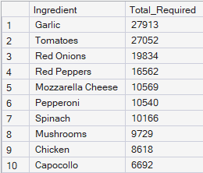
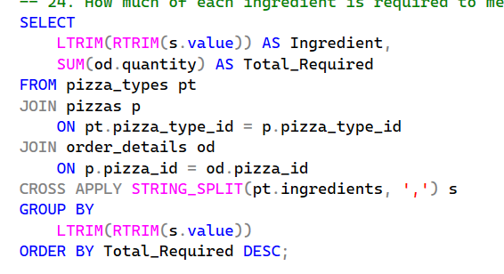
Ingredient Demand Analysis
SQL Code:
Output:
Business Insight: Frequently used ingredients should receive procurement priority to minimize stock shortages and improve inventory efficiency.

Slide 12
Executive Summary
Findings | Business Impact
Large pizzas drive revenue | Focus on premium sizes
Weekdays generate 73% of orders | Optimize weekday staffing
July recorded highest sales | Increase mid-year inventory
Top 5 pizzas dominate revenue | Promote best sellers
Bottom 5 pizzas contribute <1% each | Review menu performance

Slide 13
Expected Business Impact

Slide 14
Revenue Growth | Operations
Promote Best Sellers | Optimize Inventory
Combo Offers | Align Staffing
Upsell Side Items | Reduce Food Waste

Slide 15
Finding
Bottom 5 pizzas contribute <1%
Business Impact
Review menu performance
📅
↓
📈 ↓
🏆
↓
⚠️ ↓

