Slide 1

Crop Disease Detection
Helping hand to farmers which detects diseases and suggests cure in real time

Slide 2
Batch :T5 Project Guide:Mr. K. P. Kamble Name of the students: 2015BCS009 :Kirti Bhaskarrao Deshmukh 2015BCS016 :Sukhada Vijay Ghewari 2015BCS021 :Nagini Mallikarjun Kangle

Slide 3
Outline
Introduction
Literature Review
Problem Statement
Objectives
Methodology
Overview of work
Algorithm
UML Diagrams
Significance
References

Slide 4
Introduction
Agriculture is the most important and ancient occupation in india.
Economy is based on agricultural production
Early and accurate detection of plant diseases plays crucial role in plant production .
Proposed solution is android application-’AgroSmart’
Uses image processing techniques and machine learning.

Slide 5
Literature Review
Detection of plant leaf diseases using image segmentation and soft computing techniques
-Vijai Singh and A.K. Mishra, Sciencedirect(GA)
Using Deep Learning for Image-Based Plant Disease Detection -Sharada P. Mohanty, David P. Hughes, and Marcel Salathé

Slide 6
Problem Statement
Automatic detection of crop diseases to help farmers identify the disease and take curative measures.

Slide 7
Objectives
To study and implement image processing techniques like noise removal, preprocessing, enhancement, segmentation and feature extraction.
To measure the performance of algorithm in terms of accuracy, precision, recall and fine tune the parameters if needed.
To build android application that facilitates the above functionalities

Slide 8
Methodology
Preprocessing on image
Extract features from image
Reduce dimensionality
Measure accuracy and other performance metrics on test set
Fit the model
Apply CNN on data
Build final model and predict
Feedback

Slide 9
Existing Methods
Simply naked eye observation by experts
A large team of experts as well as continuous monitoring of plant is required
Costs very high when done with large farms
Farmers do not have proper facilities or even idea that they can contact to experts
This is laborious task and at the same time, less accurate and can be done only in limited areas

Slide 10
Overview
Preprocessing
Extracting important features
Input these features to classification algorithm
Train the model
Get the resultant disease and guide accordingly

Slide 11
Steps
Standardise the image.
Detect color characteristics of images.
Reconstruct a better image.
Create collection of masked images.
Process the mask and combine the mask.
Use final mask to for improvisation.

Slide 12
Conversion to lab color soace
L=lightness
a=color-opponent/channel adjustment
b=brightness

Slide 13
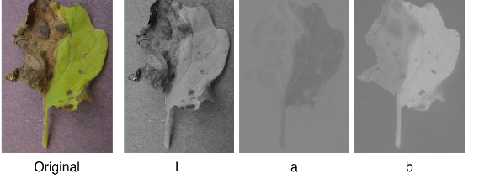
Lab color phase

Slide 14
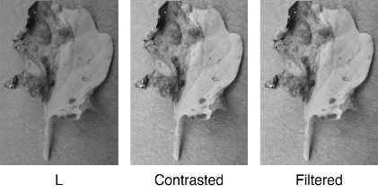
L -Channel Adjustment

Slide 15
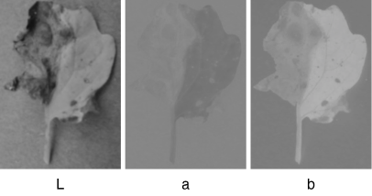
Blurring

Slide 16
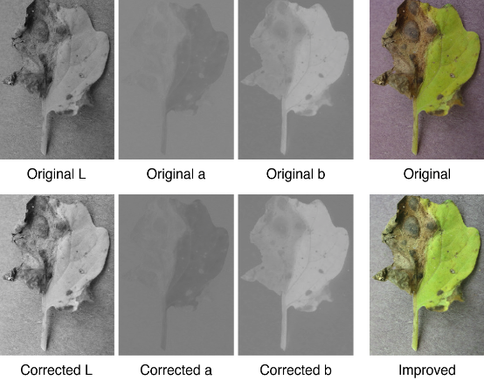
Reconstruct better image

Slide 17
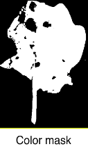
Creating collection of masks
Color mask
Generated by comparing the value of each pixel,in corresponding of the background
A threshold is applied to keep not part of the background.

Slide 18
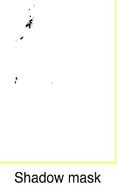
Shadow mask
It tries to keep only pixels that are not too dark and with color not too-far from that of the dark.
Finally we combine the masks together
Removes shadow areas from the color mask

Slide 19
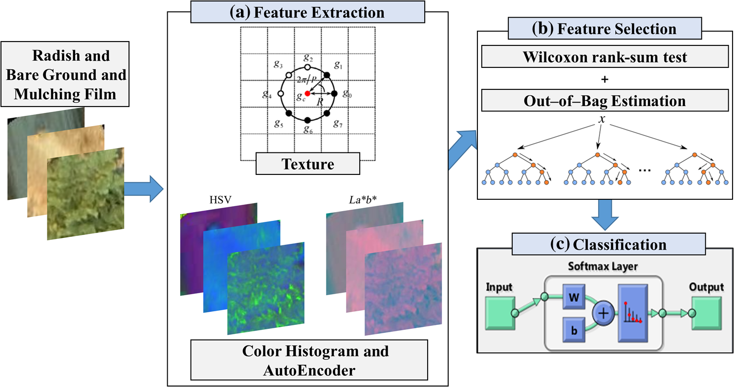

Slide 20
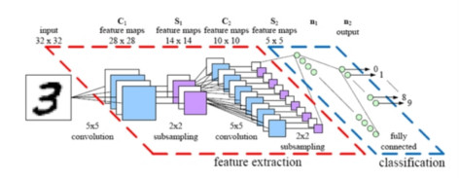
Algorithm -CNN

Slide 21
Detection steps

Slide 22
Append Leaf Image
Existing Leaf Image database Image
Image acquisition
Image enhancement
Noise reduction
Image segmentation
Feature extraction
Classifier
Detection

Slide 23
Platforms
Python
Android studio

Slide 24
Context diagram
Feature Extractor
(Preprocessing)
Feature data
raw data
Farmer
SYSTEM
Input image
predictions
Classification
Algorithm
Output disease
feature data
Training and testing dataset

Slide 25
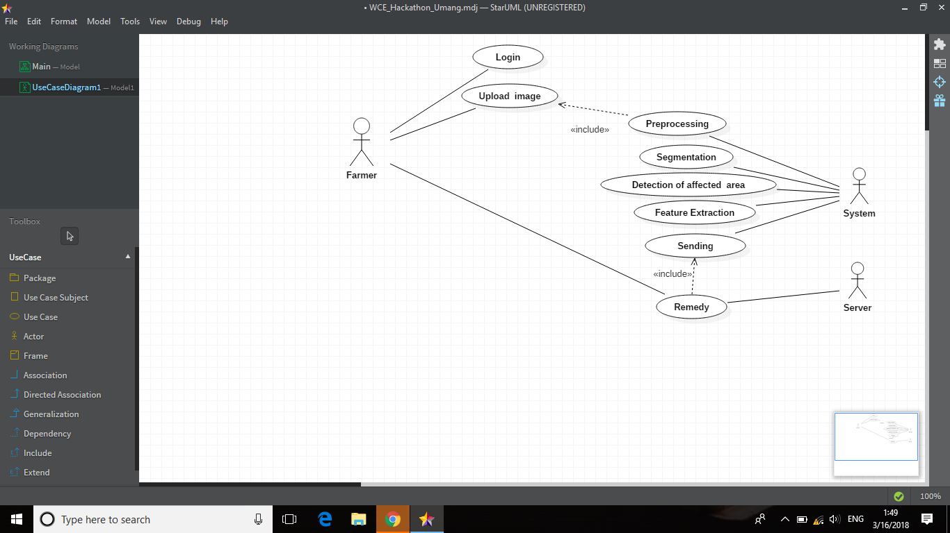
Use case diagram

Slide 26
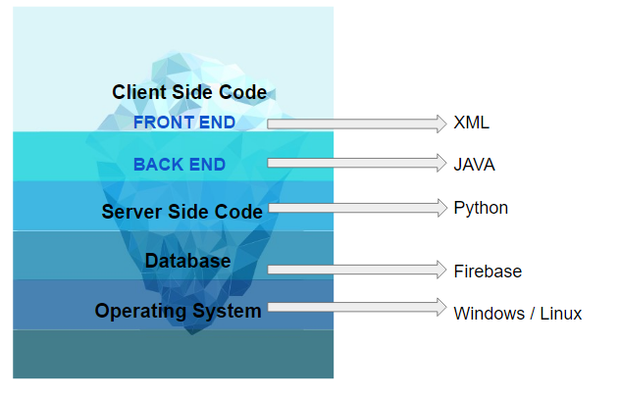
Technology Stack

Slide 27
Input format
Image
By capturing
By uploading from gallery

Slide 28
Output format
Disease caused
Symptoms
Causes

Slide 29
Our customers and users
Customers | Users
Organizations | Farmers
Institutes | Students

Slide 30
Significance
Automate manual interpretation of crop diseases
Guide farmers to cure disease accordingly
Contributing to high productivity of crops

Slide 31
Gannt Chart
Timeline | Jan,Feb | Mar 1w | Mar - Apr 2w - 1w | Apr 2w | Apr 3w
Learning
Understanding
Development
Testing
Modifications & deployment

Slide 32
References
http://ieeexplore.ieee.org/stamp/stamp.jsp?tp=&arnumber=7164858
www.sciencedirect.com
OpenCV tutorials for IP
Udacity for Android App. Dev
https://www.androidhive.info/

Slide 33
Thank you!

