Slide 1

Personalized Medicine:
Redefining Cancer Treatment
Predict the effect of Genetic Variants
to enable Personalized Medicine

Slide 2
Batch: T5
Project Guide: Mr. K. P. Kamble
Name of students:
2015BCS009: Kirti Bhaskarrao Deshmukh
2015BCS016: Sukhada Vijay Ghewari
2015BCS021: Nagini Mallikarjun Kangle

Slide 3
Outline
Introduction
Literature Review
Problem Statement
Objectives
Overview of work
Methodology
UML Diagrams
Significance
Future Scope
References

Slide 4
Introduction
Cancer is a condition which varies greatly from one individual to other.
Requirement of personalized medicine for each patient.
Studies show that particular genetic variations result into various cancers.
Can be achieved by using a recently found and powerful technique of using gene expressions to identify class of cancer.

Slide 5
Literature Review
Most of the research going in this field pertains to deciding if a patient has Cancer or not. (yes/no : binary classification).
Also, significant amount of research being done on cancer susceptibility prediction.
Cancer survival prediction
Cancer recurrence prediction
Previous works majorly used features like age, sex, tumor size, no of nodes, clinical and morphological data.

Slide 6
Problem Statement
Classification of Cancer into the defined classes using genetic mutations data to enable personalized medicine.

Slide 7
Objectives
To study various machine learning algorithms and text analysis techniques.
To implement a Machine Learning algorithm that, using the knowledge base as a baseline, automatically classifies genetic variations.
To use text analysis methods e.g. bag of words, TF-IDF to extract features from the text data.
To measure and validate the result using performance metrics

Slide 8
Overview of work
Preprocessing
Extracting important features
Input these features to classification algorithm
Train the model
Get the resultant class

Slide 9
Methodology
Extract features from text
Reduce dimensionality
Preprocessing on training variants
Build final model and predict
Combine training variants features and text features
Measure accuracy and other performance metrics on test set
Fit the model
Apply random forest algorithm on data

Slide 10
Preprocessing
Sklearn cannot work with non numeric/ string data (features)
Need to convert strings into numbers
Use of LabelEncoder: Maps features in alphabetical order to numeric value in ascending order.

Slide 11
Extraction of features from text
Use of TfidfVectorizer
TF: Term Frequency
  How many times a particular word appears in a single doc.
IDF: Inverse Term Frequency
  calculated by taking the log of {number of docs in your corpus divided by the number of docs in which this term appears}.

Slide 12
Reduce dimensionality
Use of truncatedSVD
Tfidf approach produces large number of features.
Resulting a sparse matrix
Reduces number of features.
Can work with scipy.sparse matrices efficiently.

Slide 13
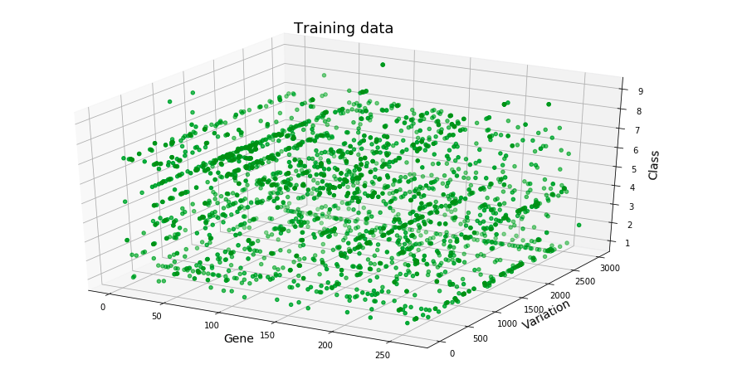

Slide 14
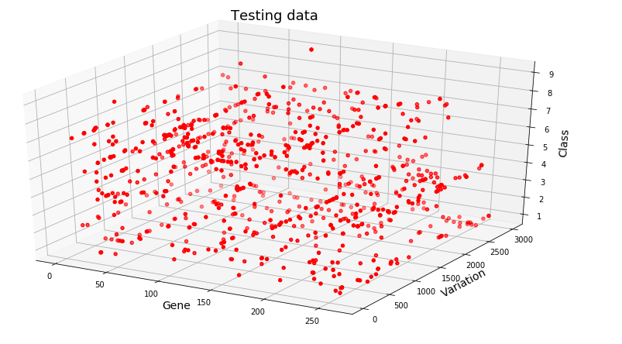

Slide 15
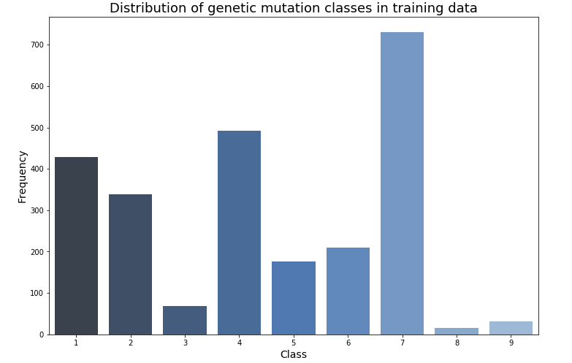

Slide 16
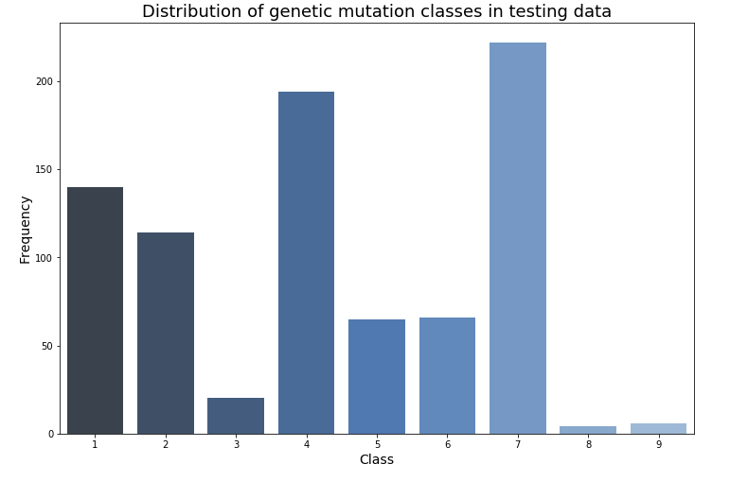

Slide 17
Apply machine learning algorithm
Random Forest: Ensemble technique
How it works?
Construct a multitude of decision trees at training time and outputting the class that is the mode of the classes of the individual trees.
Correct decision trees' habit of overfitting to their training set.

Slide 18
Performance Metrix: Evaluation
Maximum accuracy turns out to be 62.57%
Confusion Matrix:
Way to measure
  Accuracy
  Precision
  Recall

Slide 19
Comparison between different classifiers
Classifier | Accuracy
RandomForestClassifier | 0.6257
K-NearestNeighbors | 0.45487364620938631
LogisticRegression | 0.56317689530685922
LinearSVC | 0.26353790613718414

Slide 20
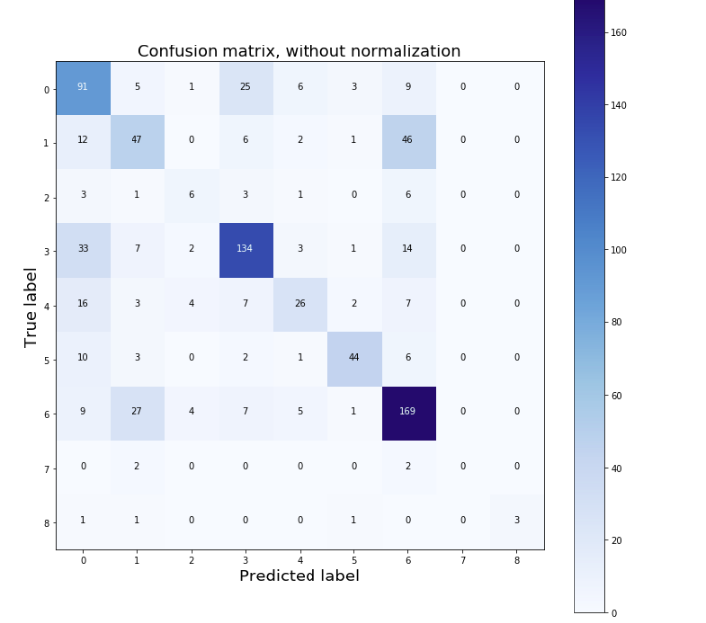

Slide 21
Terminologies
(number of) positive samples (P)
(number of) negative samples (N)
(number of) true positive (TP) : eqv. with hit
(number of) true negative (TN) : eqv. with correct rejection
(number of) false positive (FP) : eqv. with false alarm, Type I error
(number of) false negative (FN) : eqv. with miss, Type II error
Precision(A) = TP(A) / (TP(A) + FP(A))
Recall(A) / Sensitivity(A) = TP(A) / (TP(A) + FN(A)) proportion of positives that are correctly identified
Specificity(A) = TN(A) /(TN(A) + FP(A)) proportion of negatives that are correctly identified

Slide 22
Distribution of TP, TN, FP, FN
Total number of samples : 831
Class | TP | TN | FP | FN
1 | 91 | 607 | 84 | 49
2 | 47 | 668 | 49 | 67
3 | 6 | 800 | 11 | 14
4 | 134 | 587 | 50 | 60
5 | 26 | 748 | 18 | 39
6 | 44 | 756 | 9 | 22
7 | 169 | 519 | 90 | 53
8 | 0 | 827 | 0 | 4
9 | 3 | 825 | 0 | 3

Slide 23
Precision
Classes | Precision
1 | 0.52
2 | 0.48
3 | 0.54
4 | 0.72
5 | 0.59
6 | 0.83
7 | 0.62
8 | 0.00
9 | 0.1

Slide 24
Sensitivity/ Recall
Class | Sensitivity
1 | 0.65
2 | 0.4122
3 | 0.3
4 | 0.69
5 | 0.4
6 | 0.66
7 | 0.76
8 | 0
9 | 0.5

Slide 25
Specificity
Class | Specificity
1 | 0.87
2 | 0.93
3 | 0.98
4 | 0.92
5 | 0.97
6 | 0.98
7 | 0.85
8 | 1
9 | 1

Slide 26
Context Diagram
Feature Extractor
(Preprocessing)
doctor
Feature data
raw data
SYSTEM
input
predictions
Classification
Algorithm
output
Validate the result
feature data
result
Training and testing dataset

Slide 27
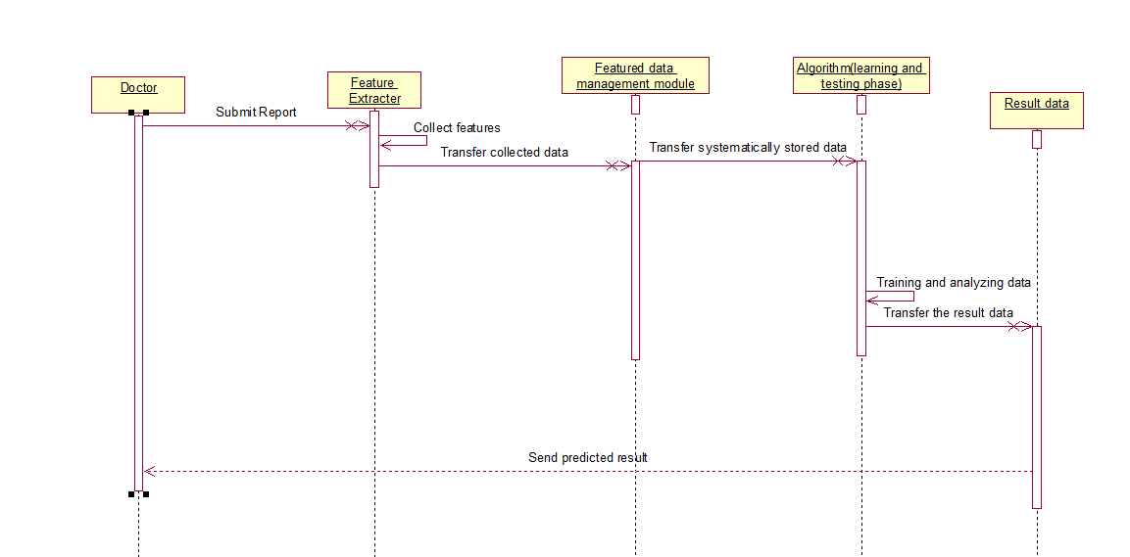
Sequence Diagram

Slide 28
Training format Output format
Variants
  ID Gene Variation Class
Mutation Description Text
  ID || Text
Class

Slide 29
Significance:
Distinguish the mutations that contribute to tumor growth.
Automate manual interpretation of genetic mutations.
Classify every single genetic mutation based on evidence from text based clinical literature.
Cancer classification using gene data works exceptionally well from previous classification techniques.

Slide 30
Significance of nine classes
Likely Loss-of-function
Likely Gain-of-function
Neutral
Loss-of-function
Likely Neutral
Inconclusive
Gain-of-function
Likely Switch-of-function
Switch-of-function

Slide 31
Future Scope
New treatment in India: Scope to implement this methodology in order to reduce manual work
Can be implemented in other conditions than cancer which use targeted therapy for cure

Slide 32
References
www.kaggle.com: For dataset
IEEE digital library: transactions on cancer
www.sciencedirect.com
www.coursera.org

