Slide 1
Digital Image Processing
Implementation of color segmentation algorithm to detect hand in the image for gesture recognition application

Slide 2
Aishwarya Milind Pawar
2015BCS003
Sukhada Vijay Ghewari
2015BCS016
Guided By: Dr. S. H. Bhandari

Slide 3
Problem Statement
The hand gestures are to be recognized to build an application. Given images of hand gestures, implement suitable segmentation algorithm to detect hand.

Slide 4
Solution
Conversion of the color image of hand gesture of the form (B,G,R) into YCbCr color model for higher accuracy
Set the base value for skin color
For each pixel in the image, find Euclidean distance of Y, Cb, Cr values from the base value
Set a threshold value for segmentation

Slide 5
Solution
If a pixel value yields the Euclidean distance less than the threshold, set it as white (identified as part of hand)
Else, set it as black (not identified as part of hand)

Slide 6
Solution
Equation for computing Euclidean distance:
math.sqrt((int(imgYCC[i,j,0])- avg_skin_color[0])**2 + (int(imgYCC[i,j,1])- avg_skin_color[1])**2 + (int(imgYCC[i,j,2])- avg_skin_color[2])**2) <= error
imgYCC = image in YCbCr color model
avg_skin_color = skin color set as the base skin color
error = value of threshold/error that can be accepted

Slide 7
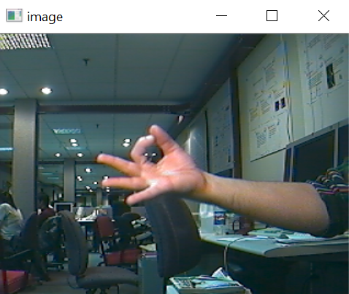
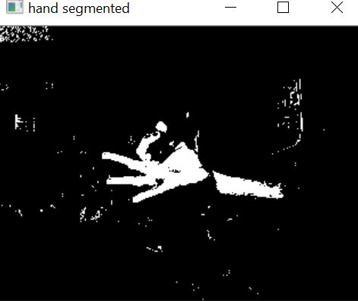
Results: Input Image Output Image

Slide 8
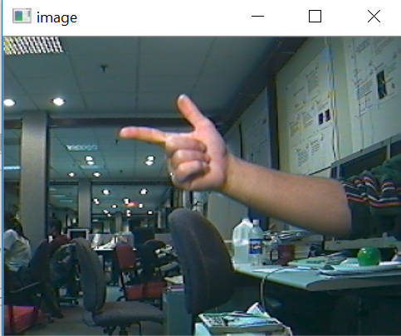
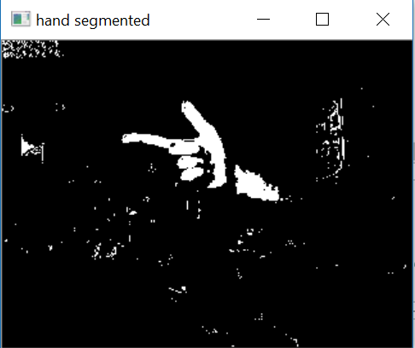
Results:
Input Image Output Image

Slide 9
Advantanages
Most of the part of hand is correctly identified
Simple, easy to implement algorithm

Slide 10
Limitations
The base skin color is chosen by the coder meaning requirement of manual intervention in the process of segmentation
Hand colors may vary by the region; this algorithm fails to generalize for all skin types
Along with the hand region, other objects with similar color are identified as regions of the hand. (made white)

Slide 11
THANK YOU !!

